Slide 1
SIG-Marcomms Meeting (GEANT)
RENU Communications
By
Louise Karungi
lkarungi@renu.ac.ug

Slide 2
Introduction
Platforms Used
Why Social Media?
Tips and Tricks
RENU Twitter Growth
Outline

Slide 3
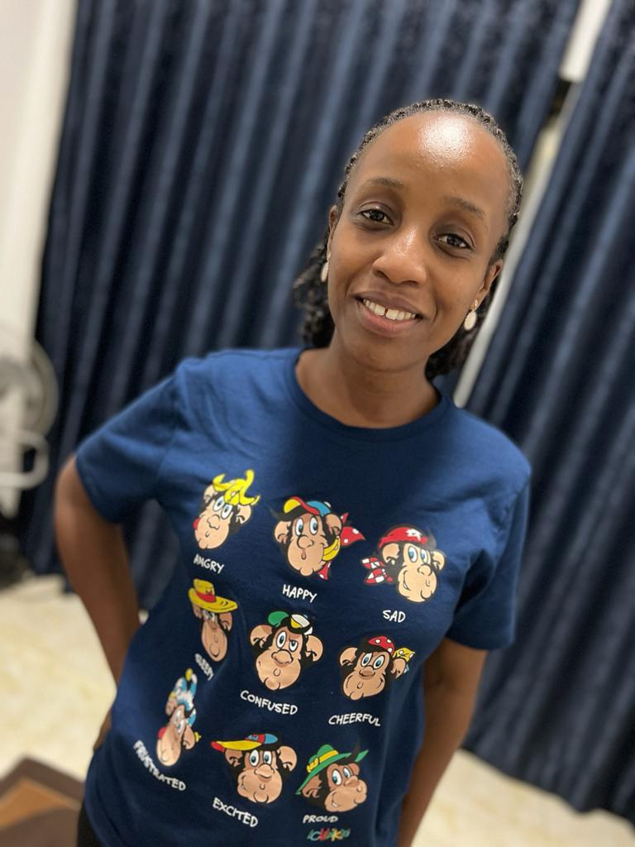
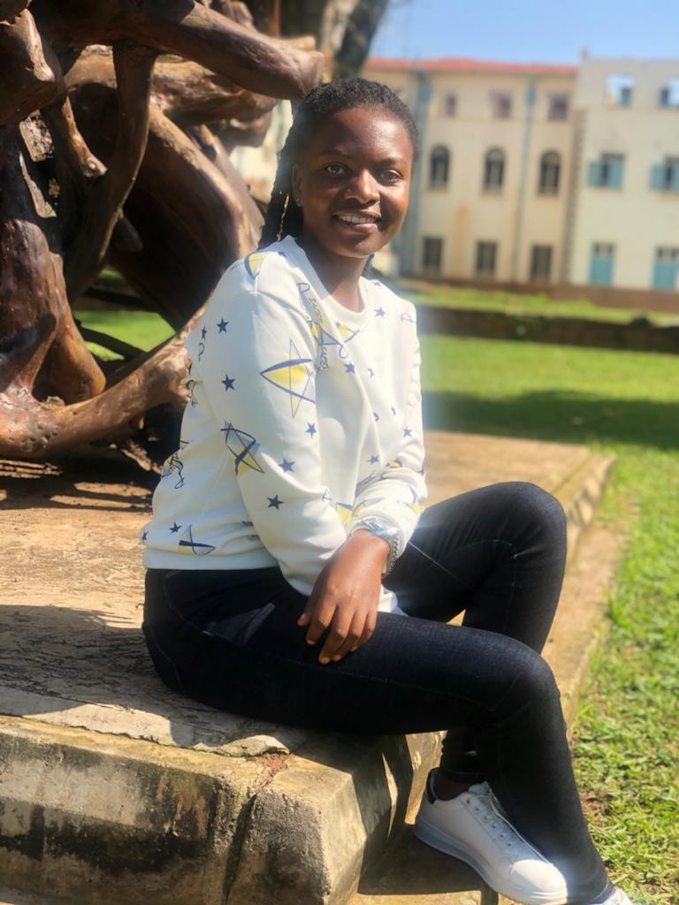
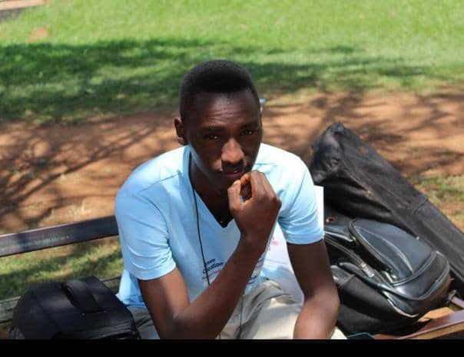
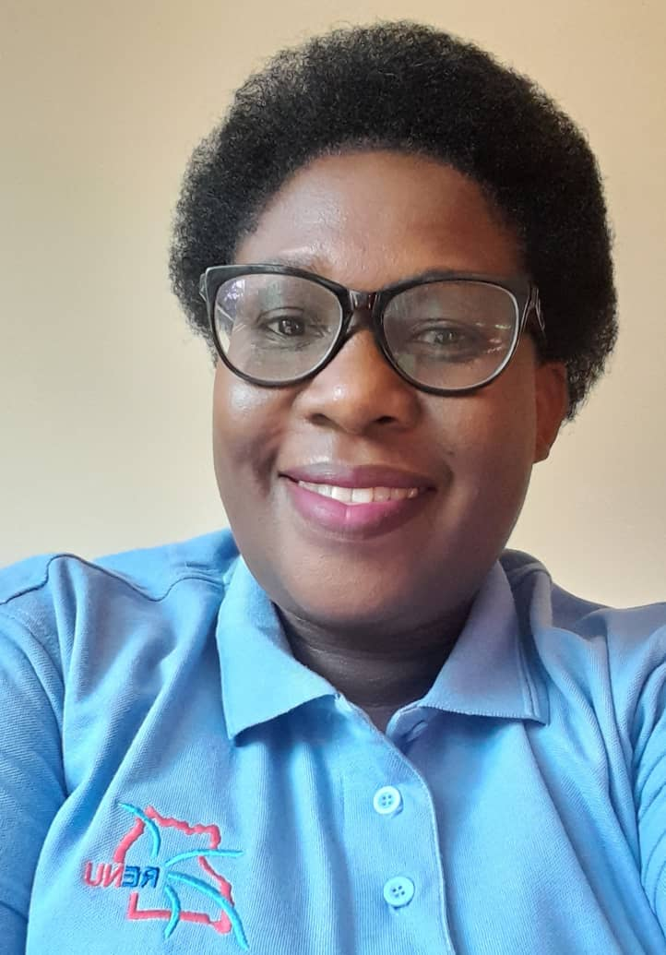
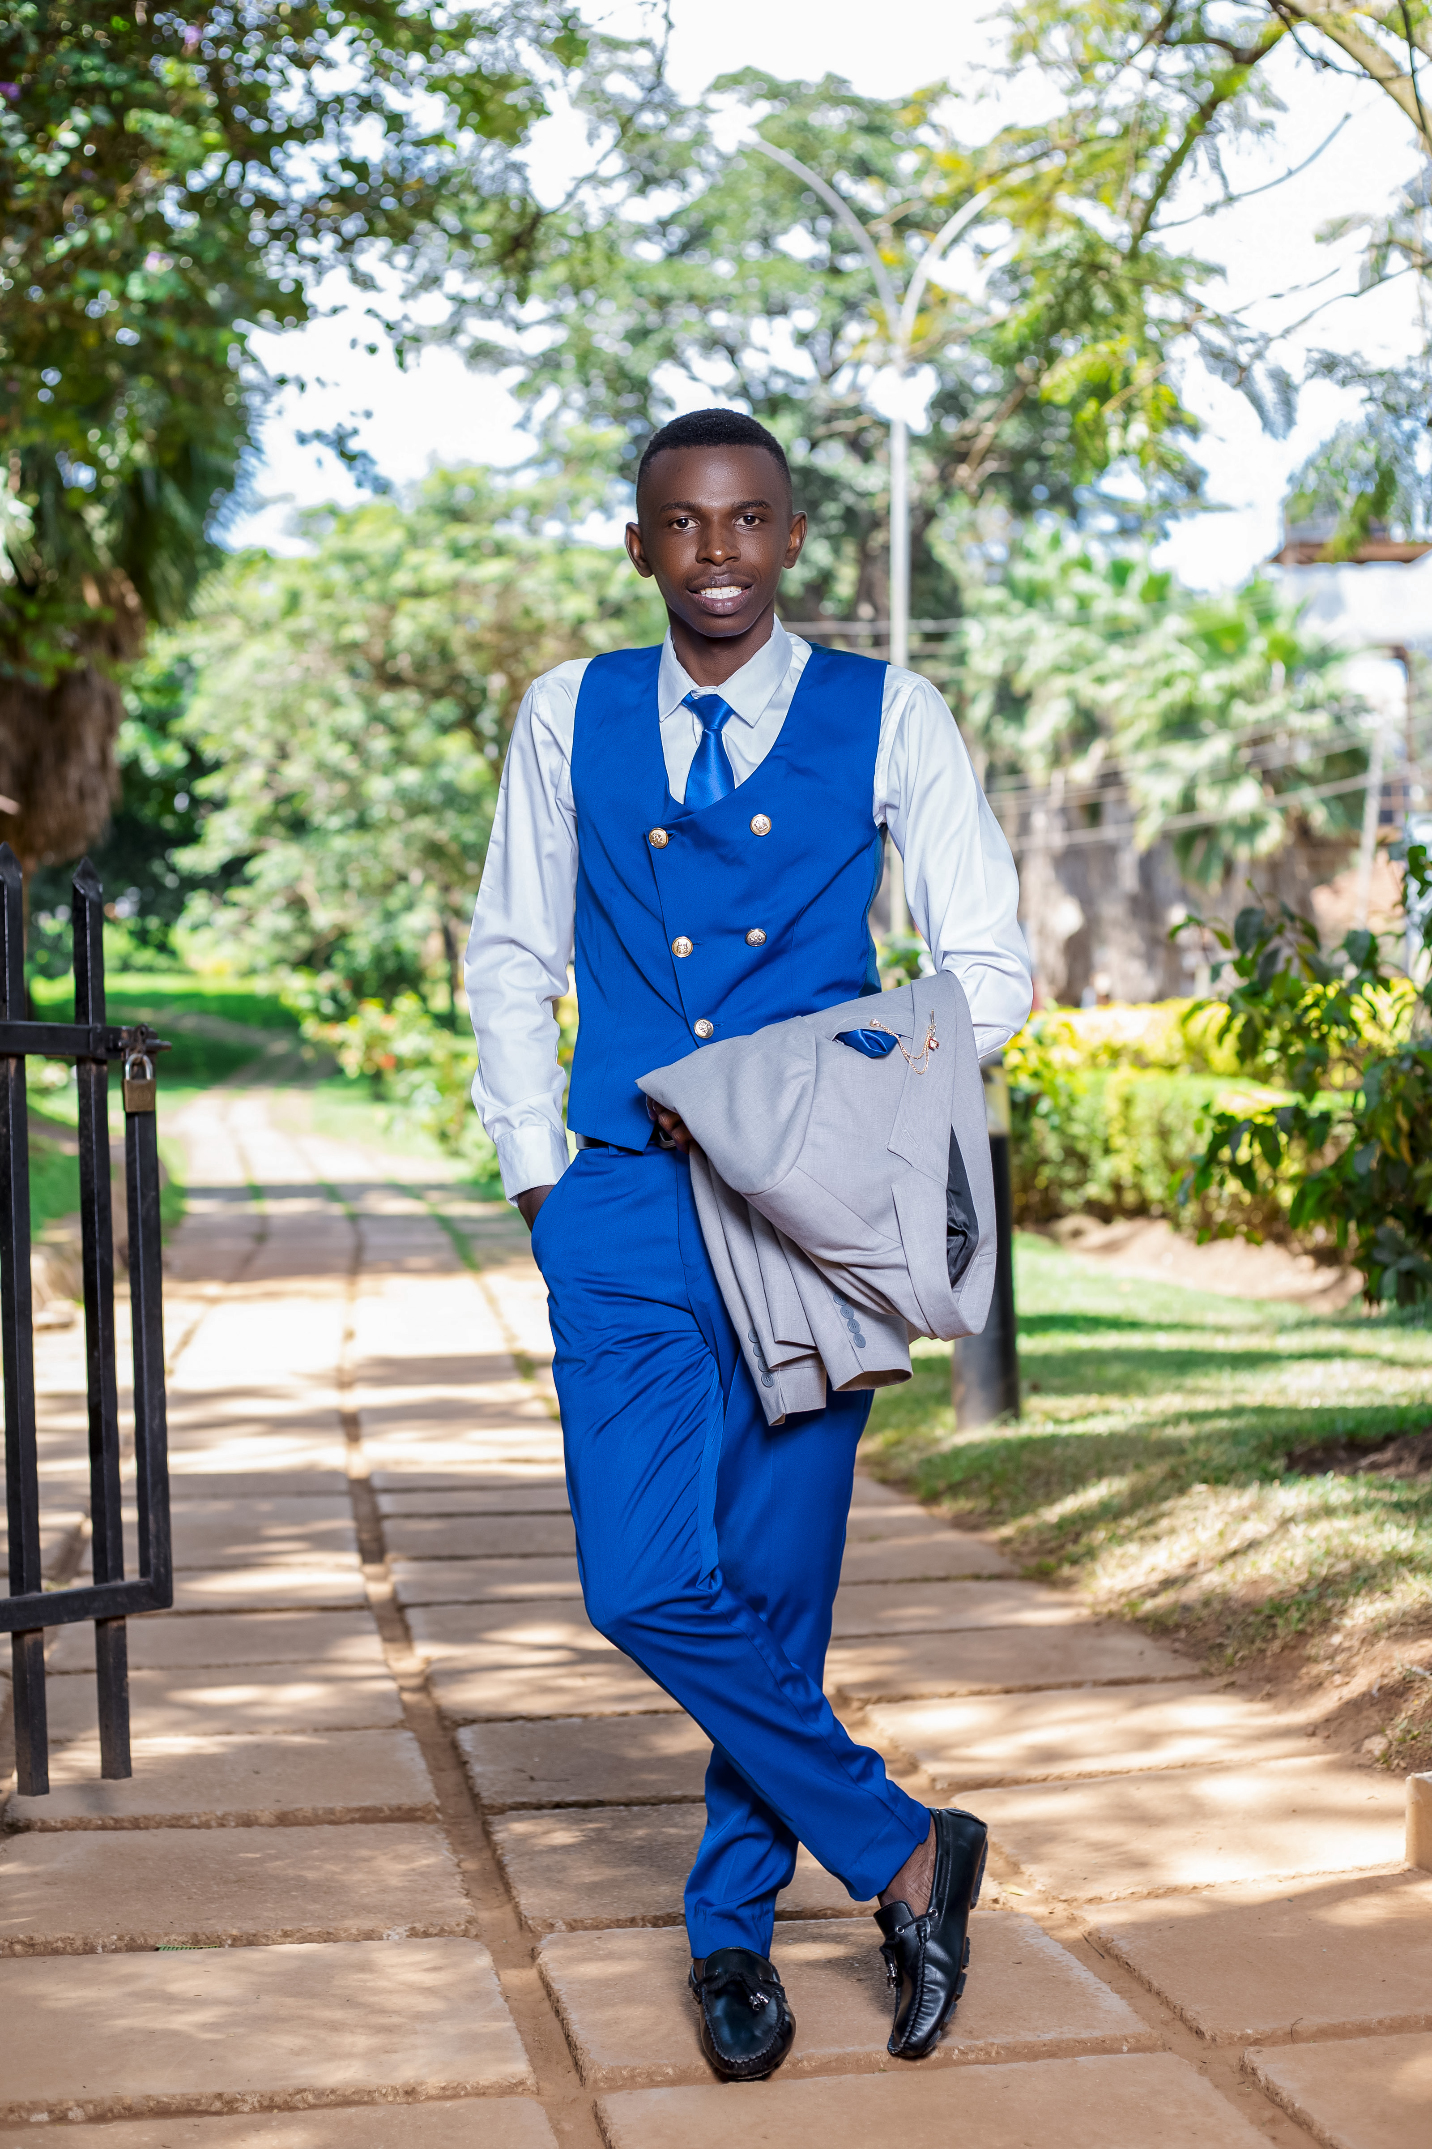
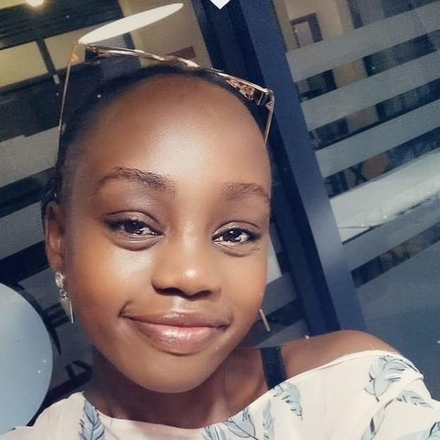
Introduction
Who are We?
Communications team est. in 2019.
Currently team of 6
Team lead: Carol Tuhwezeine
Team responsibilities:
  Communications
  Marketing
  Branding
  Logistics
  Events
  etc

Slide 4
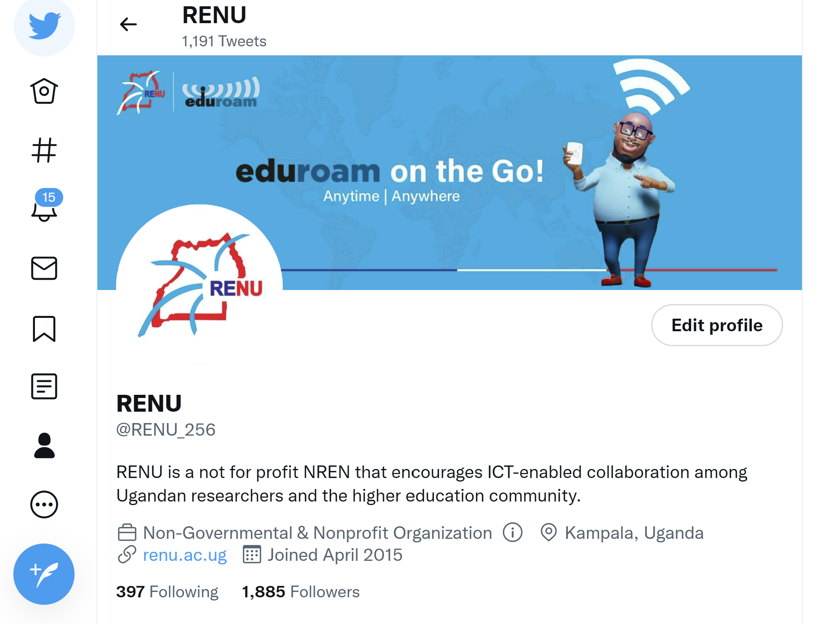
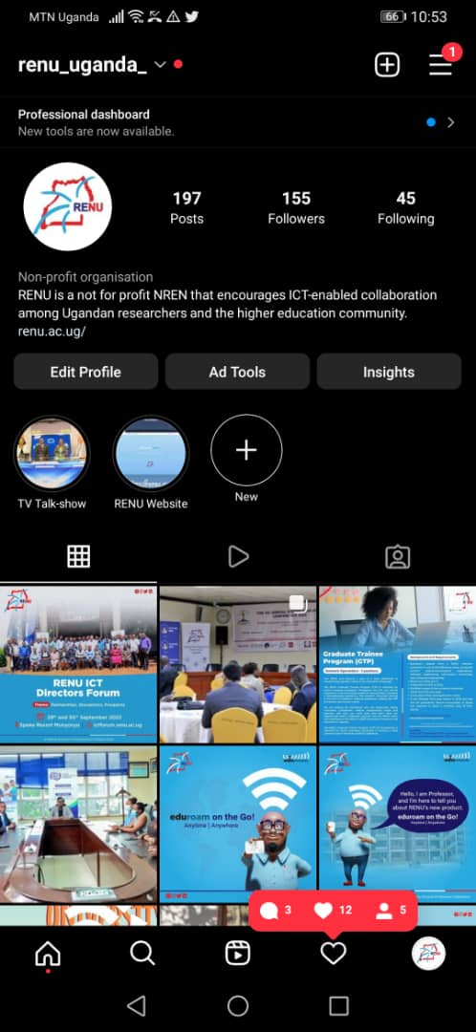

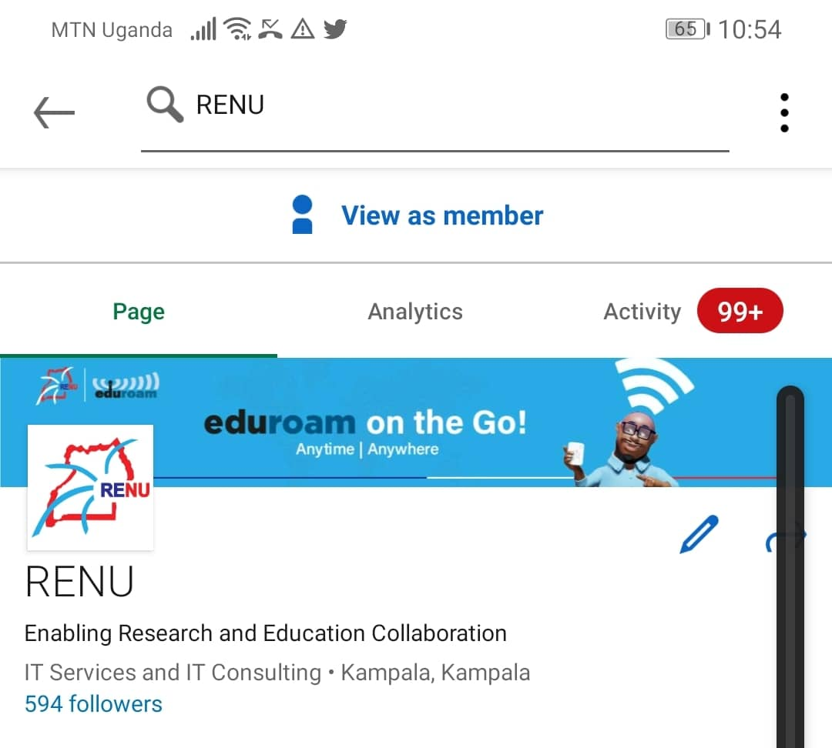


Platforms Used
Twitter: @RENU_256
Continuous updates
Instagram: renu_uganda
Pictorials and videos
LinkedIn: @RENU
Professional audience
YouTube: RENU_256
Video archives
Facebook: @RENU256
Currently restricted!

Slide 5
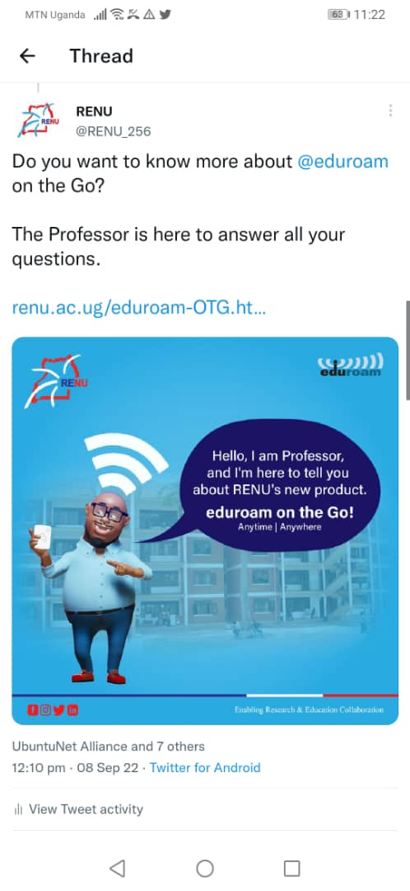
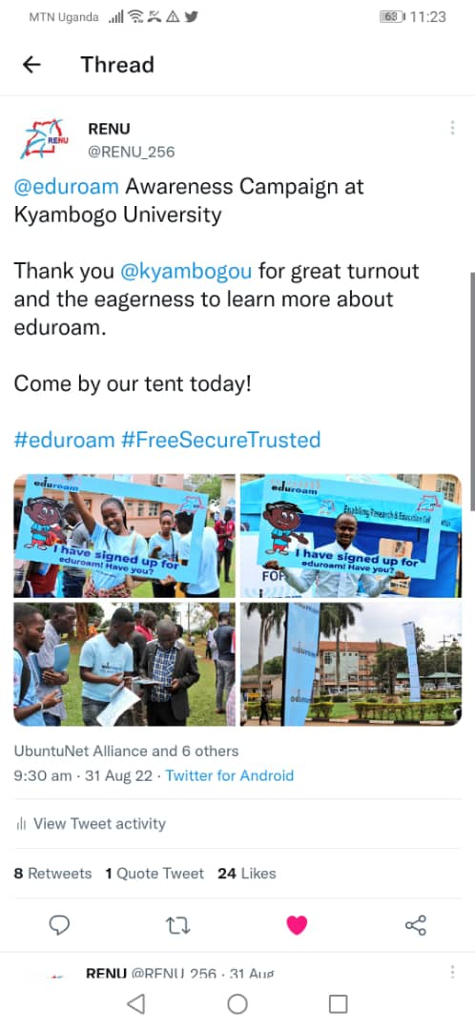

Why Social Media?
Create awareness
Publicize services to R&E community globally
Increase engagement with the target audience
Timely feedback on our services and support
Timely updates to stakeholders

Slide 6



Tips and Tricks
Timing
Relatable
Consistent (Colors & Branding)
Engage with the audience
Use of team members
Error-free
Appropriate local influencers
Cheeky content sometimes ☺

Slide 7
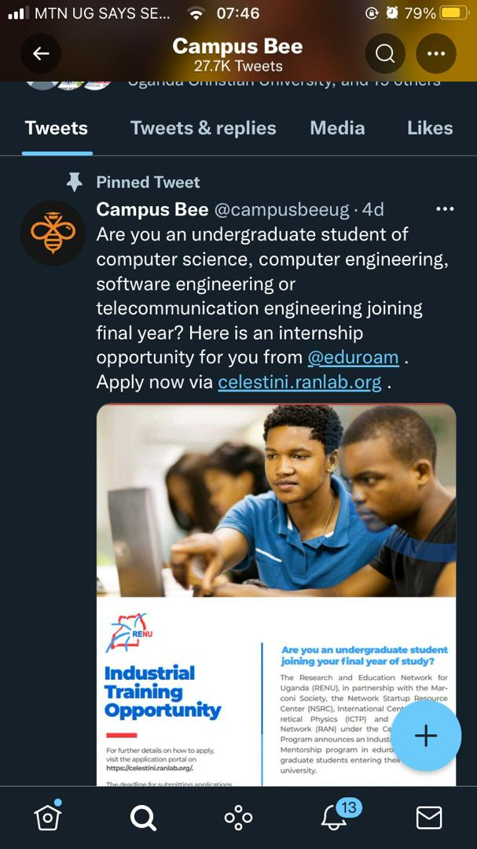
Tips and Tricks
Use of Hashtags especially on twitter
More engaging content, e.g., GIFS and motion graphics
External team – for content development
Content related to current trends within the country
Content boosting
Online digital content advertisers, e.g., Campus Bee
Relentless publication – something every week ☺

Slide 8

RENU Twitter Growth
Q3 2021 Vs Q3 2022
 | QUARTER 3 2021 | QUARTER 3 2022
Followers | 813 | 1,885
No. of Tweets | 59 | 188
Impressions | 53,734 | 736,000
Visits | 4,109 | 147,100
Mentions | 100 | 471

Slide 9
THE END
Thank You ☺

