Slide 1
MarComms Survey
Results and shared challenges

Slide 2

31 people joined the survey
AARNet
Arnes
ASNET-AM
AsScienceNet
Belnet (2 answers)
Canarie
CYNET
DeIC
FCCN (2)
GARR
Géant (3)
GRNet
HEANet
IUCC
KIFU
OMREM
RedClara
RedIRIS/Red.es
RENAN
Restena Foundation (2)
RNP
SANReN
Surf
Undentified (2)
Wacren

Slide 3
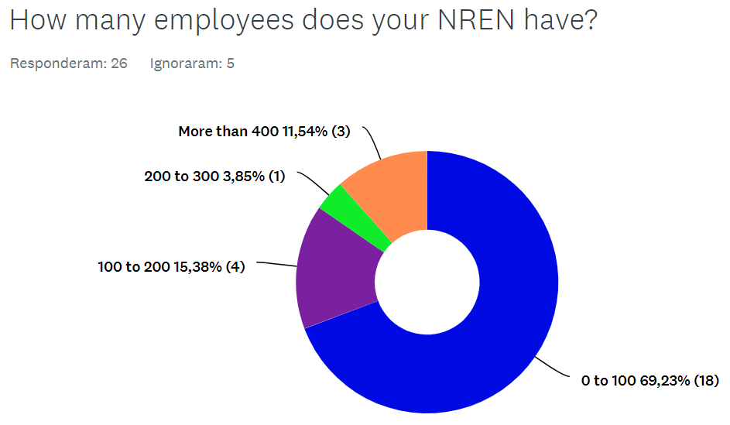
Notes:
The majority of NRENs that answered the survey have till 100 employees.

Slide 4
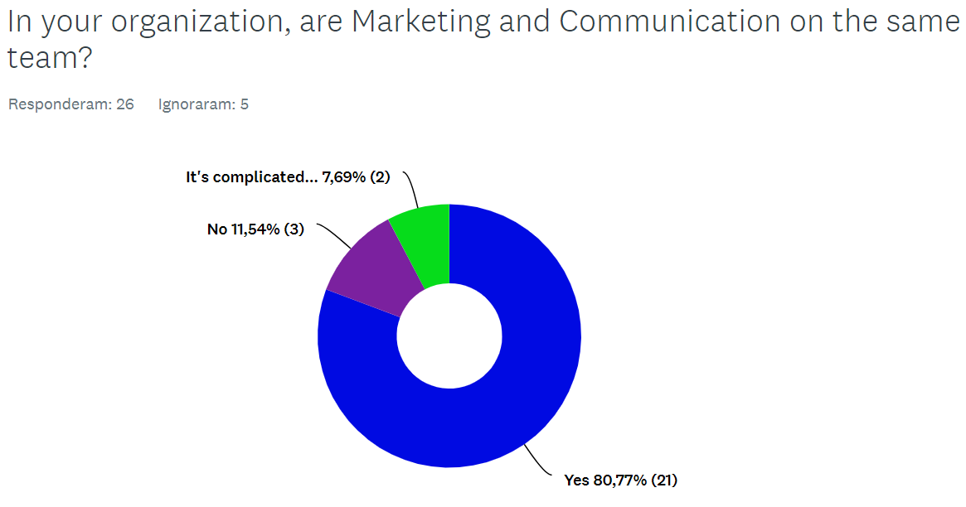
Notes:
It’s complicated – “Mktg it is part of both the Services and the Communications teams”. “We dont have a dedicated person/team for SANReN”.

Slide 5
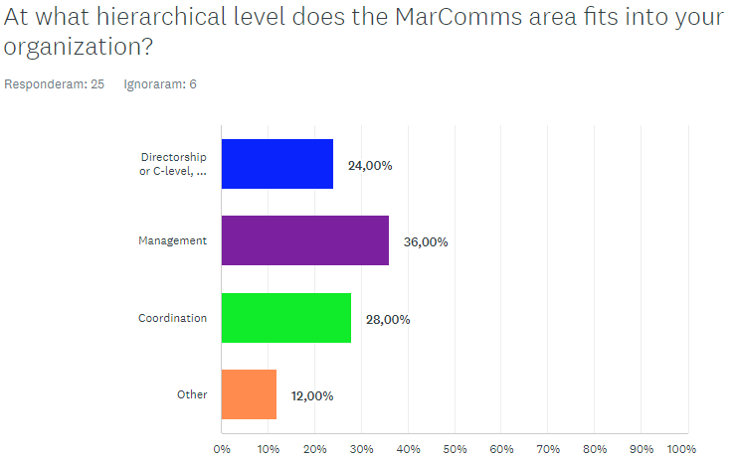

Slide 6
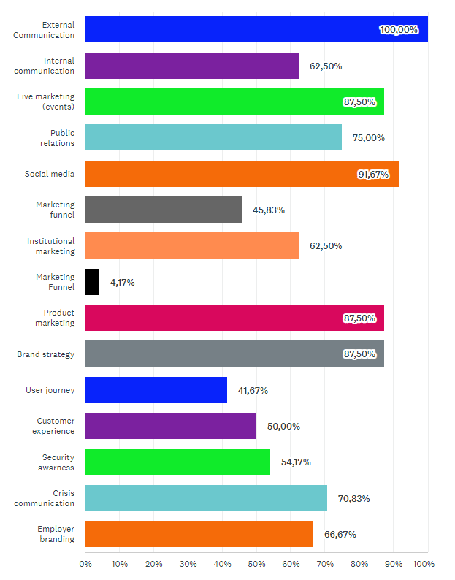
Activities under the responsibility of your MarComms team

Slide 7

Biggest challenges in MarComms
Reach the users to know their needs and to increase services usage
Adopting a user-centred approach to increase service use and satisfaction
Talking to the end users
Notes:
In slides 7 and 8, we have the challenges that appeared the most.

Slide 8


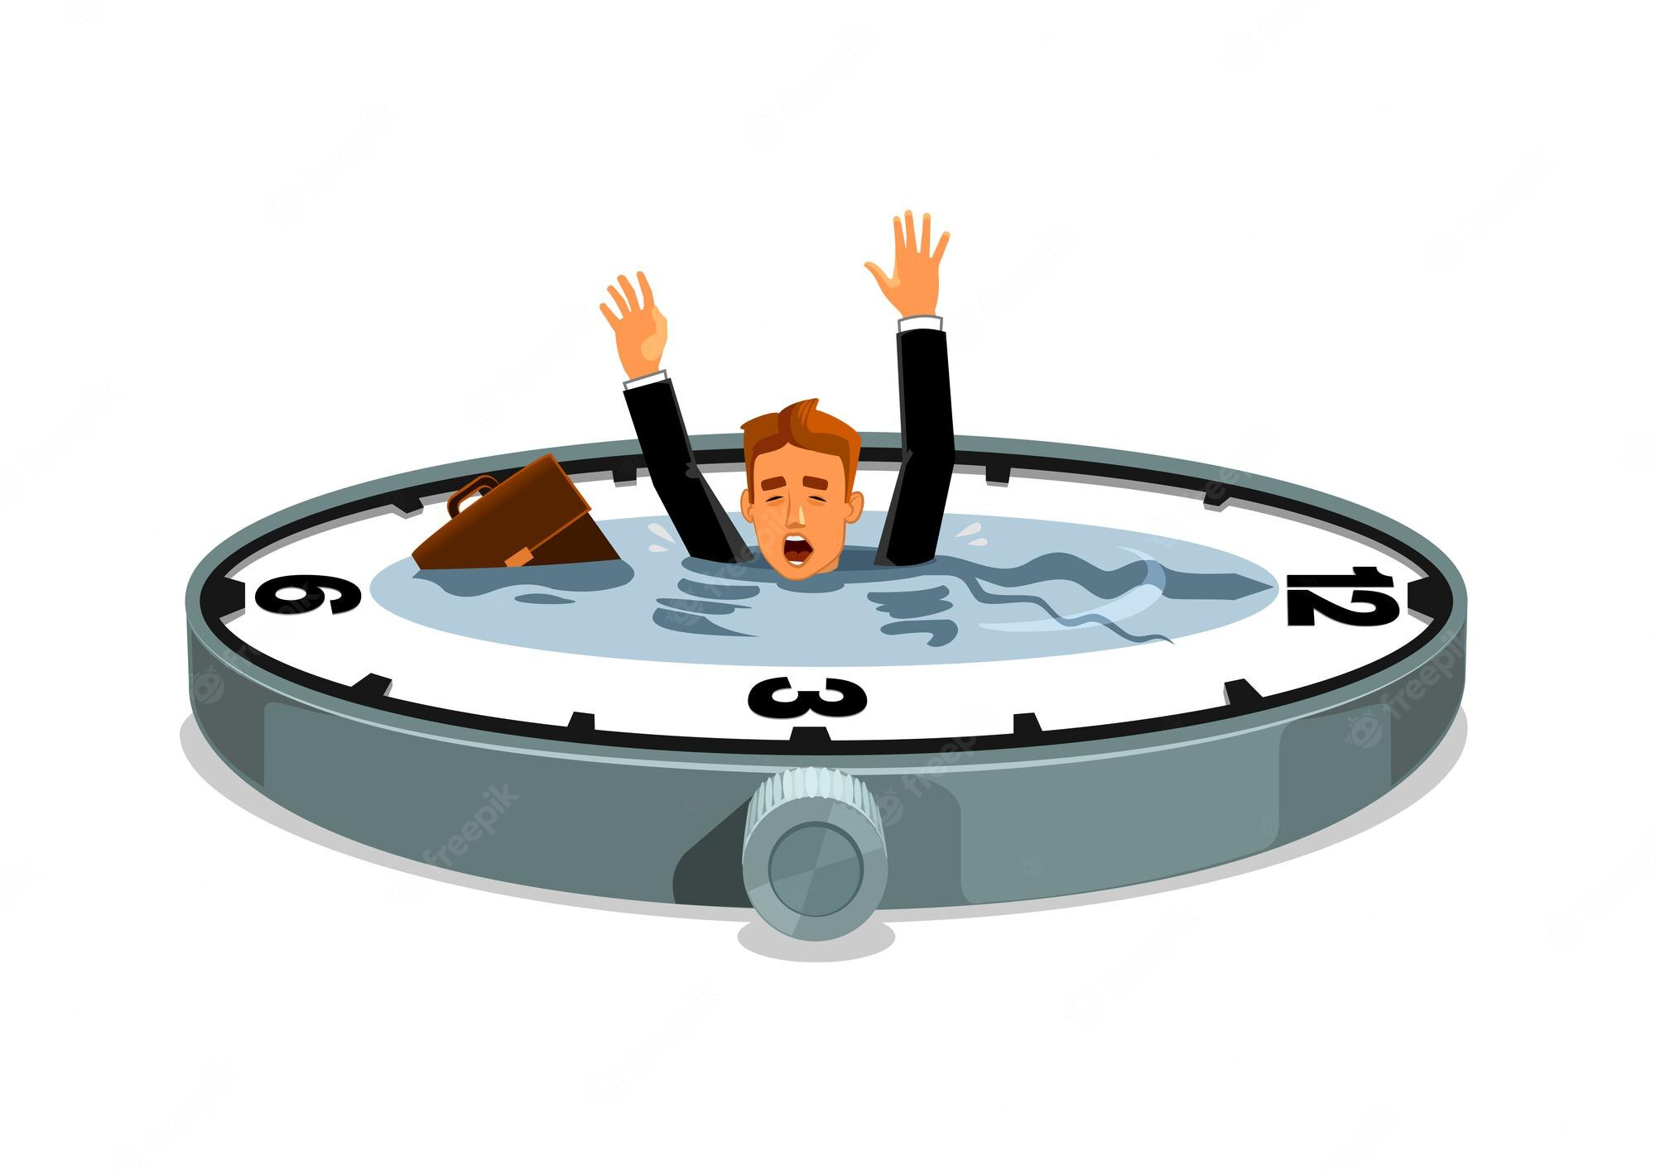
Lack of time and resources
“Human resources and financial support”
“Lack of resources - one more person would be good :)”
“Small team with many responsibilities”
“Not enough resources”
“Not enough resources”
Competing priorities
“Lack of time”
“Lack of time”
“Lack of time and resources to do everything”
Notes:
In slides 7 and 8, we have the challenges that appeared the most.

Slide 9
Biggest challenges in MarComms
“In my opinion one big challenge is related to covering the very wide range of topics and activities, obtaining relevant and timely information from the different teams and organizations, and improving processes. But we're getting better at that!”
““Time management and translating new NREN’s strategy”
“All the responsibilities above”
“To scale up”
“Management's level of appreciation of MarComms value”
“Lack of authority -approvals take long due to large hierarchy”
“Understand and act with Restena's whole structure (people, processes, strategic decisions, etc.) to be able to address its needs both for our NREN community but also for our .lu registry and registrar activities coming in addition to NREN activities”
“Reaching various and very different audiences”
“Community building and interaction with our customers in order to better understand their needs”
“Time management and translating new NREN’s strategy”
“Consistency of image and message across the organization”
“Reaching various and very different audiences”
“To really highlight and disseminate the importance of RedCLARA relevating the importance of its member NRENs. For us it is more important to show our member NRENs than RedCLARA itself”
Notes:
Some specific challenges, in “people’s words”

Slide 10



Perfect activity
External communication
Content writing for any kind of communication medium
Crisis communication
Notes:
What appeared the most.

Slide 11

Perfect activity
Notes:
In the opinion of the respondents, the best activities in Marketing and Communication are: branding, external communication, content creation and infographics and events.

Slide 12
Thank you!
Stela Tsirakis stela.tsirakis@rnp.br

