Slide 1
EOSC in Georgia
Tamara Gvenetadze
Georgian Research and Educational Networking Association GRENA

Slide 2
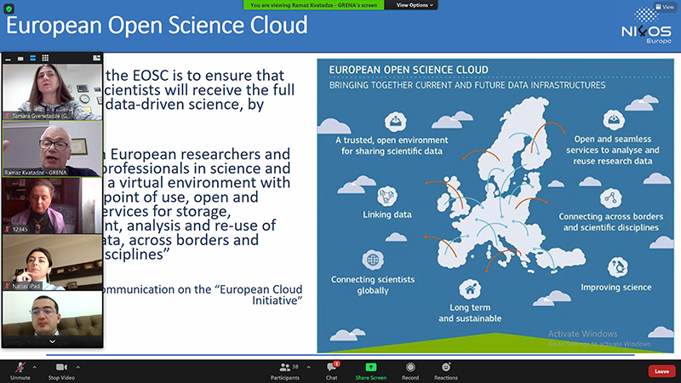
National capacity building event
On November 25, 2020 Georgian Research and Educational Networking Association GRENA within the framework of the European Commission NI4OS-Europe project hosted the national capacity building NI4OS event. A meeting of the European Open Science Cloud EOSC was held online via the ZOOM platform.
The event gathered 50 representatives of research and education community from various parts of Georgia.
The participants expressed huge interest towards EOSC, got engaged in discussions and showed interest in attending future meetings.

Slide 3
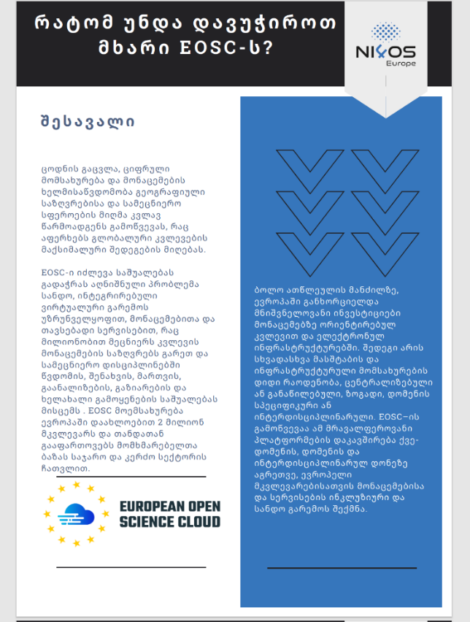
EOSC related material
The material was translated from English into Georgian language.

Slide 4
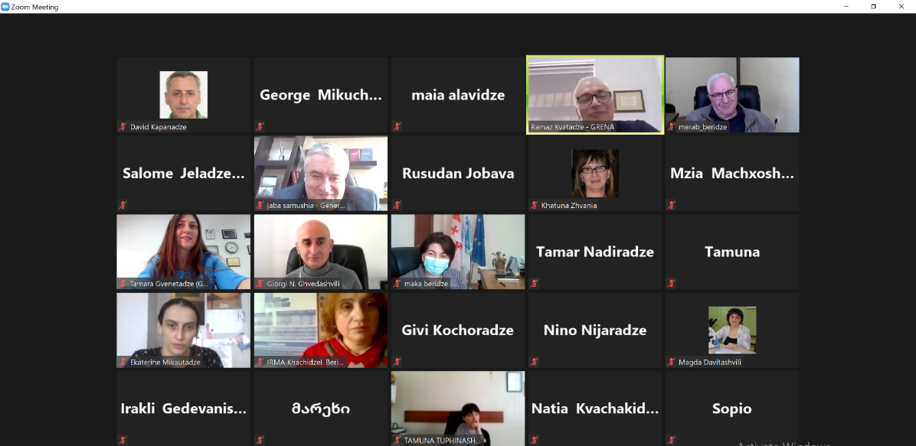
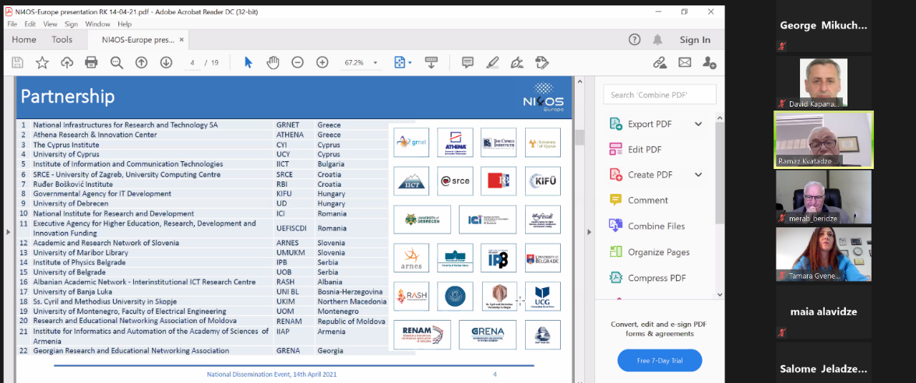
Dissemination Event – April, 2021

Slide 5
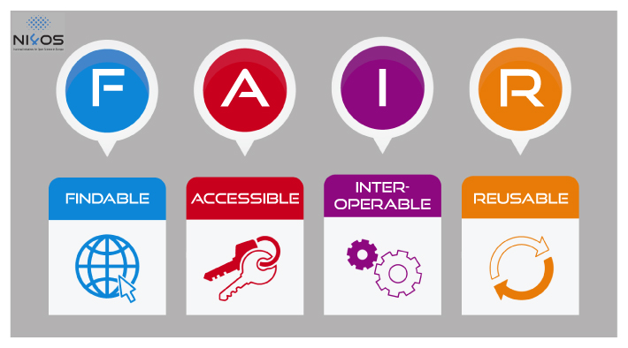
FAIR is a set of principles, not a standard, according to which FAIR research data are the data which can be Findable, Accessible, Interoperable, and Reusable.

Slide 6
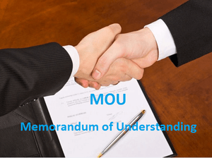
MoU possibilities were discussed with adequate stakeholders.

Slide 7

MoU
In total 10 universities and structural units

Slide 8
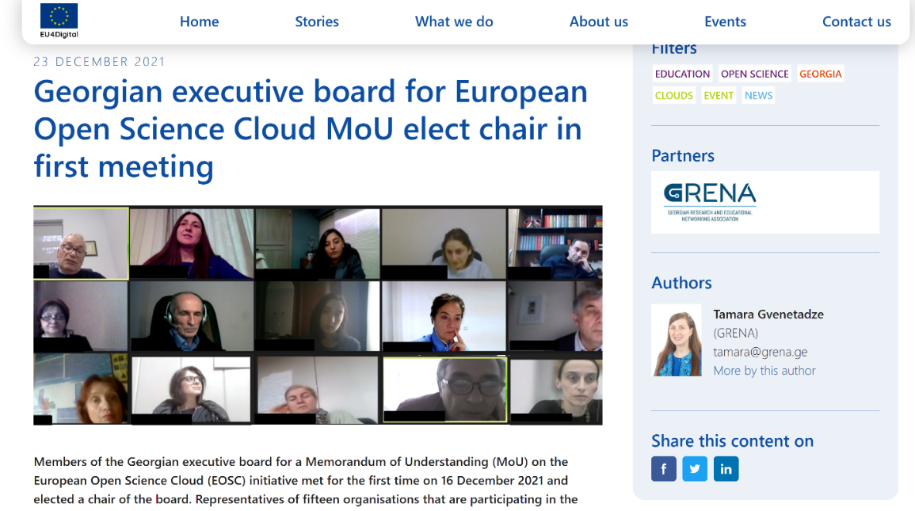
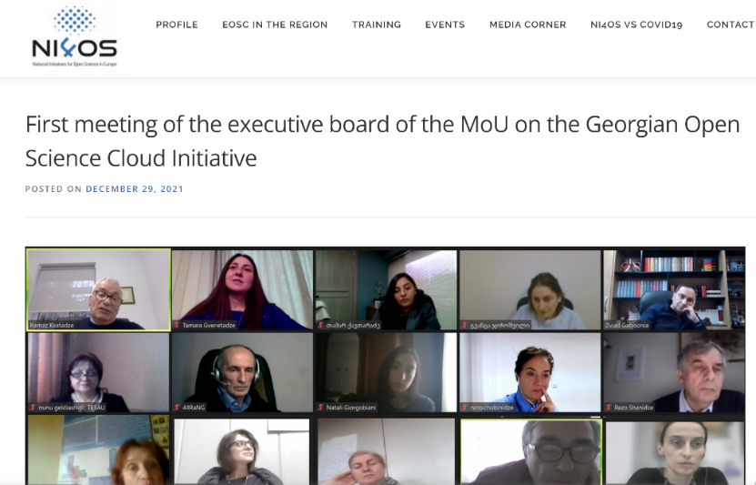
Articles
https://eapconnect.eu/stories/georgian-executive-board-on-european-open-science-cloud-mou-elect-chair-in-first-meeting/
https://ni4os.eu/2021/12/29/first-meeting-of-the-executive-board-of-the-mou-on-the-georgian-open-science-cloud-initiative/

Slide 9
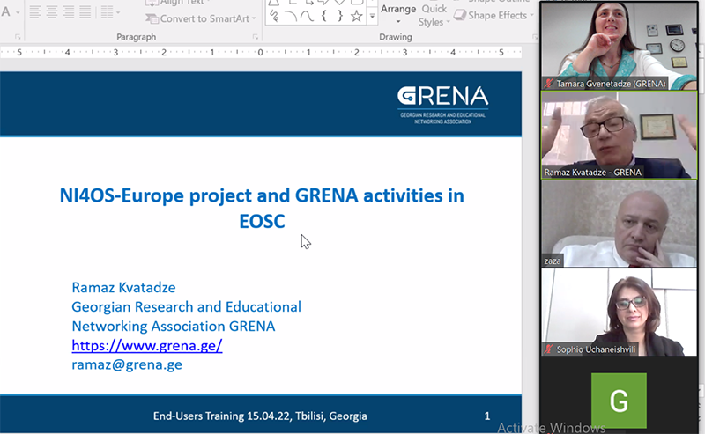
National End Users NI4OS Training – Georgia
April 15, 2022
Georgian Research and Educational Networking Association GRENA within the framework of the European Commission NI4OS-Europe project hosted the national end users EOSC training. The training was held online via the ZOOM platform.Target participants included representatives of Georgian research institution and universities, scientific libraries and other interested parties.
Main focus was put on EOSC Portal usage and functionalities.

Slide 10

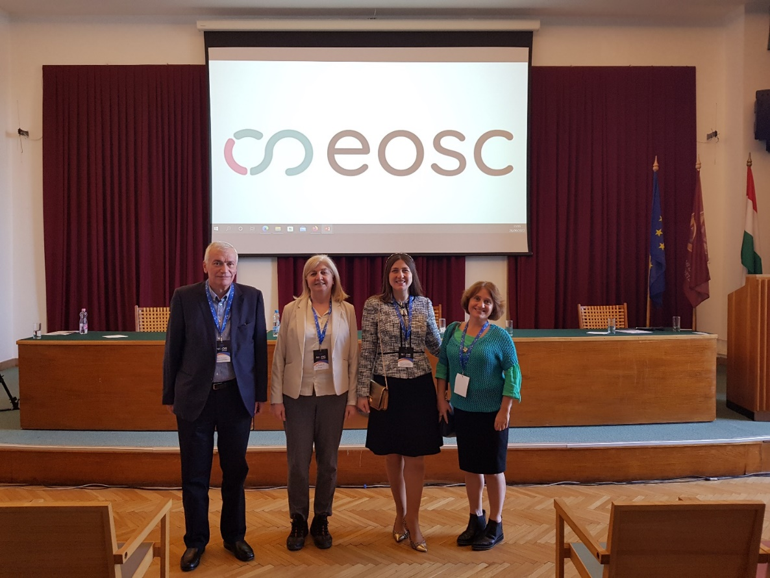
EOSC Regional Event

Slide 11
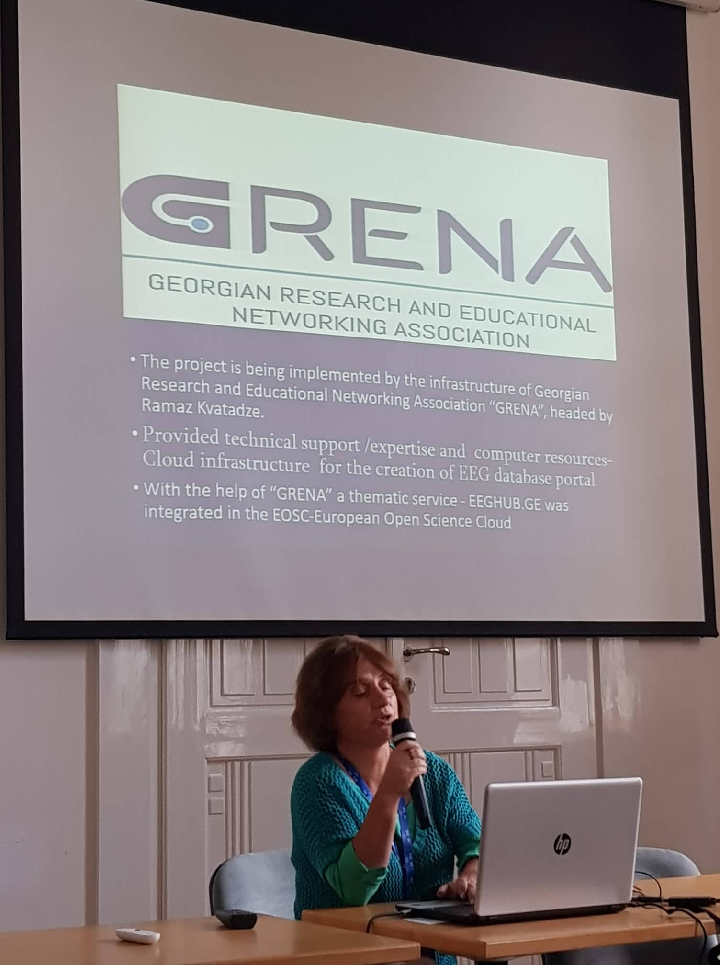
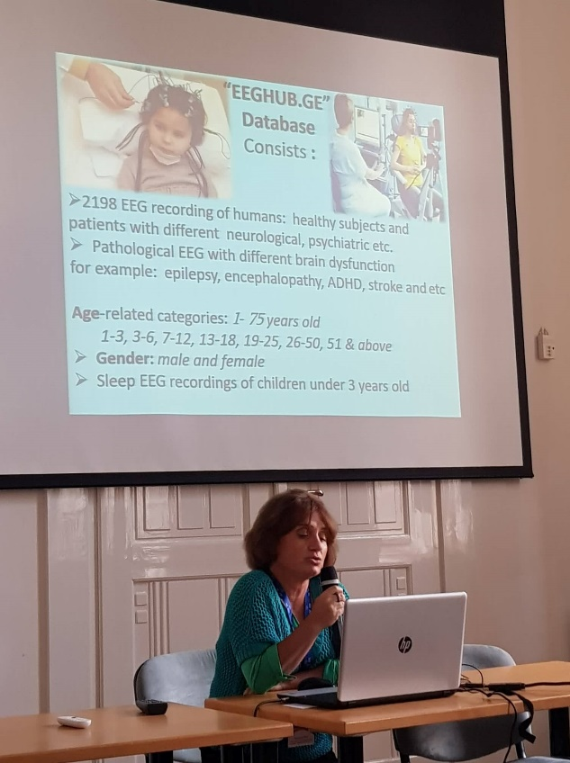
EEGHUB.GE Database

Slide 12

EOSC LOGO

Slide 13
Thank you for attention !

