Slide 1
FedSSH
martin.petri@awi.de
fabian.harms@awi.de

Slide 2
Requirements FedSSH (2018)
No local password / No SSH keys
No special client software
Respects “Federated authentication rules“
Access to internal, directory based/authenticated file services

Slide 3
Ok… kidding?

Slide 4
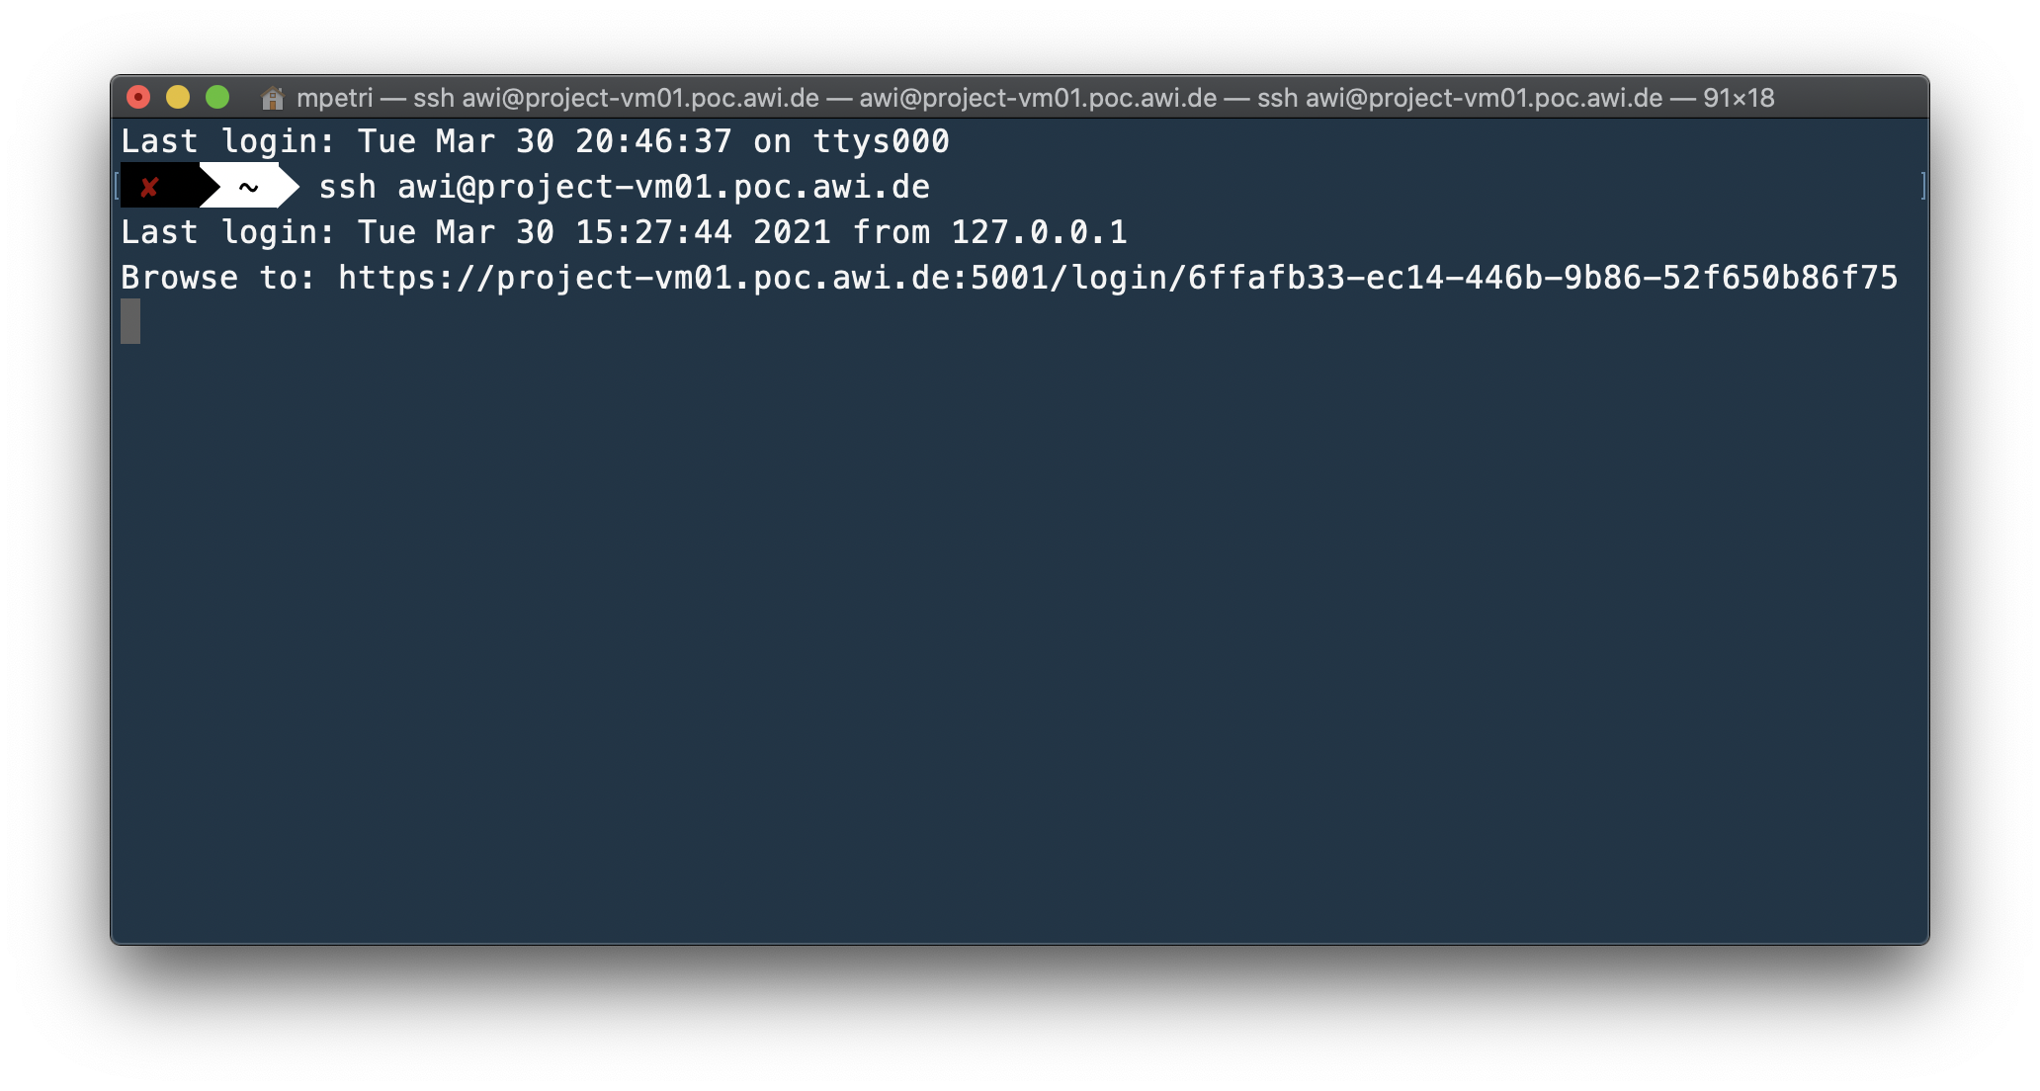
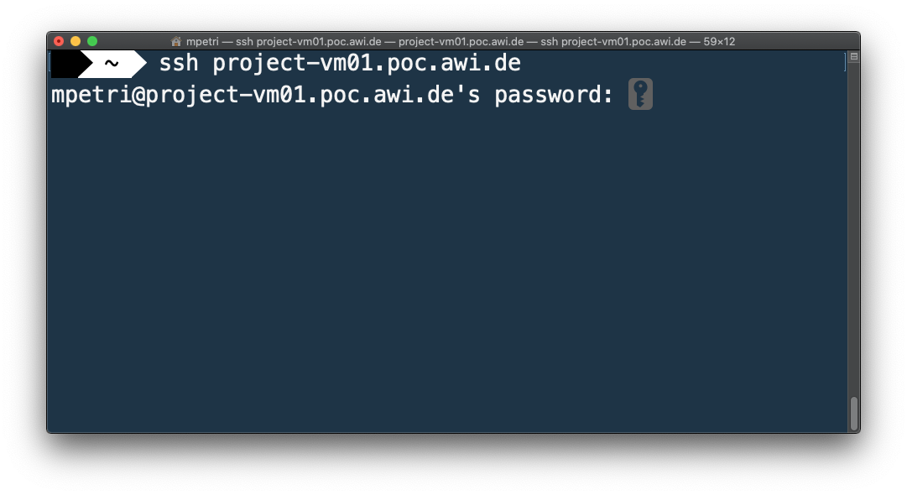
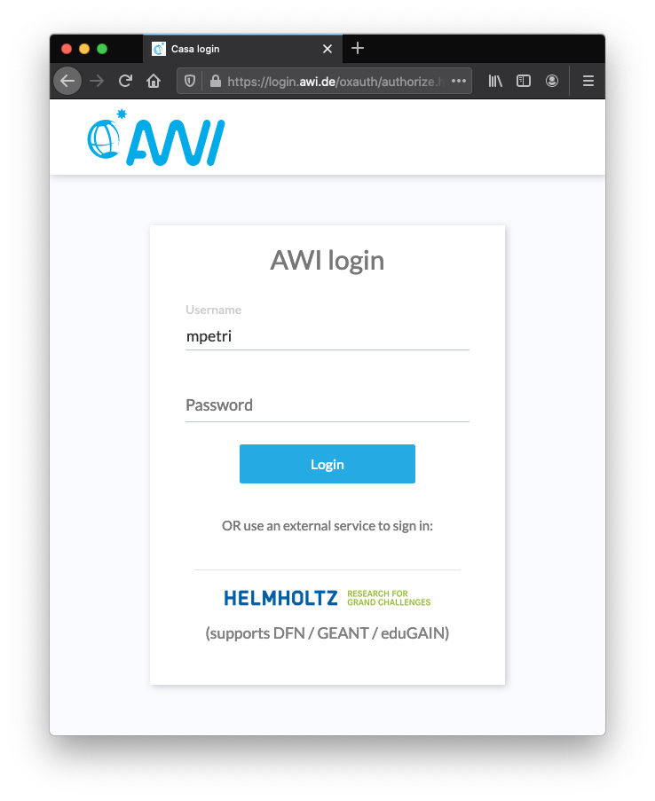
FedSSH

Slide 5
ssh awi@server
Browser
Authenticate
OIDC Authenticator
OpenSSH
3: Open URL
sshd_config
passwd
2: Return URL and wait
4: Open,Redirect,Callback
fedssh.sh
1: Login without password
fedssh binary
Temp web server
process
5: Stop web server, login right user and return bash
/bin/bash
(user lives here)

Slide 6


Ok… so we have
No local password / No SSH keys
No special client software
Respects “Federated authentication rules“
But what about
Access to internal, directory based/authenticated file services

Slide 7










OIDC
Authenticator
Prerequisite: NFS4
FedSSH
Files
KREST
Directory services

Slide 8
FedSSH
Open source (in preparation)
No special SSH client/server software
Standard federated AuthN
Supported (under discussion)
Usage is optional
Pentested
AuthZ by OIDC scopes
SAML will be added

Slide 9














THX -)
martin.petri@awi.de
fabian.harms@awi.de

