Slide 1
AARC – Authentication and Authorisation for Research and Collaboration
Started on 1 May, 2015
Two-year EC-funded project
20 partners
  NRENs, e-Infrastructure providers and Libraries as equal partners
About 3M euro budget
https://aarc-project.eu/
Working now on the proposal for AARC2

Slide 2
High level Goals and Approach for SA1/Pilots
Demonstrate that the solutions identified and proposed by JRA1 and NA3 are effective in addressing the requirements of the communities
Proof of concepts will involve services from the main e-infrastructures in Europe
Show to what extent different technologies used by the e-infrastructures and service providers are compatible and interchangeable
(Re-)using not building
Notes:
Requirements of both users communities and different service providers in terms of usability, security, reliability and provided functionalities

Slide 3
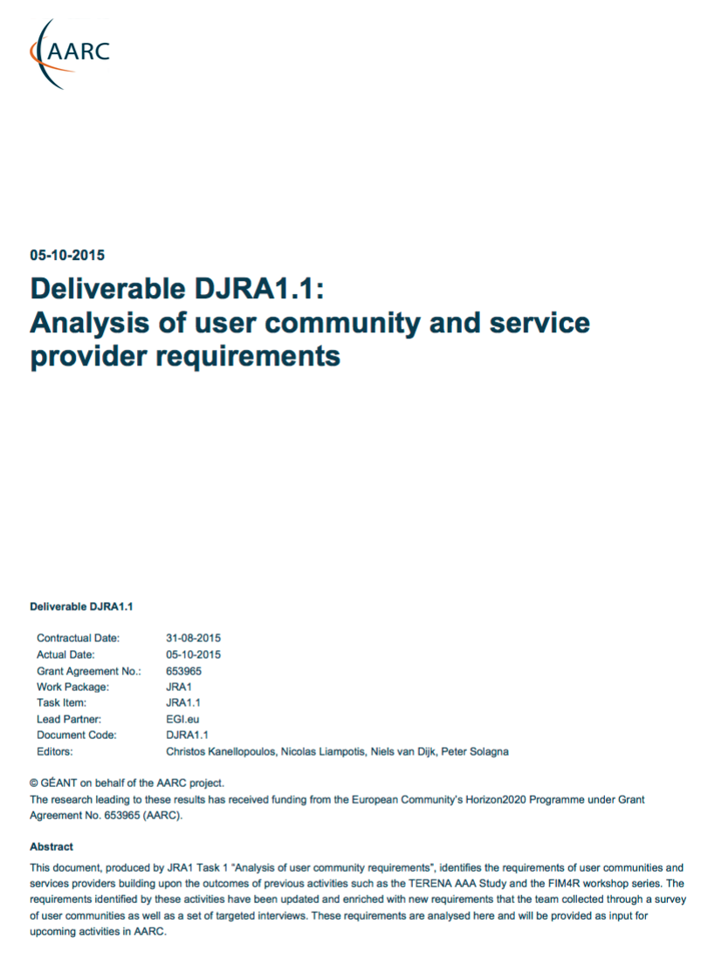
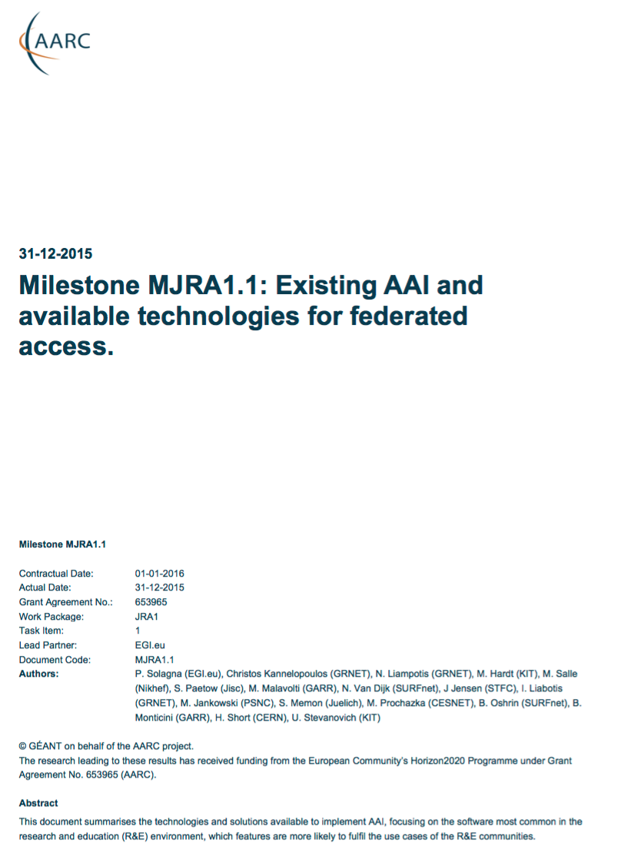
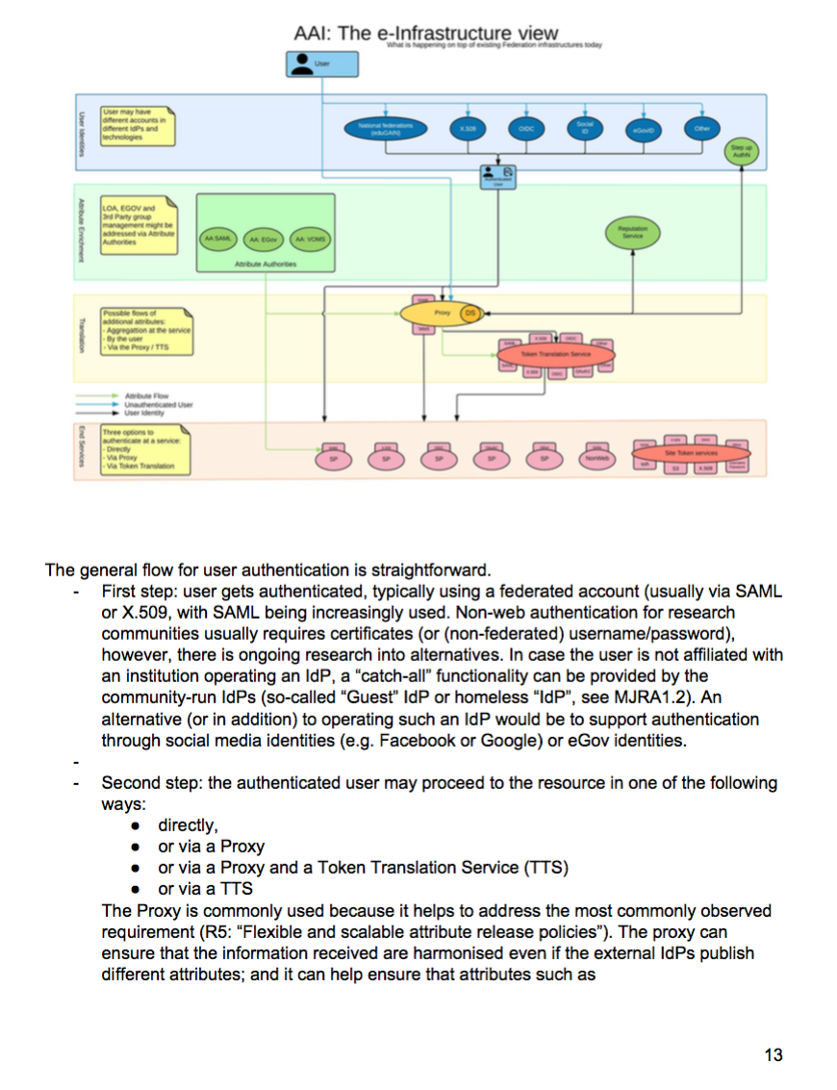
Started pilots guided by several AARC deliverables
Available @ AARC-project.eu
Requirements
User Community
Overview Available
AAI Components
(Draft) Blue-Print
Architecture
Running Pilots
With Communities
Notes:
User and Service Provider friendliness – AAI works always requires a lot of manual intervention so make it as easy as possible
User­managed identity information
Different Levels of Assurance
Community­based authorisation
Attribute aggregation / Account linking
User groups and roles
Step-up authentication
Browser & non-browser based federated access
Delegation
Federation solutions based on open and standards-based technologies
Social media identities
Integration with e-Government infrastructures
document summarises the technologies and solutions available to implement AAI, focusing on the software most common in the research and education (R&E) environment, which features are more likely to fulfil the use cases of the R&E communities.

Slide 4
Common challenges
Communities / e-infrastructures surveyed in AARC:
BioVel
DARIAH
EISCAT
WLCG
EPOS
Photon and Neutron community (Umbrella)
ELIXIR
CLARIN
EGI
EUDAT
D4Science
PSNC
FMI
Libraries and education
Attribute aggregation
User
friendliness
Credential translation
Attribute release
Levels of Assurance
Homeless
users
Bridging Communities
Non-web-SSO
Notes:
Attribute aggregation: Most federated identity management systems are limited by users' ability to choose only one identity provider per service session. There should be a linking service that lets users securely link their various identity provider (IdP) accounts without having to authenticate separately to each IdP.
User friendliness: The tools that support the FIM framework should be simple and intuitive and integrate with the many other IT tools used in daily life.
Credential translation: Converting credentials to different formats enables interaction between services using different authentication technologies
Level of insurance: 1. level of assurance as to whether someone or something is who or what it claims to be in a digital environment. 2. The way you login. How safe is the digital way to login you are using (password? Crappy. Token? Super safe) 3. How much do I trust your infrastructure (your admin? Your network?)
Bridging communities. FIM is important and it’s becoming even more. Bridging between the various communities is a central issue with an efficient mapping of the respective attributes.
non-browser federated access. Non-browser based interfaces are essential to support machine-machine interactions in secured workflows.

Slide 5
Components - Overview
Authentication | Discovery services | Attribute Management | Attribute Aggregation | Authorisation | Credential Translation
Shibboleth IdP | Shibboleth DS Shibboleth EDS
SimpleSAMLphp IdP |  |  | SimpleSAMLphp
LCMAPS |  |  |  | LCMAPS
Kerberos
Moonshot |  |  | Moonshot
Unity |  | Unity | Unity |  | Unity
 | DiscoJuice
 | DiscoPower
 | SWITCHwayf
 |  | HEXAA
 |  | VOMS
 |  | Comanage
 |  | Grouper
 |  | PERUN | PERUN
 |  |  | OpenConext
 |  |  |  | ARGUS
 |  |  |  | mod_auth_mellon
 |  |  |  |  | CI-Logon OAuth for MyProxy
 |  |  |  |  | LDAP facade
 |  |  |  |  | TCS
 |  |  |  |  | STS
 |  |  |  |  | ADFS
 |  |  |  |  | IdProxy
Notes:
How about the functional building blocks and their interplay ?

Slide 6
Components - Authentication
 | Shibboleth | LCMAPS | Kerberos | Moonshot | simpleSAMLphp | UNITY
Authentication workflow (username/pass, multifactor) | Username/password, OTP, client certificate, extendable. | X.509 proxy certificate | Username/password, OTP, Kerberos ticket | Username/password (any RADIUS EAP-supported mechanism) | Username/password from user repository (SQL/LDAP/ RADIUS), X509 authentication through userCertificate LDAP attribute, multifactor (e.g., Yubikey), Social Media identity (Facebook, LinkedIn, MySpace, Twitter, Windows Live), ADFS | Username/Password, Client Certificate, LDAP, Social Media identity (Facebook, Google, GitHub)
Supported standards |  | X.509 (RFC5280 and RFC3820), VOMS | RFC 4121, RFC 4120 | RFC3748, RFC5247, RFC7055 | SAML 1.1/2.0, X509, OpenID, OAuth 2.0, Kerberos, VOOT, SQL, LDAP, RADIUS | SAML 1.1/2.0, X.509, OIDC, LDAP
LoA support |  | Yes, via the VO-CA-AP plugin. |  | Yes, in the sense that it can transport LoA information through SAML attributes | Yes, in the sense that it can transport LoA information through SAML attributes | Yes, only an attribute containing the LoA (not attribute level)
VO hierarchical organisation |  | Yes, it supports VO | User community can be split into the realms | VO-like support through so-called communities of interest (COI) that are defined at the trust router level (i.e. not inherent to GSS-EAP mechanism). COI information is defined in vendor-specific RADIUS attributes. | Group memberships can be retrieved from an API service protected with OAuth 2.0 using the VOOT protocol and added to the list of attributes received from the IdP. Alternatively, issuing SAML2 AttributeQuery to an Attribute Authority can be supported | Yes
Import and export user data | Yes, importing/exporting underlying user repository | Not relevant | Only to other Kerberos DB | User data not relevant to technology | Yes, importing/exporting underlying user repository | Yes, importing/exporting underlying user repository
HA deployment | Yes | Deployed in the service | Yes | RADIUS service can be run in HA environments | Yes, through multiple memcached service instances | Relying on Database layer
Dependencies on other technologies | JAVA JRE, OpenSAML, Java Application Server/Container (Tomcat, Jetty), Apache httpd mod-shib | OpenSSL, VOMS C library |  | RADIUS (FreeRADIUS) for transport, SAML for attribute encapsulation. | PHP, Web servers (Apache, nginx, IIS among others), user repository (SQL database, e.g. MySQL or PostgreSQL, , LDAP directory (OpenLDAP) or a RADIUS interface (OpenRADIUS), memcached for user session management | SQL Databases (MySQL, PostgreSQL), Java
Licence | Open Source | Open Source (Apache-2.0) | Open Source | Open Source | Open Source (LGPL 2.1) | Open source, Permissive OpenBSD Licence
Expected support level | Supported/funded by Shibboleth consortium, dedicated dev team. | Supported by NIKHEF | Fully supported by Linux OS distributions | Supported by Jisc, user communities | Large user community (dev team external contributors, mailing lists) | Supported by ICM, JSC and Funded by PLGrid

Slide 7
Components – Discovery Services
 | SWITCHwayf | DiscoPower | DiscoJuice | Shibboleth DS | Shibboleth EDS
Geographical filtering of IdPs | Not supported | Partial, through IP geo-location | Yes, through HTML5 geo-location API (needs user consent) | No? | No?
UI internationalization | Yes, manually on a specific language file. Languages en, de, it, fr and some other languages are included. | Yes. Translated UI elements based on JSON-formatted configuration files and localised IdP names/descriptions are read from XML metadata | Yes | Yes | Yes, language detecting on browser settings
Search and filter capabilities | Search-as-you type or selection from a list of organisations | Search-as-you type or selection from a list of organisations that are organised in tabbed views (usually grouped by country) | Filtering by country. Search-as-you type or selection from a list of organisations | Search-as-you type or selection from a list of organisations | Search-as-you type or selection from a list of organisations
Preferred user choice | Yes | Yes | Yes | Yes, by cookie | Yes
Input standards for IdP metadata | XML | SAML V2.0, SAML V2.0 Attribute Extensions V1.0 | SAML V2.0 | SAML V2.0 | SAML V2.0
Ownership/Project | SWITCHaai/SWITCHwayf project | UNINETT | UNINETT AS | Shibboleth Consortium | Shibboleth Consortium
Licence | BSD (as-is) | Open Source (LGPL 2.1) | Open Source (LGPL 3.0) | Open Source (Apache Software License 2.0) | Open Source (Apache Software License 2.0)
Expected level of support | Not defined | Unspecified but currently supported by large user community (dev team, external contributors, mailing lists) | Unspecified. Not production ready (August 2014). | Unspecified but currently supported by large user community (dev team, external contributors, mailing lists) | Unspecified but currently supported by large user community (dev team, external contributors, mailing lists)

Slide 8
Components – Attribute Management
 | VOMS | HEXAA | COmanage | Grouper | Perun | UNITY
Input standards | X.509 | SAML2 | SAML (via Apache) | SQL, LDAP, XML | SAML2, X.509 | SAML2, X.509, LDAP, OIDC
Output standards | X.509, SAML | SAML2 | VOOT, LDAP, SAML (via Shib IdP) | LDAP, VOOT, SCIM, XML | SAML2, VOOT | OIDC, SAML
IdP configuration | CA configuration | It requires configured acceptable IdPs | No | No | It requires configured IdP | Yes
Handle attribute release consent | Not directly | Yes | Not directly | No | Via the IdP | Yes
SP configuration | Configure authoritative VOMS for the supported VOs | It requires to configure the SPs specific for the VO | Not by default | No | It requires configured SP | Yes
Membership life-cycle management | Yes | No | Yes | No | Yes | No (will be supported)
VO Organization (groups, roles, etc.) | Yes. Groups and Roles | Yes, fine grained VO organization | Yes | Yes | Yes. Groups, Roles, Attributes | Yes, (Hierarchical) Groups, Roles, Attributes
Delegated organization of the VO groups | Yes | No | Yes | Yes | Yes | Yes
Import and export of user data | Partially yes | Partially yes, through proprietary API | Yes, through API and pluggable provisioners. 1.1.0 release will introduce significant new import capabilities. | Yes, through Grouper Loader, Provisioning Service Provider, Web Services, and Import/Export tool | Yes, via various protocols. Periodical synchronization supported as well. | Yes
HA deployment | Available | Not available | Yes | Yes | Partially supported | Yes
Dependencies on technologies | TBD | PHP, SimpleSAMLphp, MySQL, Apache | PHP/Apache, RDBMS (PostgreSQL, MySQL) | Java, container, RDBMS | Java container, Apache, Shibboleth | SQL Databases (MySQL, PostgreSQL), Java
Licence | Open Source | Open Source | Open Source (Apache2) | Open Source (Apache2) | Open Source, FreeBSD licence | Open source Permissive BSD Licence
Expected level of support | Supported by INFN, bug fixes. | Supported by SZTAKI and NIIFI | Supported by Internet2 TIER, various grants, and other sources | Supported by Internet2 TIER, various grants, and other sources | Supported by CESNET and Masaryk University. Maintenance and development. | Supported by ICM, JSC and Funded by PLGrid

Slide 9
Components - Authorisation
 | Argus | LCMAPS | mod_auth_mellon
Type of input attributes | PAP Configurable, PEPd configurable via new plugins (e.g. PIP). Based on SAML2-XACML2 attributes, currently primarily X.509 and VOMS based (DNs and FQANs). Need to be profiled for interaction between clients and servers. | X.509 proxy certificates with VOMS ACs or derived attributes (subject DN, FQANs etc.). | SAML2 attributes
Support for policy management | Yes, PAP can import policies from remote PAPs. | Config file allows complicated flows of plugins, including callouts to remote services (such as Argus). | Basic policies via Apache HTTP server config files
LoA support | In principle yes, in practice needs extra plugins. | Yes, via lcmaps-plugins-vo-ca-ap | Yes, if LoA information available through SAML attributes
HA deployment | Yes, several solutions are possible. E.g. running multiple PEPd-s or PDPs. The LCMAPS Argus plugin has support for multiple endpoints. Also failover setups such as in http://wwwae.ciemat.es/~delgadop/argus/ | No, not really applicable (not a service but a library). | Yes, provided an Apache HTTP server HA deployment
Dependencies on other technologies | Numerous Java libraries (shipped along) such as cANL-java, OpenSAML, voms-java. | VOMS C-API, OpenSSL | Apache HTTP server, OpenSSL, lasso
Ownership / maintenance | INFN (Java) / Nikhef (C) | Nikhef | UNINETT
Licence | Apache-2.0 | Apache-2.0 | GPL-2
Expected support | Supported at least for bug fixes | Supported for security fixes and feature requests, provided such a feature or enhancement is also of interest for NL-NGI, EGI.eu or a community which is supported by the NL-NGI or Nikhef itself | Not specified. Project supported by UNINETT and the open-source user community

Slide 10
Components – Credential Translation
 | STS | CILogon | ADFS | LDAP Facade | Unity | IdProxy
Input credential types supported | Username Token, SAML | SAML, OpenID-Connect | Active Directory | SAML, planned: OIDC, X509 | SAML2, OpenID, OAuth, local | SAML, LDAP
Output credential types supported | X.509 certificate, Proxy certificate | X.509 certificate, Proxy certificate | SAML | LDAP | SAML, OpenID, OAuth, LDAP, Kerberos | SAML, OAuth 2.0 / OpenID Connect
Interfaces with other services | VOMS, CA, LDAP | MyProxy CA, (VOMS) | WS-* |  |  | CAS, LDAP, SAML2 IdP
UI for the users | N/A | Web, command line | Web | Web, any SSH client, including non-web | Web | No UIs or APIs provided. Admin needs to edit a series of configuration files.
High availability deployment |  | TBD | Multiple ADFS servers and IdMaaS endpoints can be deployed |  | Possible (Relying on backend database) | No
Licence | http://www.apache.org/licenses/LICENSE-2.0 | http://grid.ncsa.illinois.edu/myproxy/license.html, NCSA and BSD and ASL 2.0 | Various: some proprietary, some proprietary with source available, some open source (see description) | GPL | Open Source (BSD) | Open Source (GPL-3.0)
Expected level of support | Community driven. | Production software in US | Very high for Office365 and Azure. | In production, actively developed, installing pilots available | In production, actively developed | Supported by the open-source community. Code base has not been updated since June 2014.

Slide 11
Components – Attribute Aggregation
 | Unity | OpenConext | Perun | Moonshot | SimpleSAMLphp
Attribute retrieval standards/ protocols | SAML2 Attribute Query , OAuth, LDAP | SAML2, OAuth, VOOT1-2, XACML, OpenID Connect OP (future) | SAML2, VOOT, LDAP, SQL, CSV | Attributes are encapsulated in a SAML assertion included in a RADIUS attribute. A mix of RADIUS attributes and one SAML attribute statement (as per standard) are supported. | The VOOT groups module can fetch group memberships from an API service protected with OAuth 2.0 using the VOOT protocol (versions 1 and 2 are supported) and add them to the list of attributes received from the IdP. The Attribute Aggregator module can issue SAML2 attribute queries to Attribute Authorities that support SAML2 SOAP binding. The Attribute-from-rest-api module can request attributes from REST APIs in JSON format.
Shared (non-targeted) identifier required | Yes | Yes | Yes | No, but it is supported | Yes
HA deployment | Possible (Relying on backend database) | TBC | Partially supported | Not yet | See HA deployment options for SimpleSAMLphp above
Ownership | ICM | SURFnet | CESNET/Masaryk University | Jisc/Painless Security | VOOT groups module: OpenConext Attribute-from-rest-api module: NIIF Attribute-from-rest-api module: NIIF
Licence | (Open source) BSD | Apache 2.0 | Open Source, FreeBSD licence | Open Source | Open Source
Expected level of support | In Production, actively developed | Actively developed | In production, actively developed | In production, actively developed | Active community support

Slide 12
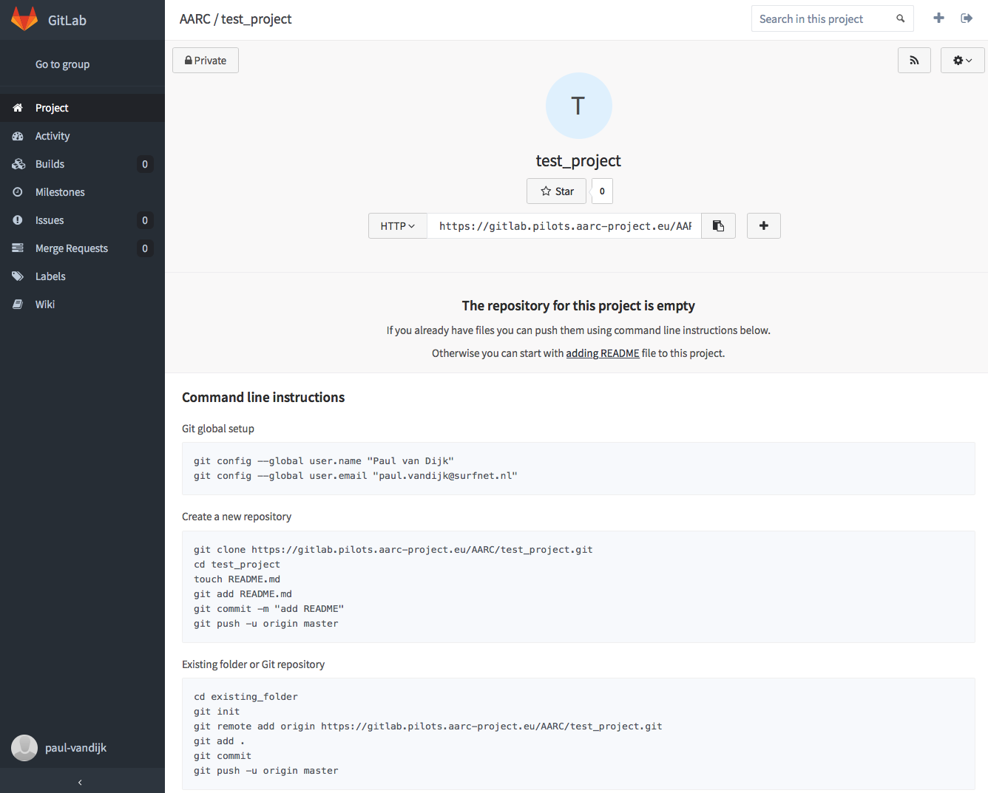
Established a pilot platform pilots.aarc-project.eu
A staging area for our services
Technical platform delivered by
>20 VMs instantiated
Using Ansible scripts for deployment
SimpleSAMLphp DIY IdP available
Gitlab for collaborative coding, deployment and
testing: gitlab.pilots.aarc-project.eu
Online support by SURFnet staff

Slide 13
AAI building blocks and pilots commenced
First results expected at Q1 2016
AAI solutions for Library Community
Establishing solutions to bridge SAML authentication with IP-address based access control which is still common practice at publishers
Showcase solutions to enable on-campus access for citizen scientists to library resources
Pilot a proxy between libraries and library reource providers to reduce interactions and complexity.
IdPs
Library, hybrid AuthN
Library, IdP-SP proxy approach
Attribute Authorities
Proxy
Perun and COmanage AAs for BBMRI & EGI
OpenConext attribute aggregation
Token Translation
TTS with CI-logon and VO portal for Elixir
Service Provider
ownCloud & LibreOffice SPs and Integration
ORCID SP

Slide 14
AAI building blocks and pilots commenced
First results expected at Q1 2016
AAI solutions for BBMRI community and EGI e-infrastructure
Manage authorisations on a central level to facilitate the sharing of biological BBMRI resources
Testing the usability of SAML based attribute authorities to regulate service access authorization within the EGI community
IdPs
Library, hybrid AuthN
Library, IdP-SP proxy approach
Attribute Authorities
Proxy
Perun and COmanage AAs for BBMRI & EGI
OpenConext attribute aggregation
Token Translation
TTS with CI-logon and VO portal for Elixir
Service Provider
ownCloud & LibreOffice SPs and Integration
ORCID SP

Slide 15
AAI building blocks and pilots commenced
First results expected at Q1 2016
AAI solutions for the ELIXIR community
Demonstrate that a SAML based login can be used to obtain (command-line) access to cloud VMs and GridFTP (Globus) data transfer portal
IdPs
Library, hybrid AuthN
Library, IdP-SP proxy approach
Attribute Authorities
Proxy
Perun and COmanage AAs for BBMRI & EGI
OpenConext attribute aggregation
Token Translation
TTS with CI-logon and VO portal for Elixir
Service Provider
ownCloud & LibreOffice SPs and Integration
ORCID SP

Slide 16
AAI building blocks and pilots commenced
First results expected at Q1 2016
AAI solutions for (commercial) service providers
Boost the adoption of AAI technologies by service providers in the public and non-public domain by showcasing the the added value of a standardised AAI for both research communities and service providers
IdPs
Library, hybrid AuthN
Library, IdP-SP proxy approach
Attribute Authorities
Proxy
Perun and COmanage AAs for BBMRI & EGI
OpenConext attribute aggregation
Token Translation
TTS with CI-logon and VO portal for Elixir
Service Provider
ownCloud & LibreOffice SPs and Integration
ORCID SP

Slide 17
Activities in SA1 Pilots: planning
Q1-2016 | Q2-2016 | Q3-2016 | Q4-2016 | Q1-2017
Guest access: Library proxy Hybrid AuthN models | Guest access: Social IDs/Catch all IdPs | Guest access: eGov IDs Reputation services
Attribute Authorities: PERUN AA and OpenConext | Attribute Authorities: VOPaaS components incl. Comanage AA | Attribute Authorities: Feasibility of multiple AAs
Token translation: CI-logon | Token translation: CI-logon – extended LDF, Unity (other solutions) | Token translation: Incorporate attributes for AuthZ in TTS
Access to (commerical) services: ORCID | Access to (commerical) services: ownCloud/LibreOffice | Access to (commerical) services: Cloud provider TBD
AARC2
To be determined
Cross community/e-infra use cases
Feedback from communities & Wrap up
pilot components
pilot integration of different components across communities
Notes:
VOPaas
External Identity Provider (extIDp) Satosa
Feed in many types of IDs
Persistent ID
Linking of IDs
VO membership services (enrolment flows, + AA)

Slide 18
Challenges/Discussion
Maturity level of components?
Documentation of sufficient quality?
Sustainability of components and exploitation models?
Adoption
  Functional requirements met?
  Easy to deploy?
  Easy to use?
  Scalable?
  ...
Notes:
Generic enough, not too generic so it lacks the tailoring needed for my RI!

Slide 19








To explore the use of guest identities
Authentication
Status & availablity
list of countries
pilot technical & policy feasibility
eGov IdPs
Vopaas/SaToSa
(TTS)
IdP with IP scoping?
or Library PCs with certificate?
Library IdP
DAASI IdP/ip filtering, EZproxy.....GRNET/HEAL-Link
Increase LoA
bonafide?
reputation service?
Resource
VoPaaS/SaToSa
Reputation service?
at enrolment
or as AA?
Social IdPs
Increase LoA
bonafide?
reputation service?
cost effective?
EGI
List of Guest IdP solutions?
Shibb plug-ins?
Community IdPs
Increase coverage
training
as a service solutions
“grease” the process
Institutional IdPs
all eduGain (academia, min. set of attributes)
* https://wiki.geant.org/display/AARC/SA1.1+Guest+identities
** http://www.geant.net/Resources/Open_Call_deliverables/Documents/WoT4LoA_final_report.pdf
Notes:
Daniela Pohn trust broker

Slide 20
To research how attribute providers fit into the blueprint, such that user attributes can be aggregated from multiple authoritative sources
Ext. Attributes
EGI
Some examples in: EGI PoC
cloud resources include:
OpenStack
OpenNebula 4.x
Synnefo
Resource
Institutional IdPs
all eduGain
OpenConext/simpleSAMLphp
platform
push (in assertion)
Management
Platform
Aggregation
platform
pull – API
May be asynchronous (VOOT)
SAML attr query (in a trust relation okay)
→ On behalf of a particular user
Attribute
Authority
Identity provider just for basic attributes, not for AuthZ
AA as a source for:
group context
attributes for AuthZ
attributes to increase LoA
Attribute Authority. Could be:
PERUN SAMLqry
GOCDB
ORCID
HEXAA
VOMS
* https://wiki.geant.org/display/AARC/SA1.2+Attribute+Management
** https://wiki.egi.eu/wiki/AAI_pilot

Slide 21


To assess the integration of security token translation services to offer seamless authentication among heterogeneous systems
Token Translation
SSH clients
WEBDAV clients
........
commercieal solutions:
eg ORCID, LibreOffice...IAAS?
Resource
Institutional IdPs
all eduGain
Token translation
support of interactive and non-interactive sessions?
personal certs?
robot certs?
key based AuthN...
addition of attributes for AuthZ (e.g. CI-logon – VOMS integration)
certificates
SAML IdP
LDAP Facade
ssh keys
app specific pass
STS
* https://wiki.geant.org/display/AARC/SA1.3+Access+to+resources
Notes:
Daniela Pohn trust broker
Bob Hulsebosch

