Slide 1
Minimal Level of Assurance (LoA)
Recommendation for low-risk research use cases
Hannah Short
GÉANT Symposium, Vienna
9 March 2016

Slide 2
AARC
Authentication and Authorisation for Research and Collaboration
Support the collaboration model across institutional and sector borders
Build on the many existing and evolving components
Technical and Policy goals
  To develop an integrated AAI built on production services (i.e. eduGAIN)
  To define an incident response framework to work in a federated context
  To agree on a LoA baseline for the R&E community
  To pilot new components and best practices guidelines in existing production services

Slide 3
Level of assurance
Research community interviews done
Interviewed 6 research infrastructures
  CLARIN (language research)
  DARIAH (arts and humanities)
  ELIXIR (life science)
  LIGO (physics)
  photon/neutron facilities (physics)
  WLCG (physics)
Interviewed 2 e-infrastructures (cyberinfrastructures)
  EGI
  PRACE
Interview results: https://wiki.geant.org/x/nQHbAg

Slide 4
Minimum LoA recommendation (30 Nov 2015)
The accounts in the Home Organisations must each belong to a known individual
Persistent user identifiers (i.e., no reassignment of user identifiers)
Documented identity vetting procedures (not necessarily face-to-face)
Password authentication (with some good practices)
Departing user’s eduPersonAffiliation must change promptly
Self-assessment (supported with specific guidelines)
The document: https://wiki.geant.org/x/wIEVAw

Slide 5
Community consultation 11/2015-1/2016
Received 25 comments (mostly from federation operators)
  https://wiki.geant.org/download/attachments/47907229/MinimalLoArecommendation--comments.pdf
”Is this a report feeding the actual profile work that will start”
”Need to involve more research communities to make them committed”
”This is an approximation of InCommon Silver which hasn’t gotten traction. Why would this?”
Many comments expected more detail
  Unique identifier (”Don’t rule out ePPN”)
  Password requirements
  eduPersonAffiliation and departing users
Mappings to existing federations policies

Slide 6
Spin-off: Self-assessment tool
Self-assessment proposed as the approach for ”IdP audit”
A web based tool to support the IdP admins in the self-assessment
  Presents the specific requirements as a check-list
  The IdP admin goes through the list one-by-one
  The tool evaluates the answers
  If ”pass”, federation operator adds an Entity Category tag
Software Requirements specification
  Together with Sirtfi
  https://docs.google.com/document/d/10kguCdxWn38z_EGRnrdjCI4GSeO44zFGeXWHGmzz27o/edit

Slide 7
hannah.short@cern.ch

Slide 8
Service Aspects of Assurance
IdPs and Federations
Daniela Pöhn
SA5T1 Subitem Service Aspects of Assurance
Research Assistant DFN/LRZ
GÉANT Symposium, Vienna
2016-03-09

Slide 9
Survey on federations
https://wiki.geant.org/display/gn41sa5/Federation+survey
Results:
LoA in place with contracts
Identity Management Practice Statement, but not enforced
Documented, but not enforced
Most federations/IdPs do not want a higher LoA
Impacts on adopting LoA: between none till high costs
Hub-and-spoke federations have more control

Slide 10
Survey on identity provider
https://wiki.geant.org/display/gn41sa5/IdP+survey
Results:
Individual accounts
Most IdPs have an identity vetting process, but not documented
Most IdPs have certain password qualities
(Almost) no second-factor authentication
Update of account/affiliation between less than 2 weeks and more than 6 months
Partly documented
Partly Incident Response Process

Slide 11
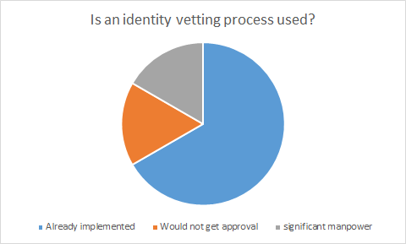
Survey on identity provider

Slide 12
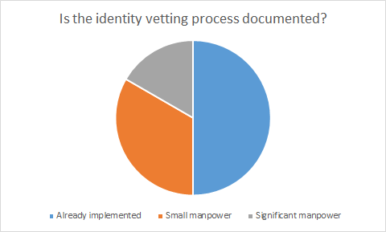
Survey on identity provider

Slide 13
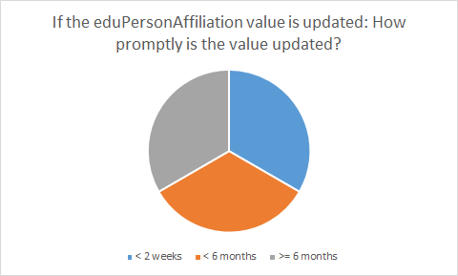
Survey on identity provider

Slide 14
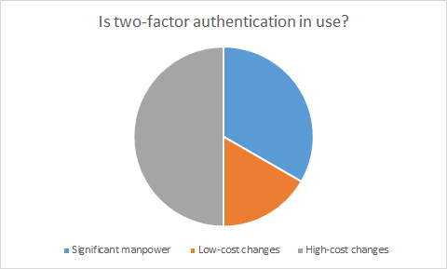
Survey on identity provider

Slide 15
Baseline requirements
Individual accounts
Persistent, non re-assigned identifiers
Documented identity vetting, which is not necessarily face to face
Password authN with some good practices
Departing user’s ePA changes promptly
Self-assessment of LoA supported with specific guidelines

Slide 16
Possible costs
Without much manpower or high costs:
Unique identifies
Persistent, not re-assigned identifiers
(Internal) documentation of the vetting process
Other aspects seem to be more expensive or time consuming:
Documentation of all processes
Promptly update of information
Second-factor authentication
Audit

Slide 17
Potential solutions
Self-assessment template / tool:
  GÉANT web tool
  including recommendations and best practices
  (combined with SIRTFI and other monitoring/testing tools),
For IdPs, who need a higher LoA:
  Peer (pairwise) auditing of IdPs
  Second-factor authentication: GÉANT could offer it as a service or procure Duo-type solution for community

Slide 18
GN4 Phase 2
Assurance within JRA3 T2
Web tool (together with SIRTFI?)
Requirements for SIRTFI currently gathered in REFEDS WG
Research is global, so assurance should be global as well
Importance of coordination with InCommon and other parties
Assurance might get an own WG

Slide 19
Do you have any questions?
daniela.poehn@lrz.de

