Slide 1
Gamification of KPIs
1st is running the Network better…
Brook Schofield
eduGAIN Product Manager (or something like that).
GÉANT Symposium 2016
Vienna

Slide 2
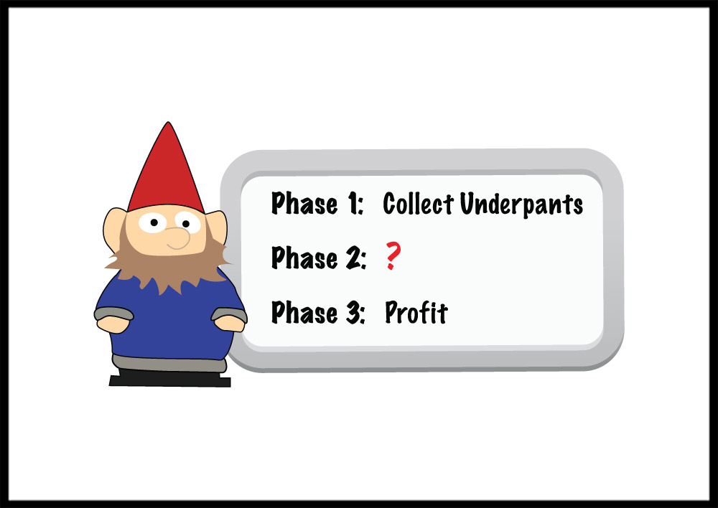
eduGAIN in 3 easy steps
Federations
http://www.tshirtlaundry.com/The-Underpants-Gnome_p_1441.html
Notes:
Image: http://www.tshirtlaundry.com/assets/images/photos/UnderpantsGnome12_2009.jpg
Page: http://www.tshirtlaundry.com/The-Underpants-Gnome_p_1441.html

Slide 3
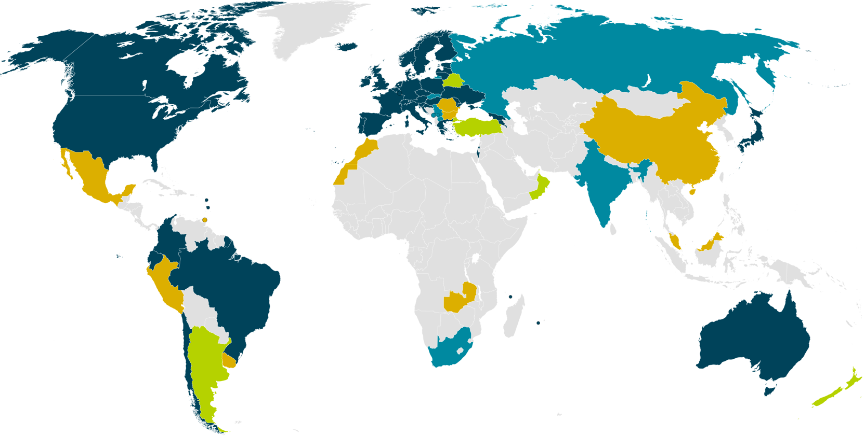
eduGAIN & Federation Status
38 eduGAIN Members
5 Joining eduGAIN
8 Candidate Federations
10 Known Federations
March 2016
Notes:
Big growth in new federations – many have aspirations to join eduGAIN and interfederate.

Slide 4
eduGAIN vs the World!
Federations: 63%
+ joining: 70%
Entities: 27% (ALL)
IdPs: 57%
SPs: 14%
Notes:
38/61=64%

Slide 5
eduGAIN & Federation Status (% of entities)
15%
29%
78%
0.3%
38 eduGAIN Members
5 Joining eduGAIN
8 Candidate Federations
10 Known Federations
March 2016
Notes:
Australia: 1/252=
Brazil: 127/162=78%
USA: 482/3192 5720=8.4% (check this for eduGAIN content)
UK: 3131

Slide 6
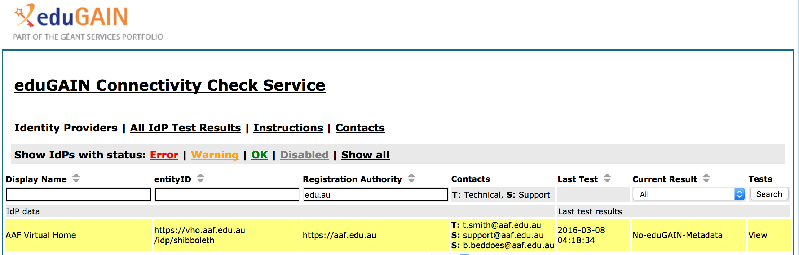
Drill down to the AAF’s 0.3%
15%
29%
Notes:
https://technical.edugain.org/eccs/

Slide 7
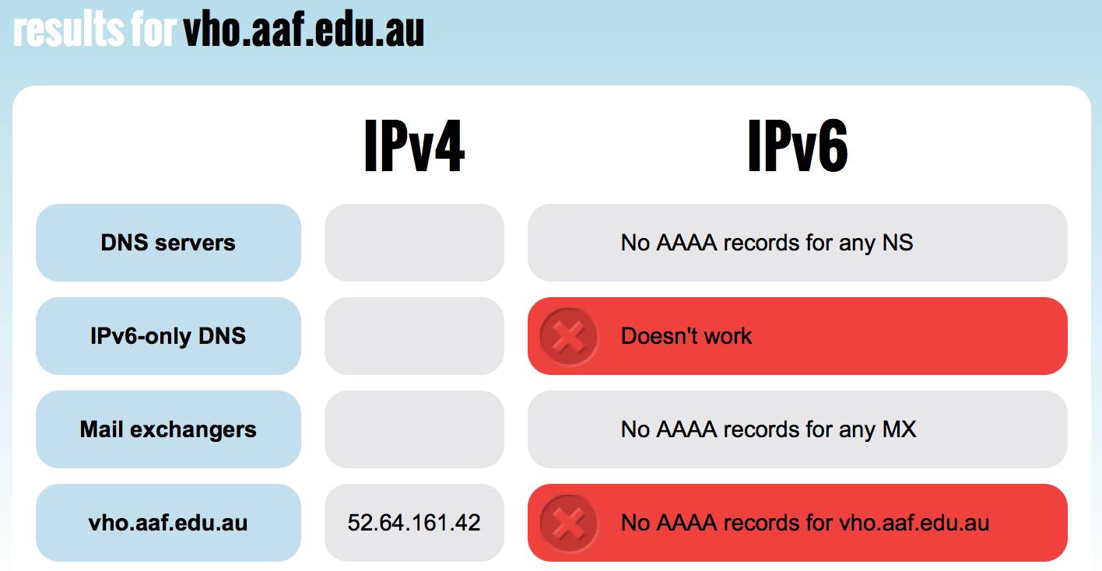
Drill down to the AAF’s 0.3%
15%
29%
Notes:
http://ip6.nl/#!vho.aaf.edu.au

Slide 8
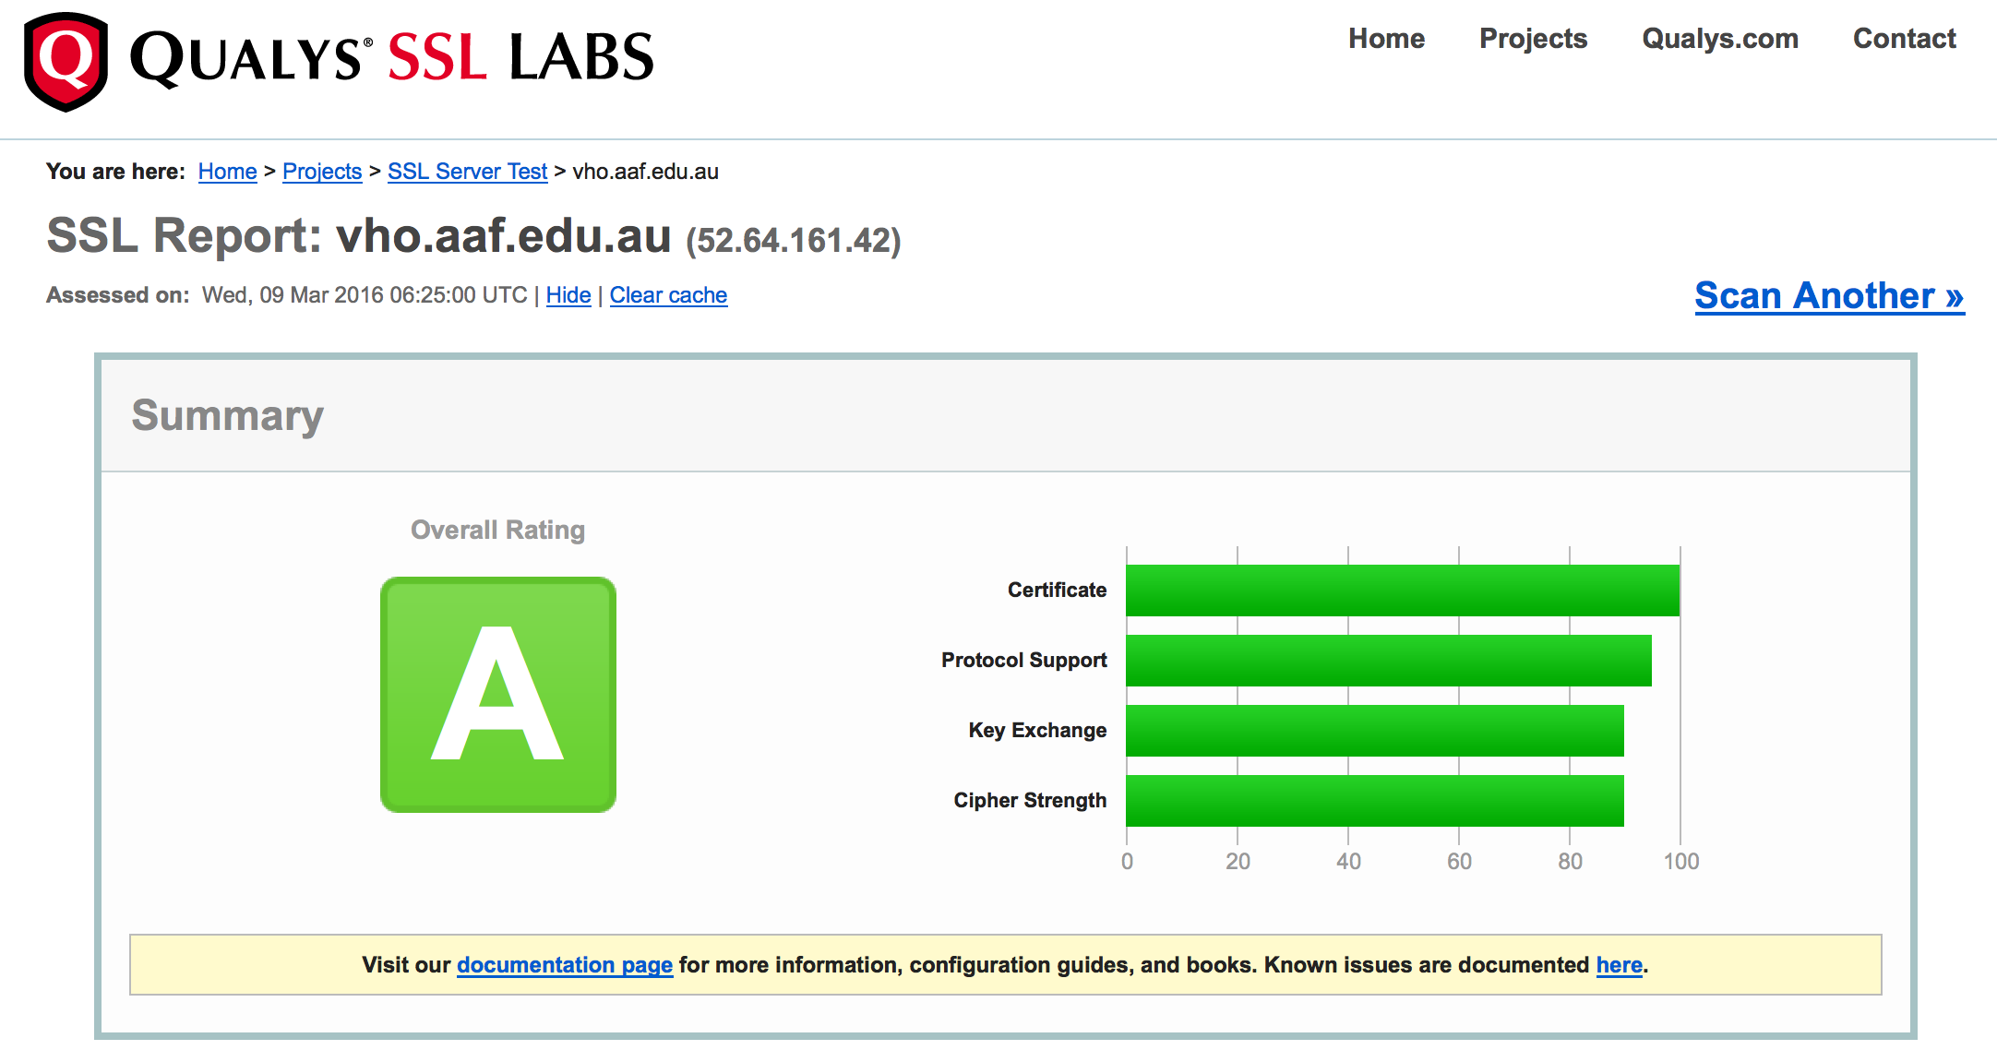
Drill down to the AAF’s 0.3%
15%
29%
Notes:
https://www.ssllabs.com/ssltest/analyze.html?d=vho.aaf.edu.au

Slide 9
eduGAIN & Federation Status
15%
29%
x
78%
38 eduGAIN Members
5 Joining eduGAIN
8 Candidate Federations
10 Known Federations
March 2016

Slide 10
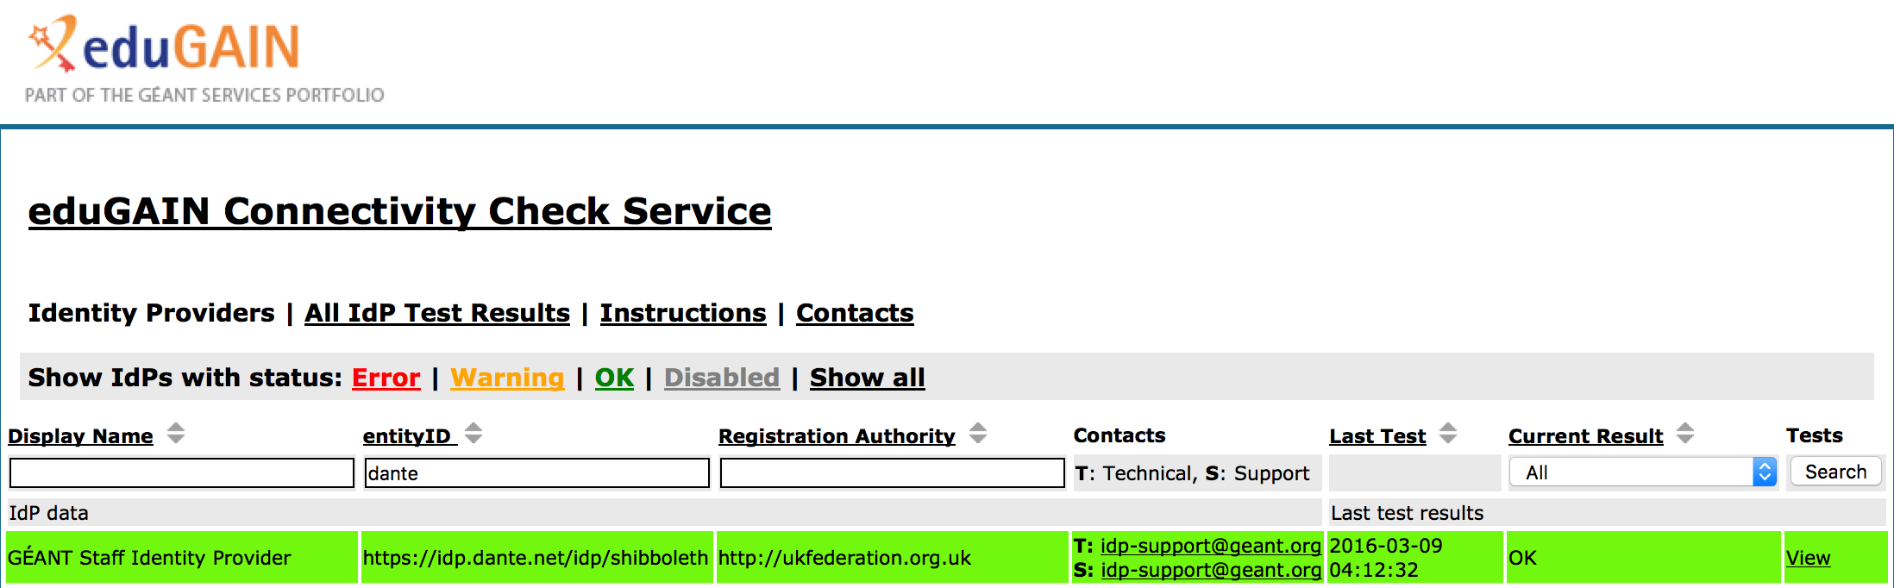
Glass Houses…

Slide 11
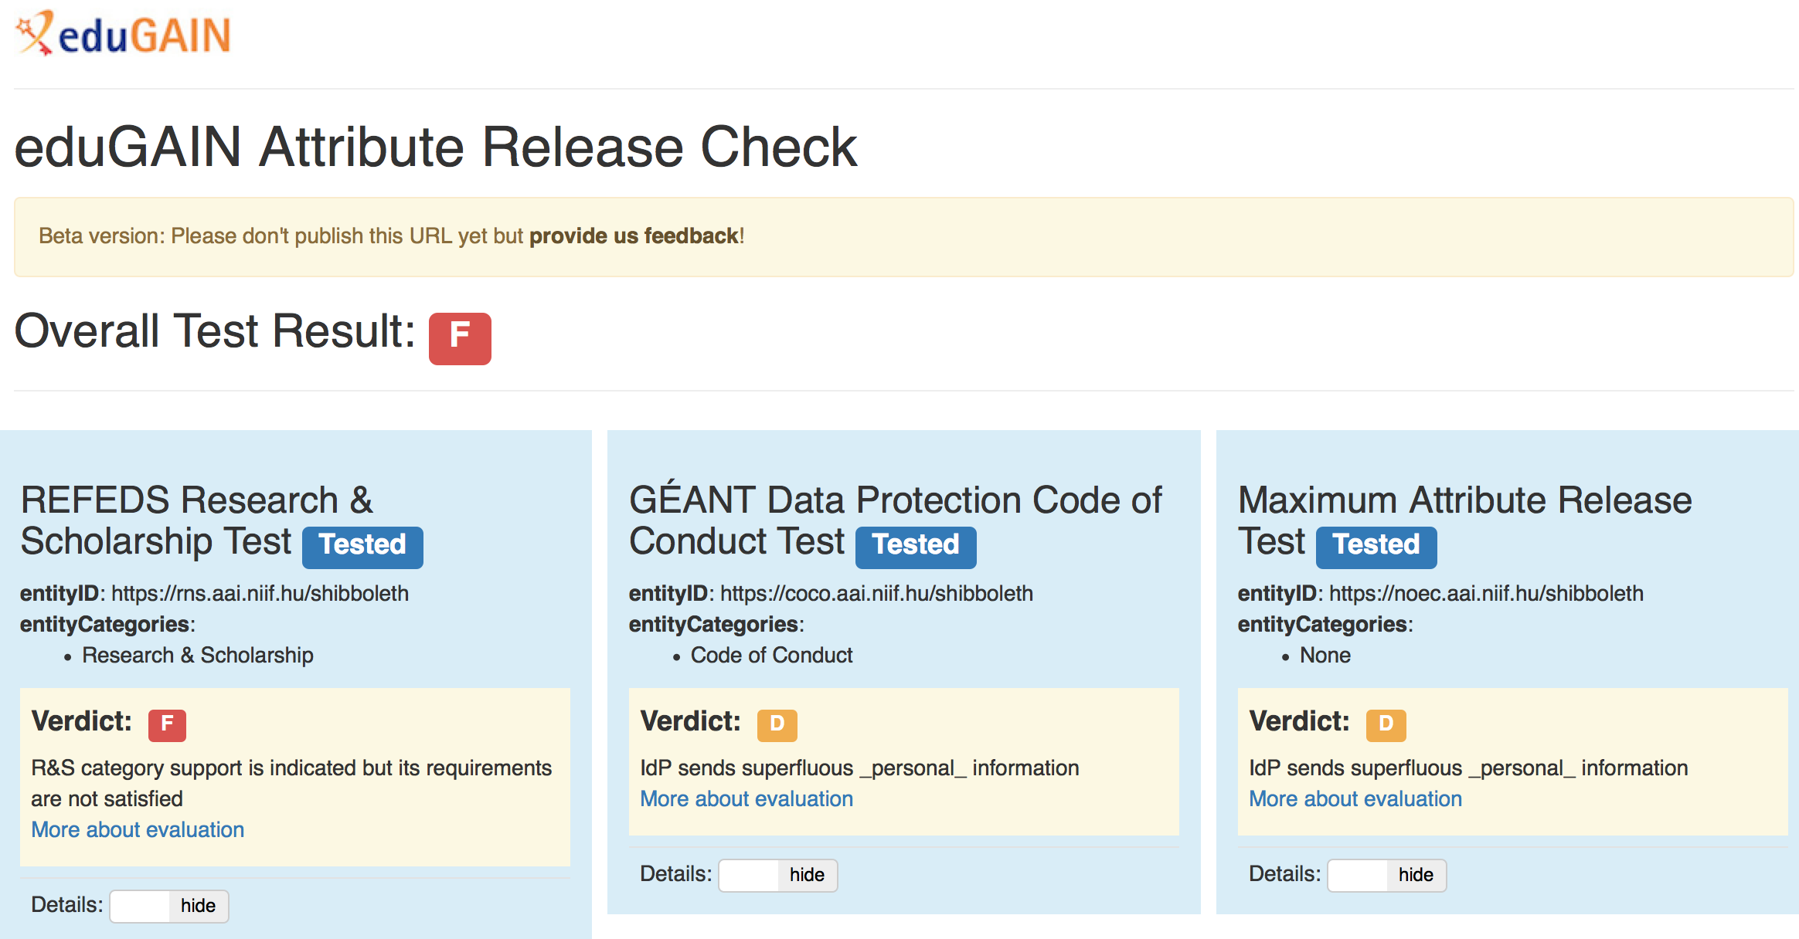
Glass Houses…

Slide 12
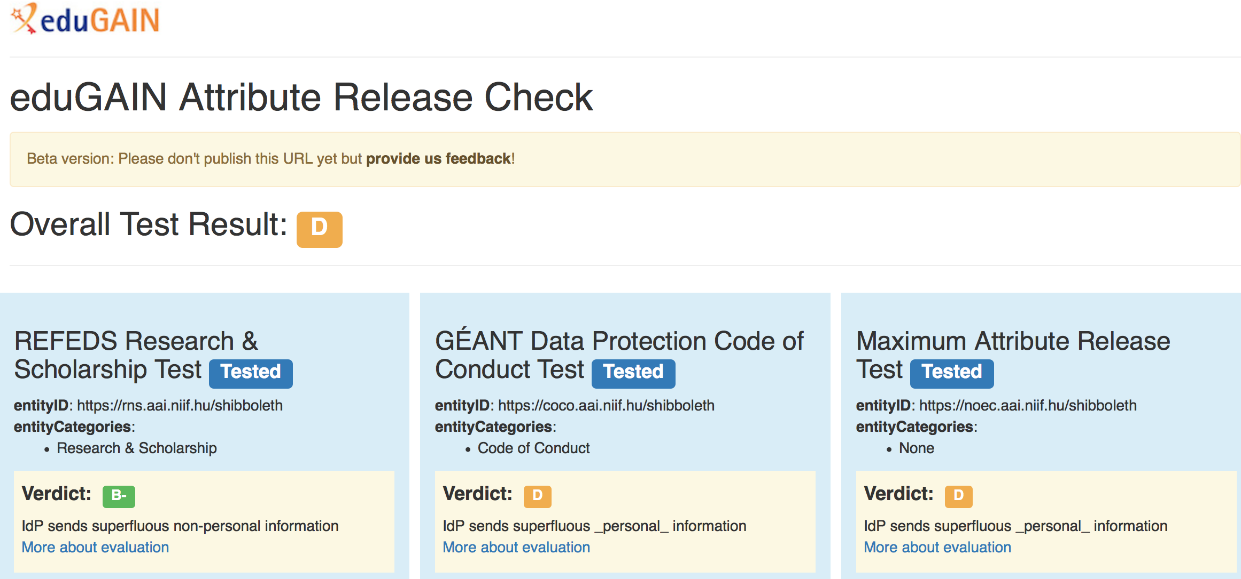
Glass Houses…

Slide 13
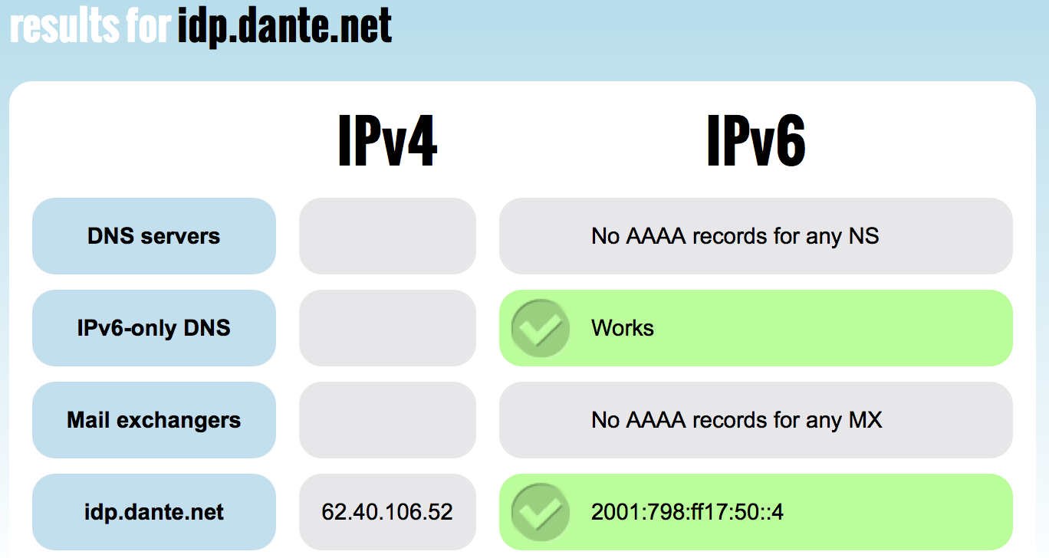
Glass Houses…

Slide 14
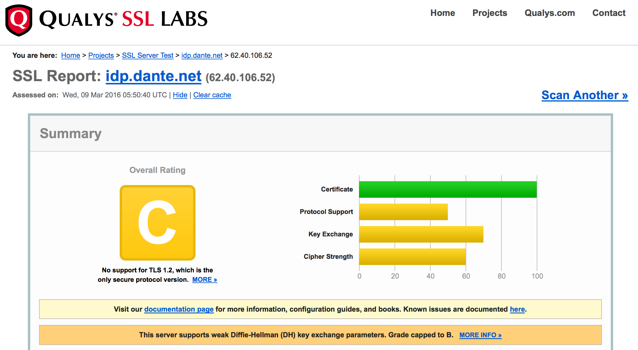
Glass Houses…

Slide 15
Results?
 | vho.aaf.edu.au | Idp.dante.net
eduGAIN Metadata Stream | ✘ | ✔
Attribute Check | ✘ | D (B-)
IPv6 | ✘ | ✔
Certificate Check | A | C
Result | ? | ?

Slide 16
Campaigns for “eduGAIN works”
100% of the federations
Does it talk with “friends”?
Is the entity in eduGAIN?
Does it release attributes?
Matches security practices?
CoCo or R&S

Slide 17
Topic tables…
Compelling reasons to “eduGAIN”
Get more federations
100% of the “useful” entities
Rally Users to make it work
Users shouldn’t need to be Rocket Scientists (unless they are).
Sys Admins can be part of this process
Campaigns for improvement
REFEDS New Years!
Incremental Ideas

