Slide 1
GÉANT AuthN / AuthZ
A case study
Jean Marie THIA
Solutions Architect - CNRS
GN4-1 Symposium, Vienna
9 march 2016

Slide 2





SharePoint authN & authZ principle
The Secure Token Service handles authentication, claims definition and provider declaration.
Custom claim provider
Alice sets authorizations with the people picker.
A custom claim provider makes the picker behave the way we want.
STS
People Picker
SharePoint
Bob needs access to a SharePoint item
Alice gives Bob access with a claim
ti*
Item

Slide 3


The puzzle
Roles
Repositories
Roles
Repositories
Roles
Repositories
Does that claim value exist
for this claim type ?
Directory
Claim values are only checked when using a custom claim provider.
Custom claim provider
STS
People Picker
Give me all the roles
For this identity
SharePoint
IdP
Authorise access to the selected claim type and value
Item
2
ADFS
OID are transformed to claim type.
Claims augmentation with attribute stores.
ti*
1
SAML attributes
1
My Claims
2
* ti = Trusted Identity Token Issuer

Slide 4
A view of GÉANT intranet
CoManage
CAMS
User is enrolled prior access
Grouper
LDAP
Sympa
IdP
Custom claim provider
ADFS
ti*
SharePoint
SAML attributes
My Claims

Slide 5
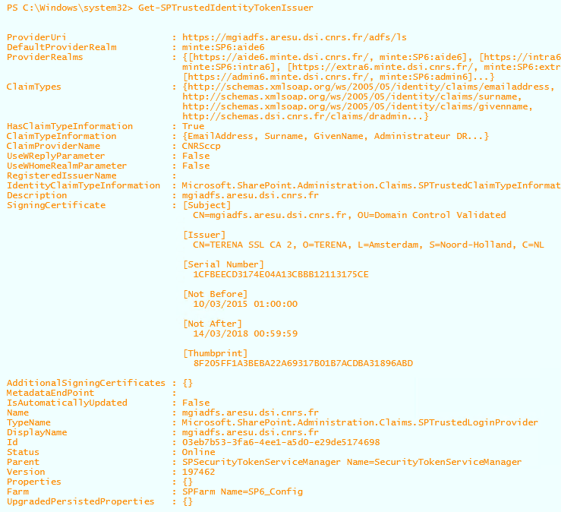
Security Token Service (STS)
Handles authentication
Talks SAML 1.1 (WS-Federation) only
Needs a Trusted Identity Token Issuer
Needs a gateway to SAML 2 (ADFS)
Lives inside SharePoint

Slide 6
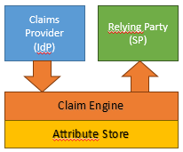
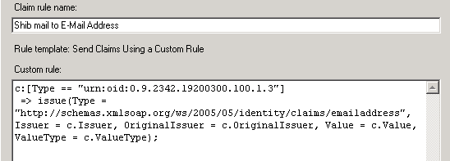
Active Directory Federation Service (ADFS)
Gateway for SAML2 -> SAML 1.1
Atribute ID to Claim Type mapping
Realm Home Discovery (WAYF)
Claims augmentation
SILA script to automate
  federation metadata loading (IdP)
  the RHD Page refresh
  Claim type mapping
  Sila.codeplex.com
  New branch for adfs3
CNRSrhd.codeplex.com for ADFS3 UI

Slide 7
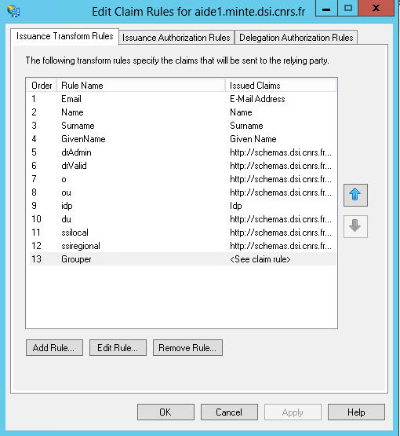
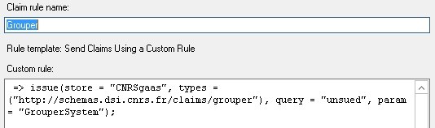
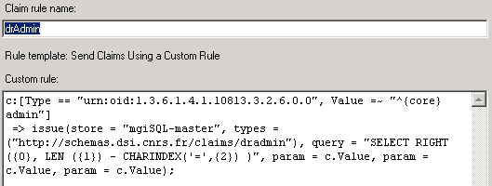
ADFS – Attribute store
Claims augmentation with attribute store
  LDAP
  Grouper
  CoManage
  SQL
  …

Slide 8
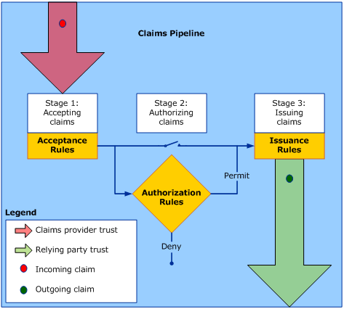
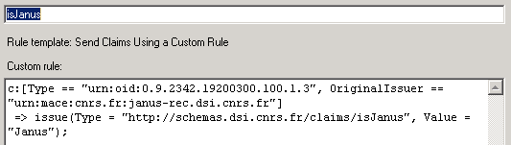
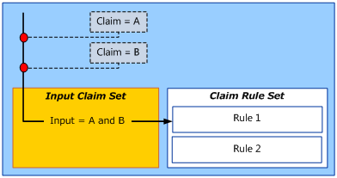
ADFS – Claims rule language
Claim pipeline
https://technet.microsoft.com/en-us/library/ee913585.aspx
Claim Engine
https://technet.microsoft.com/en-us/library/ee913582.aspx
Retrieve AD group sample
https://jmitnotes.wordpress.com/2014/02/09/get-ad-groups-as-claims-for-a-trusted-token-issuer

Slide 9
Custom Claim Provider : CNRSccp
Open source project
  In production
  Still need work
  CNRSccp.codeplex.com
Lookup in
  LDAP
  SQL
  Grouper (VOOT)
Must be configured in the token issuer

Slide 10
Takeaway links
Projects
  sila.codeplex.com : federation medata loading in ADFS
  CNRSrhd.codeplex.com : ADFS 3 UI tweak for autocomplete IdP selector
  CNRSccp.codeplex.com : Custom claim provider
  CNRSgaas.codeplex.com : Grouper attribute store for ADFS
  CNRSlas.codeplex.com : Ldap attribute store for ADFS
Informations
  @jm_thia
  jmITnotes.wordpress.com

Slide 11
Jean-Marie.THIA@cnrs.fr

