Slide 1
Session A4 Trust and Identity
Services
Ann Harding
GÉANT Activity Leader Trust & Identity Service Dev.
SWITCH Project Manager/AAI
GÉANT Symposium, Vienna
March 9 2016

Slide 2
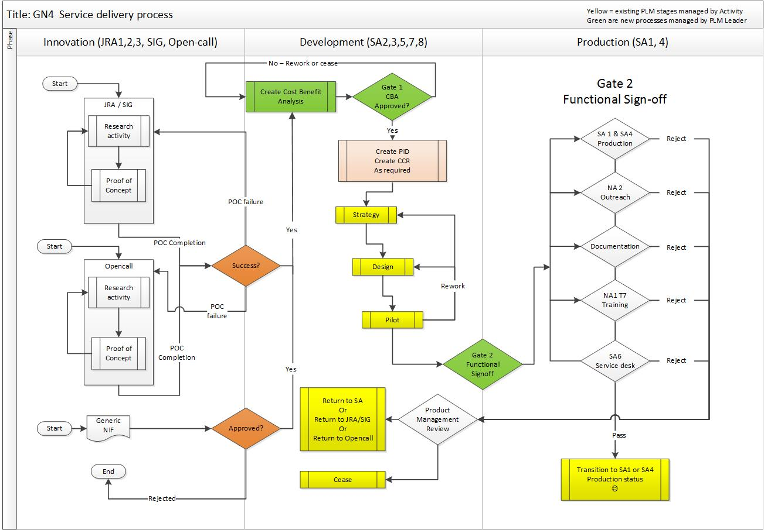

Background on JRAs, SAs other SAs and what’s a service anyway?
Notes:
How many recognise the chart?
How many of you know what makes a service good?
What’s missing from the diagram?
Session is about services, how they got there, what needs improving.

Slide 3
Agenda-bashing
Two short plenaries
a) Gamification of KPIs – Brook (20 mins)
b) Project future - services dev & ops - Ann & Marina (20 mins)
Round tables 40 mins - topics happen in parallel
eduGAIN constititution and policy – Rhys
eduGAIN technical - Brook + Tomasz
Attribute release, where next? - Lukas
Moonshot moving to service - Justin
FaaS - lessons learned - Marina & Mandeep
Notes:
Plenaries – work which impacts lots of areas.
KPI – how can you tell if the fish stinks?
Round tables – in depth discussion –
Round tables
Are there overlaps?
Would people prefer to combine the eduGAIN topics and run 2 tables of both?
Is there any topic up there with no interest?

Slide 4
ann.harding@switch.ch
skype annhardingswitch
Twitter @hardingar

