Slide 1
Session A3 Trust and Identity
Users
Ann Harding
GÉANT Activity Leader Trust & Identity Service Dev.
SWITCH Project Manager/AAI
GÉANT Symposium, Vienna
March 9 2016

Slide 2

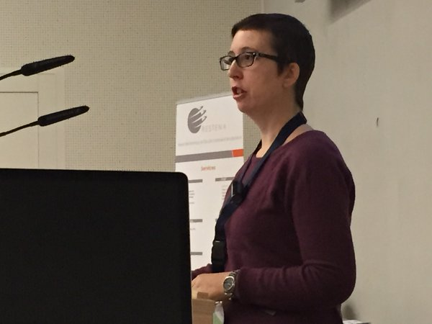
A little imagination required

Slide 3

What AARC does and where GÉANT fits
Integration, policy harmonisation, piloting and training
  Design an integrated AAI built on production infrastructures
  Use existing e-infrastructures in the delivery chain
Work with e-infras and user communities to solve existing challenges, pilot use-cases and get feedback on the results
Notes:
How many ppl only AARC in room?
How many only GÉANT
How many both?
Verbal update of how consortium and project started and why.
Link to future user driven dev/platform driven dev

Slide 4

What AARC does not do
‘Fix’ eduGAIN
Run services
‘Take’ work from GÉANT
Do deployment
Harmonise attribute semantics
Fix attribute release
Do all kinds of training
Fix all the problems in the universe!

Slide 5
Agenda-bashing from the bottom-up
Open with two short plenaries
a) AAI Architectures - current and future (20 mins) Christos & Lukas
b) Assurance (20 mins) - Daniela
Round tables 40 mins - topics happen in parallel
Sirfti - security & fed ID transition from AARC to GÉANT (Hannah)
Assurance - transition from AARC to GÉANT (Daniela)
Training and outreach for federated identity - (Lalla)
VO Platform & Pilots - (Lukas H and Paul van D)
  inc. GÉANT AuthN/AuthZ as a case study
eduroam to end users - Stefan
Notes:
Plenaries – work which was complementary
Round tables – in depth discussion – how should GÉANT/AARC proceed with these topics?
Round tables
Are there overlaps?
Is there any topic up there with no interest?

Slide 6
ann.harding@switch.ch
skype annhardingswitch
Twitter @hardingar

