Slide 1
Release the Attributes!
Nicole Harris
Project Development Officer
GCC Meeting, Amsterdam
26.04.2016

Slide 2


Trust and Identity today
Classic Identity Federations
  Identity Provider (IdP) asserts authentication and information about users.
  Service Providers (SP) check and consume this information for authorization and make it available to an application
A group of organizations running IdPs and SPs that agree on a common set of rules and standards that build trust
Notes:
Typical use cases – journals, e-learning, contracts happen out of band. Simple 1:many models.

Slide 3
8218 Service Providers
3560 Identity Provider
39 Federations

Slide 4











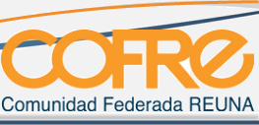






















From local to global
4

Slide 5





e-Research Trust and Identity Infrastructures
Campus
Federation
eduGAIN
General and Specific e-Research Infrastructures
Individual Experiments
Hundreds of thousands of users
Tens of thousands of services
Thousands of services
Hundreds of services
Tens to hundreds of individuals *
SPECIFIC
GENERIC
Notes:
39 federations providing statistics to REFEDS Feb 29 2016
3493 IdP 7893 SPs
– inc. centralised IdPs
Numbers for eduGAIN Feb 2016–
Federations 38
IdPs: 1999
SPs: 1119
21 ESFRI Projects with a high degree of maturity - including 6 new Projects - and 29 ESFRI Landmarks

Slide 6

Selected Roadmap
Developments until 2016
Next Generation Architectures and Protocols
Assurance
Campus IdP Services
e-Research Support
AARC Collaboration
Entity Categories for Attribute Release
InAcademia Simple Validation Service
Virtual Organisation Platform
Moonshot Production

Slide 7

What we can do
Now can LIGO have some attributes please?
We have many more years of gravitational-wave astronomy
discoveries to come and realizing the full science potential
will require close collaboration with astronomers and
astrophysicists from around the world. eduGAIN and your
national federations can help make that happen.
- Scott Koranda, lead architect for the Laser Interferometer Gravitational-Wave Observatory Identity and Access Management
Read more about releasing attributes for Science https://refeds.org/a/1154

Slide 8
Attribute Release via Entity Categories
Tools to automate risk-analysis-based support of e-Research
Entity Categories group federation entities that share common criteria.
Facilitate IdP decisions to release a defined set of attributes to SPs without the need for detailed local review for each SP
Research and Scholarship Entity Category relies on the legitimate interest approach
Safeguards of data minimisation, privacy enhancing tech
Limits the types of services that are allowed to claim this category and focusing on low-risk, high benefit services that have a clearly identifiable need for personal information
Each SP is considered on a case-by-case basis by the federation in question and reviewed annually.
GÉANT Code of Conduct approach aims to minimise the risk that arises from depending on each other.
Legitimate interest is also fundamental
Signals that the Home Organisation and Service Provider are aware of the legal requirements
Based on Directive 95/46/EC 1995
Support provided by
local federation

Slide 9

Balancing Risk
https://wiki.refeds.org/display/ENT/Guidance+on+justification+for+attribute+release
Notes:
Note balance between user freedom from and freedom to.
Note balance between regulatory risk and ‘commercial business purpose’ risk for campus.
Note R&E tends to do more for privacy than industry for whom legislation is normally designed.
Reminder of project engagement in pan Euro research has worth.
Processing is necessary for the purposes of the legitimate interests pursued by the controller or by the third party or parties to whom the data are disclosed.

Slide 10
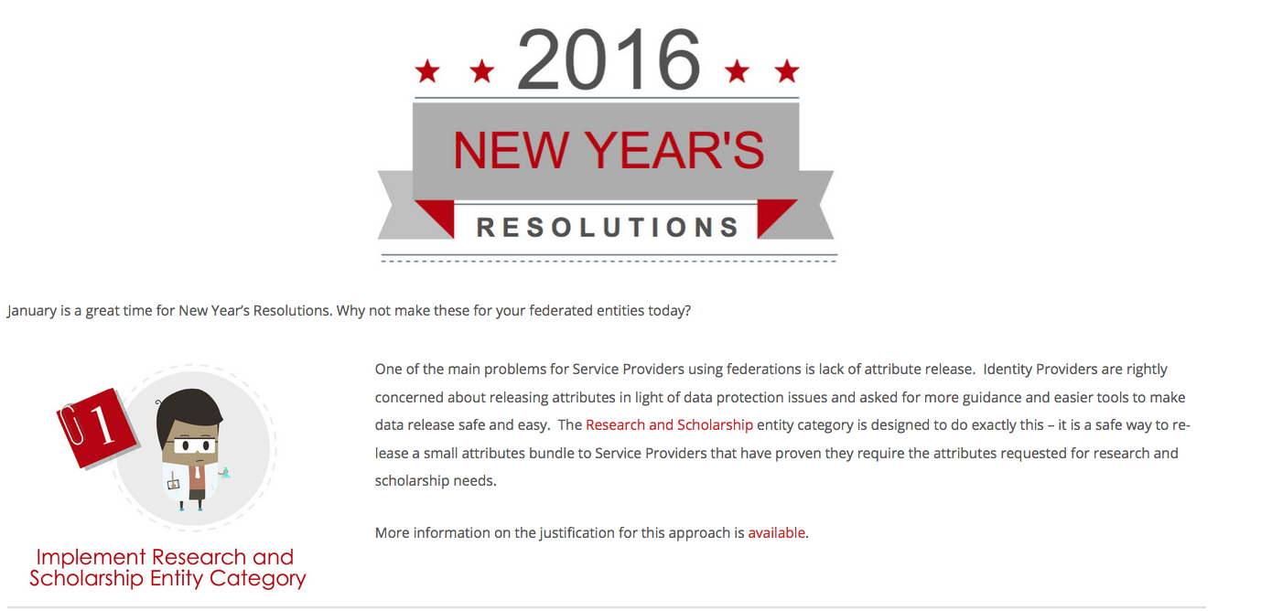
Promotion Campaigns

Slide 11
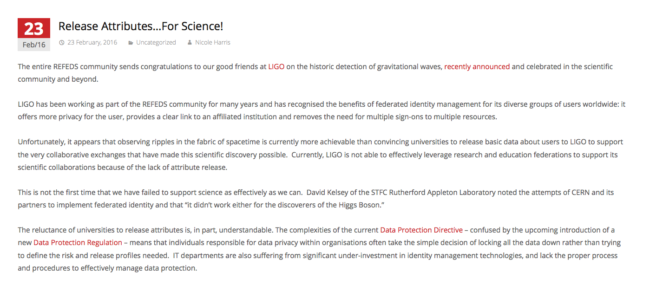
Supporting Blogs

Slide 12
Research and Scholarship Entity Category in eduGAIN
R&S entities:
Yellow – IdPs (104)
Blue = SPs (88)
Total eduGAIN:
2037 IdPs
1197 - SPs

Slide 13
The Issues?
Slow uptake.
Poor influence over IdP and IdP decision making.
Poor support within organisations.
Federations are still thinking locally, not globally.
Converting SP demand to IdP requirement is hard.
This will make identity federations irrelevant for authorisation.

Slide 14
What do we want from you?
How can we influence federations?
How can be bring more attention to the problem? (CEO Forum? GA? Outreach to campuses?)
What messages should we be formatting? How?

Slide 15
@hardingar

