Slide 1

ABEBox: end-to-end encryption for Cloud-based file sharing services
E. Raso, L. Bracciale , P. Loreti, G. Bianchi
Emanuele Raso
University of Rome "Tor Vergata"

Slide 2








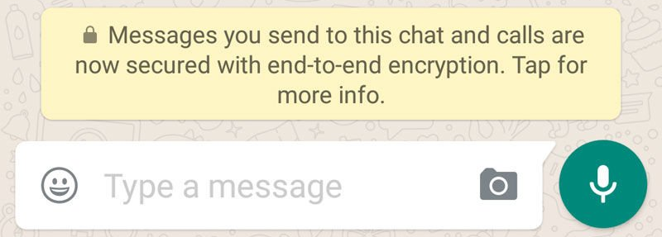

E2E encryption in file sharing
Owncloud EE2E
Nordlocker
Boxcryptor
CryFs

Slide 3




A trivial exercise?
Secret key
Encrypted file
Cloud service
Icons made by Freepik and Roundicons from Flaticon

Slide 4




It's not about encryption it's about key management
I am leaving
Cloud service
I am the newcomer

Slide 5
ABEBox
Key management system to bring privacy on cloud shared files
  Without any Trusted Third Party
It decouples access control from data transfering and synchronization
It runs on top of existing file sharing services
  Serverless
Provide solutions for peer churn
  New users and revoked ones

Slide 6

CP-ABE: Ciphertext-Policy Attribute-Based Encryption
IT dept
AND
Manager
IT dept
Manager
IT dept
Admin
Policy
HR dept
Attributes
Bethencourt, John, Amit Sahai, and Brent Waters. "Ciphertext-policy attribute-based encryption." 2007 IEEE symposium on security and privacy (SP'07). IEEE, 2007.

Slide 7
CP-ABE for file sharing
Pro
Attribute-Based Access Control (ABAC) fits nice the needs for flexibility
Newcomers can be just provided with a single key with the right set of attributes
Cons/Still missing
How can we send ABE secret key to users?
Revocation is still not addressed
CP-ABE is tremendously SLOW (~1000 times slower than RSA)

Slide 8
Providing ABE secret key
Access token
ABE Secret key
Cloud service

Slide 9
Hybrid Encryption and Revocation
Protected file
Protected file
Asym encrypted symmetric key
Asym encrypted symmetric key
Sym encrypted content
Sym encrypted content
Re-encryption

Slide 10

Key scraping attack
Protected file
Asym encrypted symmetric key
Pre-fetch all the asym encrypted sym keys
Decrypt the sym keys
Have access to file conent, even after the re-encryption
Sym encrypted content
Efficient Hybrid Proxy Re-Encryption for Practical Revocation and Key Rotation (S. Meyers and A. Shull) 2017

Slide 11
Meyers and Shull’s solution
Protected file
Protected file
Asym encrypted
re-enc symmetric key
Asym encrypted
symmetric key
Asym encrypted
symmetric key
All-Or-Nothing Transform
All-Or-Nothing Transform
Sym encrypted content
Re-encryption
Sym encrypted content
Punctured data
Bellare, Mihir, and Phillip Rogaway. "Optimal asymmetric encryption." Workshop on the Theory and Application of of Cryptographic Techniques. Springer, Berlin, Heidelberg, 1994.

Slide 12
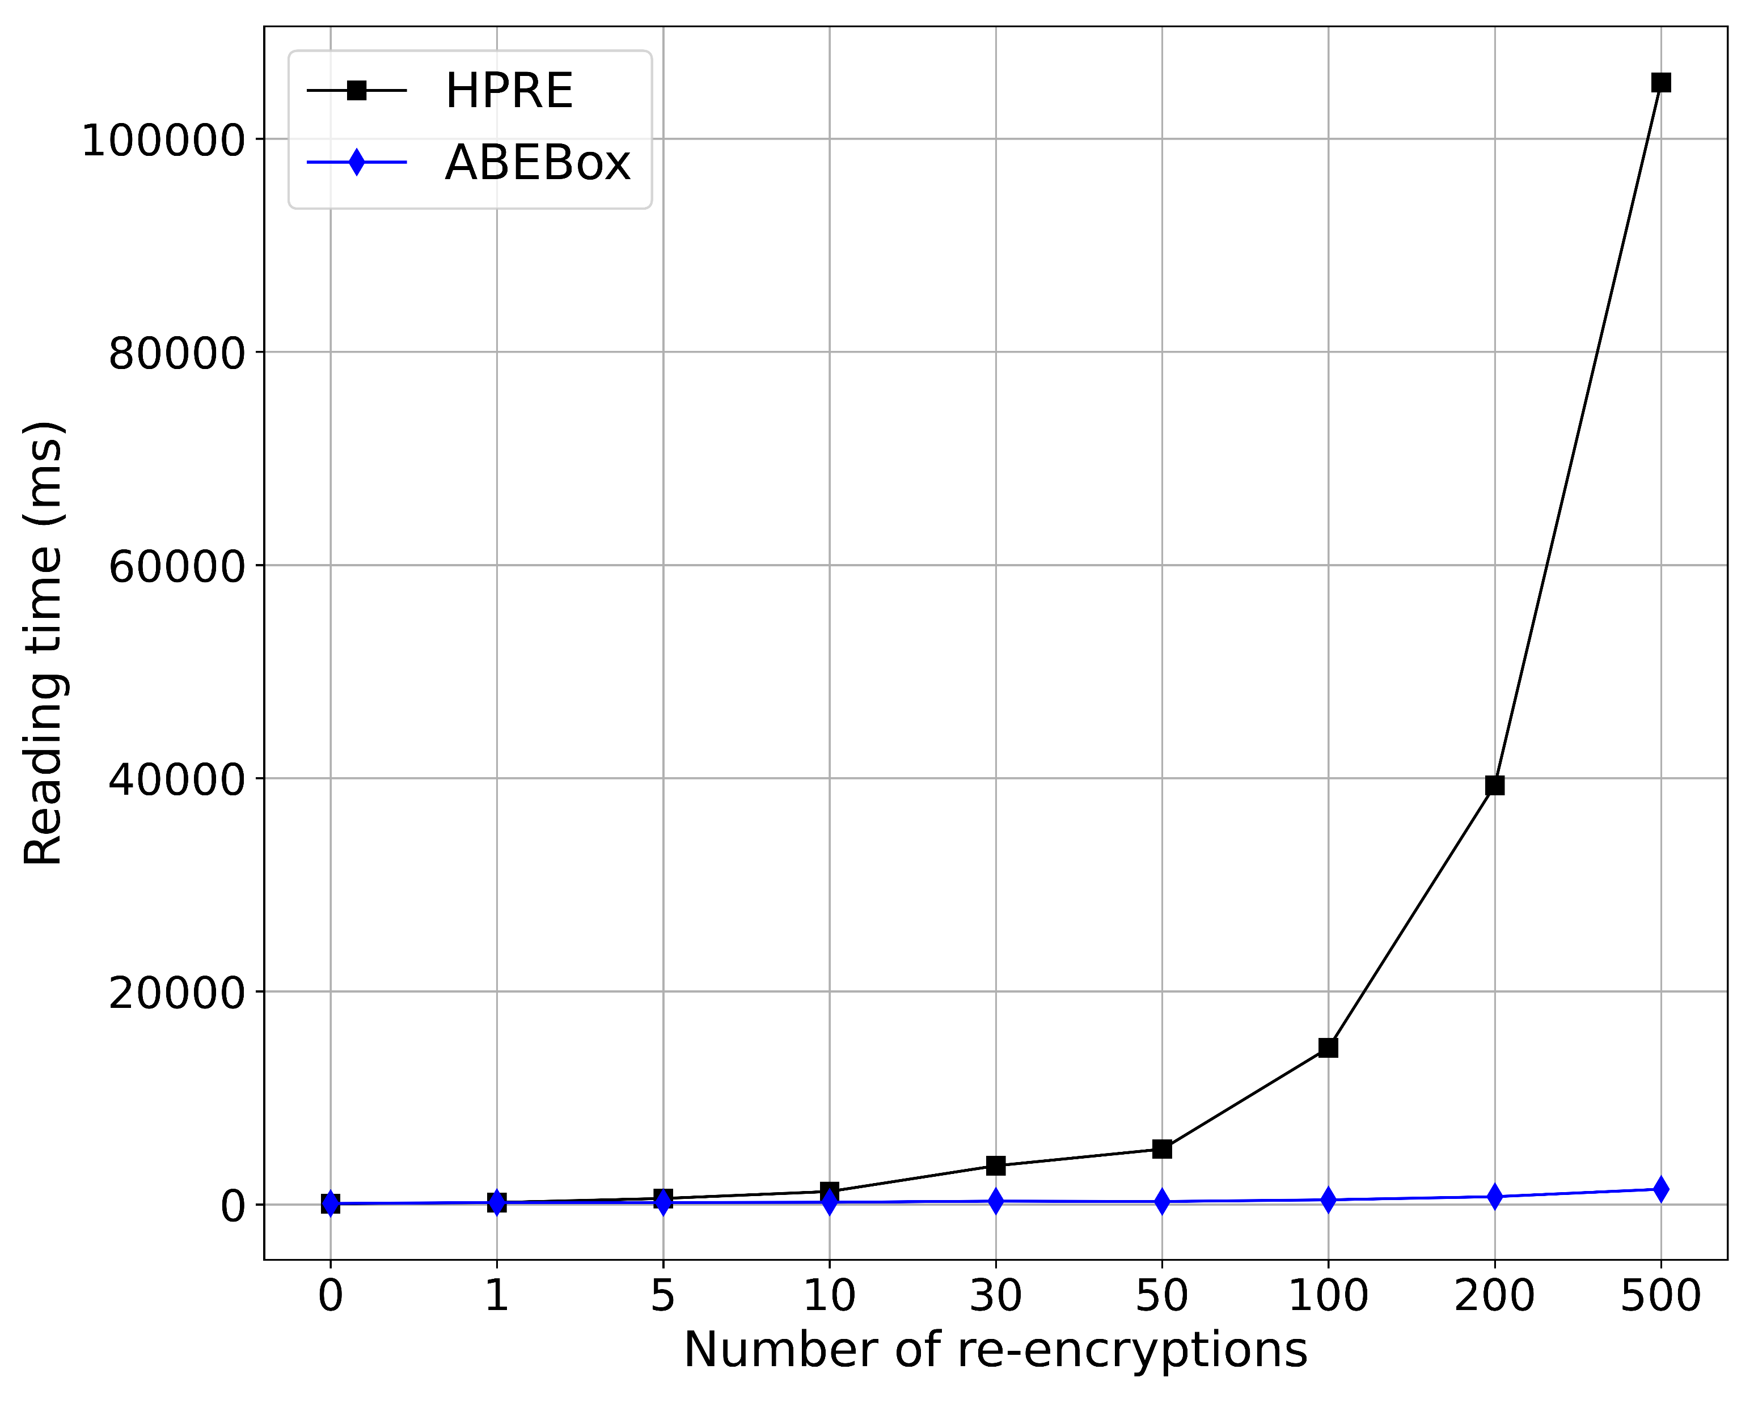
Faster decryption
Use Reverse Hash Chain to derive new re-encryption keys
Only one ABE decryption is necessary!
Raso, Bracciale, et al. "ABEBox: A data driven access control for securing public cloud storage with efficient key revocation." The 16th International Conference on Availability, Reliability and Security. 2021.

Slide 13
Implementation
ABEBox v1 uses FUSE (Filesystem in User Space) for seamless encrypt/decrypt files
FUSE
Data sync
Plaintext files local folder
Shared folder
https://github.com/netgroup/ABEbox

Slide 14
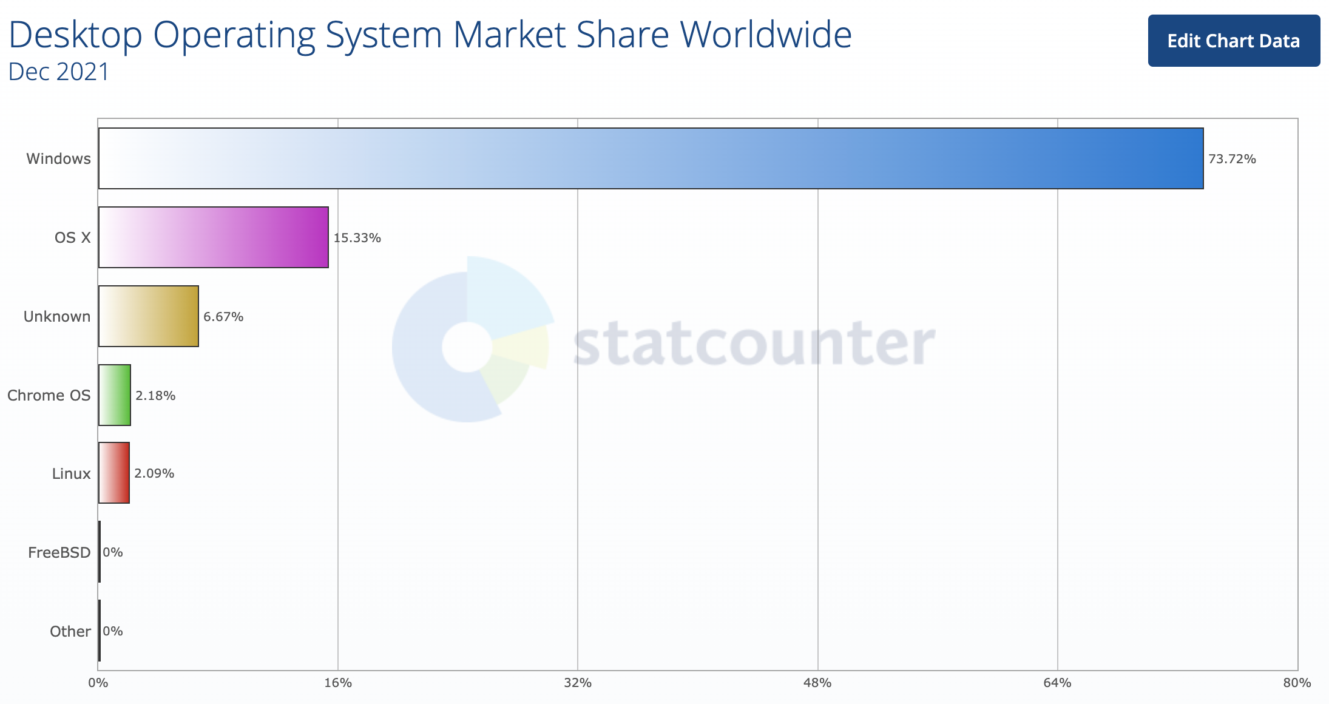
Desktop Operating Systems (Dec 2021)
FUSE not supported
Desktop Operating Systems Stats (Dec 2021)
https://gs.statcounter.com/os-market-share/desktop/worldwide/#monthly-202112-202112-bar

Slide 15

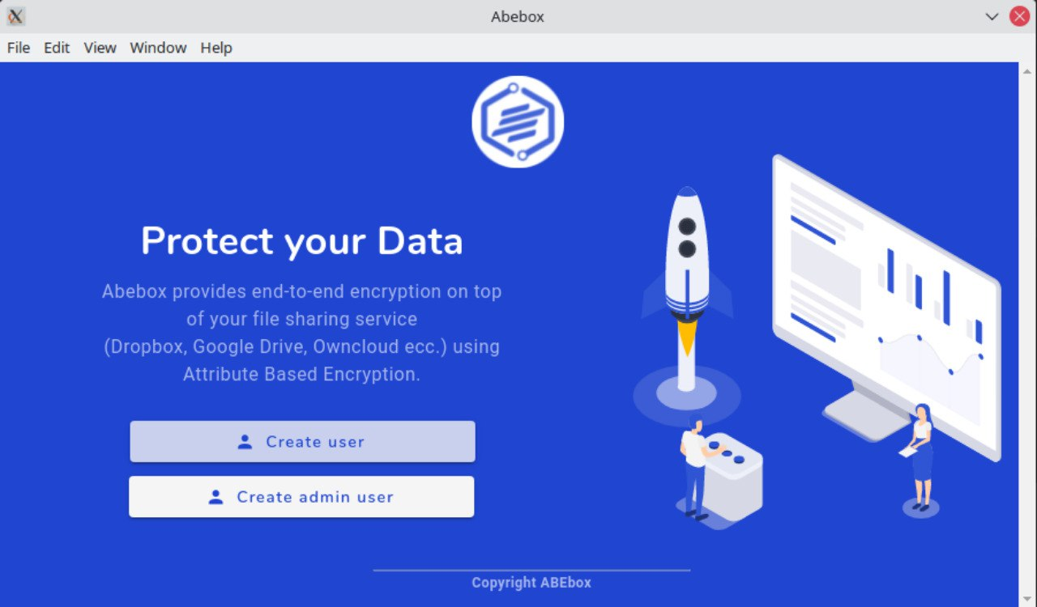
Electron version
Multi platform app
  Win, linux, mac
GUI for configuration
  policies, attributes, users
https://github.com/netgroup/abebox-electron

Slide 16
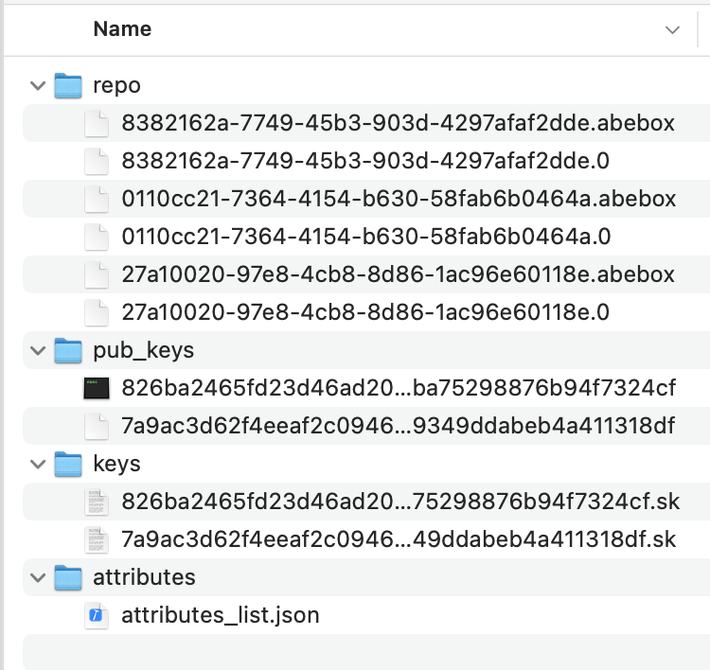
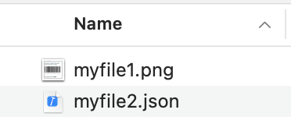
ABEBox
Plaintext files local folder
Shared folder

Slide 17
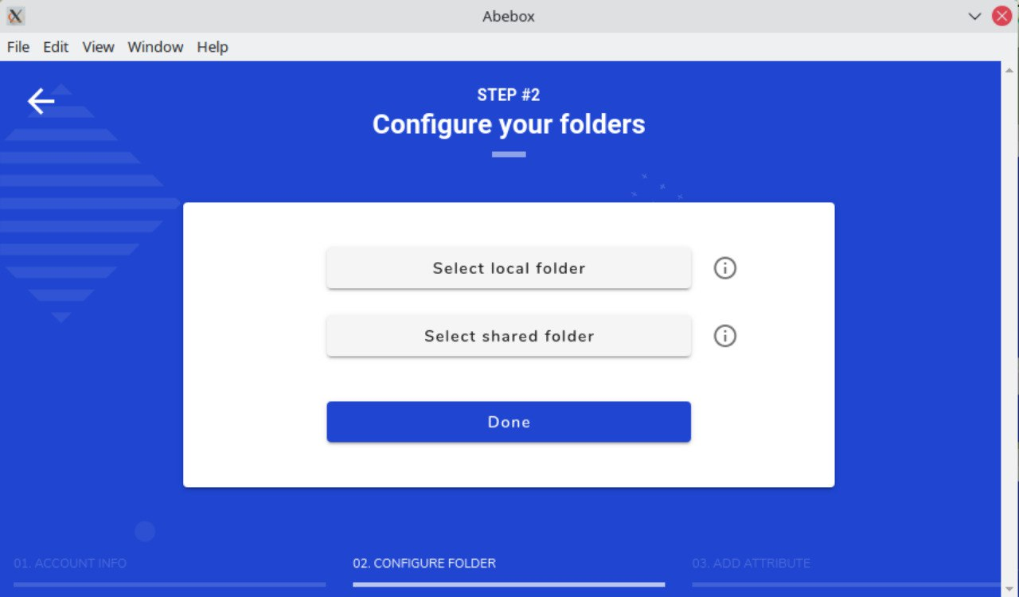
ABEBox operational flow
Invited User or Admin?
Users
  Select folders
  Insert token
Admin
  Set attributes
  Add users, assign them attributes and get their tokens
  Select folders

Slide 18
Testing
Testing groups:
  50 Computer Science 101 students (Electronic and Internet Engineering)
  6 e-health students (Electronic Engineering)
Testing methodology
  Interview & Questionnaires
Result (summary)
  Almost all succeded in accessing a shared file
  Setup problems installing a new (uncertified) app on some OSs (OS security policies)
  Major bug reported and patched

Slide 19
Conclusion
E2E encryption for cloud file sharing systems is more a key management problem than an "encryption" problem
Attribute-Based Encryption can solve part of problems
We propose some solutions for the revocation problem
We implemented such solutions on a multi-platform application and release the code as open-source
http://abebox.netgroup.uniroma2.it/
binaries
https://github.com/netgroup/abebox-electron
code

Slide 20


Thanks!
Emanuele Raso
emanuele.raso@uniroma2.it
Lorenzo Bracciale
Pierpaolo Loreti
Giuseppe Bianchi
Innovation programme
Horizon 2020 innovation programme
grant agreement No.787149

