Slide 1
HEAnet use of cloud

Slide 2
Contents
media.heanet.ie on AWS
gitlab.heanet.ie on aWS
Miscelleneous use of cloud
Strategy for cloud

Slide 3
Media.heanet.ie
A shared service for the storage and transcoded playback of audio and video
Our first foray into AWS
API Gateway
ECS for containerized front-end web applications and SSO login
Lambda for spawning EC2 containers and streaming files out of S3
AWS WAF for protection and cost reduction
RDS and Aurora
Cloudwatch for monitoring
Backups of stored originals on Azure

Slide 4
Media.heanet.ie
Lessons learned.
Hand built , no use of orchestration (e.g. terraform)
Root account rather than IAM accounts
No true development environment
Lamba is too proprietary, locked in with AWS until rewritten
No storage archival strategy e.g. S3->Infrequent access S3 -> Glacier -> Delete

Slide 5
Gitlab.heanet.ie
Private Gitlab repository and CI/CD engine for all HEAnet services on AWS
Lift and shift of on-premise system
Business case is the lack of standard database encryption, AWS RDS provides this need.
Uses
  EC2 and all that entails (ALB, VPC)
  RDS
  Elasticache (Redis)
  Route53 for single zone
  Custom AMI
  S3

Slide 6
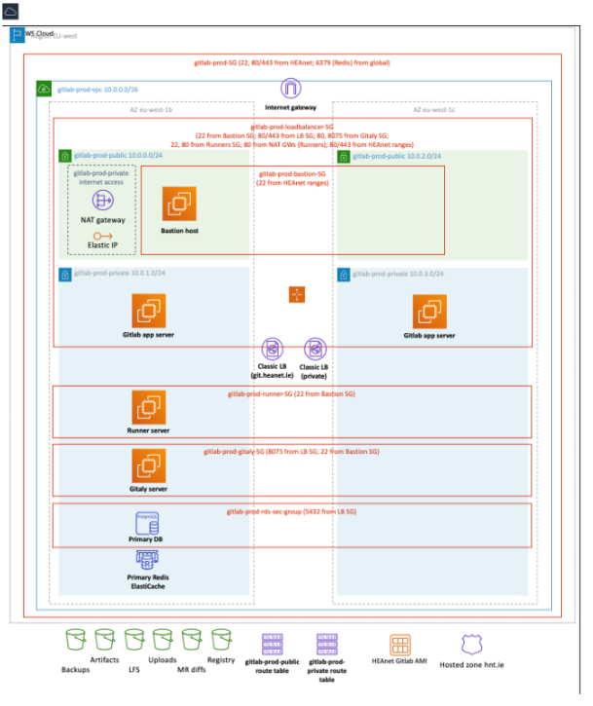
Gitlab Lessons learned
Always-on nature of EC2 costs €
VPC security groups have a limit of 100 fw rules
Direct Connect could have been used but DC link resiliency was not sufficient at the time

Slide 7
Miscellaneous use of cloud
Azure storage gateway for off-site storage of VM backups
EC2 instances to run Icinga monitoring agent to monitor how our services respond from outside the HEAnet network
Azure ServiceBus for sharing events and triggering actions (e.g. Teams web-hook notification)

Slide 8
HEAnet Strategy on cloud use
Containerization for all LAMP stack applications
Deploy containers to on-premise current Docker Swarm cluster
Migrate to on-premise Kubernetes (2023-2024)
Start to use hybrid cloud with Kubernetes (2024+)
2025 plan based on cost comparison between replacing VMWare with Cloud compute and storage.
Hosted SaaS (e.g Gitlab Ultimate, EKS ) to be compared with both on-premise and cloud plus the cost of effort per year

Slide 9
Any questions?

