Slide 2
Passwordless eduroam with FIDO
(either trivial and lame, or fancy and innovative; at your option)

Slide 3
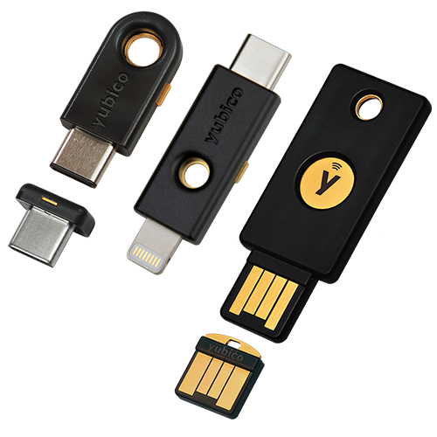
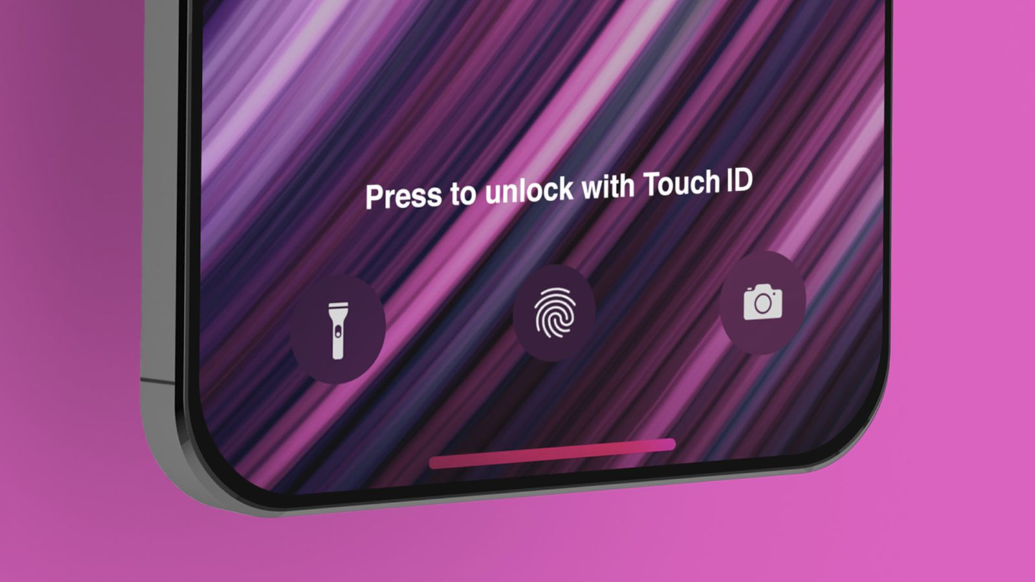
Passwordless with FIDO2?
1.
FIDO2 tokens are like little HSMs.
They generate keypairs and sign challenges.
Often, on the web and user-interactive (touch/biometric-activated).

Slide 4

Not with Wi-Fi.
2.
Not on the web.
Not user-interactive.
(But the HSM and keypair part is nice!)

Slide 5
Trivial and lame.
3.
Want to see a demo?
Use geteduroam!
Passwordless on web-SSO side
Generate client cert (also passwordless)
…
Profit!

Slide 6
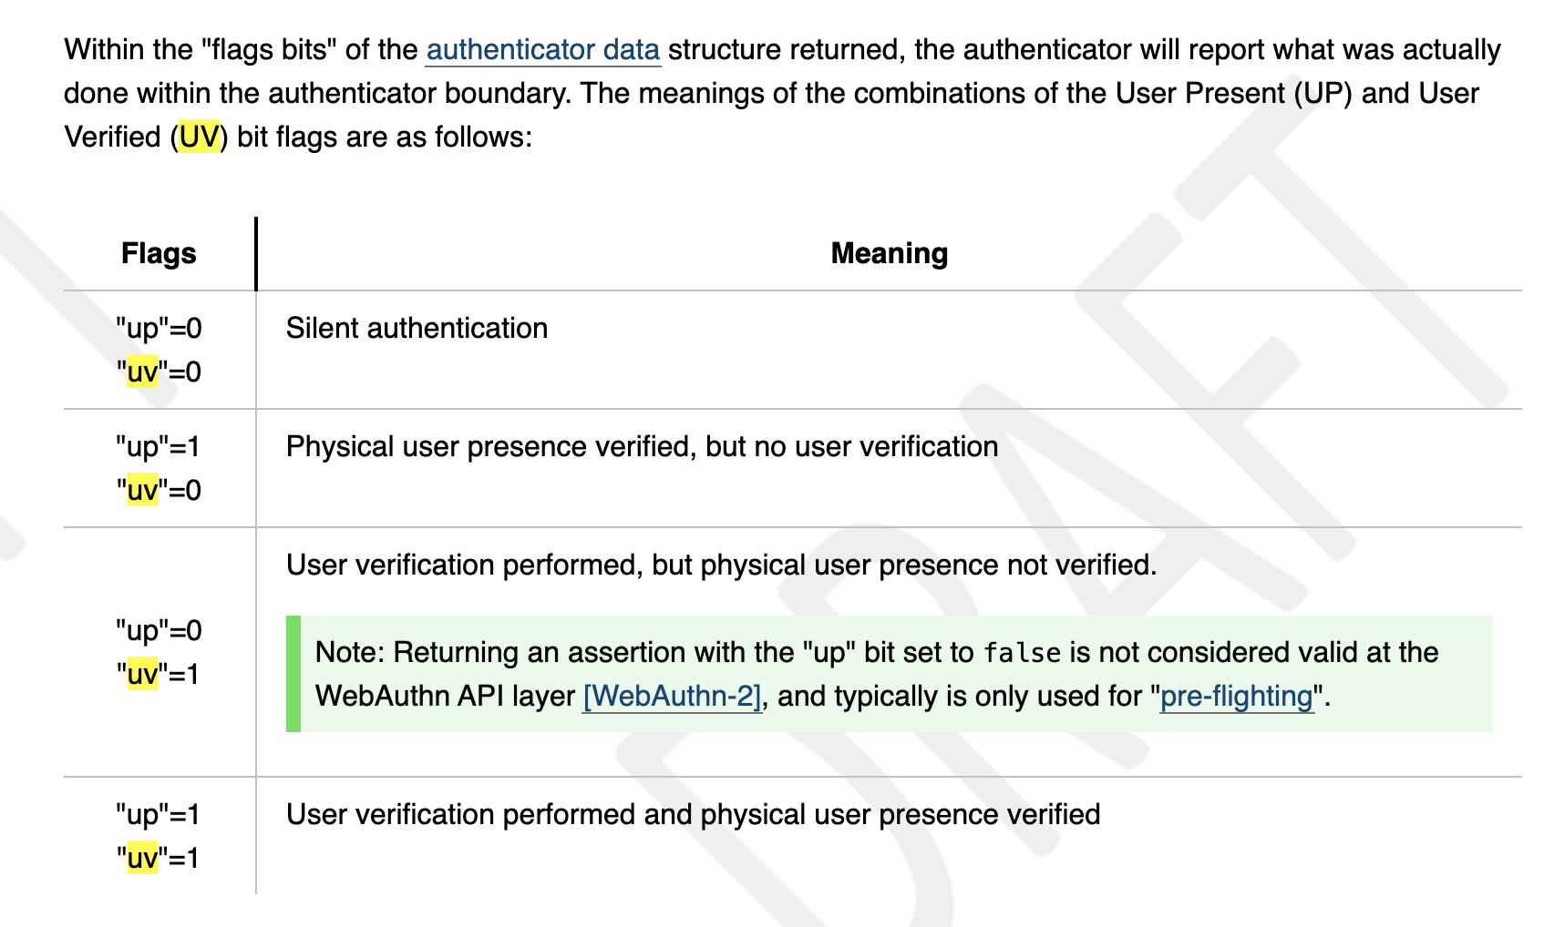
Fancy and innovative.
4.
Use FIDO2 token directly in the EAP context.
In a non-interactive mode.

Slide 7
Theory
All we need is an industry-wide change.
Specification to transport FIDO2 authentication transactions inside EAP – « EAP-FIDO »; @IETF.
  Privacy by design: no usernames
FIDO2 support for non-interactive authentication – « silent authentication »; @FIDO Alliance – NOOP.
Supplicant and server support.
@Janfred, Alan, Karri … ☺

Slide 8
Benefits
FIDO keypairs are not unlike PKIX client certificates, but:
    They do not expire!
    No CA involved!
The secret key starts by design its life on the client device:
    No key transfer from server (Import PIN…) or rubber-stamping (SCEP)!
Initial registration can be on the web, later usage on EAP:
    User can be guided through enrollment
    Once signed up for web, « magically » also gives her eduroam
    Finally, uSSO as we dreamt of in 2006.
GN2-06-261v4-DJ5-3-1_Documentation_on_GEANT2_uSSO_requirements_20070201095918.pdf

Slide 9
Practice
But that’s a pipe dream?!
Gordon Teal, Texas Instruments, 1954:
  Contrary to what my colleagues have told you about the bleak prospects for silicon transistors, I happen to have a few of them here in my pocket.
  s/silicon transistors/EAP-FIDO
  s/I/Janfred

Slide 10
Merci.

