Slide 1
geteduroam

Slide 2
geteduroam presence at Mobility Day
You as users/contributors ;-)
Wenche
Stefan
Jeroen
Jørn
Paul

Slide 3
Discussion topics
Now that the geteduroam clients are feature complete: what do we do with the CAT discovery
How do we authorize geteduroam admins (from CAT?) and how do we auto-enroll on the OT service
Pseudo account outer identity
  Anonymizing didn’t make sense with TLS 1.2, pseudo’s are not direct usernames anyway
  TLS 1.3 hides certificate field contents, iOS 17 uses 1.3 – starts to make more sense
Pseudo account adoption
  Better documentation?
  Easier installation
    Docker
    Packages

Slide 4
New release
Tuesday we presented the new iOS and macOS version of the Apps, now in TestFlight
  How long before we release and test?
    Feature parity
    Sync w/Android
    Release macOS ahead of things
    Time to modify documentation
Future work
  Profile view in the client, ability to revoke end-users own profiles? (Identify by date, device)
  Wired authentication? (Largely untested)

Slide 5
Portal functions
Split between admin and CA functions
Wishes from community?
  API
  SCEP
  …
Priorities?
Anomaly detection algorithms?
  Flag concurrent MACs with the same pseudo IDs; this is very unlikely with normal use

Slide 6
Installation example
git clone https://github.com/geteduroam/letswifi-portal.git /opt/letswifi-portal
cd /opt/letswifi-portal
make vendor
Pick example and config etc/letswifi.conf.php
Prepare
  Webserver
  Database (mysql advised for production)
  SAML config

Slide 7
Example Apache config
<VirtualHost *:80>
RewriteEngine On
RewriteRule ^(.*)$ https://%{HTTP_HOST}$1 [R=301,L]
</VirtualHost>
<VirtualHost *:443>
ServerName geteduroam.nl
ServerAlias *.geteduroam.nl
UseCanonicalName On
SSLEngine on
SSLCertificateFile /etc/ssl/geteduroam.nl.pem
SSLCertificateKeyFile /etc/ssl/geteduroam.nl.key
Protocols h2 http/1.1
Header always set Strict-Transport-Security "max-age=63072000"
SetEnvIf Authorization "(.*)" HTTP_AUTHORIZATION=$1
DocumentRoot /opt/letswifi-portal/www
DirectoryIndex index.php
<FilesMatch \.php$>
SetHandler proxy:unix:/var/run/php/php-fpm.sock|fcgi://dummy
</FilesMatch>
Alias /simplesaml /opt/simplesamlphp/www
<Directory /opt/letswifi-portal/www>
AllowOverride None
Require all granted
</Directory>
<Directory /opt/simplesamlphp/www>
AllowOverride None
Require all granted
</Directory>
</VirtualHost>

Slide 8
Walkthrough configuration

Slide 9
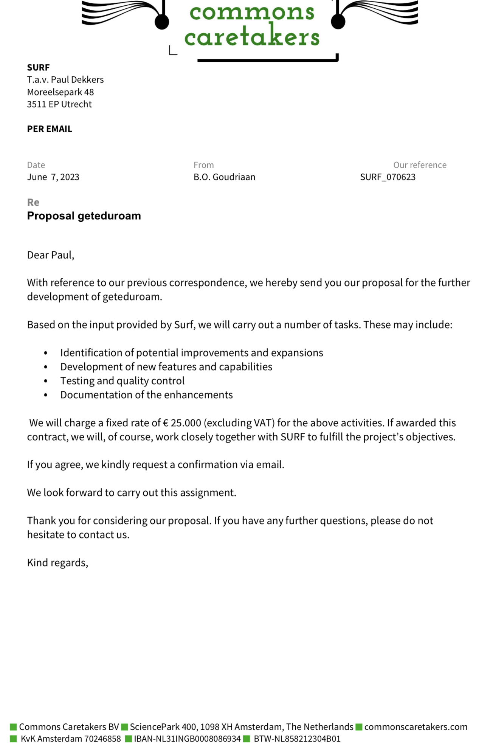
Contributions, Funding
Easy to contribute something (once, periodically) via Commons Conservancy, example quote:
In-kind contributions also very welcome, developments, reviews, user tests, …
We need funding for maintenance and support contracts for Apps and platforms

Slide 10
Thank you
Any questions?

