Slide 1
WISE Information Security for collaborating e-Infrastructures
David Kelsey (STFC-RAL, UK Research and Innovation)
Presented by David Groep (NIKHEF) and Hannah Short (CERN)
WISE and SIG-ISM, Kaunas
In collaboration with and
co-supported by EU H2020 AARC2
In collaboration with and
co-supported by EU H2020 EOSC-HUB
Notes:
Hannah

Slide 2
Contents
The WISE community
Older working groups and publications
New working groups
SCI-WG including
  Policy Development Kit
  WISE Baseline AUP
Next steps

Slide 3
WISE Community – short history
Started in October 2015 – Workshop – Barcelona
  Jointly organized by GEANT SIG-ISM and IGTF SCI
Community members come from e-Infrastructures across the world
Governed by a steering committee
  Project managed by GEANT staff
Real work done by Working Groups
Meetings since mid 2017
  NSF Cybersecurity Summit, USA – August 2017
  STFC Abingdon, UK – February 2018
  NSF Cybersecurity Summit, USA – August 2018
  LITNET – Kaunas, Lithuania – April 2019

Slide 4
WISE Mission
Why? The WISE community enhances best practice in information security for IT infrastructures for research.
What? WISE fosters a collaborative community of security experts and builds trust between IT infrastructures, i.e. all the various types of distributed computing, data, and network infrastructures in use today for the benefit of research, including cyberinfrastructures, e-infrastructures and research infrastructures.
How? Through membership of working groups and attendance at workshops these experts participate in the joint development of policy frameworks, guidelines, and templates.

Slide 5
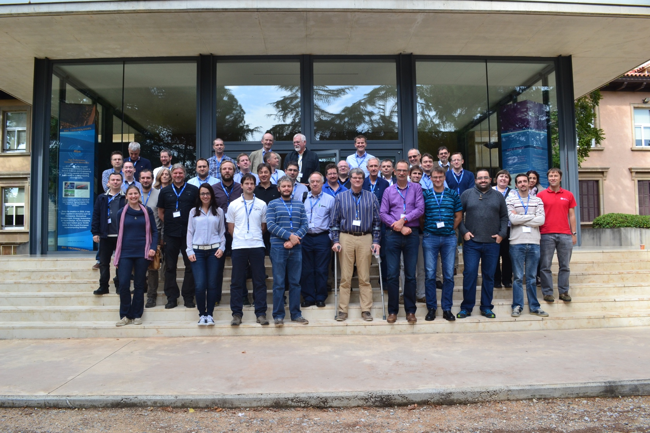
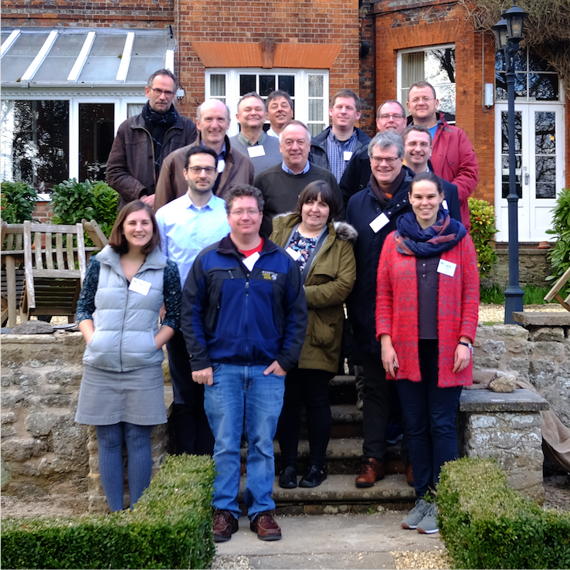
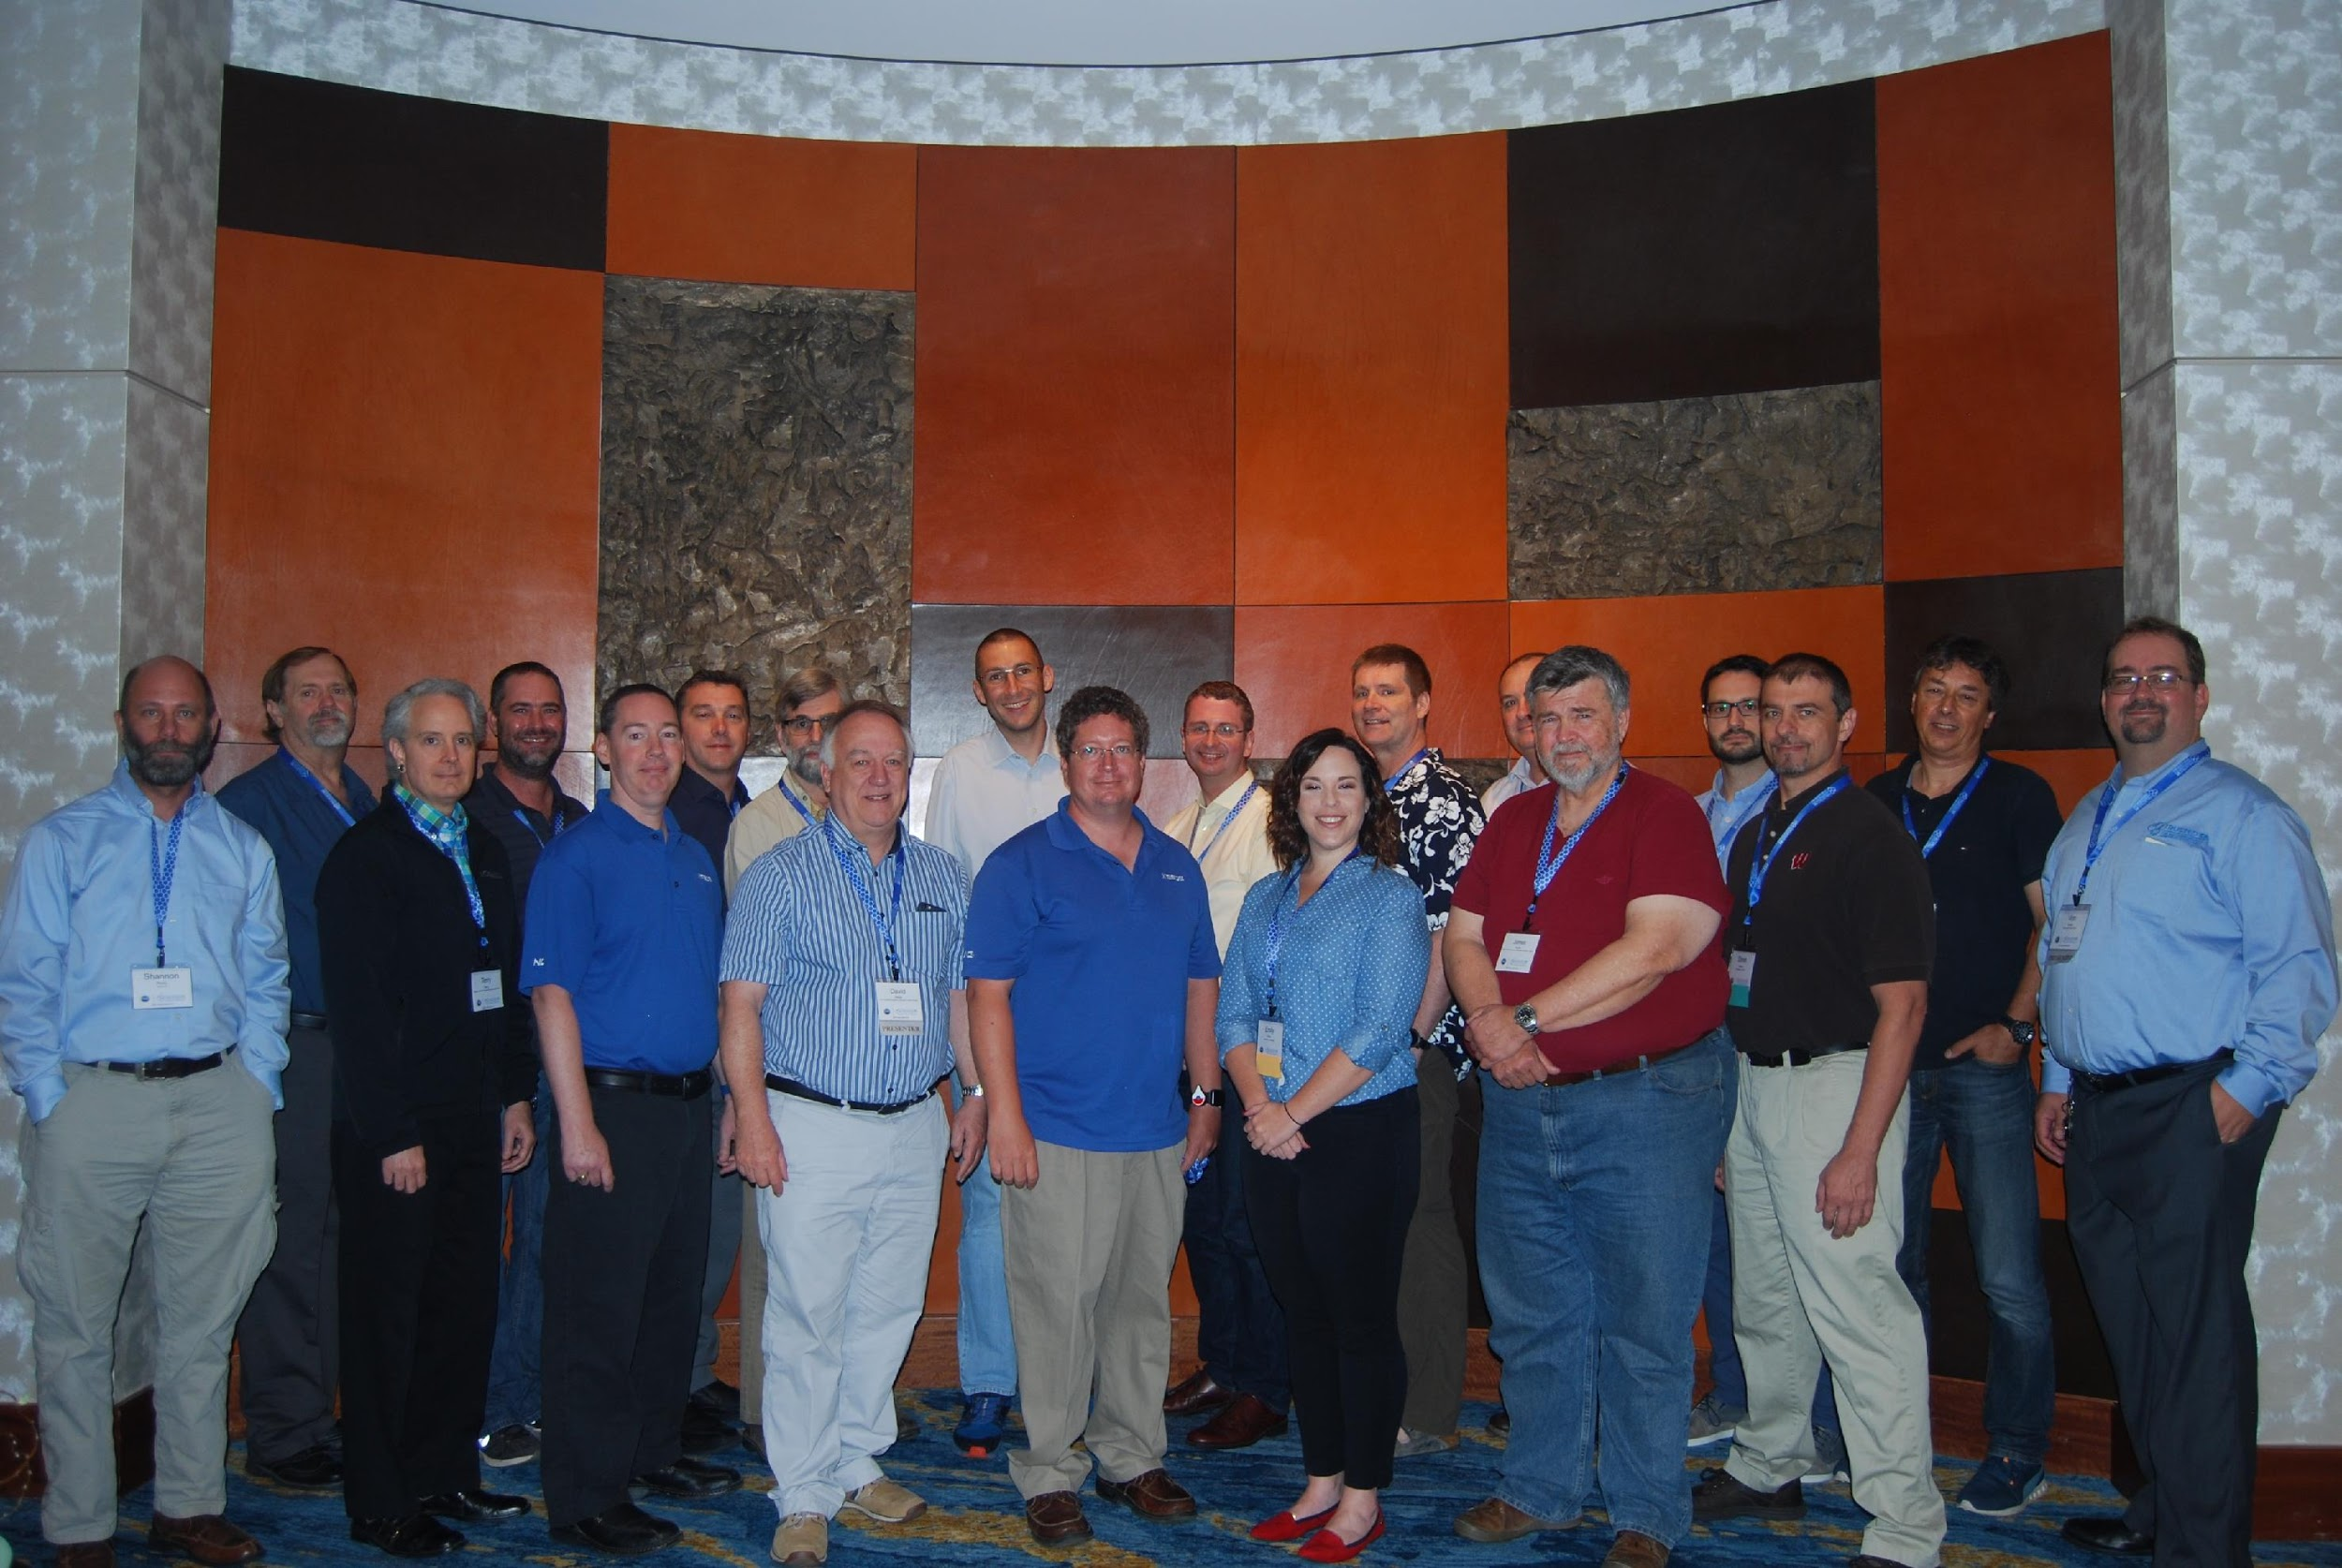
WISE meetings (Oct 2015, Feb & Aug 2018)
Barcelona, Spain
Abingdon, UK
Alexandria, VA, USA

Slide 6
WISE Working Groups
Active Working Groups:
Updating the SCI framework (SCI-WG)
Risk Assessment WISE (RAW-WG)
Working Groups being created:
Incident Response & Threat Intelligence Working Group (IRTI-WG)
Security Communications Challenge Coordination Working Group (SCCC-WG)
Security for High Speed Transmissions Working Group (S4HST-WG)
Closed Working Groups:
Security Training and Awareness (STAA-WG)
Security in Big and Open Data (SBOD-WG)

Slide 7
Currently active WGs
Security for Collaborating Infrastructures (SCI-WG) - see later
Risk Assessment Working Group (RAW-WG)
  risk identification, risk analysis and risk evaluation
  effective security controls
  Many cannot afford to have an ISMS conforming to ISO27001
  Share experiences and best practice on performing risk analysis
  Produce a WISE risk assessment template and associated guidelines

Slide 8
WISE recommendations & papers
Security for Collaborating Infrastructures Trust Framework v2
https://wise-community.org/sci/
Risk Management Template
https://wise-community.org/risk-assessment-template/
Also
Catalogue of security training material (STAA-WG)
white papers on state of security in big data management (SBOD-WG)

Slide 9
New working groups …

Slide 10
Incident Response & Threat Intelligence Working Group (IRTI-WG) – Romain Wartel & David Crooks
Not competing with other operational security trust groups
Sharing security information is a challenge
  Proactive threat intelligence
  Reactive incident response handling
Useful to share threat intelligence to help protect organisations
Handling security incidents important to protect services and data and to prevent re-occurrence
IRTI-WG will address
  Security Operations Centres (see talk on WLCG SOC at this conference)
  Collating security contact information
  Incident response procedures

Slide 11
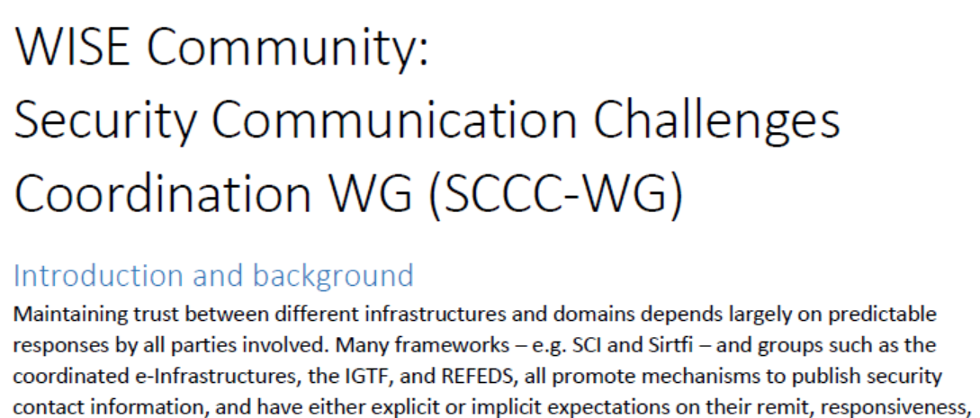
Security Communications Challenge Coordination Working Group (SCCC-WG)

Slide 12
SCCC-WG (2) – David Groep
Candidates that could all run Communication Challenges (CCs)
  and ‘legitimately’ claim an interest
eduGAIN
GEANT.org, Trusted Introducer and TF-CSIRT
EOSC-hub operations, EGI CSIRT
IGTF Risk Assessment Team
e-Infrastructures XSEDE, EGI, EUDAT, PRACE, OSG, HPCI, ...
research infrastructures: WLCG, LSAAI, BBMRI, ELIXIR, ...
SCCC-WG should become a standing interest group
  maintain a timetable of planned CCs
  coordinate CCs and promotes the sharing of results

Slide 13
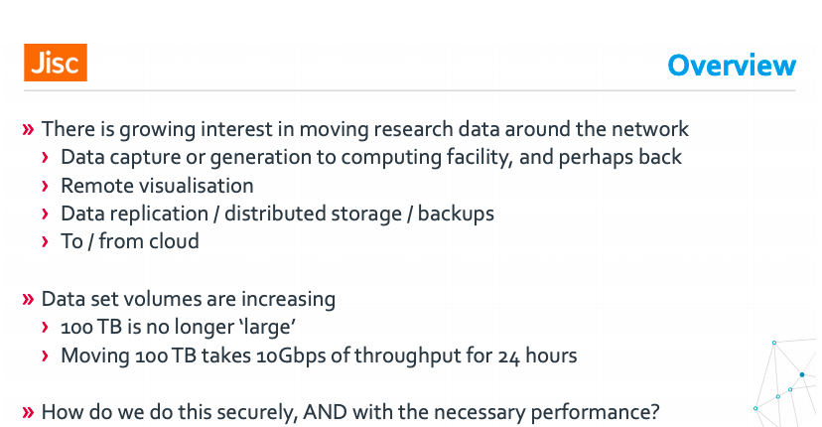
Security for High Speed Transmissions Working Group (S4HST-WG) – Tim Chown

Slide 14
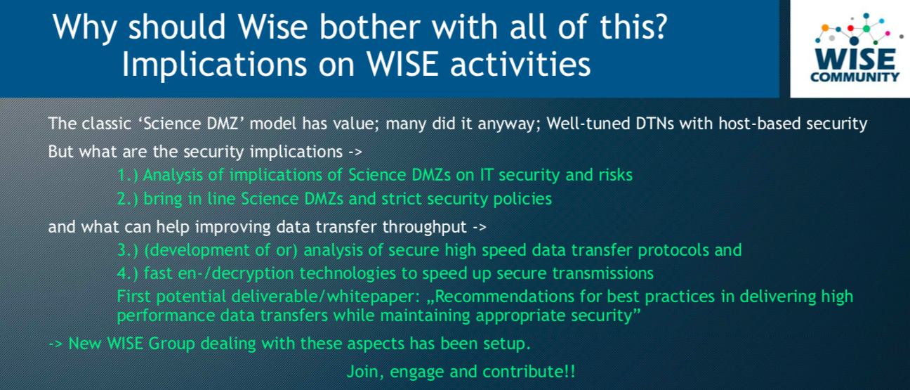
S4HST-WG Ralph Niederberger
Notes:
Hannah hands over to David

Slide 15
Security for Collaborating Infrastructures …
Notes:
David

Slide 16
Shared threats & shared users
Infrastructures are subject to many of the same threats
  Shared technology, middleware, applications and users
User communities use multiple e-Infrastructures
  Often using same federated identity credentials
Security incidents often spread by following the user
  E.g. compromised credentials
Several e-Infrastructure security teams decided “we should collaborate”

Slide 17
Security for Collaborating Infrastructures (SCI-WG)
A collaborative activity of information security officers from large-scale infrastructures
  EGI, OSG, PRACE, EUDAT, CHAIN, WLCG, XSEDE, HBP…
Grew out of EGEE/WLCG JSPG and IGTF – from the ground up
We developed a Trust framework
  Enable interoperation (security teams)
  Manage cross-infrastructure security risks
  Develop policy standards
  Especially where not able to share identical security policies

Slide 18
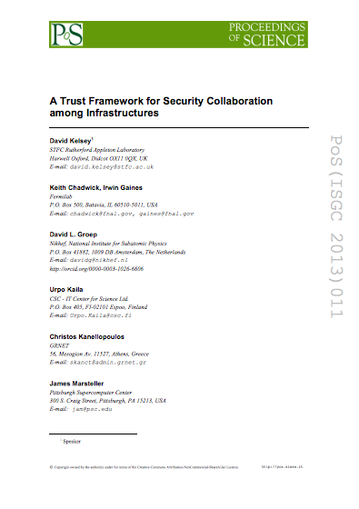
SCI Document – version 1
Proceedings of the ISGC 2013 conference
http://pos.sissa.it/archive/conferences/179/011/ISGC%202013_011.pdf
The document defined a series of numbered requirements in 6 areas

Slide 19
SCI Version 1 “children”

Slide 20
SCI version 1 (2013) - children
Both separate derivatives of SCI version 1
REFEDS Sirtfi - The Security Incident Response Trust Framework for Federated Identity
  requirement in FIM4R version 1 paper
  https://refeds.org/sirtfi
AARC/IGTF Snctfi – The Scalable Negotiator for a Community Trust Framework in Federated Infrastructures
  For scalable policy – Research Services behind a SP/IdP proxy
  https://www.igtf.net/snctfi/

Slide 21
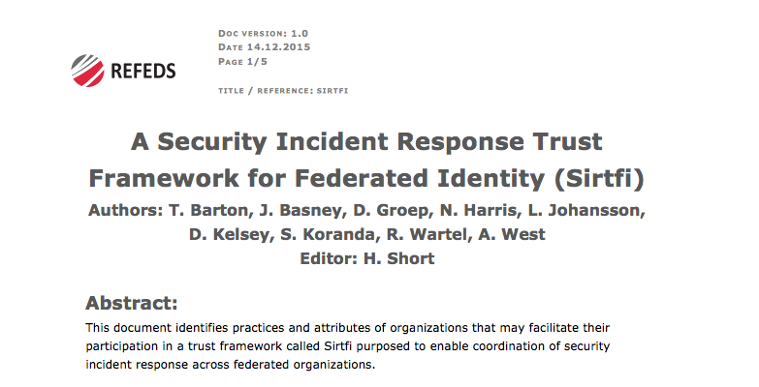
Sirtfi

Slide 22
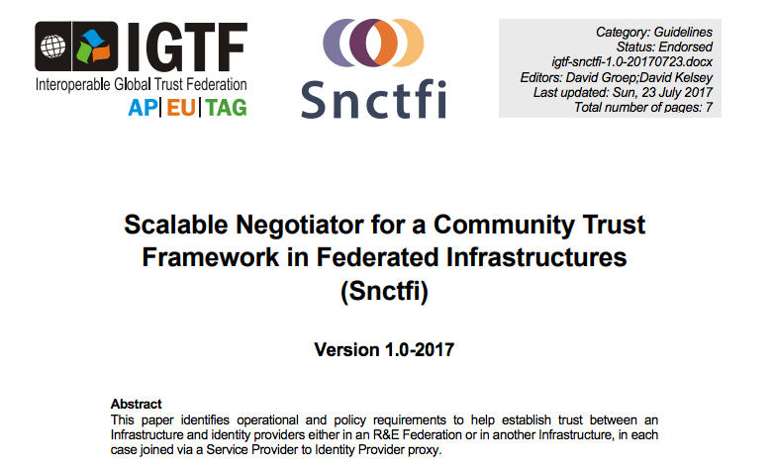
Snctfi

Slide 23
SCI version 2

Slide 24
WISE SCI Version 2
Aims
  Involve wider range of stakeholders
    GEANT, NRENS, Identity federations, …
  Address any conflicts in version 1 for new stakeholders
  Add new topics/areas if needed (and indeed remove topics)
  Revise all wording of requirements
  Simplify!
SCI Version 2 was published on 31 May 2017
https://wise-community.org/sci/

Slide 25
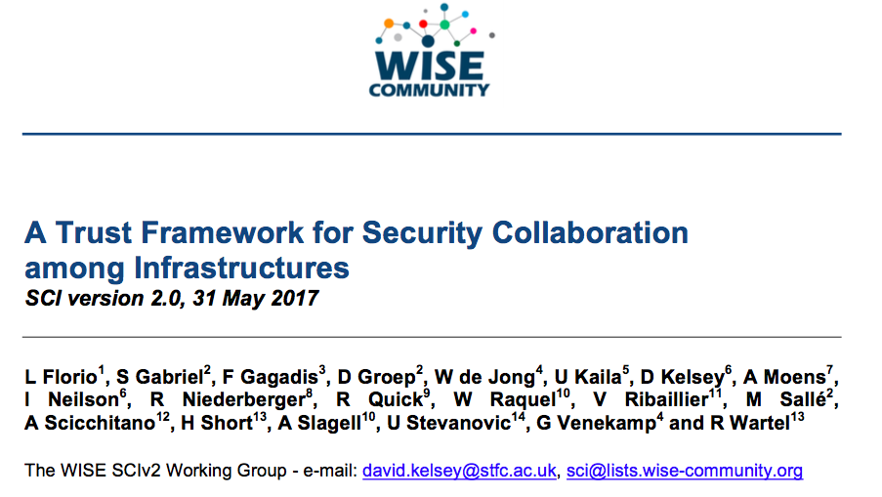
SCI Version 2 – published 31 May 2017

Slide 26
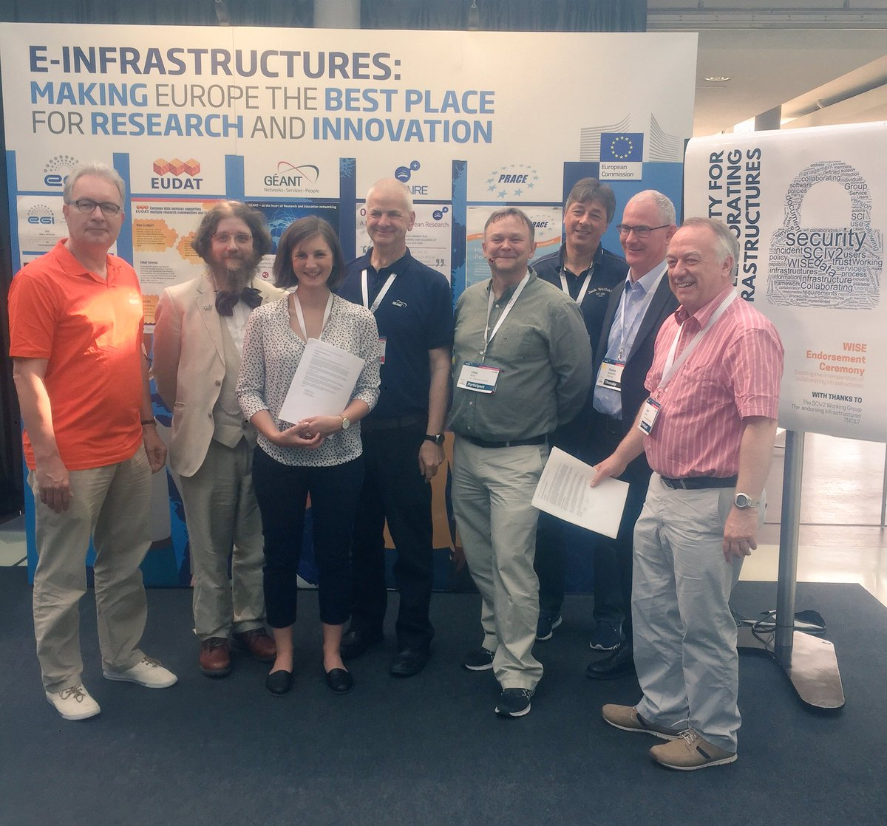
Endorsement of SCI Version 2 at TNC17 (Linz)
1st June 2017
Infrastructures endorse the governing principles and approach of SCI, as produced by WISE, as a medium of building trust between infrastructures, to facilitate the exchange of security information in the event of a cross-infrastructure incident, and the collaboration of e-Infrastructures to support the process. These Infrastructures welcome the development of an information security community for the Infrastructures, and underline that the present activities by the research and e-Infrastructures should be continued and reinforced
Endorsements have been received from the following infrastructures; EGI, EUDAT, GEANT, GridPP, MYREN, PRACE, SURF, WLCG, XSEDE, HBP
https://www.geant.org/News_and_Events/Pages/supporting-security-for-collaborating-infrastructures.aspx

Slide 27
Sections of V2 paper
In this document, we lay out a series of numbered requirements in five areas (operational security, incident response, traceability, participant responsibilities and data protection) that each Infrastructure should address as part of promoting trust between Infrastructures
I will now show an example of some text from SCI V2

Slide 28
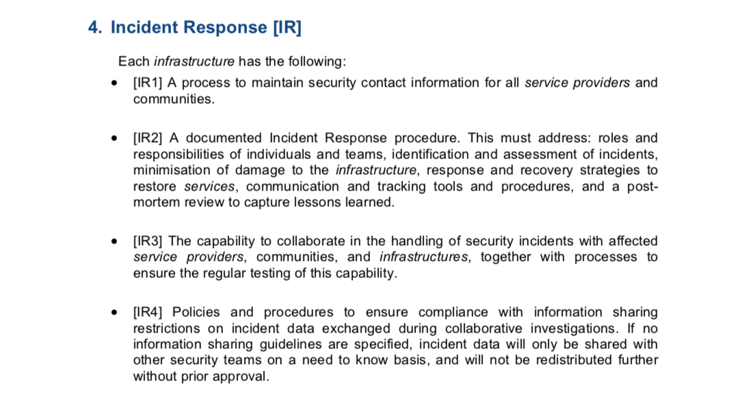

Slide 29
SCI Assessment of maturity
To evaluate extent to which requirements are met, we recommend Infrastructures to assess the maturity of their implementations
According to following levels
  Level 0: Function/feature not implemented
  Level 1: Function/feature exists, is operationally implemented but not documented
  Level 2: … and comprehensively documented
  Level 3: … and reviewed by independent external body

Slide 30
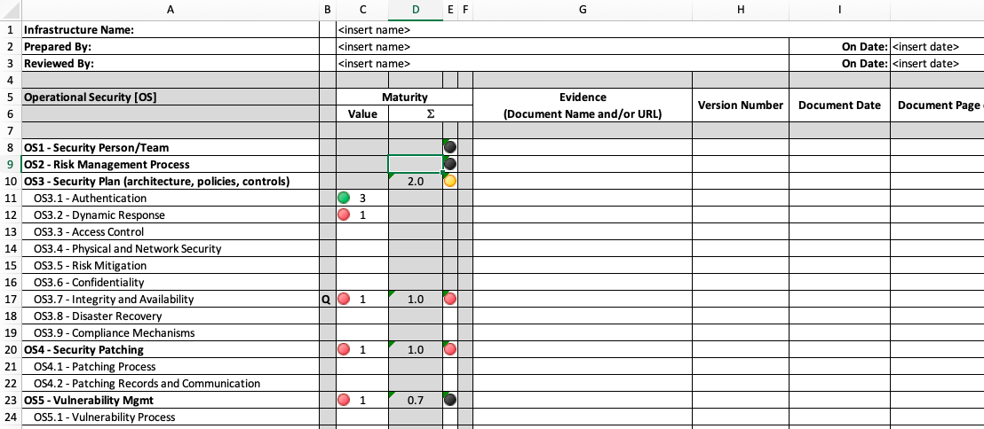
Assessment spreadsheet (AARC2 development)

Slide 31
Current SCI activities

Slide 32
SCI–WG in 2019
Work in progress
Joint work AARC2/EOSC-hub on Policy Development Kit
WISE Baseline AUP v1.0 (from AARC PDK)
On the to-do list
Produce FAQ/Guidelines & Training – how to satisfy SCI V2?
Maturity Assessments from a number of Infrastructures
Notes:
David hands over to Hannah

Slide 33
WISE/SCI – long term home for policy output from AARC/AARC2 NA3
In EOSC-hub – we use the AARC PDK as starting point
Security Policies – AARC2
Policy Development Kit
https://aarc-project.eu/policies/policy-development-kit/

Slide 34
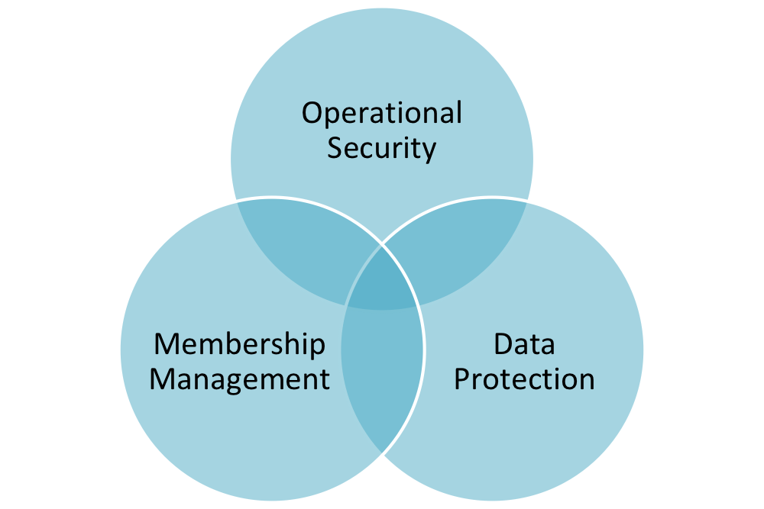
Which policies?
SNCTFI (Scalable Negotiator for a Community Trust Framework in Federated Infrastructures)
  Top level policy
    Operational Security
    Membership management
    Data protection
Consider current best practices (EGI, CERN, ELIXIR, TrustedCI, etc.)
Policies started from EGI versions
  And then modified
Some other policies (Infrastructure-related) will need to be
handled by WISE/EOSC-hub

Slide 35
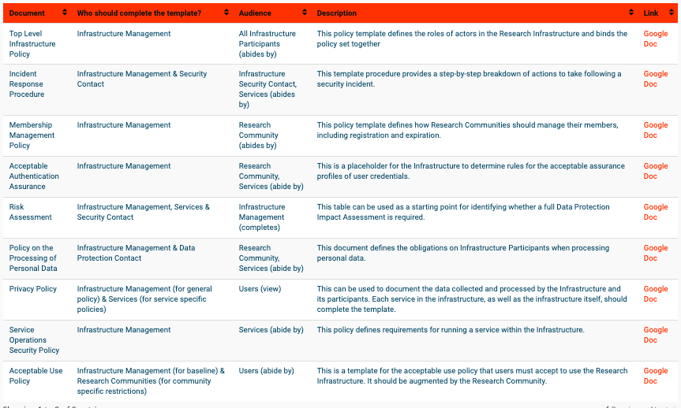
AARC2 Policy Development Kit https://aarc-project.eu/policies/policy-development-kit/

Slide 36
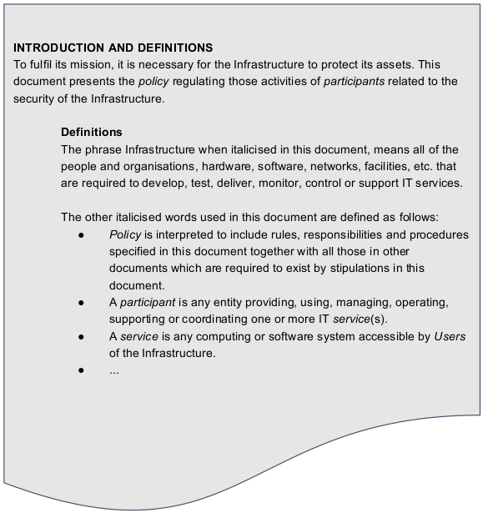
Top Level Infrastructure Policy
Top policy regulating activities and duties with all participants (with other policies..)
EGI Top Policy served as an input
Content:
Definitions
  Objectives
  Scope
Roles and Responsibilities
  Management
  Security Contacts
Security
Sanctions
Exceptions

Slide 37
AARC PDK – Acceptable Use Policy

Slide 38
2018 study of existing AUPs
AARC2 NA3 policy team
For details see: https://wiki.geant.org/pages/viewpage.action?pageId=86736956
Looked at AUPs from 11 infrastructures
Then considered clause by clause in a spreadsheet:
https://docs.google.com/spreadsheets/d/1bg5I9n_DM7QcXdnja_7r0OEpTfjrb72ftq7-xHQxfxM/edit#gid=822235717

Slide 39
A new common baseline AUP
To make a recommendation for the content of an Acceptable Use Policy (AUP) to act as a baseline policy (or template) for adoption by research communities
To facilitate -
  a more rapid community infrastructure ‘bootstrap’
  ease the trust of users across infrastructures
  provide a consistent and more understandable enrolment for users.
Adoption of a single policy preferred to modifying a template

Slide 40
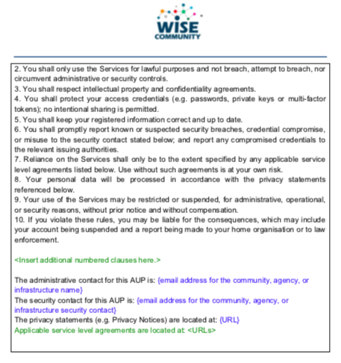
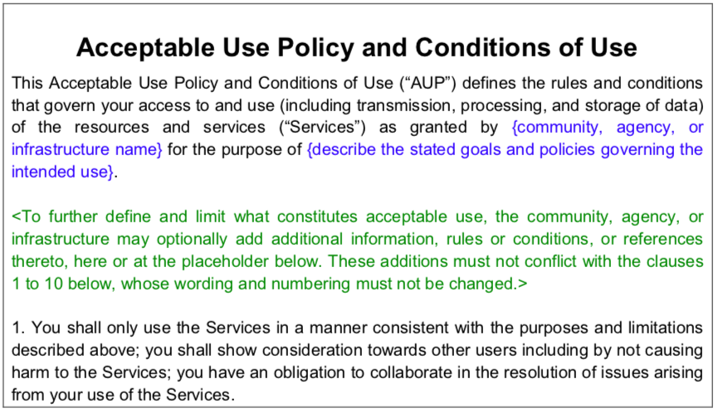
WISE Baseline AUP v1 – to be published by WISE very soon
AARC Guidline on use of baseline AUP:
https://aarc-project.eu/wp-content/uploads/2019/03/AARC-I044-Implementers-Guide-to-the-WISE-Baseline-AUP.pdf
Notes:
Authors?

Slide 41
How will this Baseline AUP used?
Forms part of the information shown to a user during registration with his/her community
AUP provides information on expected behaviour and restrictions
"baseline" text can, optionally, be augmented with additional, community or infrastructure specific, clauses as required, but the numbered clauses should not be changed
The registration point where the user is presented with the AUP may be operated directly by the user's research community or by a third party on the community's behalf

Slide 42
AUP use (2)
Other information shown to user during registration
Privacy Notice - information about the processing of their personal data together with their rights under law regarding this processing
Service Level Agreements - information about what the user can expect from the service in terms of quality such as reliability and availability
(Optional) Terms of Service

Slide 43
Next steps
Discuss recent work and plan future activities
WISE
  Review of current working groups and plans
  Some real work on Security Communication Challenges
ALL welcome to the various mail lists and F2F meetings

Slide 44
Acknowledgements
Many thanks to all colleagues in AARC2 policy team for slides
Thanks to all colleagues in WISE & SCI-WG
  and co-authors of SCI version 1 and version 2
For funding received from EU H2020 projects, including
  AARC2
  EOSC-hub
EGI, WLCG, GridPP, EUDAT, HBP, PRACE, …
The Extreme Science and Engineering Discovery Environment (XSEDE) is supported by the National Science Foundation.

Slide 45
Questions?
And discussion ….

