Slide 1
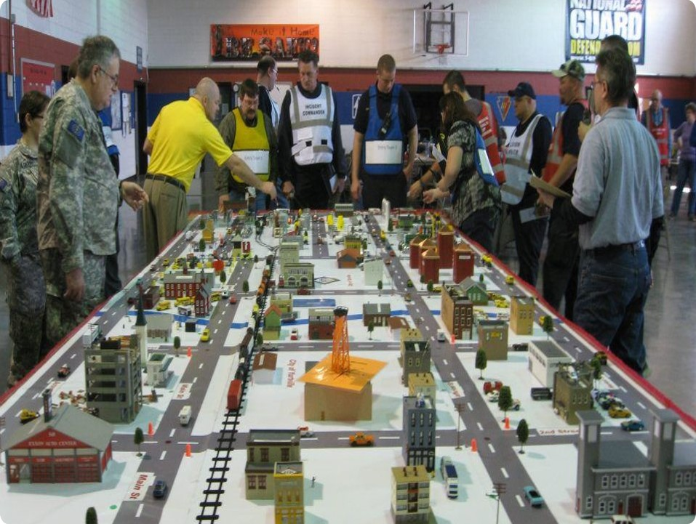
CLAW2018
Crisis in Malaga
Charlie van Genuchten (SURFnet)
Notes:
Talk a bit about OZON/NOZON/CLAW

Slide 2
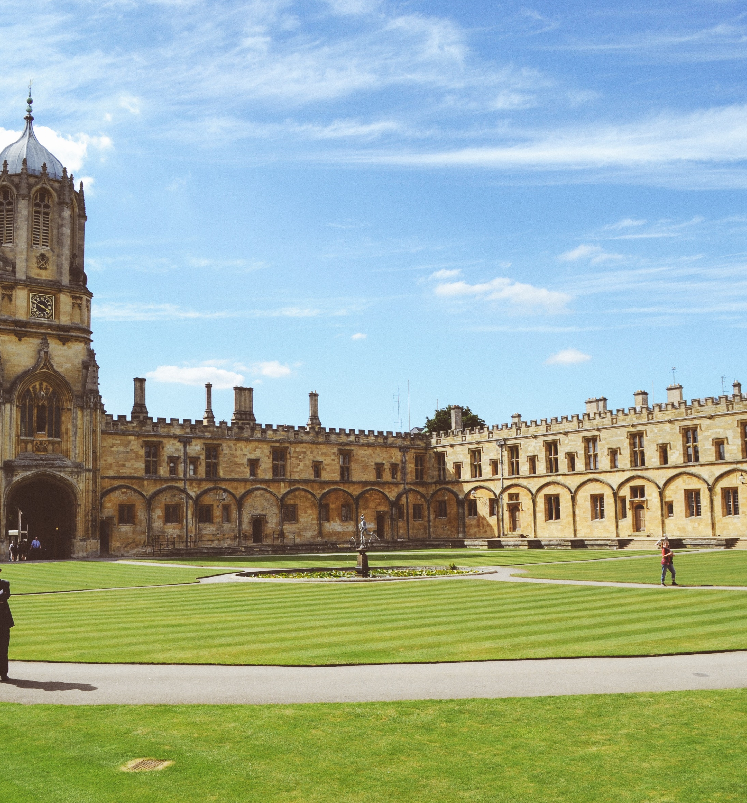
Welcome to Guilder
A beautiful, fictional country in Europe
Imagine that you are part of the crisis management team for the NREN of Guilder (GuilREN)
With this crisis management team, you are responsible for coordinating a crisis, if one occurs

Slide 3
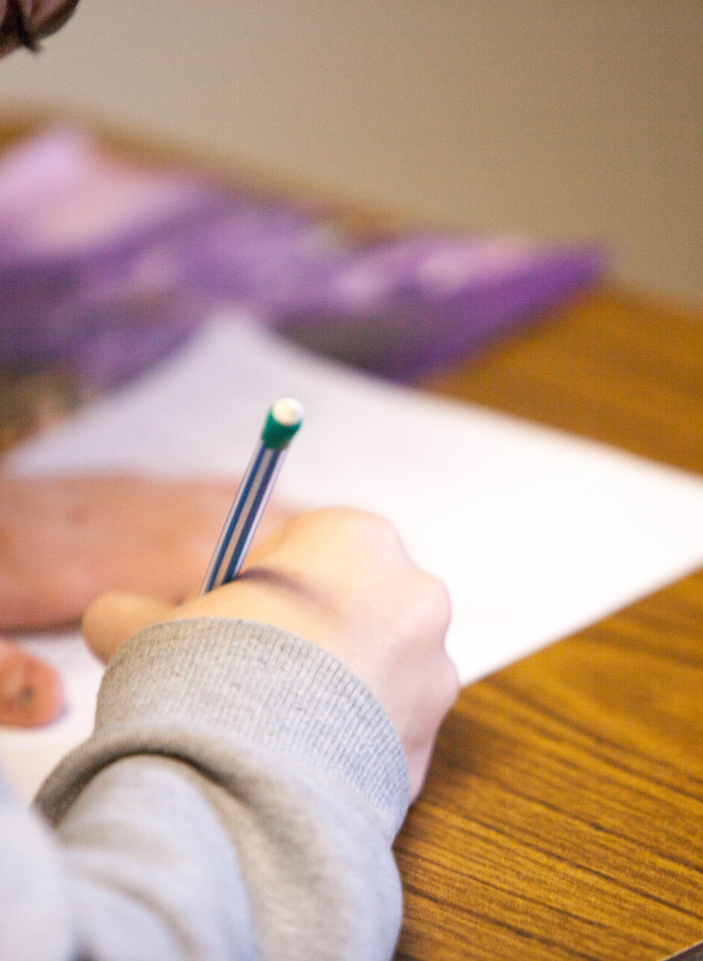
Countrywide test
It’s an important day in Guilder with the same standardized test on English language skills taking place all over the country.
In total, 200.000 students are supposed to take this test today between 11.00 and 13.00.
This is the first time that this standardized test will be taken countrywide by all students.
It has been a controversial issue to have this test, so there is a lot of publicity already surrounding this test.
Notes:
This is the first time that this standardised test will be taken countrywide by all students.
It has been a controversial issue to have this test, but the Minister of Education pushed it through to make sure all students in Guilder are up to standard on their English language skills. There is a lot of publicity already surrounding this test, with news crews posting outside the biggest universities to get quotes from students if they think this test is necessary. A failing grade for the test will impact the possibility to be admitted into the more prestigious Master programs.

Slide 4

There’s a problem
About half of the students have started taking the test, however the other half has not been able to start because of a connectivity issue
The tests are being made on ipads/portable devices/desktops and they can’t load the tests at some locations.
We are coming up to the one hour mark (almost 12) and students will want to leave the exam room.

Slide 5
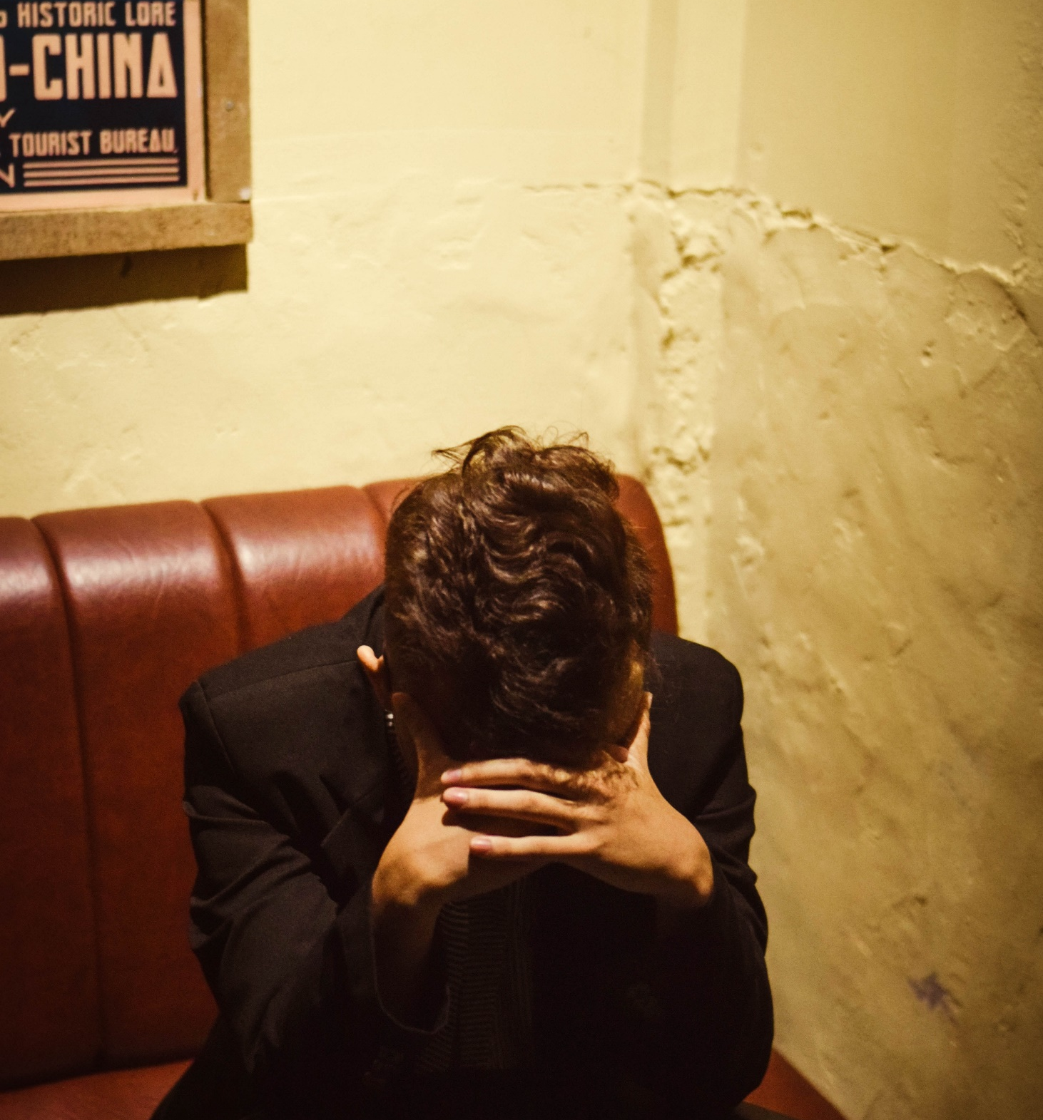
It’s becoming a crisis
However, as there are students that have not yet started the test and still have their phones etc. the people that have taken the test cannot leave the exam rooms, as there is the possibility of the exam questions and answers leaking.
So there are 100.000 students countrywide that can’t leave the exam rooms until it is clear that everyone has started the test and another 100.000 students waiting to take the exam getting more and more irritable about having to wait.

Slide 6
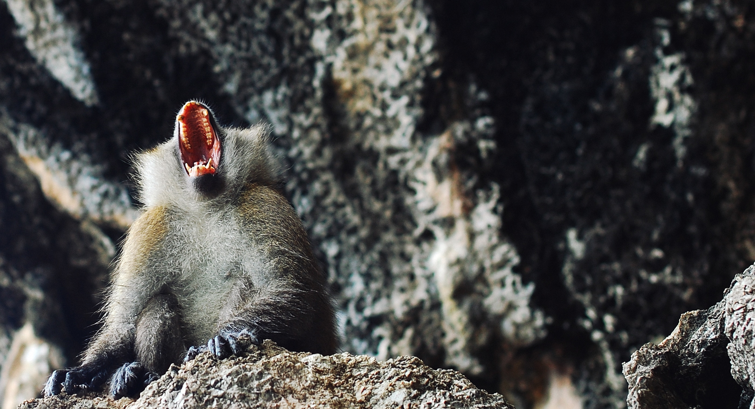
What would you do?

Slide 7
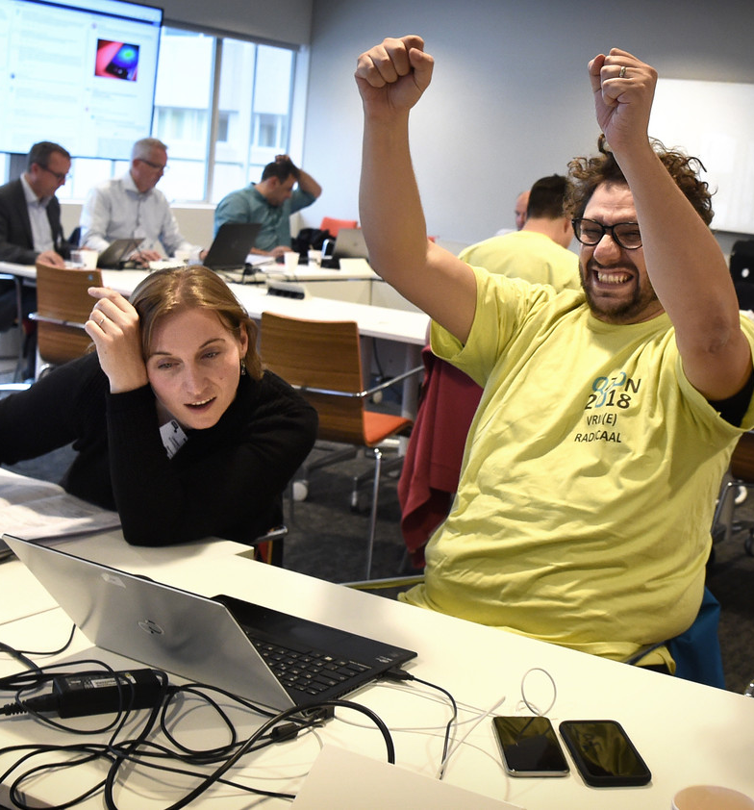
Observations exercise
Some great team work
Stress!
Focusing on the technical issue
Overruling communication
No triage of incoming information
A lot of creativity

Slide 8

CLAW 2018
Exercise
Training on stress management in teams
Lightning talks
Train the trainer: how to organize your own exercise?
Training on the basics of crisis management

Slide 9

2019
CLAW 2019: November 6 and 7 in Poznan at PSNC
What do you need/want in terms of training?
Training how to organize your own crisis exercise: May 27th in Utrecht at SURFnet

