Slide 1
Master Thesis
Metrics and Key Performance Indicators for
Information Security Reports of Universities
Matthias Mödinger
University of Applied Sciences Augsburg
matthias.moedinger@hs-augsburg.de
Friday, April 12, 2019

Slide 2
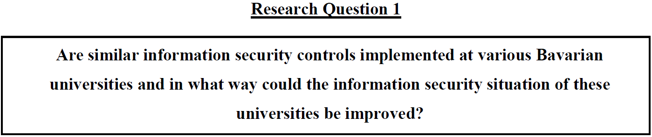

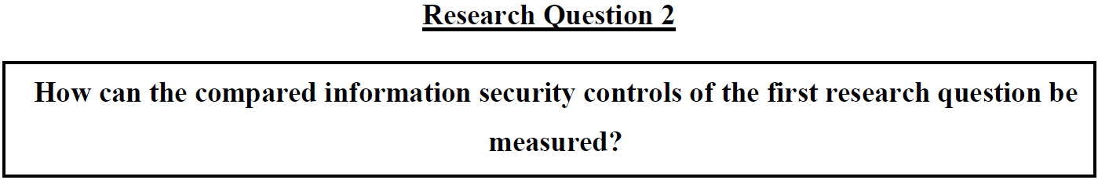

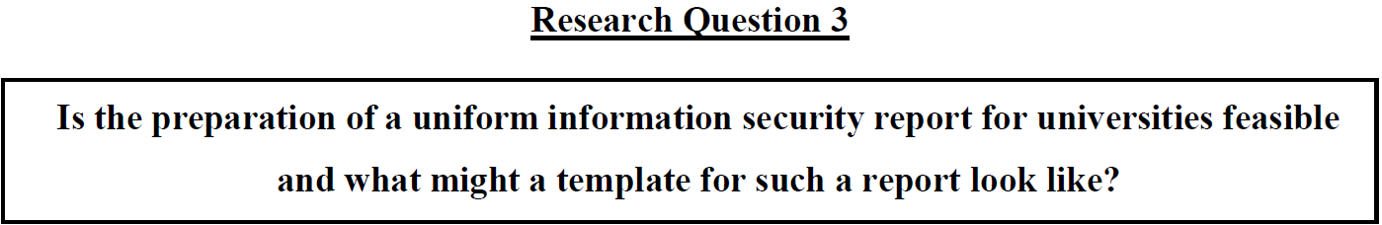


Slide 3
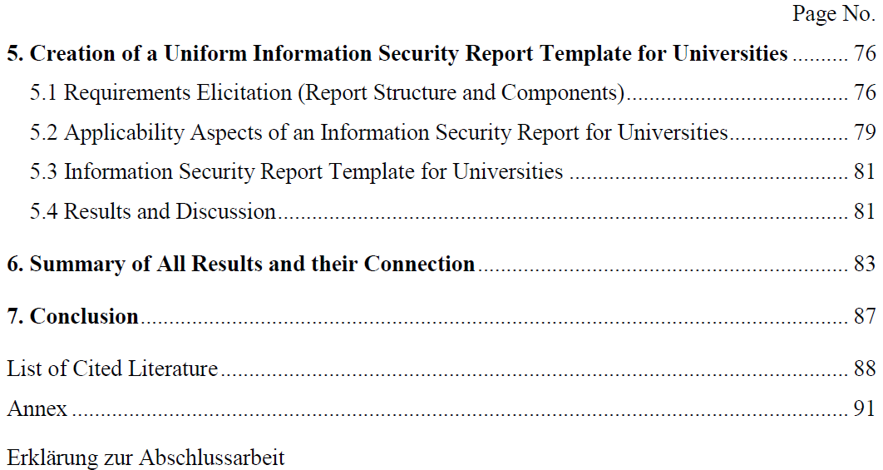
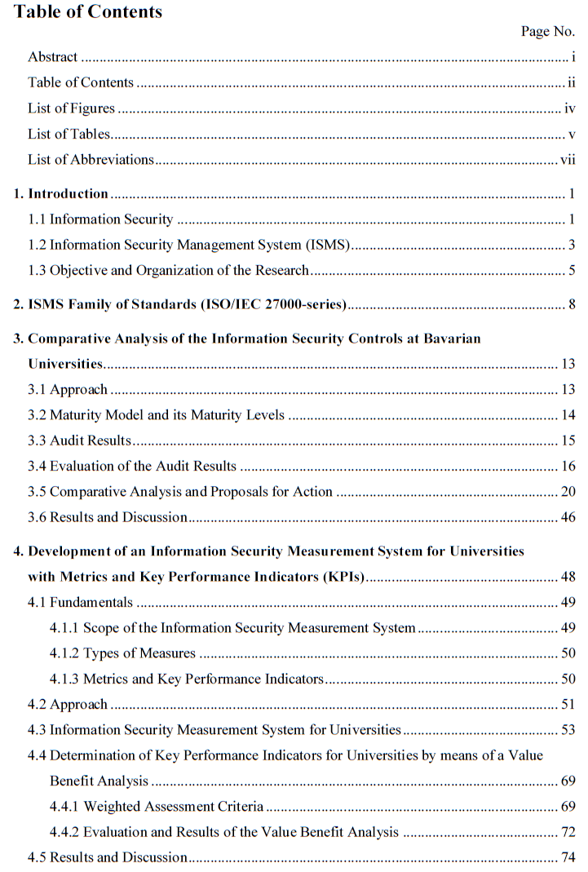
RQ3
RQ1
RQ2

Slide 4
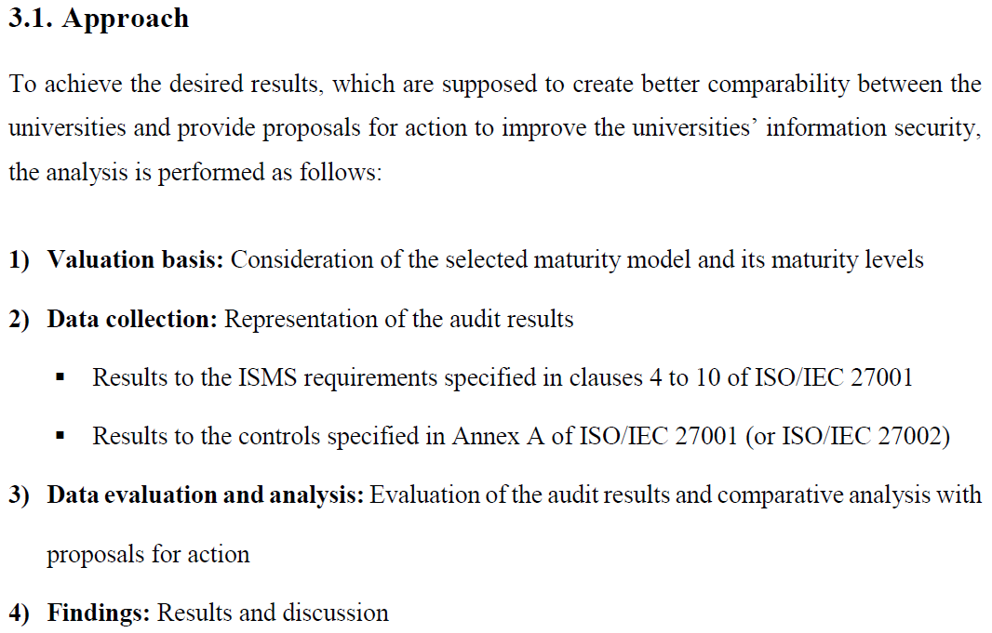
Research Question 1

Slide 5
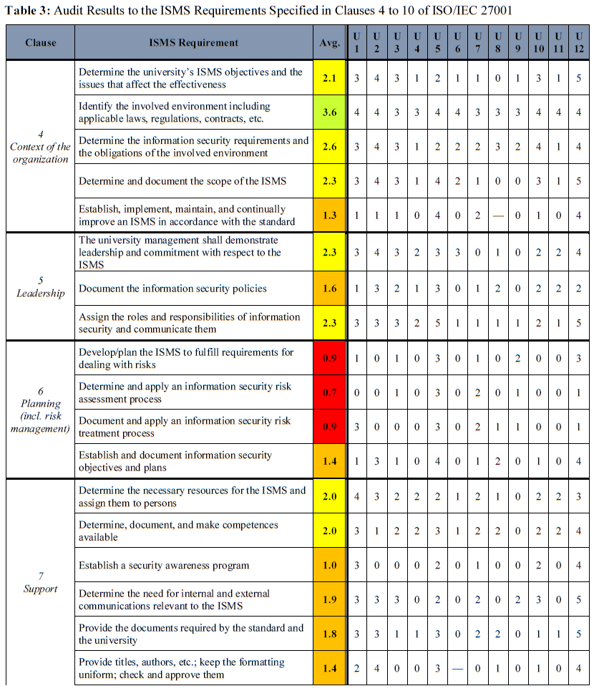
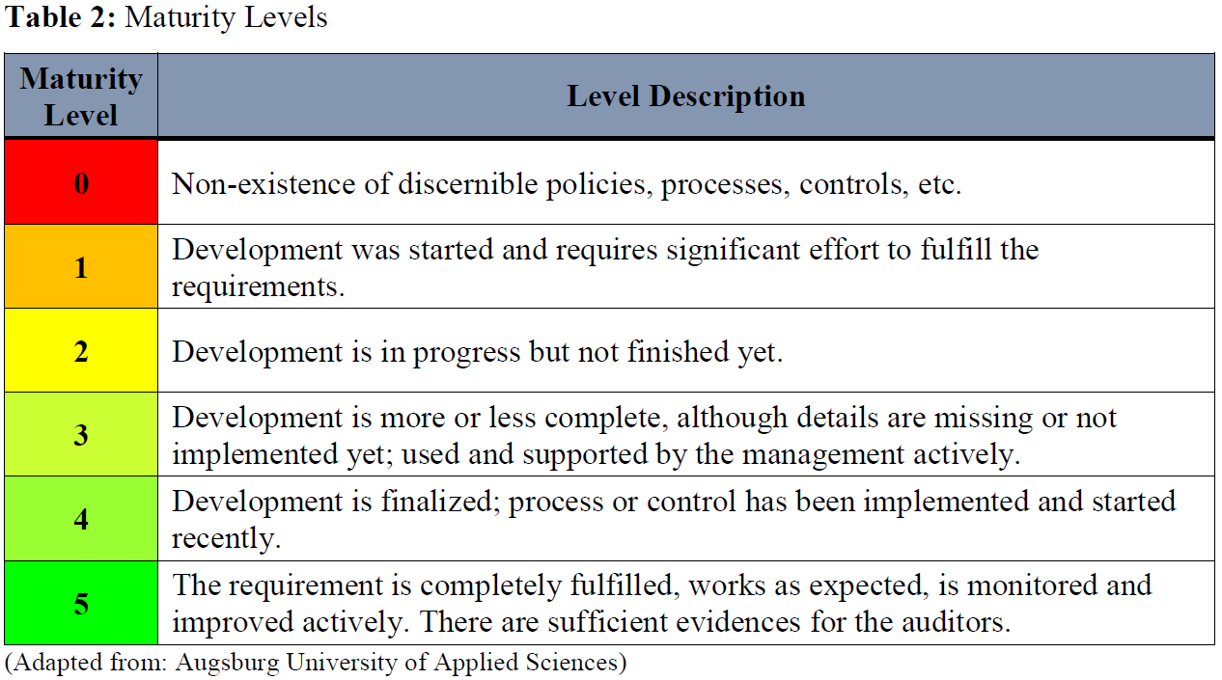
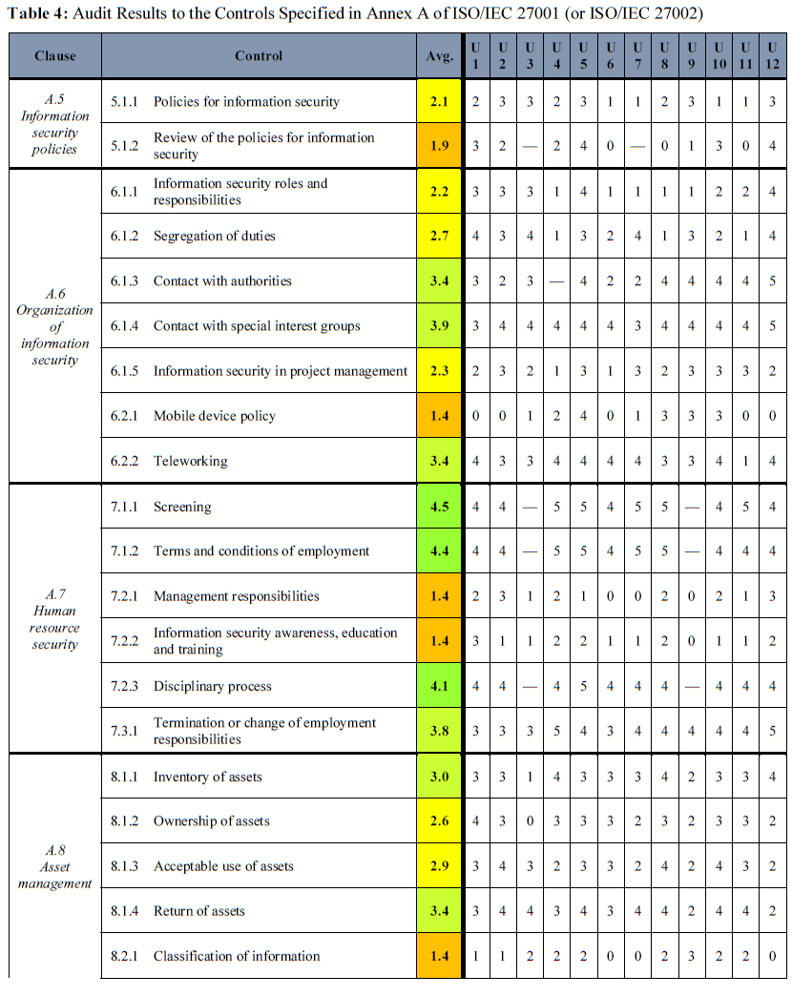
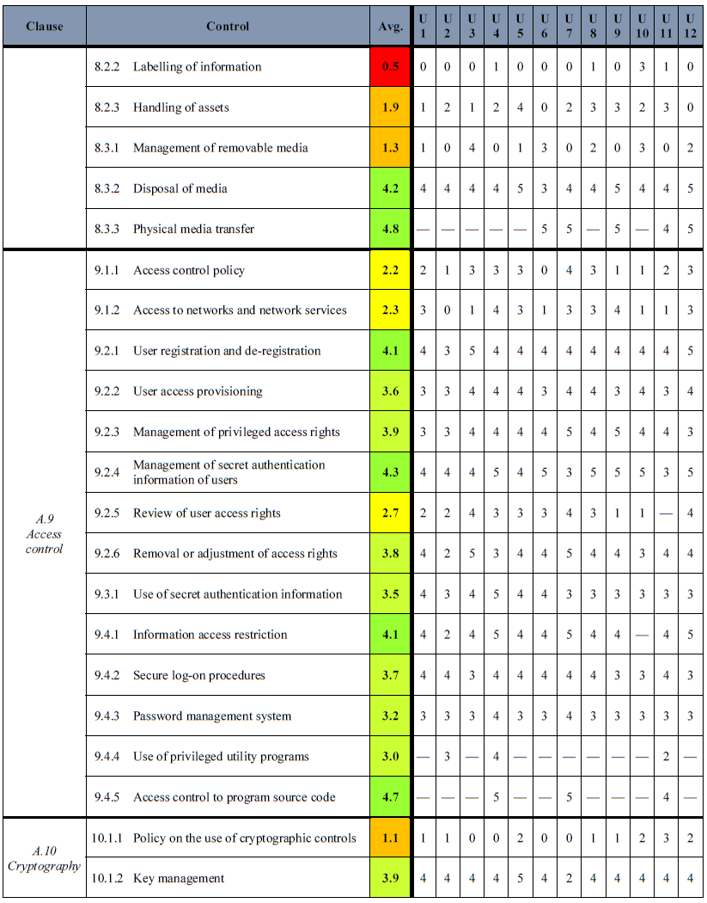

Slide 6
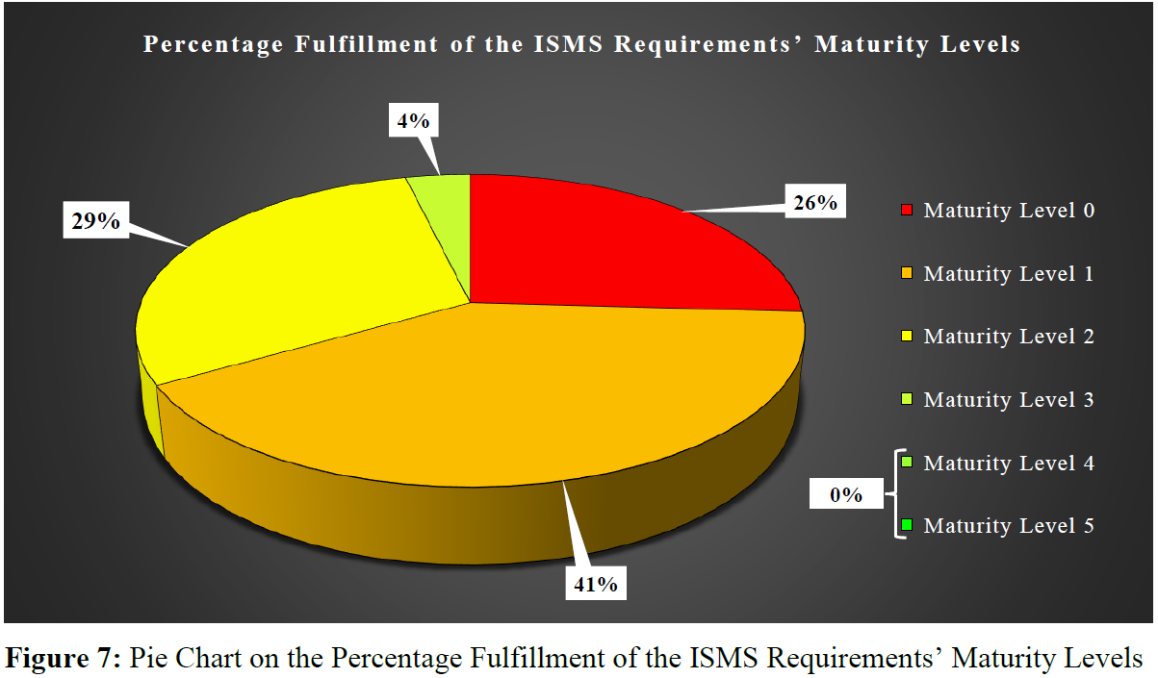

Slide 7
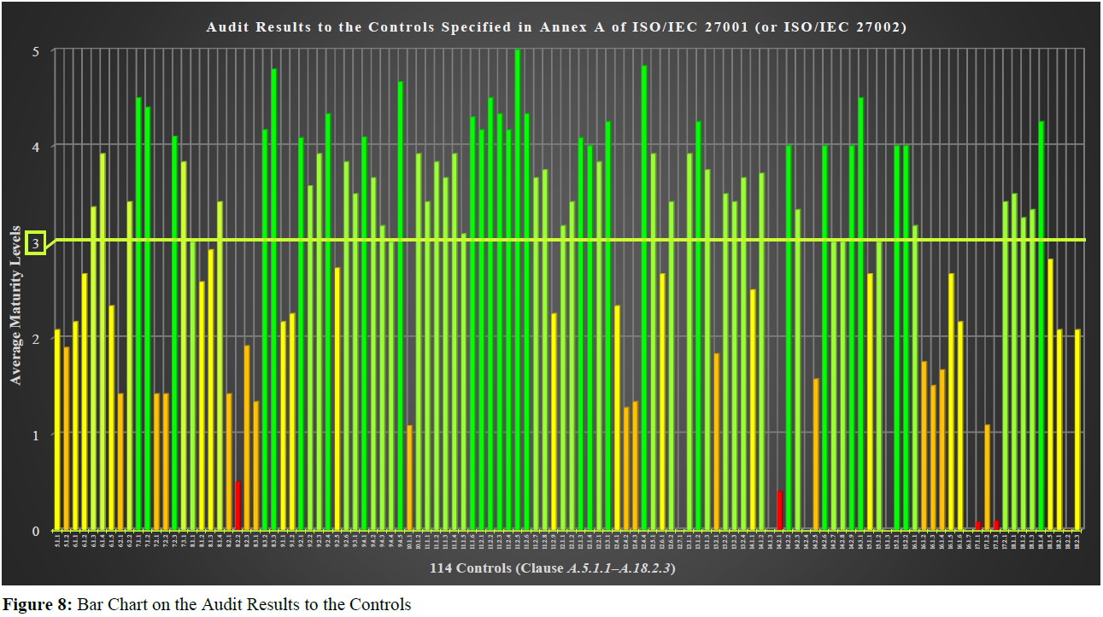

Slide 8
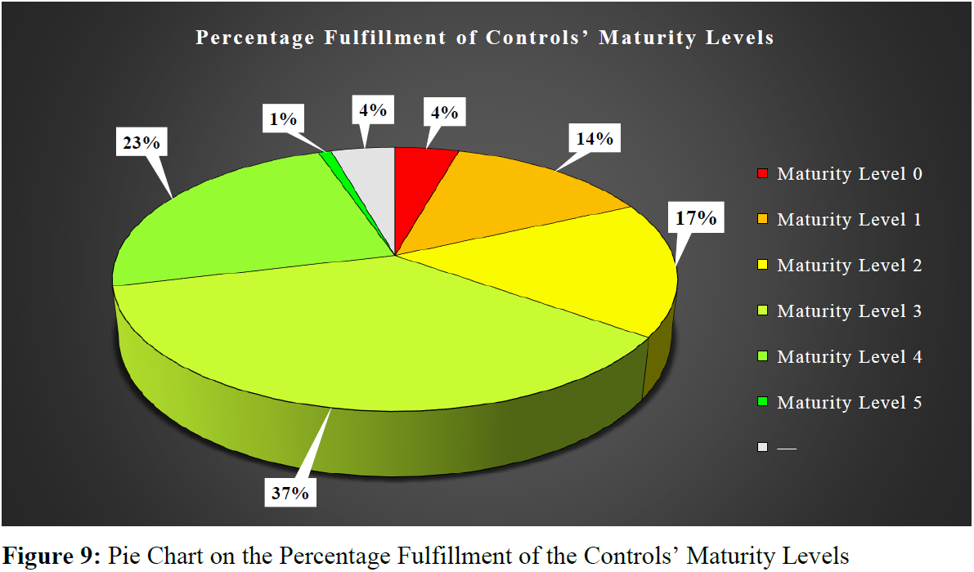

Slide 9
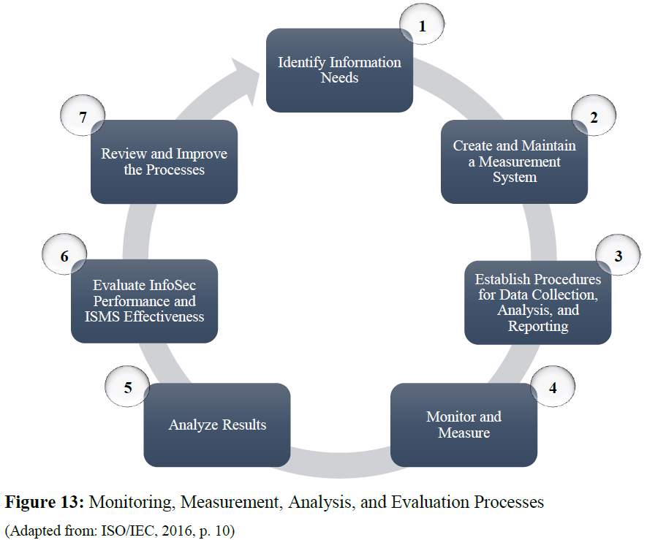
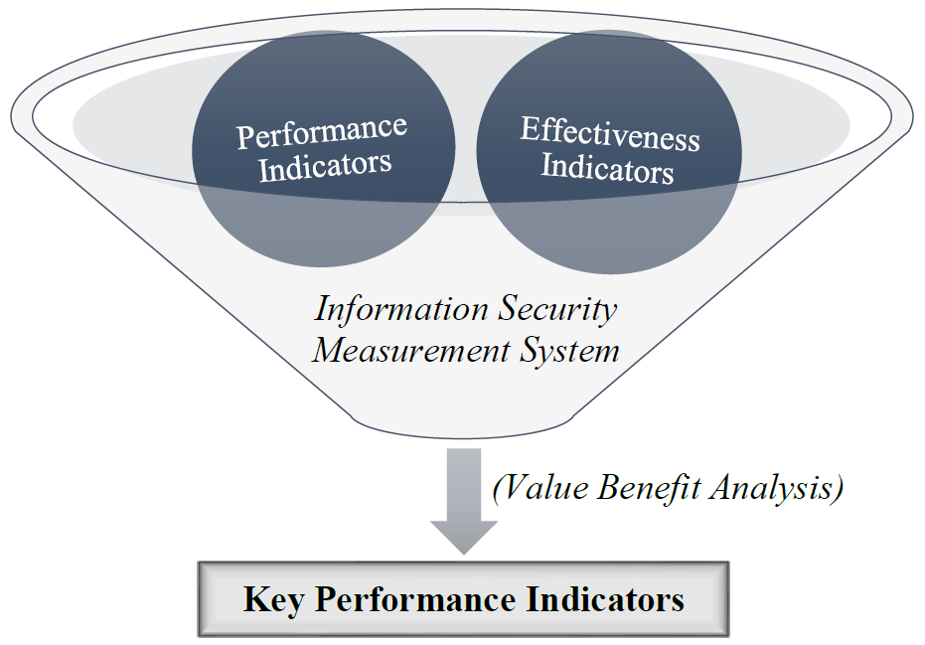
Research Question 2

Slide 10
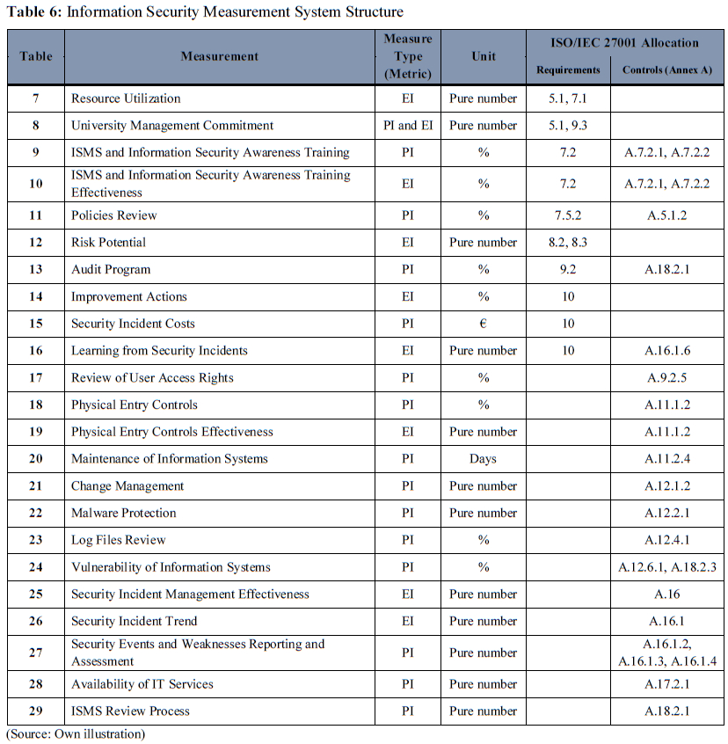
15 Performance Indicators
9 Effectiveness Indicators

Slide 11
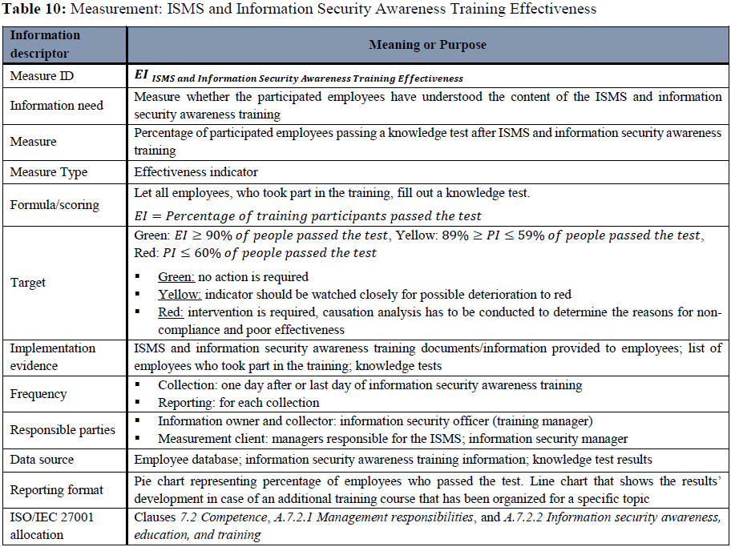

Slide 12
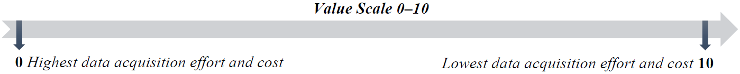
Determination of Key Performance Indicators by means of a Value Benefit Analysis
5 Weighted Assessment Criteria

Slide 14
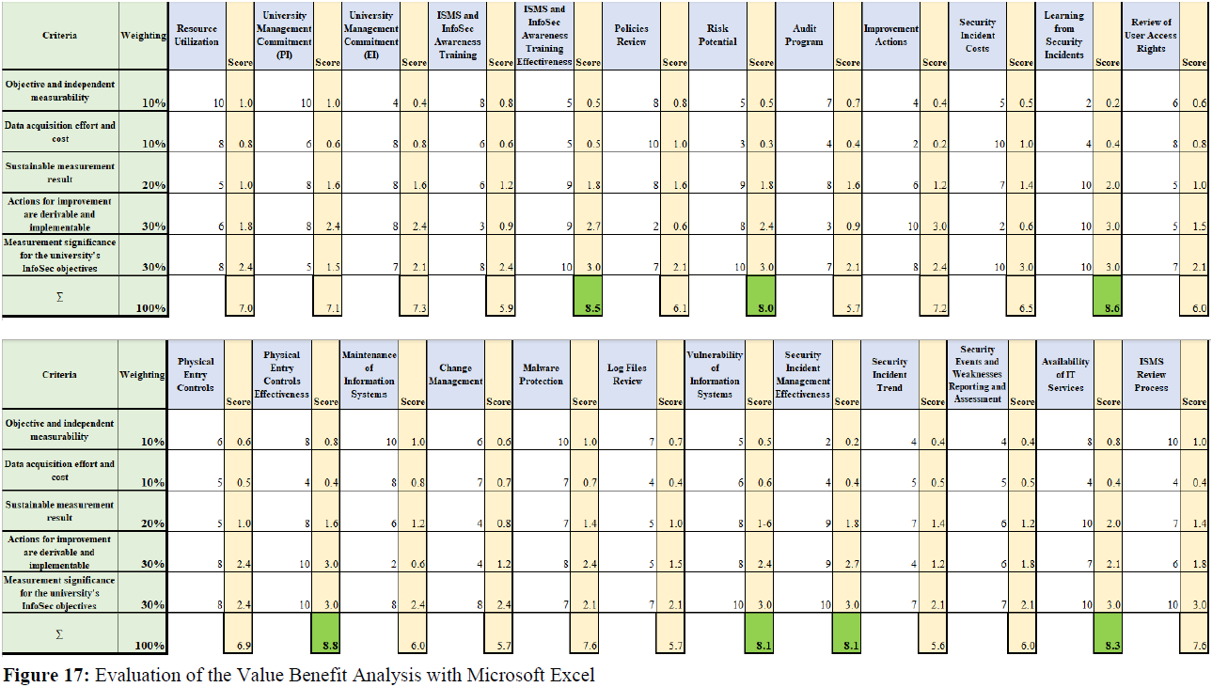

Slide 15
Research Question 3
Requirements Elicitation (Report Structure and Components)
Requirements and Recommendations of ISO/IEC 27003, ISO/IEC 27005, and ISO/IEC 27014
Applicabilty Aspects of an Information Security Report for Universities
Who should be the recipients of the report?
Which period of time should be gathered by the report and how often should it be submitted?
Is the report template suitable for universities of various sizes (universities/universities of applied sciences)?
Would an overall information security report of all universities be feasible?

Slide 16
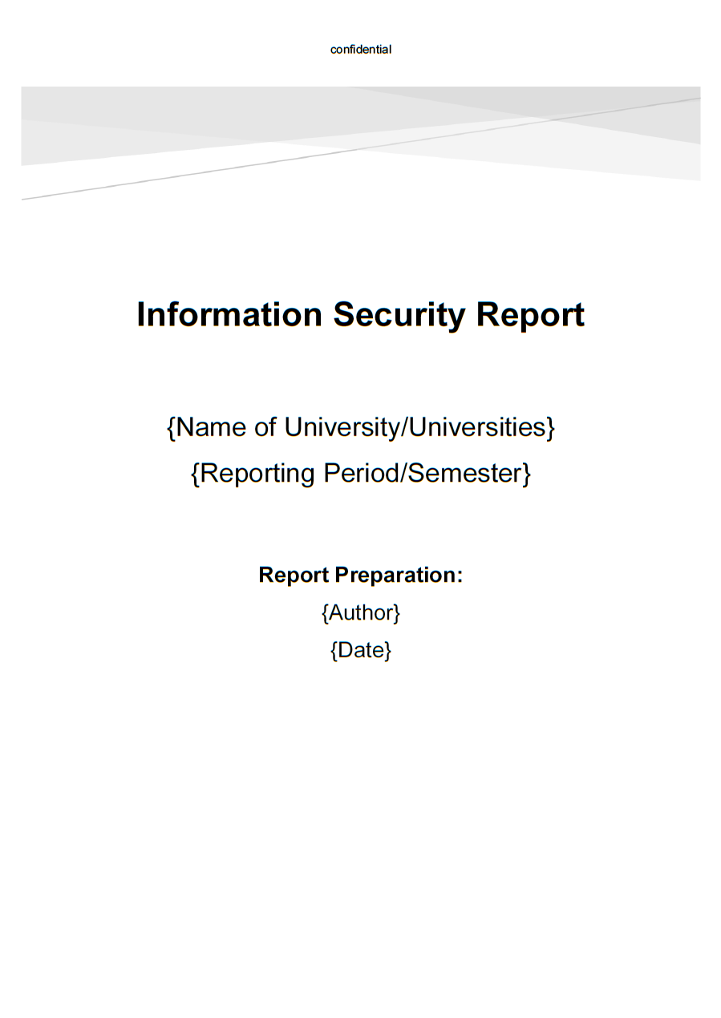
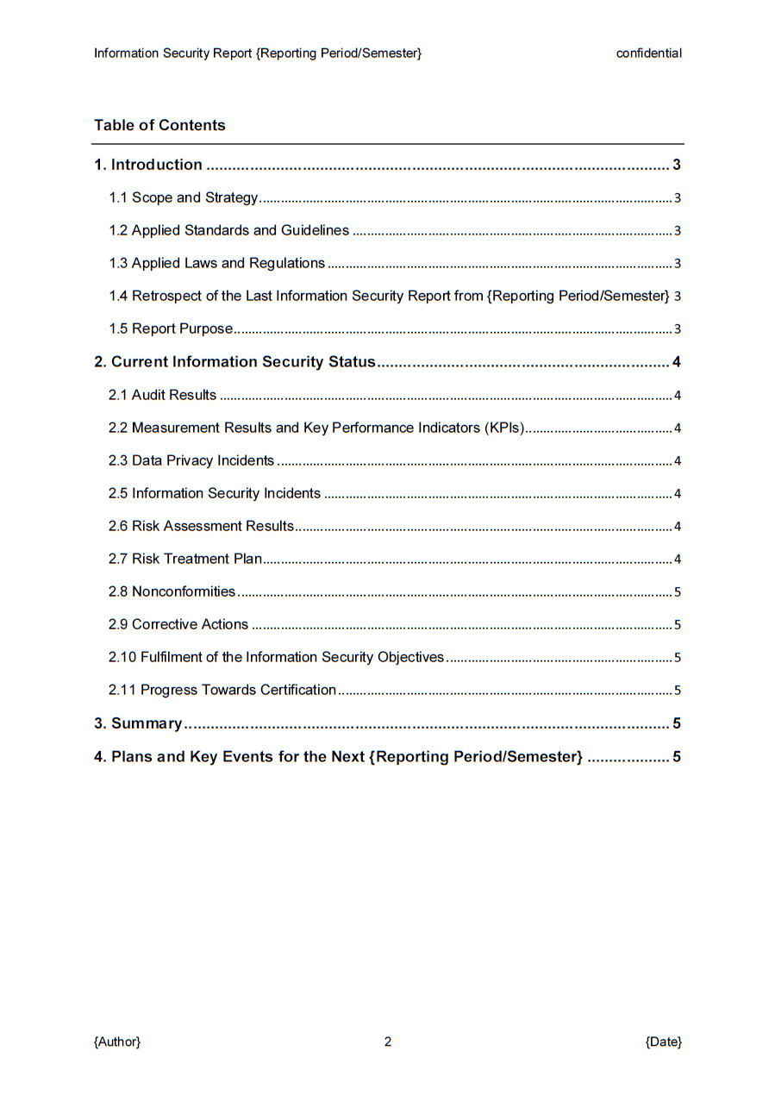

Slide 17
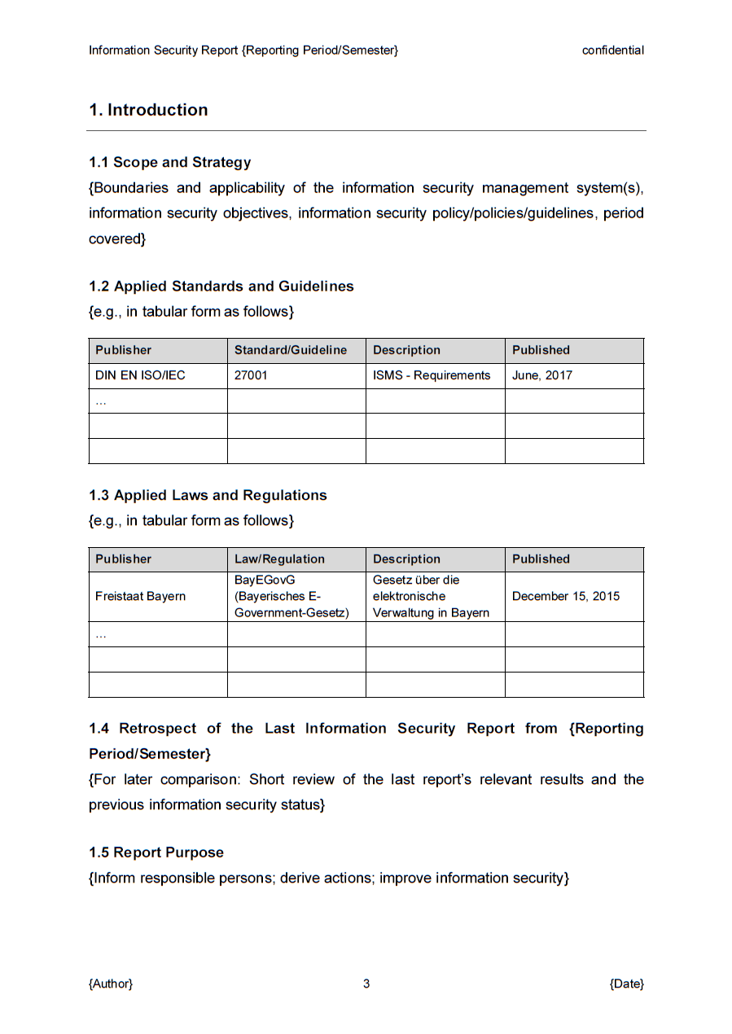
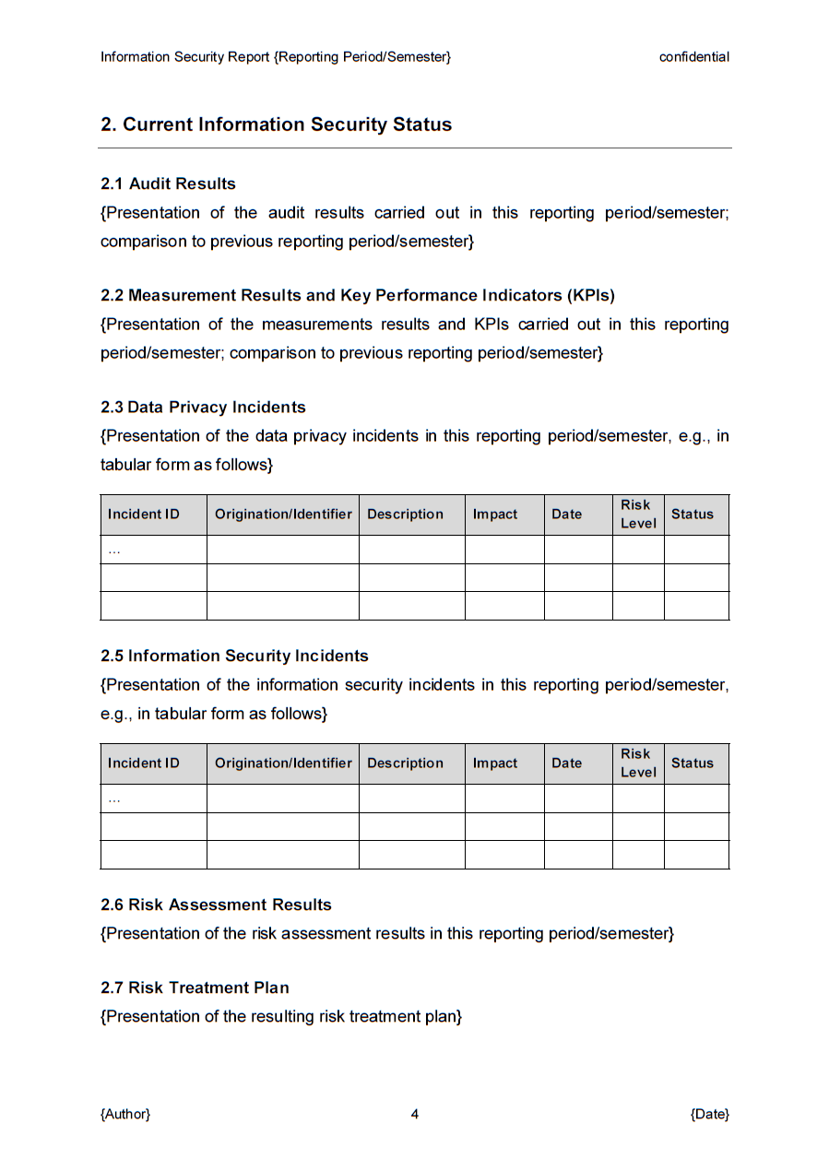
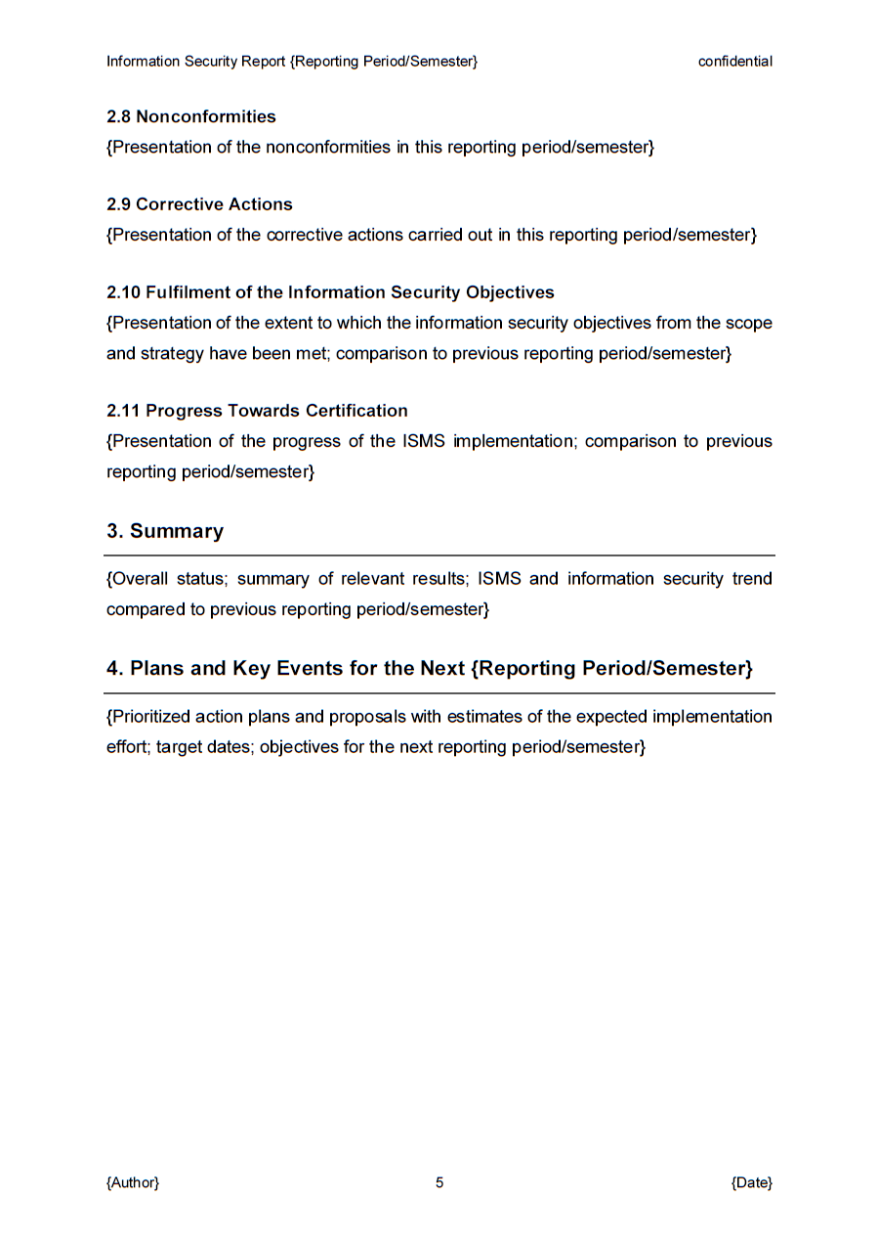

Slide 18
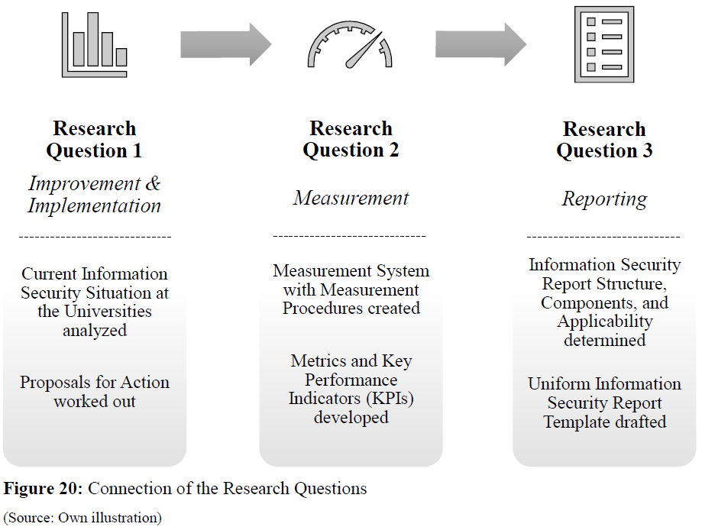
Summary

Slide 19
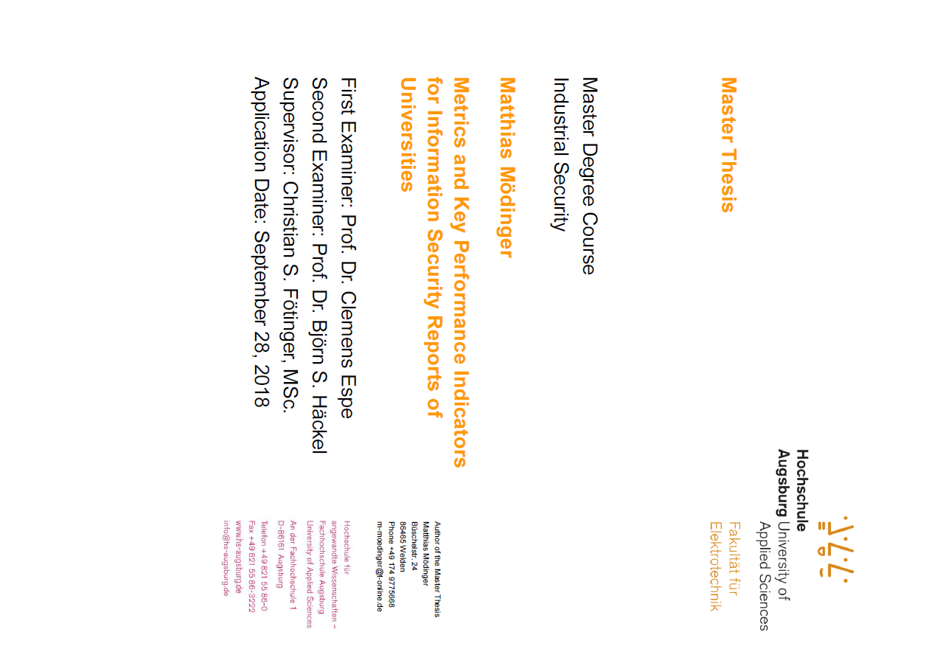
Thank you for your attention!
Matthias Mödinger
University of Applied Sciences Augsburg
matthias.moedinger@hs-augsburg.de
Friday, April 12, 2019

