Slide 1
Sharing Threat Intelligence
David Crooks

Slide 2
Initial context
Worldwide LHC Computing Grid
  > 170 computing centres in 42 countries
  Provide global computing resources to store, distribute and analyse the ~50 Petabytes of data expected in 2018, generated by the Large Hadron Collider (LHC) at CERN
Tier-0: CERN
Tier-1: National centres
Tier-2: Sites distributed within each country

Slide 3
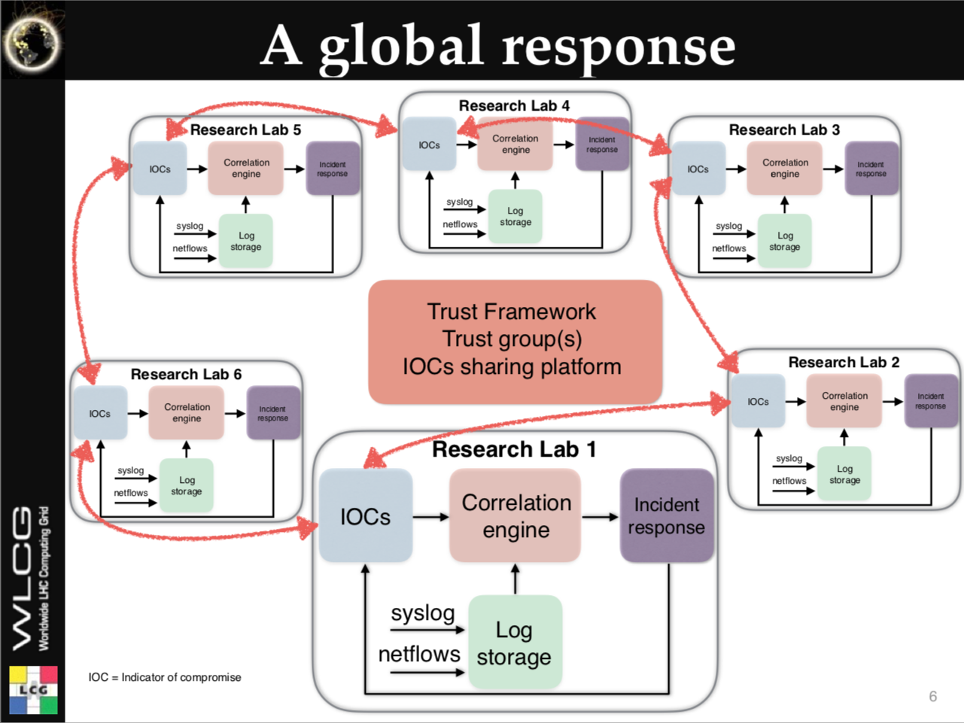
Motivation
The future of academic computing security
  Romain Wartel, CHEP2016

Slide 4
Motivation
Adversaries are motivated and well funded
  Cybercrime
  Better funded than us
Malware as a Service (MaaS)
  Ransomware
  Straightforward to spend a few dollars for a DoS
What do we have?
  Our community

Slide 5
Motivation
Within a given community (such as the WLCG), we see similar threats from similar actors
Acting together, we can establish common response mechanisms and support each other
By sharing threat intelligence we can better inform fellow sites to take action
  Active (firewall blocks)
  Passive (awareness and improved response)

Slide 6
Motivation
Grid and campus teams
Traditionally, haven’t always worked together
Additional benefit of threat intelligence
  Provide route to increase cooperation
  Grid team has intelligence
  Campus team has access to deeper (network) monitoring

Slide 7
Introduction
Key element: sharing between trusted parties
  How to achieve this?
WLCG already has a level of trust both
  via assertion
    I trust this organization so I trust this site
  years of effort

Slide 8
WLCG SOC WG
Working group designed to enhance site security monitoring in light of virtualized environments (including containers)
  Network monitoring
Coupled with threat intelligence and real time search capabilities
Minimally viable Security Operations Centre

Slide 9
WLCG SOC WG
Originally mandated to give guidance to WLCG sites
Area of work enhanced by including neighbouring communities
NRENs
University CSIRTs
Hoping to involve EGI Fedcloud

Slide 10
Security Operations Centre
The purpose of a Security Operations Center (SOC):
  Gather relevant security monitoring data from different sources
  Aggregate, enrich and analyse that data for use in the detection of security events and any subsequent actions
A SOC consists of a set of software tools and the processes connecting them

Slide 11
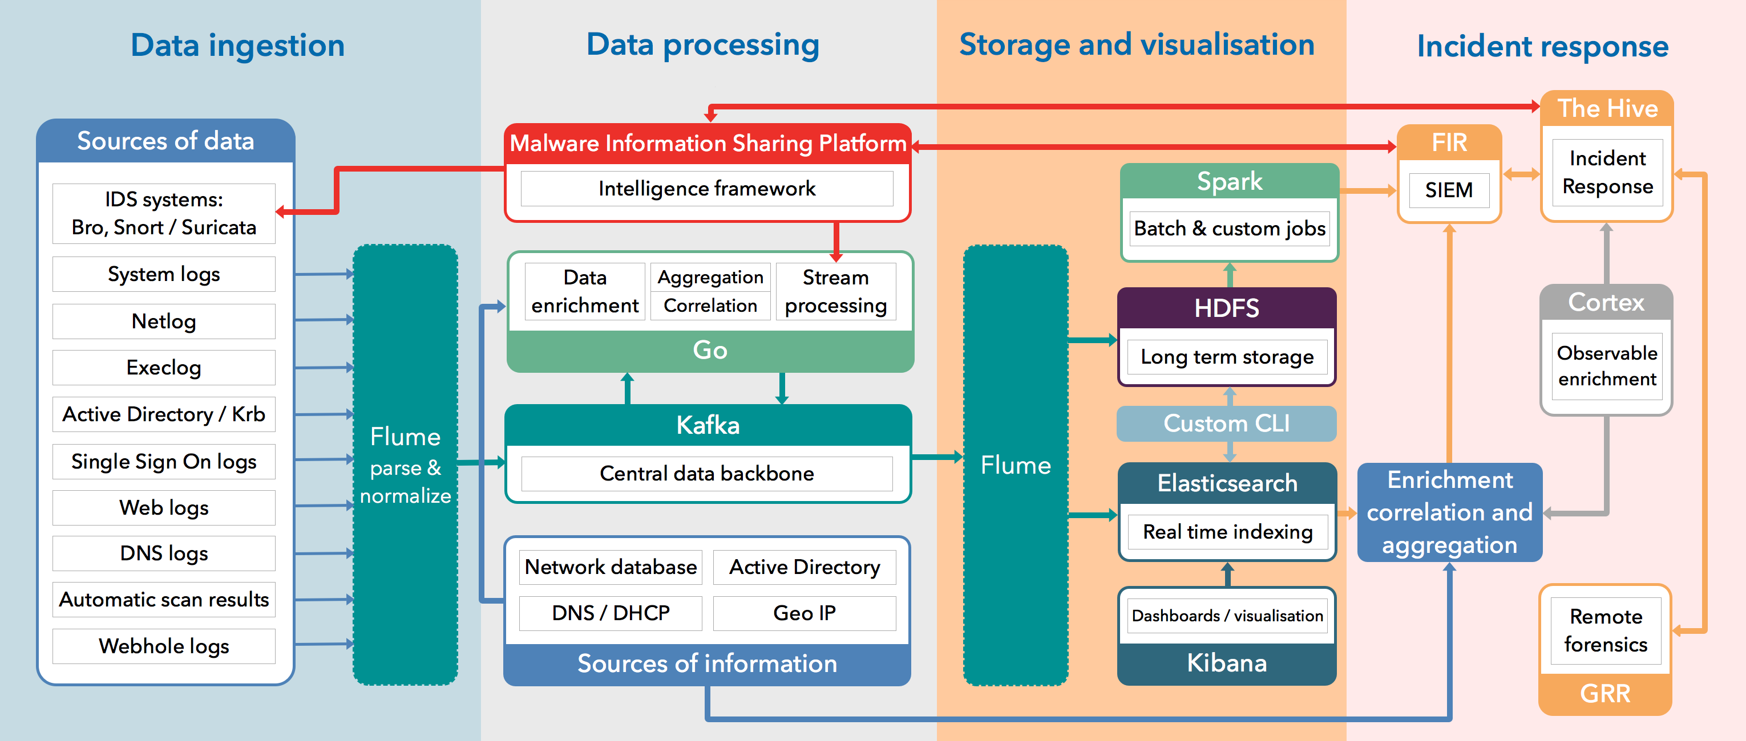
CERN SOC diagram

Slide 12
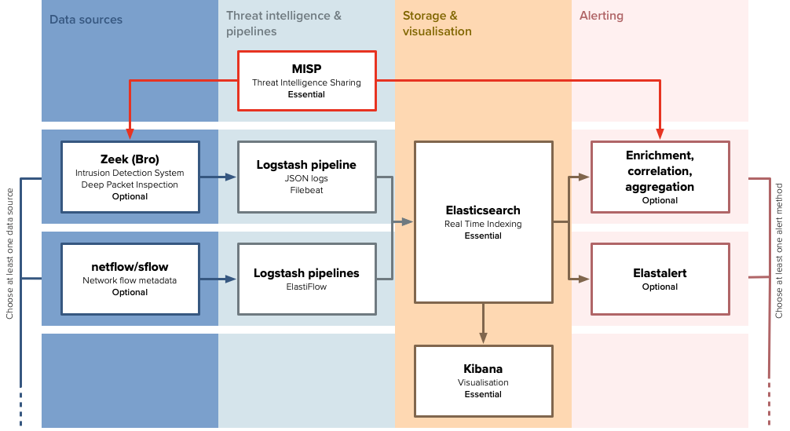
SOC WG Initial Model

Slide 13
SOC WG Initial Model
Define 4 stages
  Data sources
  Threat Intelligence and pipelines
  Storage and visualisation
  Alerting

Slide 14
SOC WG Initial Model
Define 4 stages
  Data sources
  Threat Intelligence and pipelines
  Storage and visualisation
  Alerting

Slide 15
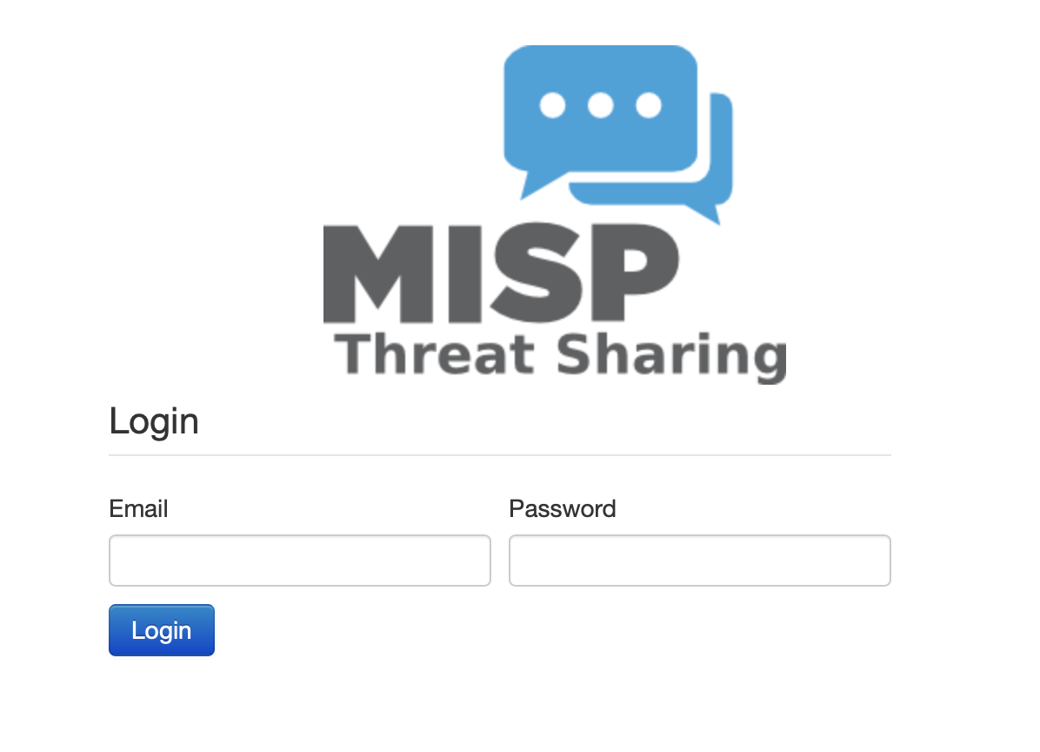
MISP
Malware Information Sharing Platform
  https://misp-project.org

Slide 16
WLCG MISP instance
Initial sharing model
  Hub and spoke
  Benefit from CERN trust frameworks and experience
TLP: GREEN and TLP:WHITE
  For now
Available to people via CERN SSO
  CERN accounts
  Federated ID with SIRTFI: https://technical.edugain.org/entities

Slide 17
WLCG MISP instance
Start with sites pulling event data from WLCG instance
Via
  web app (visually inspect data)
  API client (direct to IDS)

Slide 18
Current status
Currently have a handful of sites that have synced to WLCG instance
Most deployments in development phase
Following SOC Workshop in February focus on threat intelligence

Slide 19
PocketSOC
PocketSOC is intended as
  Demonstration of the individual components in the SOC initial model
  Testbed for adding new components (recently Elastiflow)
Docker cluster, orchestrated with docker-compose
Generally follows installation guides from wlcg-soc-wg-docs wherever possible

Slide 20
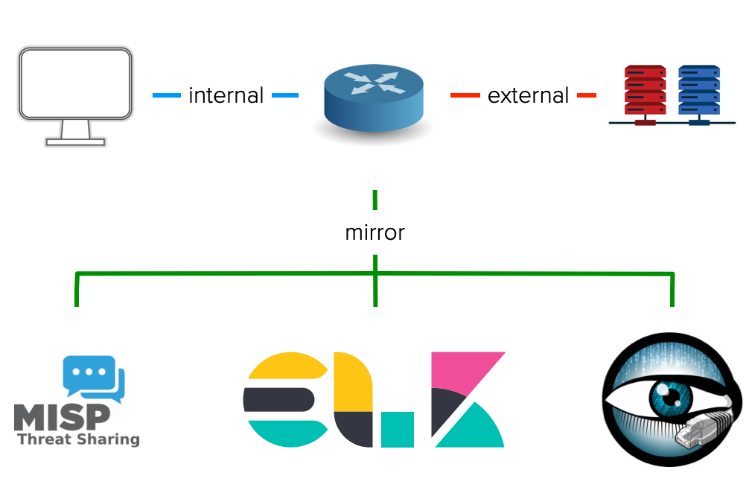
PocketSOC block diagram

Slide 21
Recent updates
Project to explore a SOC deployment at Nikhef (a student working on it)
Another project to deploy a SOC at the STFC Cloud – graduate started work
  also working on other aspects of the Cloud
Deployment of CERN alerting scripts at AGLT2

Slide 22
Recent updates
PocketSOC
ISGC Security Workshop
  Ingest stored packet capture pcap files
Last week
  Ingest malware analysis traffic pcap
  Locally import actual MISP event
  Triggered intelligence hits within Zeek
  Hope to use to demonstrate “real” events

Slide 23
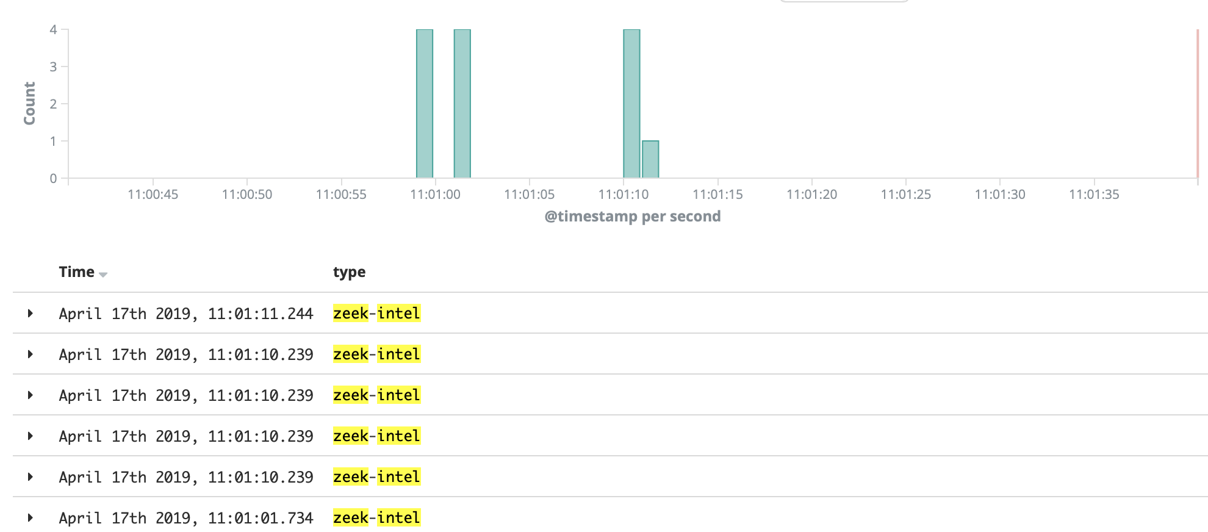
Recent updates

Slide 24
Recent updates
Next workshop
  Planning underway for SOC WG Workshop Nikhef in October following HEPiX meeting
  Focus on Threat Intelligence
  Dates around 21-23 October
  Timing and agenda to be confirmed
    But informed by meetings such as this

Slide 25
Conclusion
The technology to share intelligence exists and is mature
  In use in many communities already
  We can benefit from this!
Alongside this, have initial model to use threat intelligence at site level

Slide 26
Contact details
Main working group page
  https://wlcg-soc-wg.web.cern.ch
Documentation
  https://wlcg-soc-wg-doc.web.cern.ch
PocketSOC
  https://gitlab.cern.ch/wlcg-soc-wg/PocketSOC

