Slide 1


Australian Access Federation Update
John Scullen & Nick Rossow
OCTOBER 2023

Slide 2







Agenda
Technical Developments
Trust & Identity for NCRIS
Policy Work
Incubators

Slide 3

Australian Access Federation (AAF) on a page
AAF is Australia's leading provider of identity and access management services to the education and research sector.
We make it easy for researchers and students to securely access education and research institutions nationally and internationally.
1
FEDERATION
Single sign on for authentication and access to over 1.5 million users
2
ORCID
National consortium lead for ORCID in Australia
3
TRUST & IDENTITY
Access and authentication for national research infrastructure in Australia

Slide 4
CILogon (and COmanage) Penetration Test
Scope
  Web application
  User roles (researcher, community manager, CO admin, platform admin)
  Core API (most c
  Management API

Slide 5
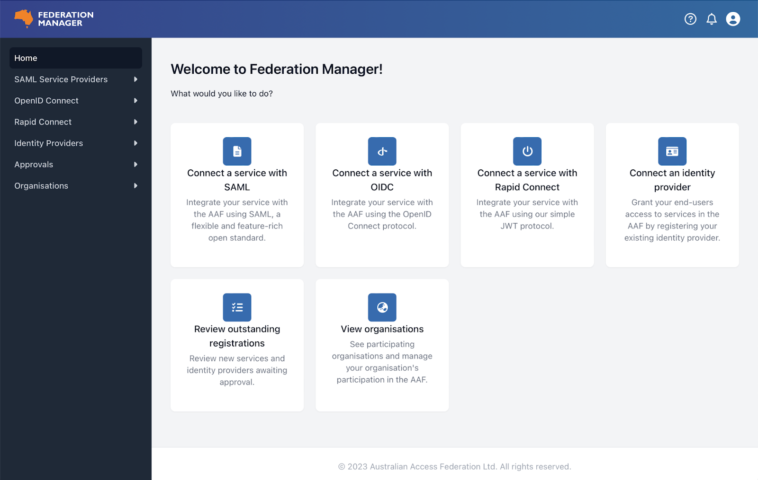
Federation Manager

Slide 6
Proxy improvements
Current proxies
  JWT
  OIDC
SAML proxy coming soon
  integrate services that assume a single SAML IdP (eg. AWS Cognito, Salesforce)
Other improvements under development:
  DS page describes the target service (not the proxy)
  service-by-service attribute release configuration
  service-by-service publication to eduGAIN
  F-Ticks data about the target service, not just the proxy

Slide 7
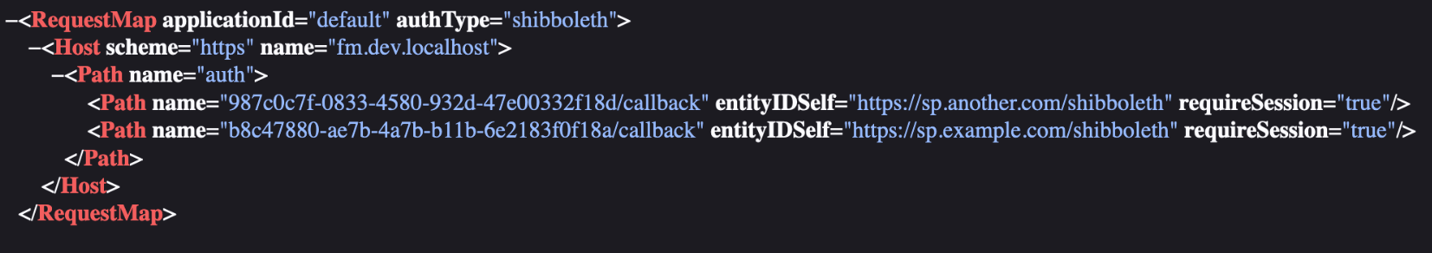
Synthetic EntityIDs
SAML RequestMap

Slide 8

Trust & Identity for NCRIS

Slide 9

Who, what and why
National Collaborative Research Infrastructure Scheme
10-year Roadmap
25 National Research Infrastructures
2021 Roadmap called out Trust and Identity

Slide 10


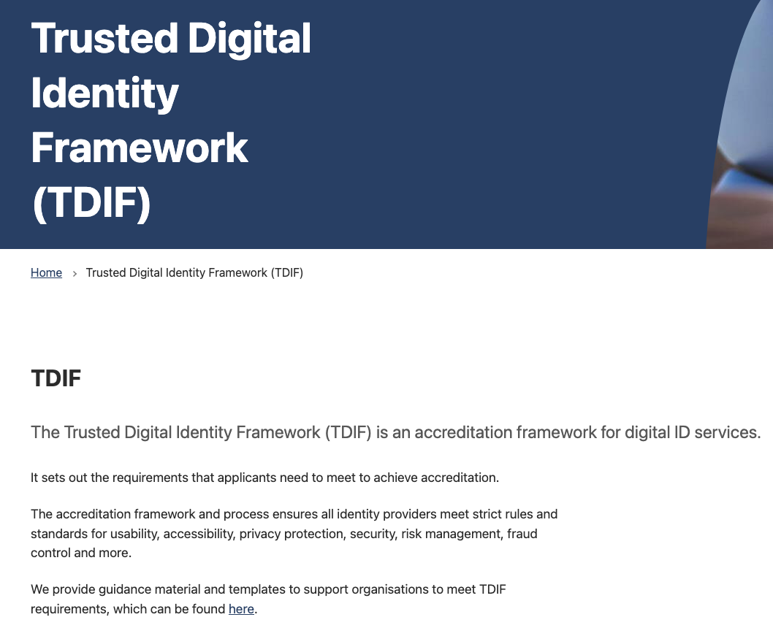

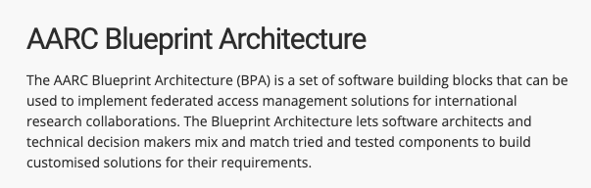
Why Trust & Identity now?

Slide 11



Progress
WORKING GROUP
Provide an opportunity for NRI to have valuable input into the design and make up of the Framework.
INCUBATOR
Test and demonstrate the capabilities and benefits of the T&I Framework.
SHOWCASE
Showcase the project to the broader NCRIS infrastructure community, to foster relationships with experts and identify potential project collaborators.

Slide 12




Approach
1
NATIONAL TRUST & IDENTITY FRAMEWORK
2
ACCELERATOR COMPONENTS
3
INCUBATORS

Slide 13

Any questions?
trust_identity@aaf.edu.au
trust@aaf.edu.au

