Slide 1
WHAT IS REFEDS?
Heather Flanagan, REFEDS Coordinator
11 October 2023, REFEDS 47 at the eduGAIN Town Hall / REFEDS meeting

Slide 2
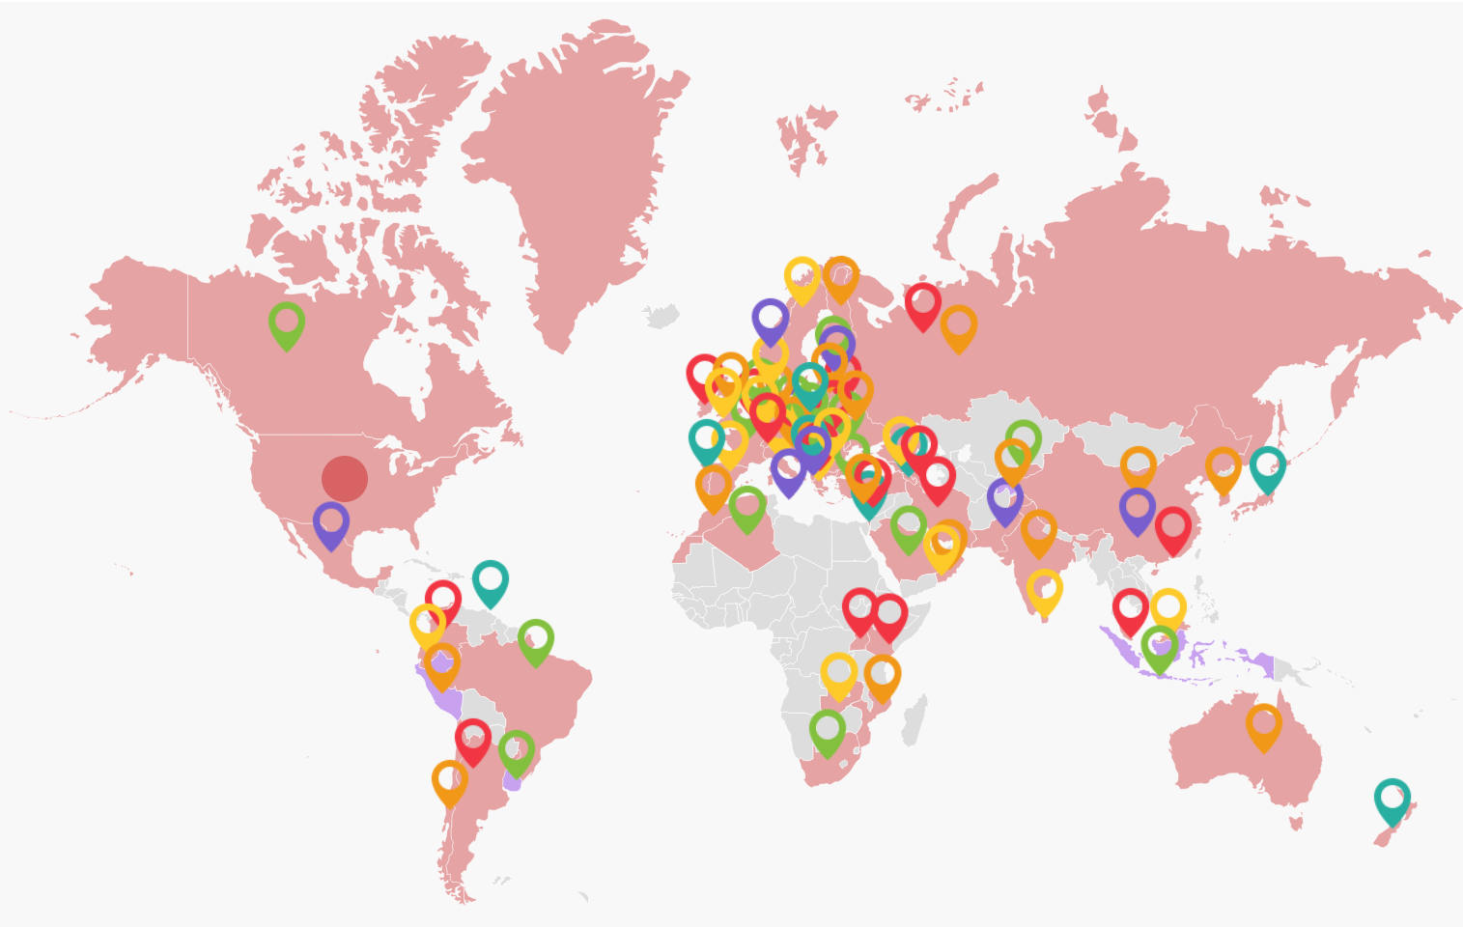
OUR COMMUNITY

Slide 3




Sponsors
Notes:
Happy to announce a new Bronze sponsor: KIFÜ, the NREN and federation for Hungary!
What sponsors get to do:
A seat on the REFEDS sponsor committee;
• Recognition of sponsorship at the given level on the REFEDS website;
• An annual report from REFEDS on the work carried out within any given year with the detailed break down of the expenditures;
• The opportunity to approve the workplan and priorities proposed by the REFEDS Steering Committee;
• The opportunity to nominate candidates for the REFEDS Steering Committee

Slide 4
REFEDS Steering Committee
Pål Axelsson (SUNET) (2018 - 2023)
Maarten Kremers (SURF) (2016-2023)
John Scullen(AAF) (2023-2025)
Alex Stuart (2022-2025)
Albert Wu (Internet2) (2020 - 2025)
…
Nominations are now open for 2024-2026
Notes:
REFEDS Participants nominate candidates to fill these vacancies. Each candidate must be supported by at least one sponsor.

Slide 5

https://refeds.org/strategic-plan

Slide 6
CORE VALUES
Trust: through openness, transparency, and pragmatism in everything we do;
Community: we are an enthusiastic, collaborative and inclusive community that makes strategic decisions based on consensus; and
Leadership: we are global leaders with expertise in trust and identity.

Slide 7
CRITICAL SUCCESS FACTORS
Sustainable Standards Development Process and Adoption
Meeting Attendance and Community Representation
Supporting and Educating Stakeholders

Slide 8
PARTICIPANT’S AGREEMENT
Objectives
REFEDS mailing lists, website, and meetings
REFEDS Participants
REFEDS Sponsors
Annual REFEDS workplan and budget
Funding of the annual REFEDS workplan
REFEDS Steering Committee
Annual report
Intellectual Property Rights (IPR)
REFEDS Working Group

Slide 9
WORKING GROUPS
Assurance Working Group (open).
MFA Subgroup (open).
MRPS Update (open).
Browser Changes and Federation (open).
FOG - Federation Operators Group (by nomination only; see group page for membership requirements).
SPOG - SP Operator Group (see group page for membership requirements)

Slide 10
  SCHEMA EDITORIAL BOARD
The REFEDS Schema Editorial Board is responsible for the various schema managed and maintained by the REFEDS community
Schemas currently under REFEDS SEB management
eduPerson
voPerson
SCHAC

Slide 11
  SPECIFICATIONS
TYPE: SAML Entity Category
Research & Scholarship (R&S)
Anonymous Access, Pseudonymous Access, and Personalized
Hide From Discovery
Code of Conduct v2 (also a Best Practice)
TYPE: SAML Entity Attribute
SIRTFI v1 & v2
TYPE: Metadata Extension Schema
Security Contact Metadata Extension Schema

Slide 12
  SPECIFICATIONS
TYPE: Framework
Assurance
Baseline Expectations
TYPE: Profiles
MFA
SFA
Error Handling
TYPE: Schema
eduPerson
SCHAC
voPerson

Slide 13
  2024 PLANNING
Understanding the REFEDS Work Planning Process (17 November 2022) – YouTube, Slides
Are there areas where new policy or best practice guidance would help federations?
Are there special interest groups that could form to help answer technical questions?
What new technologies should federations be preparing for? What will that preparation look like?

Slide 14
  MORE INFO AND USEFUL LINKS
REFEDS Strategic Plan
  https://refeds.org/strategic-plan
2024 REFEDS Planning Documents
  https://wiki.refeds.org/display/WOR/2024+Work+Plan+Preparation
REFEDS Wiki
  https://wiki.refeds.org
Mailing list
  https://lists.refeds.org/sympa/info/refeds
Slack channel
  because of course there is
YouTube channel
https://www.youtube.com/@REFEDS

Slide 15
  SCHEMA BOARD
REFEDS Schema Board-managed schema:
eduPerson
voPerson
SCHAC
Board members:
David Bantz (U. Alaska) (2019-2024)
Alan Buxey (UNiDAYS) (2019-2025)
Keith Hazelton (Internet2) (2019-2025)
Christos Kanellopoulos (GÉANT) (2020-2024)
Benn Oshrin (SCG) (2019-2025, Chair)
Mark Rank (Cirrus Identity (2022-2024)
Mario Reale (GARR-GEANT) (2019-2025)
Terry Smith (AAF) (2019-2025)
Heather Flanagan (ex officio, Secretary)
https://wiki.refeds.org/display/STAN/Schema+Editorial+Board

Slide 16
  ENTITY CATEGORIES
Entity Categories = “group federation entities that share common criteria. The intent is that all entities in a given entity category are obliged to conform to the characteristics set out in the definition of that category.”
Hide from Discovery
REFEDS Data Protection Code of Conduct
Research & Scholarship
Anonymous Access
Pseudonymous Access
Personalized Access

Slide 17
  REFEDS 47 Agenda
Morning Sessions
Afternoon Sessions
DFN eduID Project
RENATER?
AAF Update
InCommon Update
eduID.cz Update
Jisc Update
IDEM Update
SURF Update
LAIFE Update
SAFIRE Update
WAYF
Questions to Federation Operators
Baseline Expectations Update
Baseline Expectations at InCommon
Assurance Working Group Update
Assurance at SWAMID
Seamless Access Update
FedCM
Outcomes from the GÉANT Incubator
Lobbying for Change

