Slide 1
SeamlessAccess Update

Slide 2
SeamlessAccess
Project updates
Browser changes
Development roadmap

Slide 3
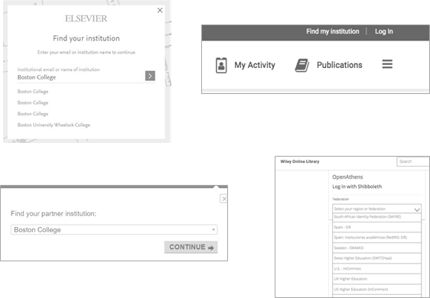


Why SeamlessAccess?
SeamlessAccess is about improving access to online content and services for researchers:
Improve the access user experience, both on- and off-campus, making it easier for researchers to benefit from federated authentication
Enable continued identity federation infrastructure and standards development
Improve campus response to security incidents; limit site-wide disruption caused by abuse by individuals

Slide 4
SeamlessAccess is not…
A Federation | SeamlessAccess consumes metadata from federations including eduGAIN, OpenAthens etc.
An Authentication Service | SeamlessAccess gets the user to their IdP; SeamlessAccess does not have anything to do with the authentication process itself
A Data Collection Service | SeamlessAccess neither sees nor collects any user information; the only information it sees and stores is the user’s choice of IdP

Slide 5
What is SeamlessAccess?
An IdP Discovery Service
An Access button
A Persistence Service

Slide 6

What is SeamlessAccess?
An IdP Discovery Service
An Access button
Standard visual cue
Context-aware
Integrated into SP access flow
A Persistence Service

Slide 7
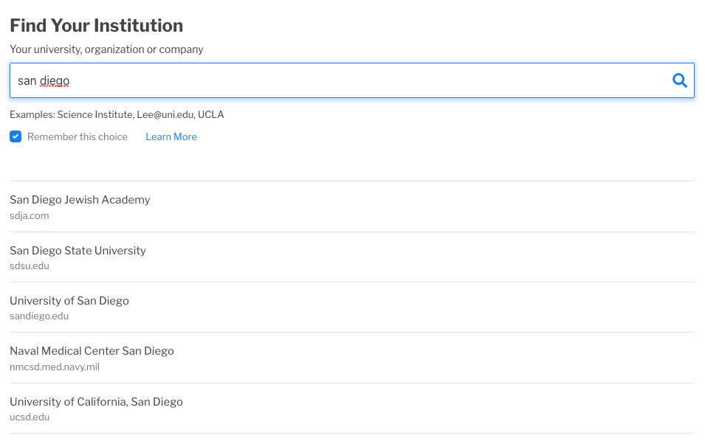
What is SeamlessAccess?
An IdP Discovery Service
An Access button
A Persistence Service
Standardized, best-practice method to find your institution
Try it out: https://service.seamlessaccess.org/ds/

Slide 8
What is SeamlessAccess?
An IdP Discovery Service
User’s choices of IdP stored in Local Browser Storage
Only accessible by SeamlessAccess.org and approved integrators
Privacy-preserving
User can opt out
An Access button
A Persistence Service

Slide 9
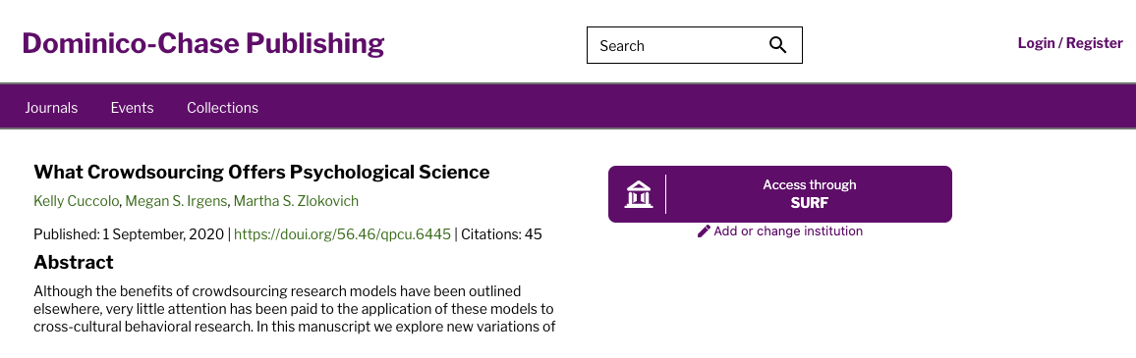
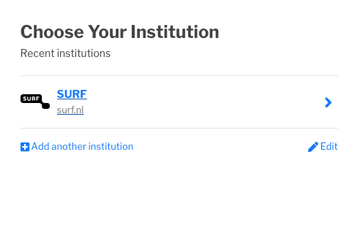
Three different flavours: Standard
Customized SeamlessAccess button (with remembered IdP) pointing to SeamlessAccess IdP discovery service
https://demo.seamlessaccess.org/custom-seamlessaccess-button

Slide 10
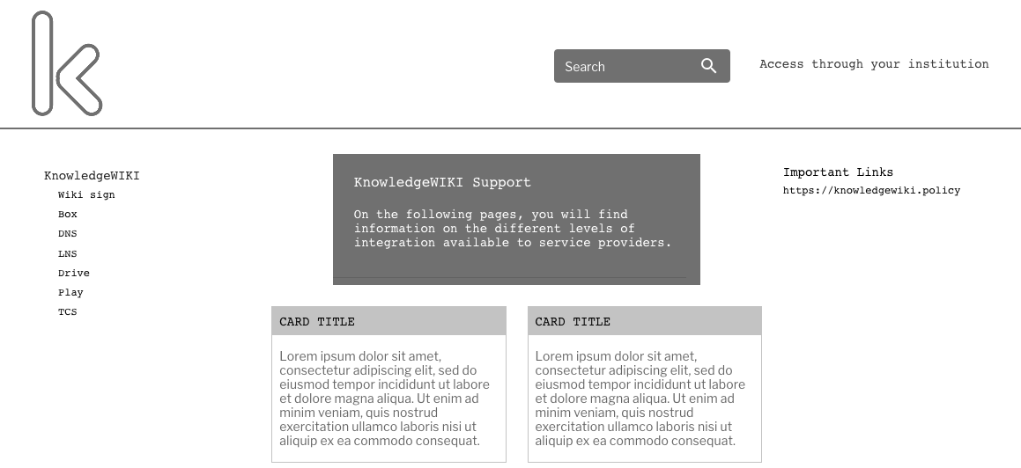
Three different flavours: Limited
Custom text link points to standard SeamlessAccess IdP discovery service
https://demo.seamlessaccess.org/custom-link

Slide 11
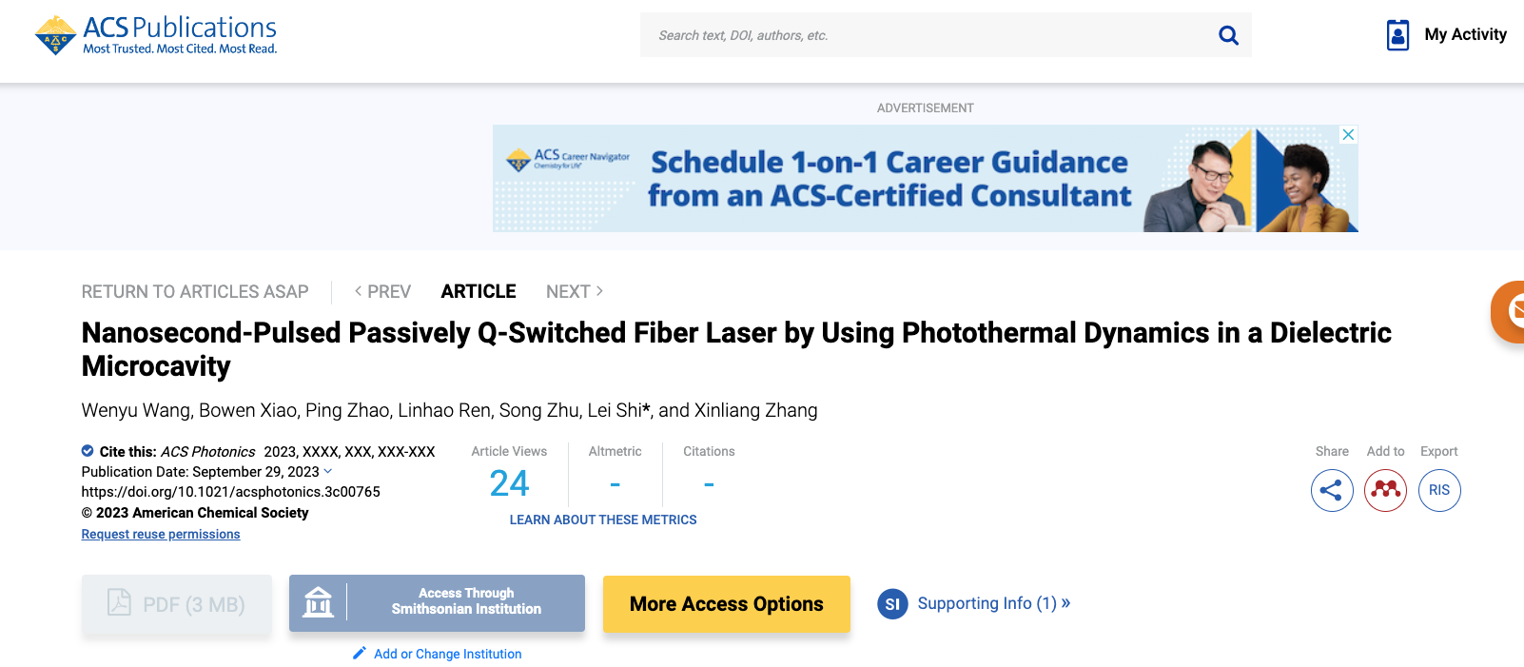
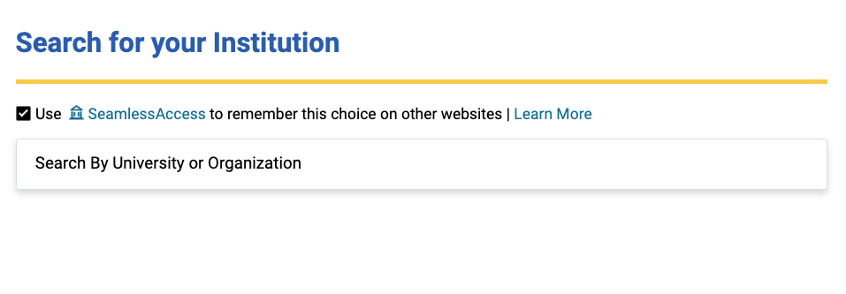
Three different flavours: Advanced
Locally implemented SeamlessAccess button (with remembered IdP) pointing to Service Provider’s own IdP discovery service (with own metadata)
https://demo.seamlessaccess.org/custom-seamlessaccess-button

Slide 12
Functionality per integration model
Button
Persistence
IdP Discovery
Metadata
Integration Model | Seamless- Access button | Locally managed button | 1st-party (seamless-access.org) | 3rd-party access | Seamless-Access IdP Discovery Service | Local IdP Discovery Service | Seamless- Access managed metadata | Locally managed metadata
Limited |  |  | Yes |  | Yes |  | Yes
Standard | Yes |  | Yes |  | Yes |  | Yes
Advanced |  | Yes |  | Yes |  | Yes |  | Yes

Slide 13
Functionality per integration model
Button
Persistence
IdP Discovery
Metadata
Integration Model | Seamless- Access button | Locally managed button | 1st-party (seamless-access.org) | 3rd-party access | Seamless-Access IdP Discovery Service | Local IdP Discovery Service | Seamless- Access managed metadata | Locally managed metadata
Limited |  |  | Yes |  | Yes |  | Yes
Standard | Yes |  | Yes |  | Yes |  | Yes
Advanced |  | Yes |  | Yes |  | Yes |  | Yes
Greater flexibility & greater complexity

Slide 14
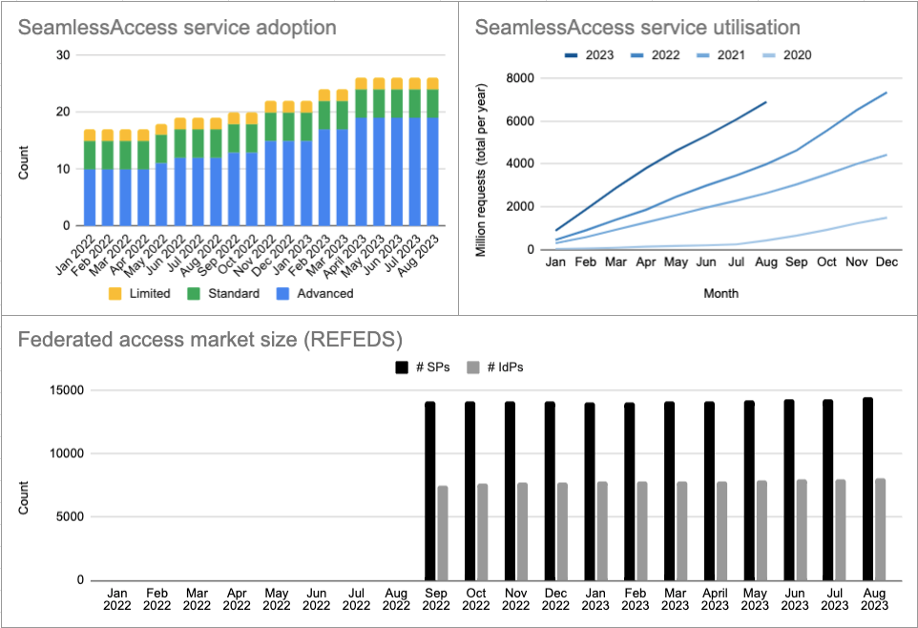
Adoption is steadily growing
Recent joiners:
NORDUnet (Finland, Denmark, Iceland, Norway, Sweden) switched to SeamlessAccess IdP service last month

Slide 15
Adoption is steadily growing
Recent joiners:
NORDUnet (Finland, Denmark, Iceland, Norway, Sweden) switched to SeamlessAccess IdP service last month
Over a beer 🍺

Slide 16
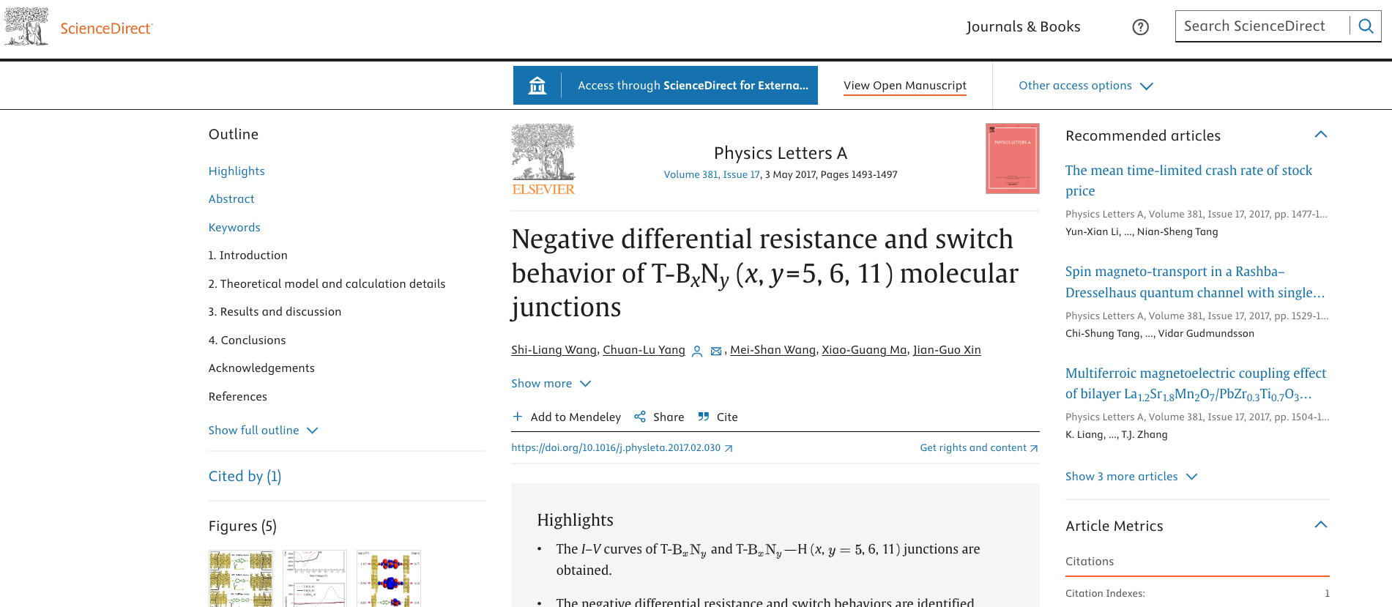
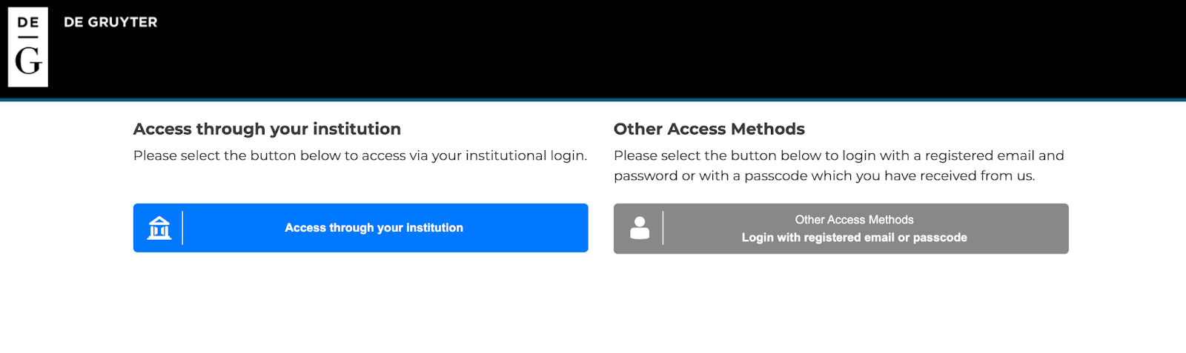
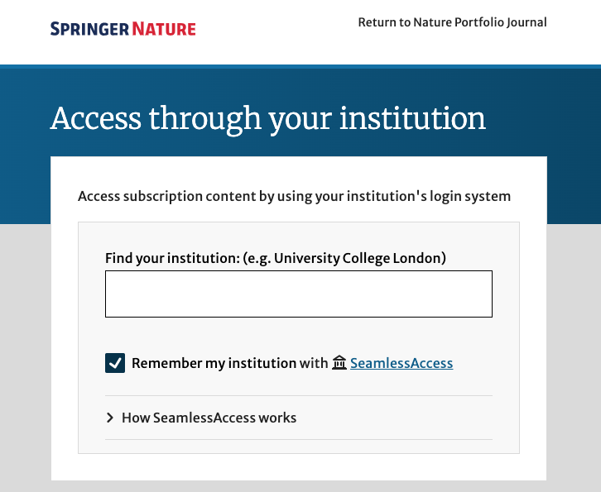
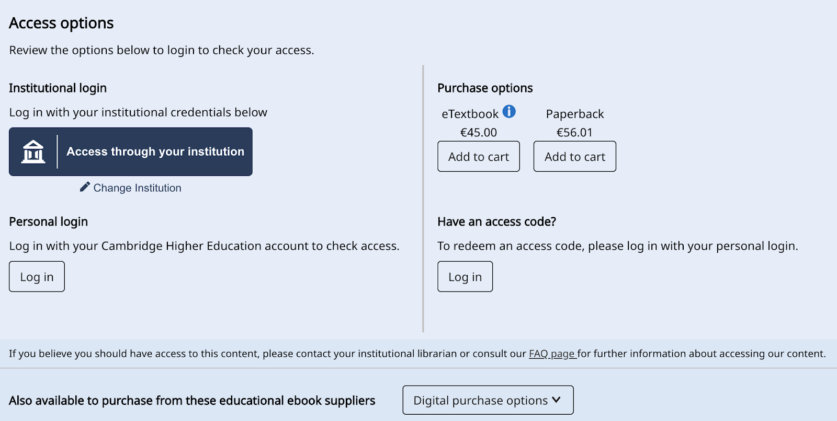
Adoption is steadily growing

Slide 17
Value for federations
SeamlessAccess is part of a virtuous circle that supports federated access:
Improve the access user experience, both on- and off-campus. Example: IOP Publishing reported 82% increase in use of federated access after implementing SeamlessAccess
Better user experience means value for Service Providers, making it easier and more beneficial for them to adopt federated access
More SP’s means more value for IdP’s to join federations

Slide 18
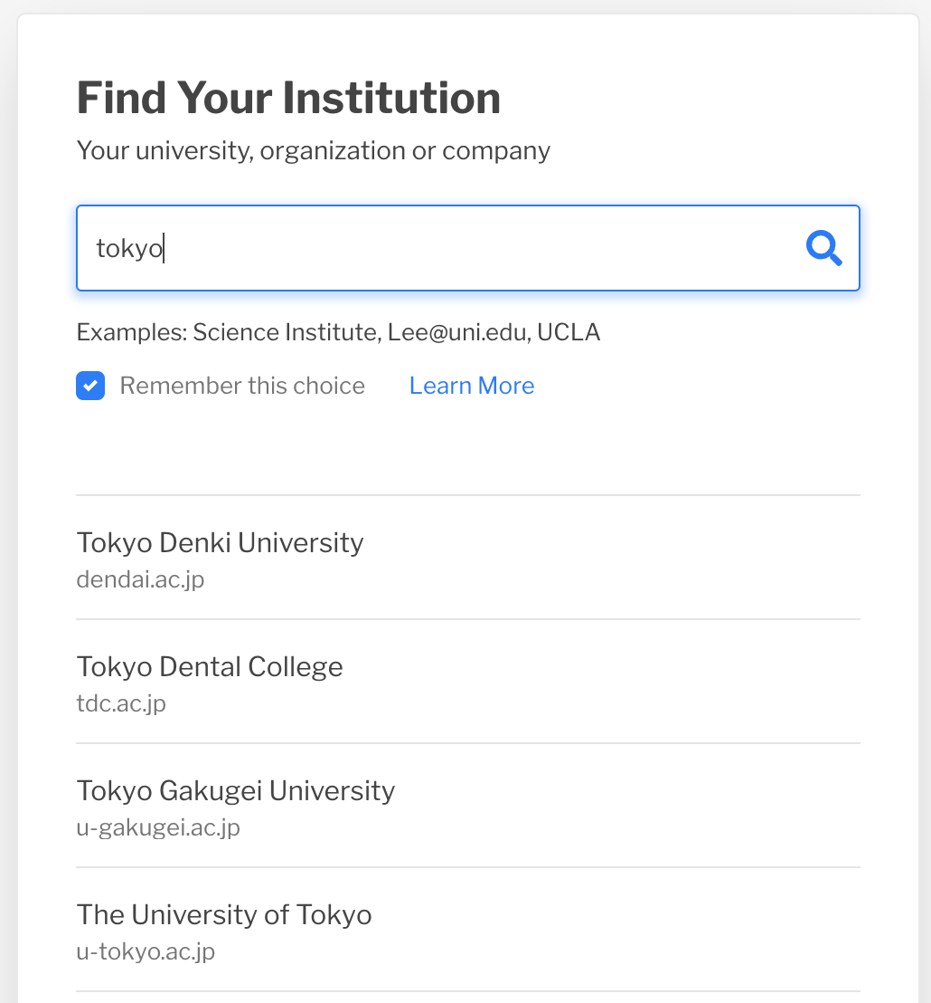
Value for federations
SeamlessAccess means you do not have to run your own federation discovery service:
As SeamlessAccess continues to enhance its Standard Integration with features like IdP Filtering, federations will be able to present IdPs only in their federation to interested Service Providers
Requires additions to metadata which federations will need to be prepare to support
Try it out here: https://service.seamlessaccess.org/ds/

Slide 19
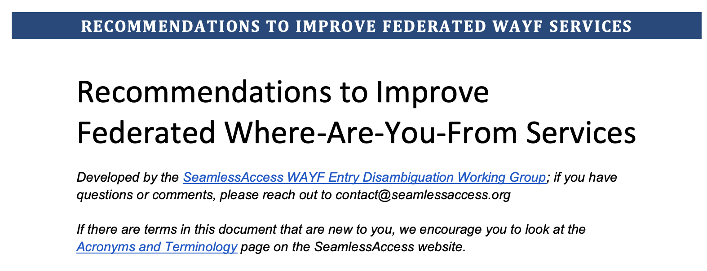
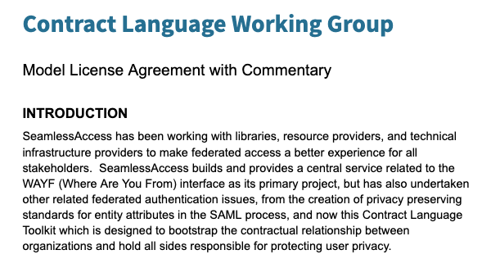
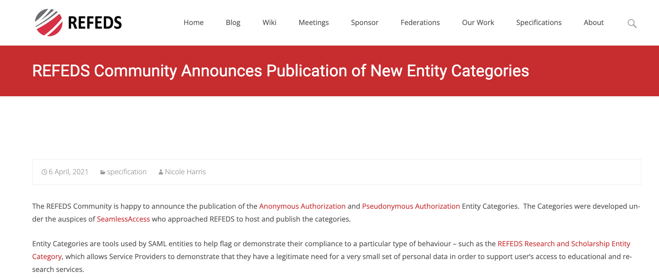
SeamlessAccess is more than a service
UX group

Slide 20
SeamlessAccess & browser changes

Slide 21

SeamlessAccess’ global persistence drives a network effect
User interaction on service A …
Improves the user experience on service B

Slide 22
This is likely to break

Slide 23
Functionality per integration model
Button
Persistence
IdP Discovery
Metadata
Integration Model | Seamless- Access button | Locally managed button | 1st-party (seamless-access.org) | 3rd-party access | Seamless-Access IdP Discovery Service | Local IdP Discovery Service | Seamless- Access managed metadata | Locally managed metadata
Limited |  |  | Yes |  | Yes |  | Yes
Standard | Yes |  | Yes |  | Yes |  | Yes
Advanced |  | Yes |  | Yes |  | Yes |  | Yes

Slide 24
Expected impact of browser tech changes
Button
Persistence
IdP Discovery
Metadata
Integration Model | Seamless- Access button | Locally managed button | 1st-party (seamless-access.org) | 3rd-party access | Seamless-Access IdP Discovery Service | Local IdP Discovery Service | Seamless- Access managed metadata | Locally managed metadata
Limited |  |  | Yes |  | Yes |  | Yes
Standard | Yes |  | Yes |  | Yes |  | Yes
Advanced |  | Yes |  | Yes |  | Yes |  | Yes
Green: no impact
Orange: degradation of functionality (not ‘smart’ anymore)
Red: will break

Slide 25
Expected impact of browser tech changes
Possible impact (worst case):
SeamlessAccess button will no longer be 'smart’ (i.e. showing the user’s remembered choice of IdP across different SPs)
Advanced integration pattern, combining SeamlessAccess and local metadata for a bespoke IdP discovery service and a global ‘remember me’ functionality, will break
What is not at risk?
Limited and Standard integration patterns with a static SeamlessAccess button
(which still brings huge UI standardization benefits)
SeamlessAccess central IdP discovery service (including central ‘remember me’ functionality)

Slide 26
Expected impact of browser tech changes
What are doing about this?
Support advocacy efforts; engagements with browser vendors, influence design choices, looking for alternative solutions to cross-site persistence,
Test emerging new technologies like FedCM
Reduce the feature gap between ‘Advanced’ and ‘Standard’ integration pattern, in particular the ability for an SP to customize the IdP discovery flow by combining SeamlessAccess and local metadata.

Slide 27
Development work

Slide 28
Product development roadmap
Q3 (2023)
Q4 (2023)
Website rework - demo-site and path for librarians
Pinning front-end
Filtering Front end & UX
Filtering backend
Filtering backend
Networking: Best practices
& user journey standardisation
UX/UI/guides best practices implementation
Reviewed path of new integrator
FedCM SA
prototyping
Notes:
Q4 “Filtering pre-relese”, “Filtering release”, “Best practices UX and better path for integrators”
Graphs used as estimates, does not represent exact development times

Slide 29
Product development roadmap
Q3 (2023)
Q4 (2023)
Website rework - demo-site and path for librarians
Pinning front-end
Filtering Front end & UX
Filtering backend
Filtering backend
Networking: Best practices
& user journey standardisation
UX/UI/guides best practices implementation
Reviewed path of new integrator
FedCM SA
prototyping
Notes:
Q4 “Filtering pre-relese”, “Filtering release”, “Best practices UX and better path for integrators”
Graphs used as estimates, does not represent exact development times

Slide 30
Product development roadmap
Q3 (2023)
Q4 (2023)
Website rework - demo-site and path for librarians
Pinning front-end
Filtering Front end & UX
Filtering backend
Filtering backend
Networking: Best practices
& user journey standardisation
UX/UI/guides best practices implementation
Reviewed path of new integrator
FedCM SA
prototyping
Notes:
Q4 “Filtering pre-relese”, “Filtering release”, “Best practices UX and better path for integrators”
Graphs used as estimates, does not represent exact development times

Slide 31
Product development roadmap
Q3 (2023)
Q4 (2023)
Website rework - demo-site and path for librarians
Pinning front-end
Filtering Front end & UX
Filtering backend
Filtering backend
Networking: Best practices
& user journey standardisation
UX/UI/guides best practices implementation
Reviewed path of new integrator
FedCM SA
prototyping
Notes:
Q4 “Filtering pre-relese”, “Filtering release”, “Best practices UX and better path for integrators”
Graphs used as estimates, does not represent exact development times

Slide 32
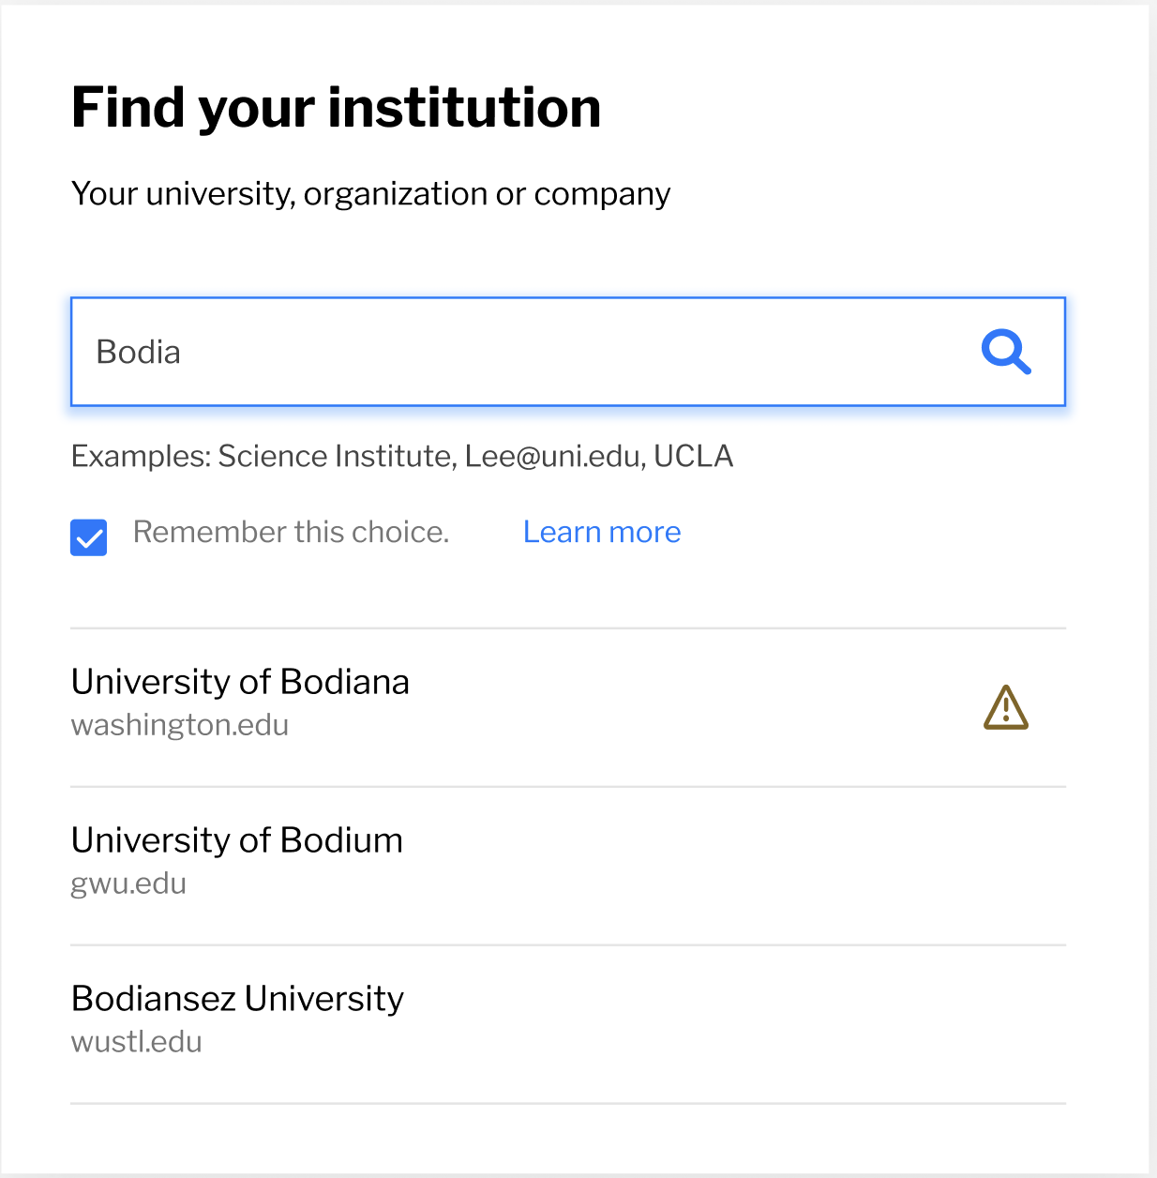
IdP filtering
‘Filtering out’: Lets the SP deselect IdPs from SeamlessAccess standard metadata - for example to reduce ambiguity for the user
Key development priority
Requirement for many SPs within GEANT and Internet2 community
Reduces the functional gap between ‘Standard’ and ‘Advanced’ integration patterns

Slide 33
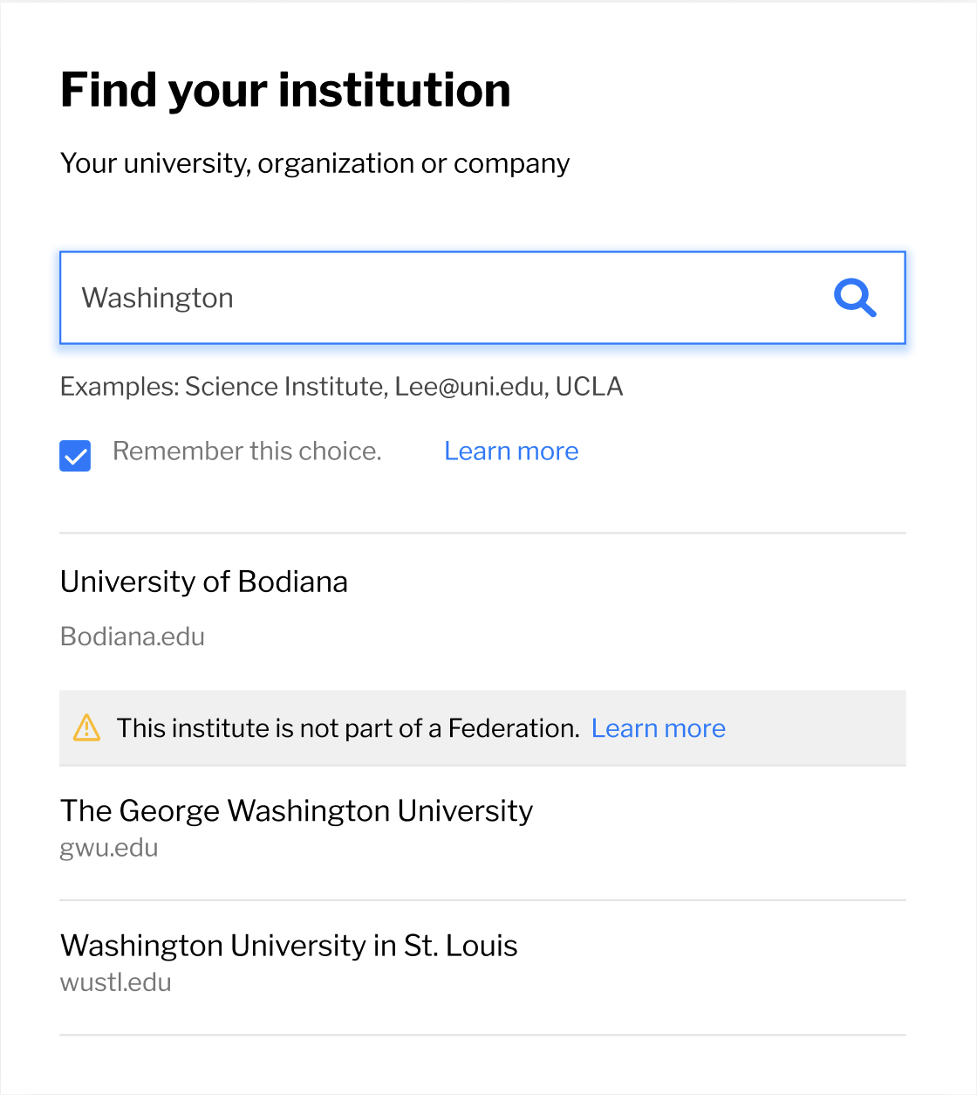
IdP filtering
Key development priority
Requirement for many SPs within GEANT and Internet2 community
Reduces the functional gap between ‘Standard’ and ‘Advanced’ integration patterns
‘Filtering in’: Lets the SP add IdPs from outside the scope of SeamlessAccess standard metadata - for example to add corporate or social logins

Slide 34
IdP filtering
Roll-out plan
Firm up and deploy IdP filtering into SeamlessAccess ‘standard’ service
Trial (live) with 2 or 3 selected SPs - selected by GEANT and Internet2 - to validate that everything works as expected
Roll out to 10-20 SPs, monitor onboarding time per SP to see if we need more support staff
Staggered roll-out, wave by wave, size of wave TBD by what we learn in Q1

Slide 35
Product development priorities 2024
FedCM prototyping
Roll out IdP filtering
Explore connections with wallets
Notes:
Q4 “Filtering pre-relese”, “Filtering release”, “Best practices UX and better path for integrators”
Graphs used as estimates, does not represent exact development times

Slide 36



Who is SeamlessAccess?
A coalition of 4 founding organizations:
Community-driven effort to support seamless access to information resources, scholarly collaboration tools, and shared research infrastructure.

Slide 37
Thank you!
Any questions? Let’s discuss

Slide 38
Thank you!
hylke@stm-solutions.org

