Slide 1
GAMon:
Accounting and Monitoring for the GARR Cloud
Francesco Lombardo and Marco Lorini
GARR

Slide 2


Outline
Introduction
Objectives
GAMon
Architecture
Current status
Next steps
Notes:
AGENDA SLIDE

Slide 3
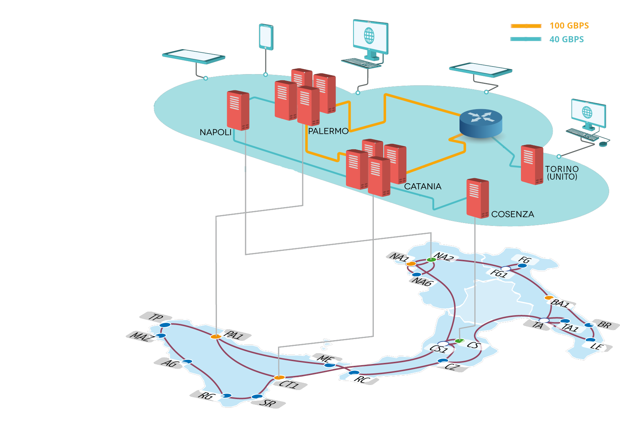
Introduction
Services:
  IaaS
  Object Storage
Cores: 11500
RAM: 90 TB
Storage: 16.3 PB (15% SSD)
GPU: 333 TFlop

Slide 4
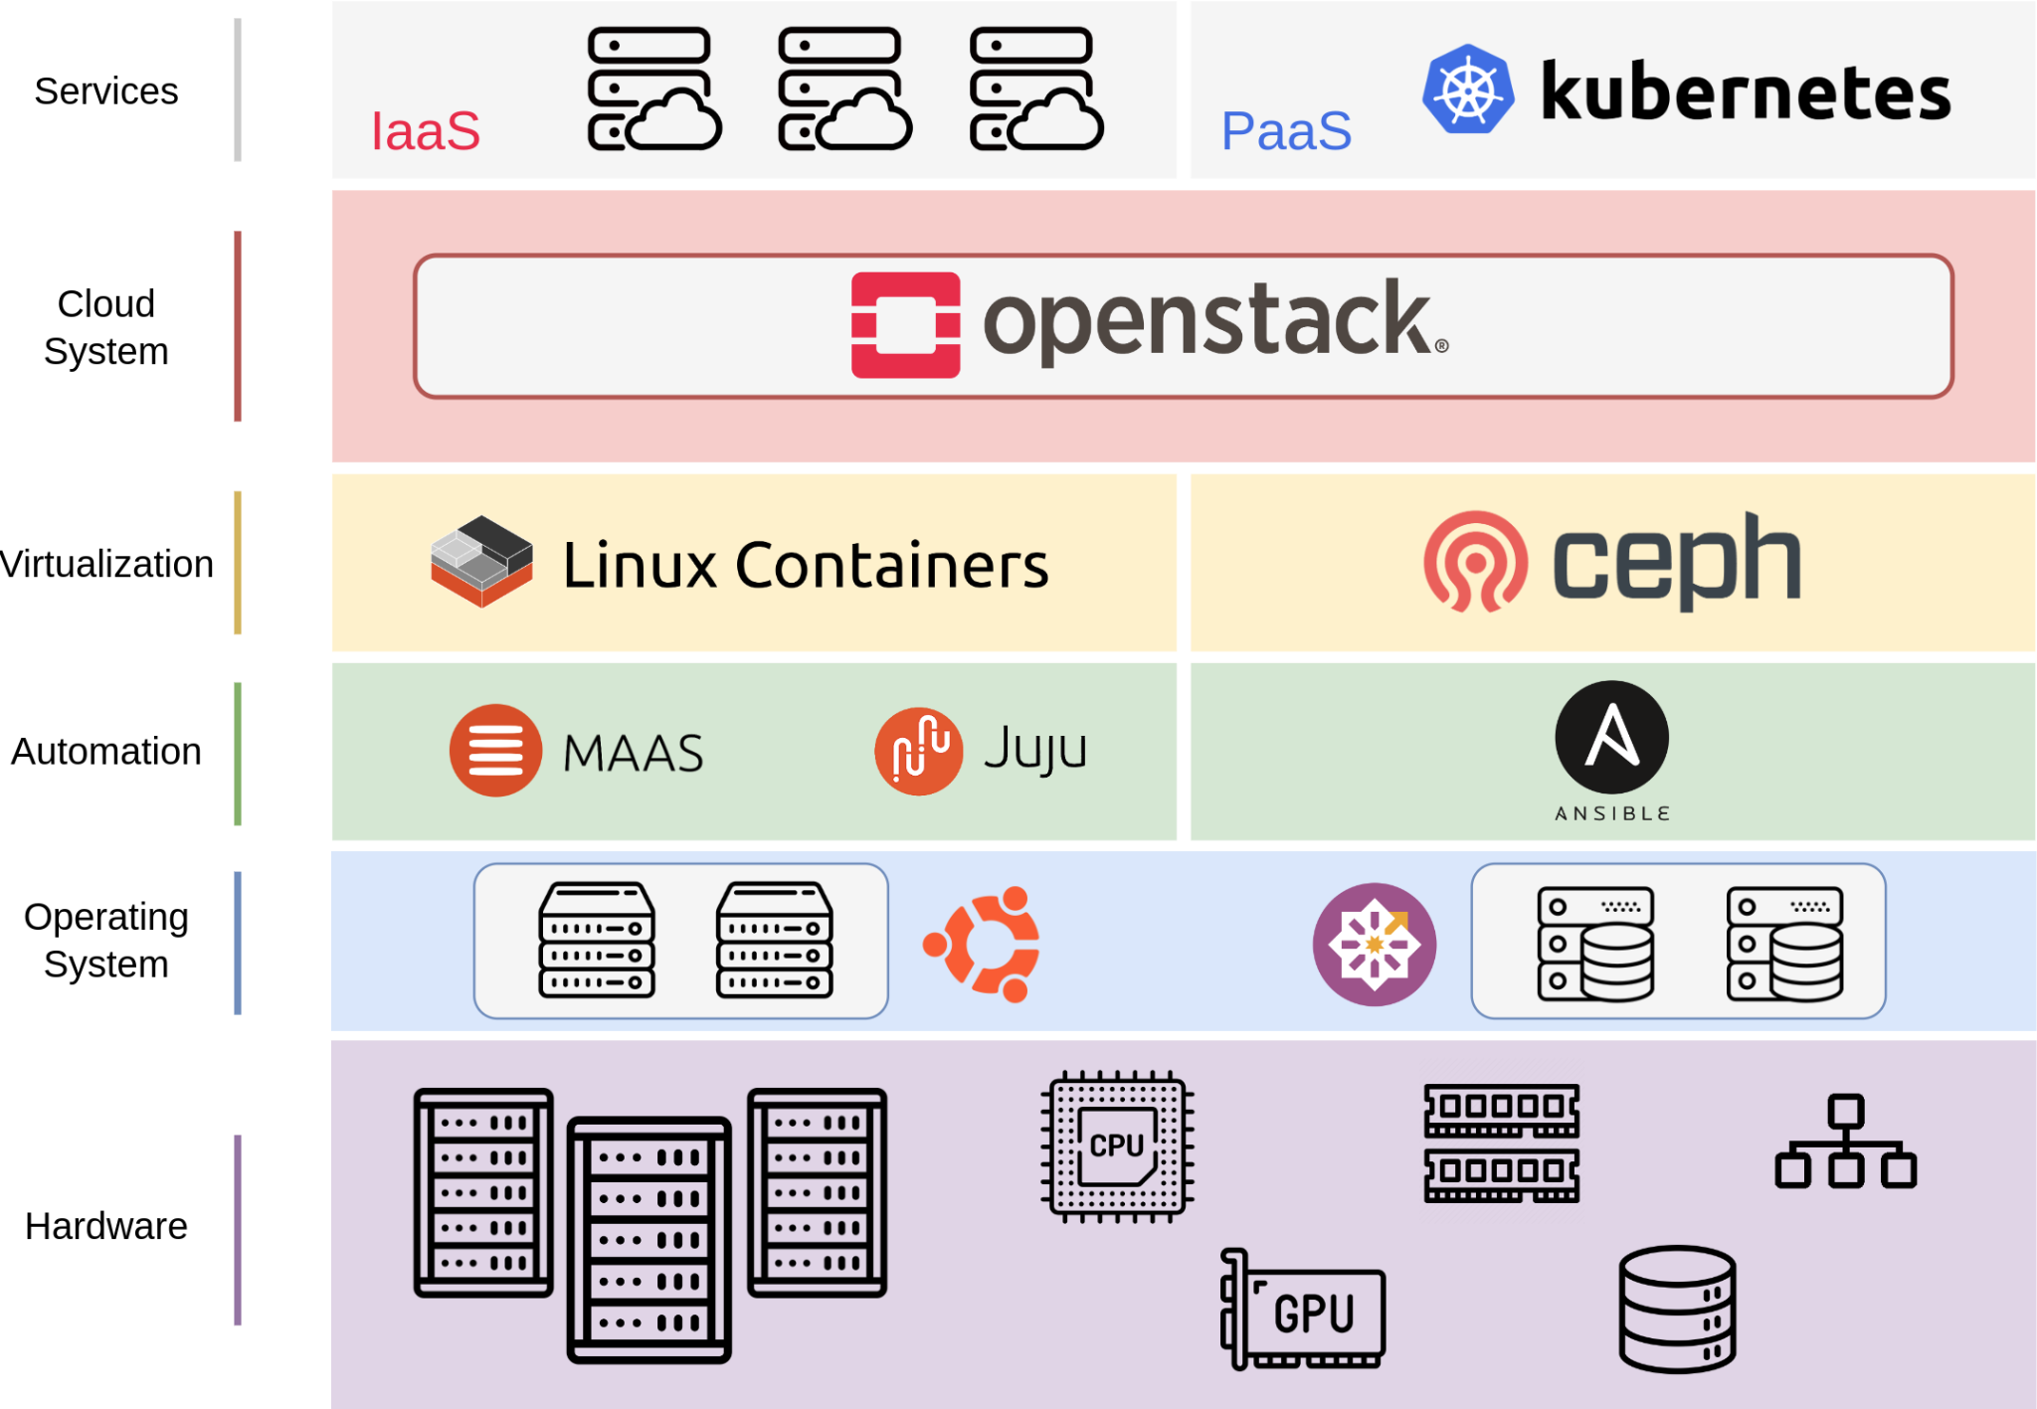
Introduction

Slide 5

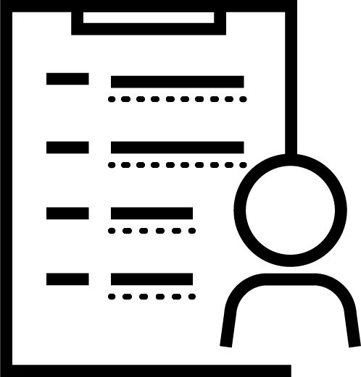

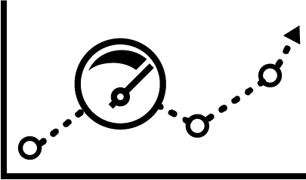
Introduction
Users
Institutions
Services Users
Services
IaaS (vDC)
Object Storage
Accounting
Agreements
Mandatory for the Activation of Cloud Services
Terms of the Service
Resources
Duration of the Agreement
History of Agreement Changes
Monitoring

Slide 6
Introduction
Physical Infrastructure
Compute
Storage
Network
Accounting
Cloud System
OpenStack Services
Ceph Services
User Services
vDC
Object Storage
Monitoring

Slide 7
Objectives
Creation of a data aggregation platform
Efficiency and Optimization of Current Processes
Giving Visibility Outside the Group of Systems Engineers
Accounting
GARR Users: Institutions and Universities
Cloud Users: O~S Users
Active Services
Assigned Quotas and History Changes
Active Agreements
Monitoring
Services Status: vDC, O~S Project and Object Store
Resources: Quota, Allocation and Usage
History Changes
Security Incidents

Slide 8








GAMon (GARR Cloud Accounting & Monitoring)
Functional Aspects
Data Collection
Data Viewing and Search
Reports
Fine Grained Roles
Administrative and Technical
Different Levels of Granularity and Aggregation Criteria
Accounting and Monitoring Data with Different Aggregation Criteria
Different Data Access Roles

Slide 9




GAMon (GARR Cloud Accounting & Monitoring)
Technical Aspects
Modular
Cloud Native
API First
Authn & Authz
Microservices Architecture
Microservices and Containers
OpenAPI Standard
IDEM Authentication
and
Granular Authorization

Slide 10
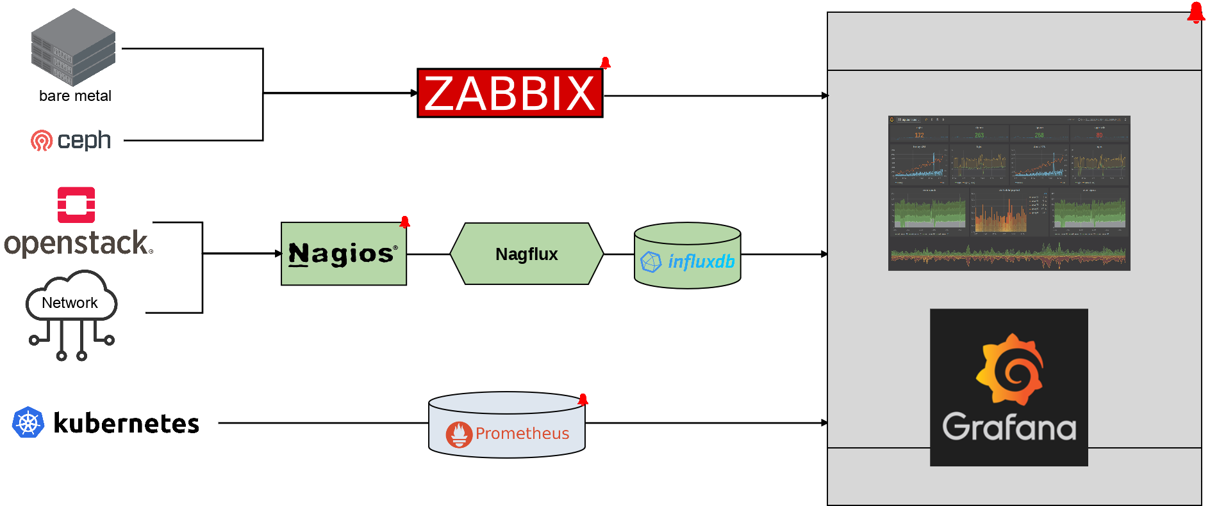
Old Monitoring Architecture

Slide 11
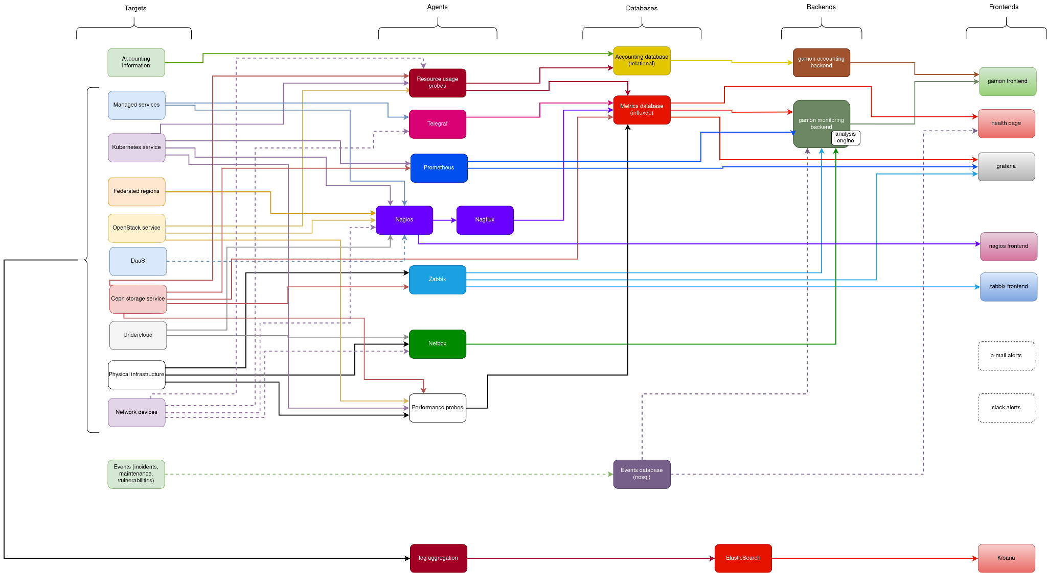
Overview New Architecture

Slide 12
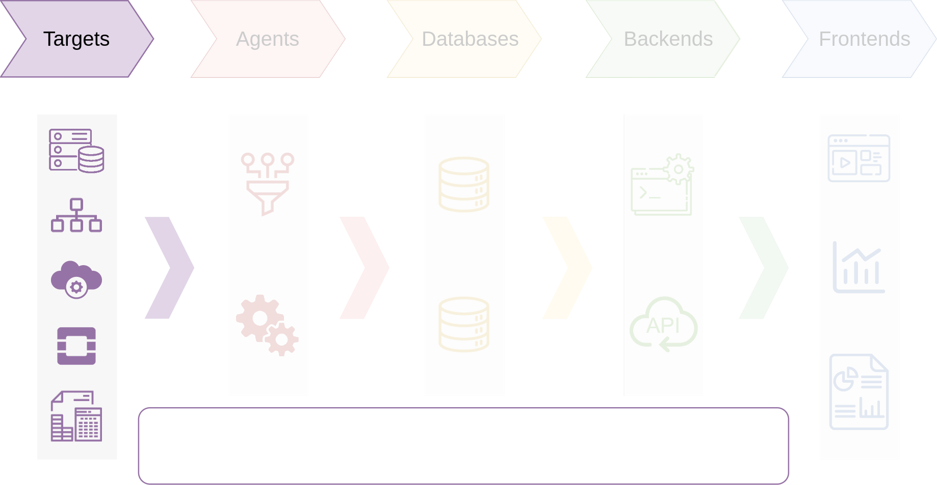
Workflow - Targets
Accounting Data
Physical Infrastructure
Network Devices
OpenStack Services
Ceph

Slide 13
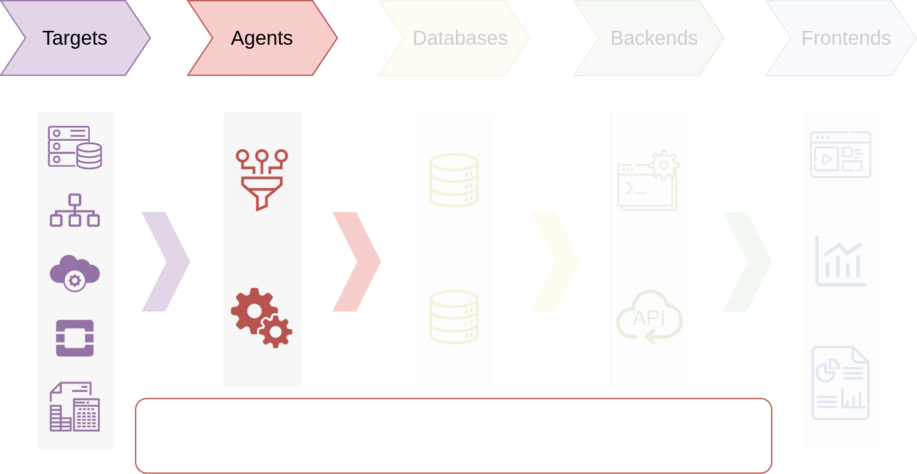
Workflow - Agents
Agents:
Resource usage
Nagflux
Telegraf
Performance Probes
Operations:
Collecting
Filtering
Refinement
Storing

Slide 14
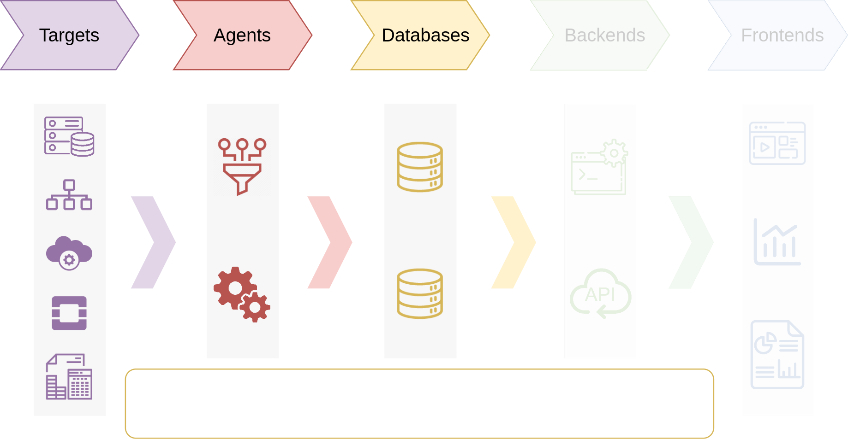
Workflow - Databases
Time Series Database ( InfluxDB ): Monitoring Data
Relational Database ( PostgreSQL ): Accounting Data
NoSQL Database ( MongoDB ): Events

Slide 15
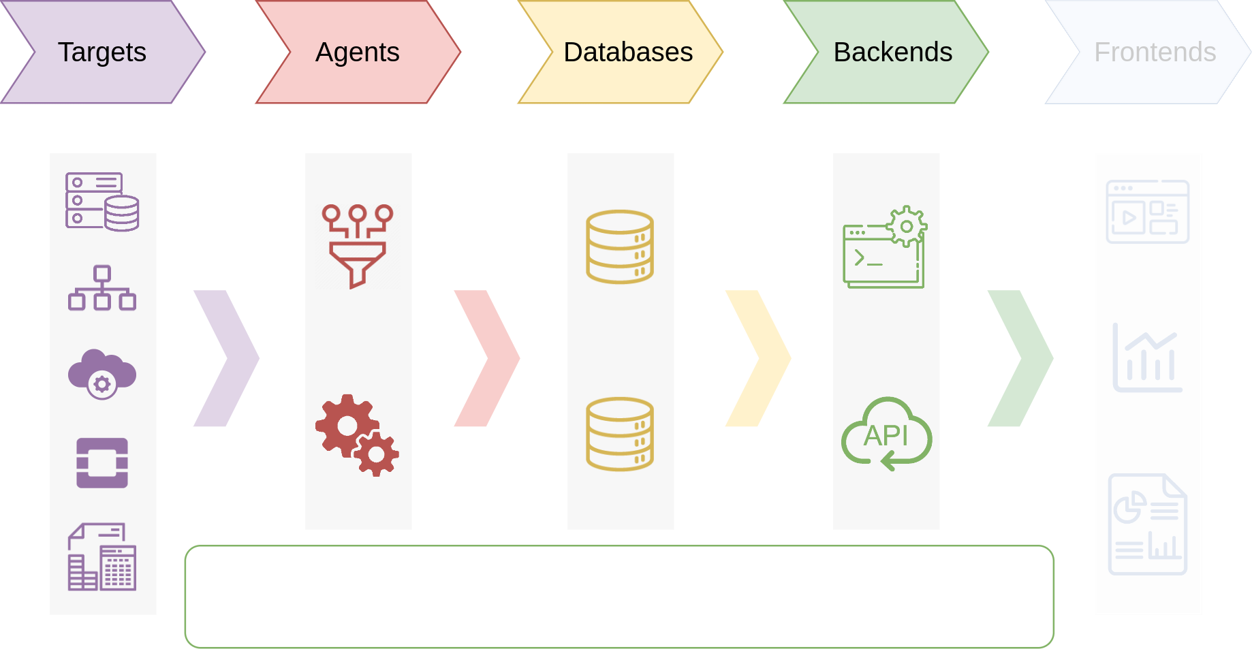
Workflow - Backends
Microservices:
Accounting BE
Monitoring BE

Slide 16
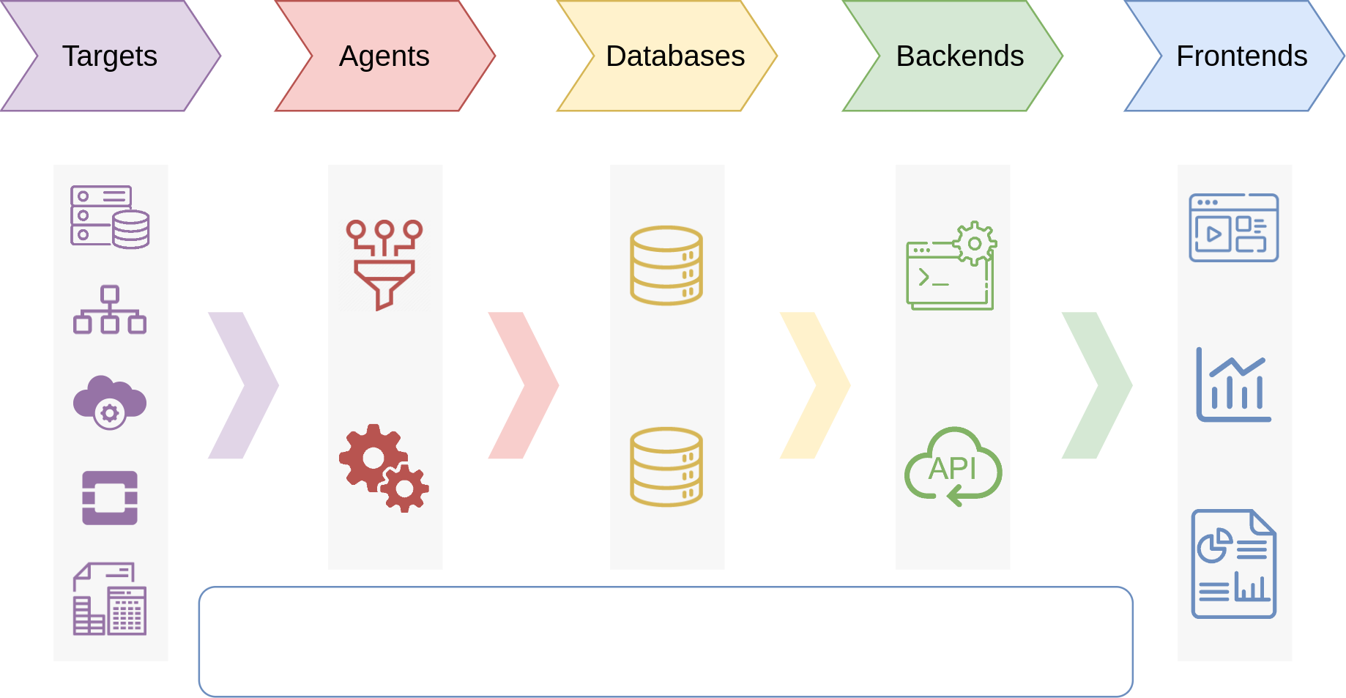
Workflow - Frontends
GAMon Dashboard
Public Health Page
Grafana

Slide 17
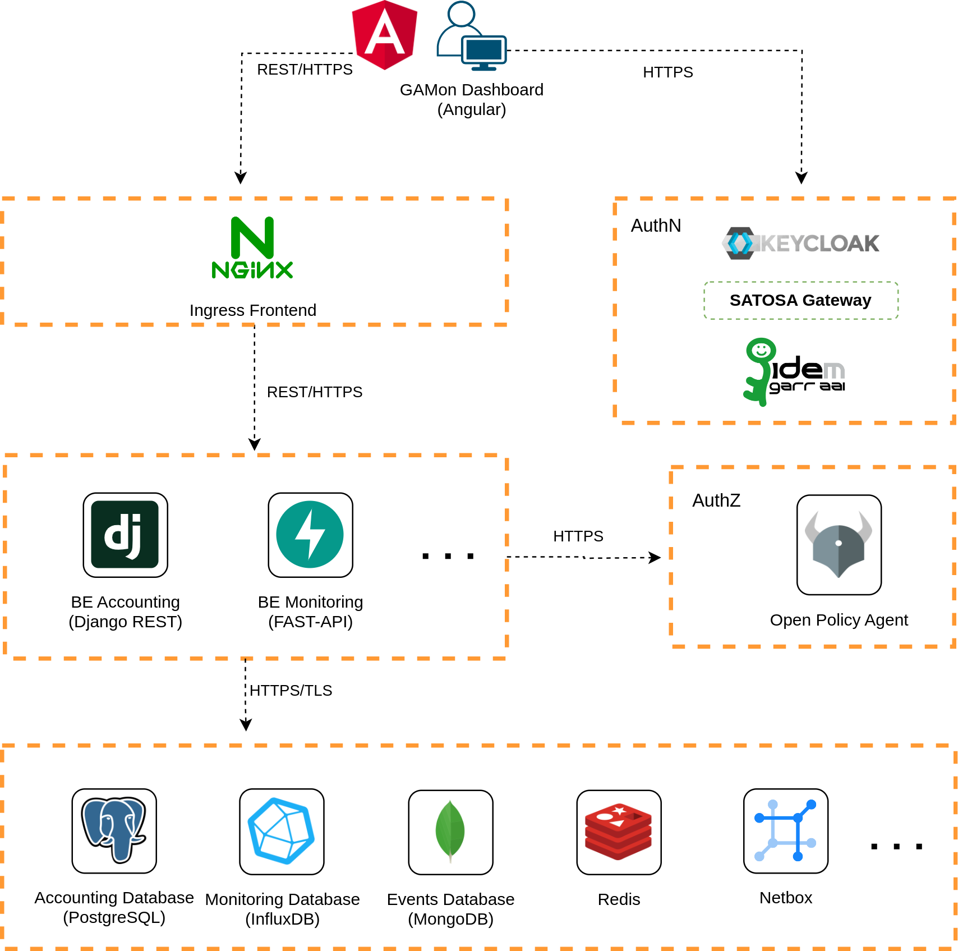
Microservices Architecture

Slide 18
Microservices Architecture
Accounting Data
Relational Database PostgreSQL
Monitoring Data
Time Series Database InfluxDB
Events Data
NoSQL Database MongoDB
Redis
Cache
Netbox
Physical Infrastructure

Slide 19
Microservices Architecture
Frontend
Angular Framework
Ingress
Nginx
Accounting BE
Django REST
Monitoring BE
FAST-API
REST API
OpenAPI Standard

Slide 20
Microservices Architecture
OpenID Connect
Dashboard Client OIDC
Authentication
Keycloak +
Satosa Gateway + IDEM
Authorization
Open Policy Agent: Policy-Engine for Cloud Native Environments

Slide 21
Current Status - GAMon v0.4.0
Accounting
Institutions: Search, Details
Person: Search, Details
Agreements: Search, Details
vDC: Search, Details, Quotas History
Object Storage: Search, Details, Quotas History
Reports: ex. Aggregation of Resource Usage Grouped by Institution
Monitoring
Services status: vDC and Object Store
vDC: Allocation and Usage,
Observability up to the O~S Projects
Object Storage: Allocation and Usage
Allocation and Usage Aggregation: ex. Grouped by Institution
Floating IP: Search, History of Association States with Tenants
O~S Stats

Slide 22
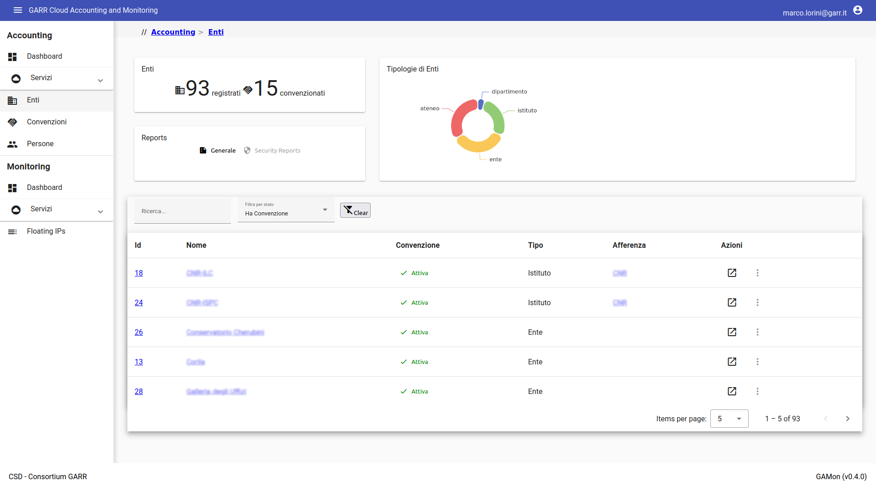
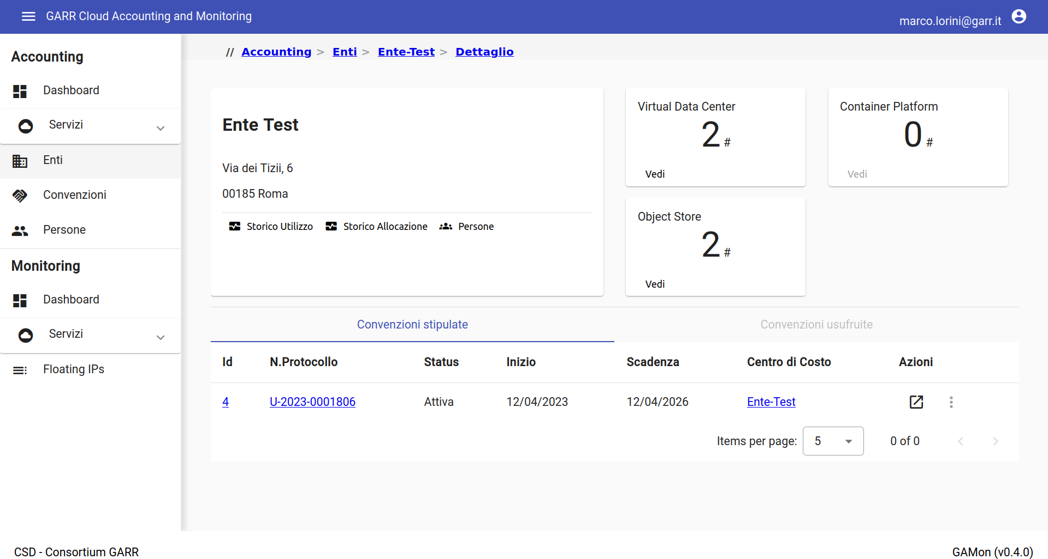
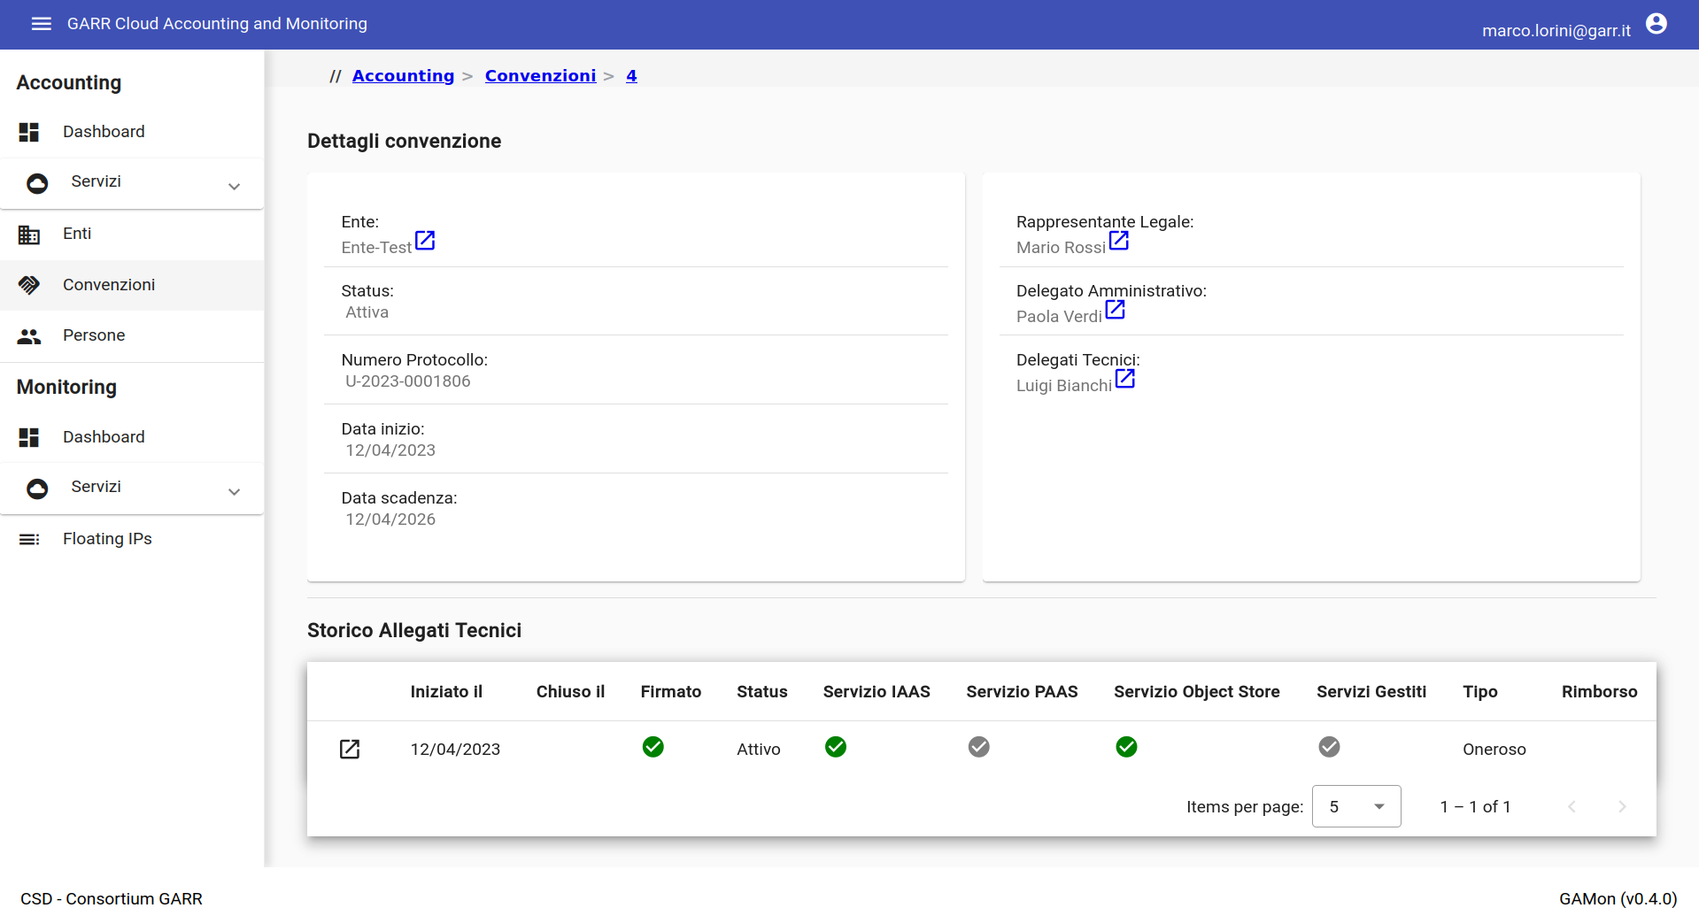
Current Status - GAMon v0.4.0
Institutions list
General Information about Registered Institutions, Search by Name and Affiliated Institutions
Institutions details
Details about Institution, Active Services and General Informations about Agreements (Stipulated or Benefited)
Agreements
Agreement Details and Show
the Technical Annex History

Slide 23
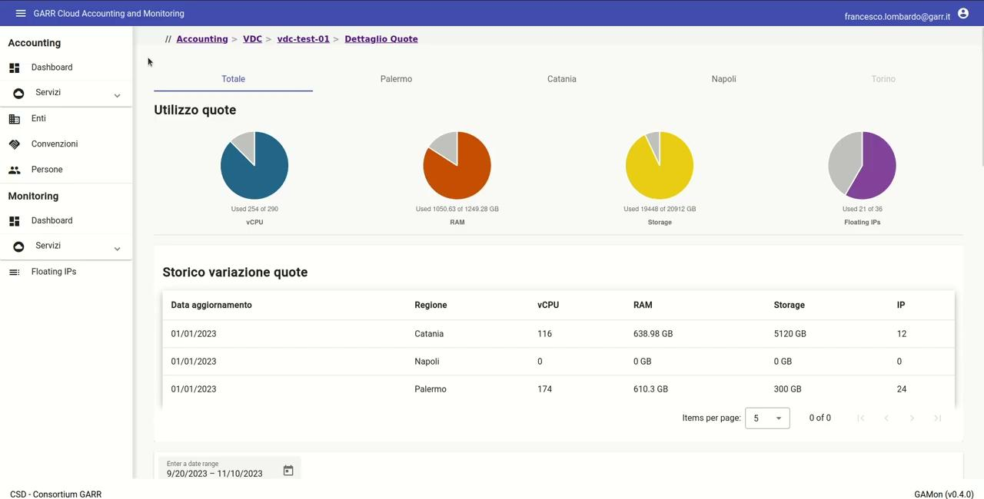

Slide 24
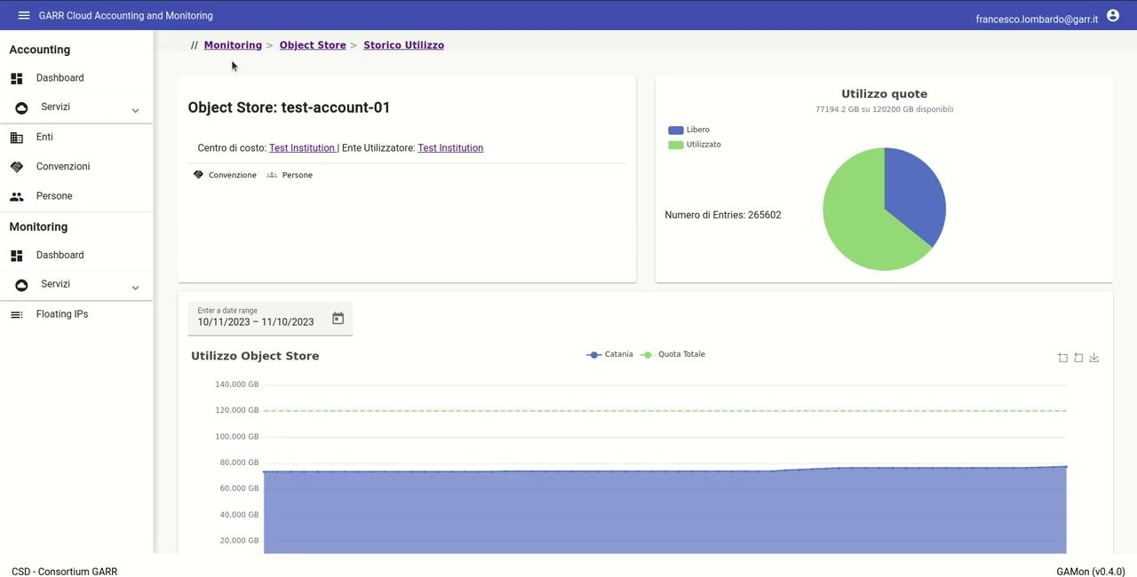
Stato attuale - GAMon v0.4.0

Slide 25
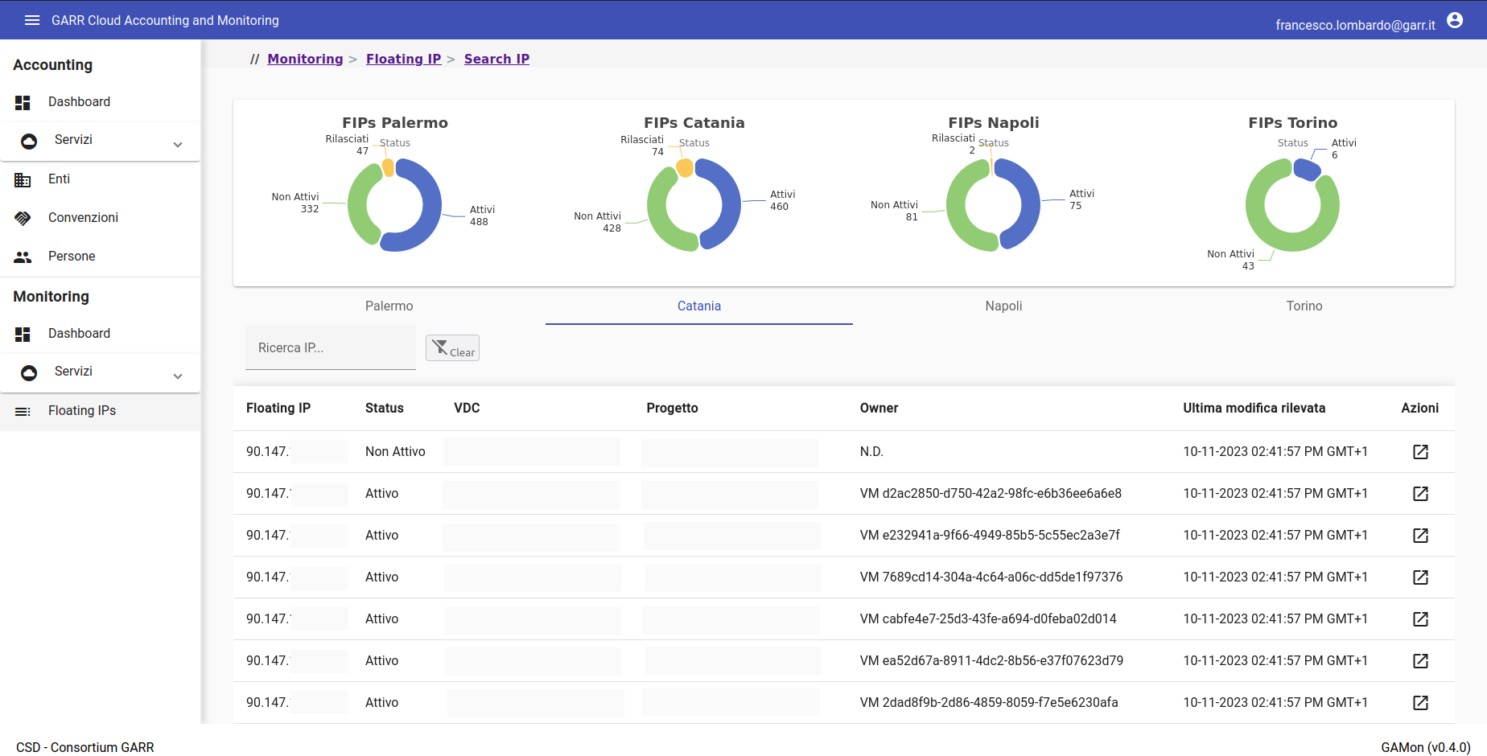
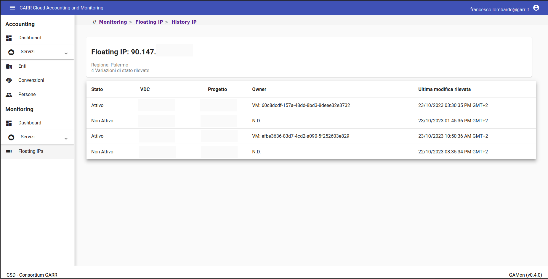
Current Status - GAMon v0.4.0
Floating IP list
Listing and Search
Floating IP history
History of status changes of
a Floating IP address

Slide 26
Conclusions and Future Developments
Conclusions
Tailored solution
  No vendor Lock-In
  Totally Integrated with the Various Layers
Developed Using Open Source Tools
Scalable and Expandable
Future Developments
Development of Additional Microservices: ex. Report Generator
Integrations with GARR Services
Event Management: ex. Scheduled Maintenance, Security Alert (CERT)
Enable Access to End-Users

Slide 27
Thank You!
GAMon Contributors:
A. Barchiesi
A. Colla
M. Di Fazio
F. Galeazzi
F. Lombardo
M. Lorini
D. Passalacqua
E. Petagna
C. Pisa
Francesco Lombardo and Marco Lorini

