Slide 1
Deployment Workflow for SwitchCloud
Version 01,

Slide 2

Agenda
SwitchCloud
1. | Introduction of presenters | 5'
2. | SwitchCloud runs on Openstack | 5'
3. | Deployment approach | 5'
4. | Repositories structure | 5'
5. | Multiple environments | 5'
6. | Demo | 5’

Slide 3
About us
Nemanja Jevtic
Cloud Engineer
CURE Team
nemanja.jevtic@switch.ch
Werdstrasse 2
8004 Zürich
Piotr Kacprzak
Cloud Engineer
CURE Team
piotr.kacprzak@switch.ch
Werdstrasse 2
8004 Zürich

Slide 4
Openstack overview
SwitchEngines will run Openstack on K8s
Why on K8s:
Scalability
High-Availability
Declarative deployment
Automatic checking and enforcing desired configuration
Strong community with fast-paced development
Why not other methods:
Juju – existing restrictions (i.e. not supporting IPv6 natively) and need to fork and maintain any Switch-specific customization
Control plane on Bare-metal or within some virtualized environment – issues with scalability, moving services around, reinventing the wheel for some tasks, operating the cloud feels more complex

Slide 5
Old deployment vs new deployment
Old way:
Deployment is based on running Ansible playbooks within in-house developed Ansible roles that would share common resources with help of Ansible-Galaxy or via other means
There is not way enforce desired state on target systems expect to rerun Ansible playbooks
For operation purposes in one moment we ended up with 20 repositories per Cloud team member
All of above lead to situation with many stale and not up-to-date repositories, high congnitive load for developing and maintaining those roles, very wide security implications due do significant share of common resources (like secrets) and a need to often reimplement some features (deploying customization on top of K8s cluster using Ansible is not necessary best practice).

Slide 6
Old deployment vs new deployment
New way
GitOps approach with the use of FluxCD
Heavy usage of Openstack-Helm framework to deploy Openstack services
Usage of existing Openstack and K8s community tools to automate testing, monitoring and deployment of aditional resources
GitOps, Helm charts, repository structure, propagating changes brings additional complexity. Once initial complexity is well uderstood, one can make leverage GitOps approach abd have everything deployed in automated and declarative way, and be able to audit changes by following repository history.

Slide 7

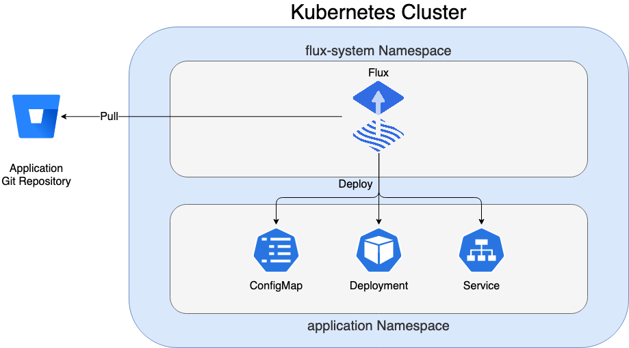
FluxCD
What’s Flux and how it works
How it solves problem that Cloud Team in Switch is facing

Slide 8
Different repository structure approaches
Monorepo
All your Kubernetes manifests in a single Git repository
Cluster state is defined in a dedicated folder
Separation between Openstack services and Infrastructure in folder stucture
Repo per environment
Additional layers of security and permission management
Promoting changes from one environment to another is more time-consuming
Dedicated production repository limits the scope of changes and makes the review process less error prone
Repo per team
Splitting repos between Admin/Operation and Dev Teams can be beneficial due clear separation of responsibilities and specializations
We have only one Cloud Team with high level of overlap, therefore it would not be optimal

Slide 9
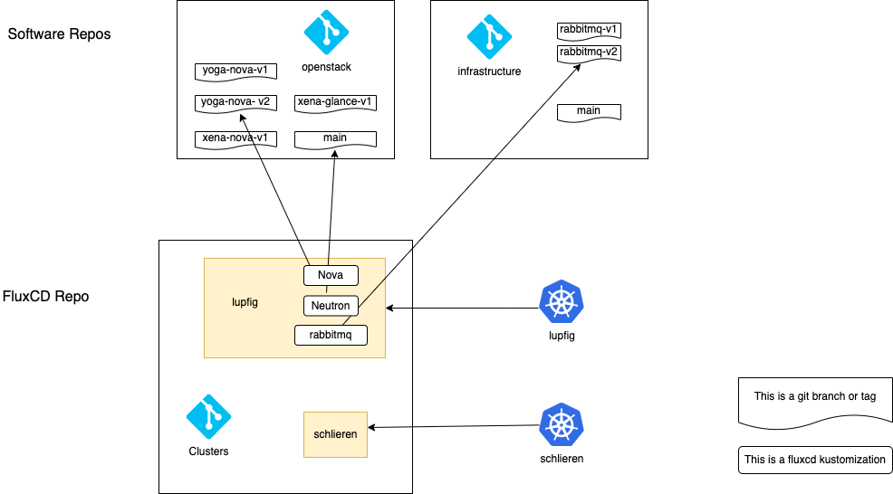
Repositories structure

Slide 10
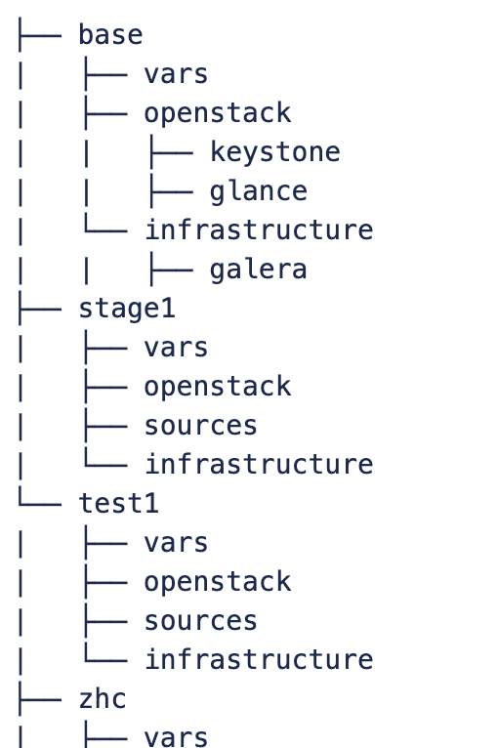
Clusters folder structure

Slide 11
Branches and environments
prod-e2-l
prod-e2-s
production
MR
stage
stage-e2-l
MR
feature branch
test
test-e2-s

Slide 12
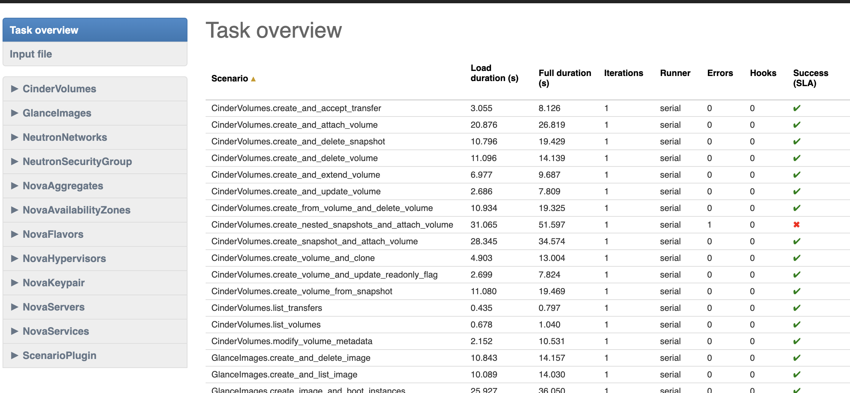
Automated testing

Slide 13
Logging and Monitoring
Logging and Monitoring are provided by dedicated (PLAT) team as services where SwitchCloud is a user of the service and client side.
Logging
Fluent-Bit is a log-scraper, which gets the defined log files and forwards them to Loki
CURE Team needs to configure its products to ship logs and metrics to Central Logging service
Monitoring
Deployment of Monitoring is done using FluxCD and Helm and utilizes Prometheus for scraping and Grafana for visualization
Code is in Infrastructure repository

Slide 14
Live Demo: deployment of changes
Demo goal:
Showcase simple configuration change propagation from the moment of change in configuration untill deployment in target environment

Slide 15
Q&A
Nemanja Jevtic
Cloud Engineer
CURE Team
nemanja.jevtic@switch.ch
Werdstrasse 2
8004 Zürich
Piotr Kacprzak
Cloud Engineer
CURE Team
piotr.kacprzak@switch.ch
Werdstrasse 2
8004 Zürich

