Slide 1
Campus IdP
Status and plans
GARR
Mario Reale
GN4.2 JRA3 All-Hands - F2F - December 12-13, 2016

Slide 2
Agenda
Goals and implementation
Survey
Market Analysis Deliverable (D9.1)
Cost Benefit Analysis
Requirements for the Campus IdP platform
Initial design
Roadmap ahead and timeline ( milestones, deliverables )
Discussion - People’s involvement

Slide 3
Goals
Develop a Campus IDP platform to support the deployment of Identity Providers at Campuses
Bring it to production level for possible endorsement and adoption by GEANT
Pursue integration with current existing GEANT FaaS service (“add the last mile..”)
Exploit possible synergies/collaborations with Internet2 TIER project
From the GN4.2 DoW:
“Based on findings from AARC, TIER (Internet2) and NREN developments, develop a campus IdP extension to the FaaS service for sites and regions who currently do not have the ability to support or offer a cloud IdP-type of service to campuses”
Reference products:
  Jagger
  Other FaaS components: HSM, DS, MDA
  Cloud IDP ( Some NRENs already offer a Cloud IdP solutions to customers )

Slide 4
Implementation
Write a Market Analysis with assessment of existing Cloud IdP solutions by NRENs
Produce a Costs-Benefits analysis
Provide it to GEAN PLM Team
Design an initial architecture for an integrated solution: Campus IdP + FaaS platform
Start a pilot service
Review CBA periodically
Go through all steps required by SA2 T1 Services transition to production procedures
  Write all required Service Templates: SDP, Requirements, Documentation
  Fill all required Service Templates

Slide 5
The scenario: options to provide supporting services for Campus IdP
GEANT / NRENs Hosted Campus IDP Cloud Service integrated with FaaS
Design
Implementation
Pilot Service
Transition to Production
Collection of community requirements
Hosted Cloud Campus IdP
platform integrated with FaaS components
Assessment of existing solutions
Market Analysis document
Toolkit deploying Cloud IdP
for Campus
Costs Benefits Analysis document
Cloud Campus IdP service catalogue

Slide 6
GEANT NREN Survey on Cloud IdP
Survey on Cloud IdP circulated to the Fed Operators list - early October
Aimed at better understanding the Campus IdP problem definition: Community Requirements, Potential for Cloud-based Campus IdP solutions
Got 17 answers from the following NRENs:
ARNES, CANARIE, CESNET, GARR, GRNET, GEANT, HEANet, Internet2, JANET,
RedIRIS, RENATER, SURFnet, SWITCH
A relevant outcome:
there is high desire but little or none internal ability for institutions to deliver identity
provider services to their users
( ~ 40 % of answers)
Survey Still online on http://tinyurl.com/z33jond
Detailed answers report available at http://tinyurl.com/zdr9gf5

Slide 7
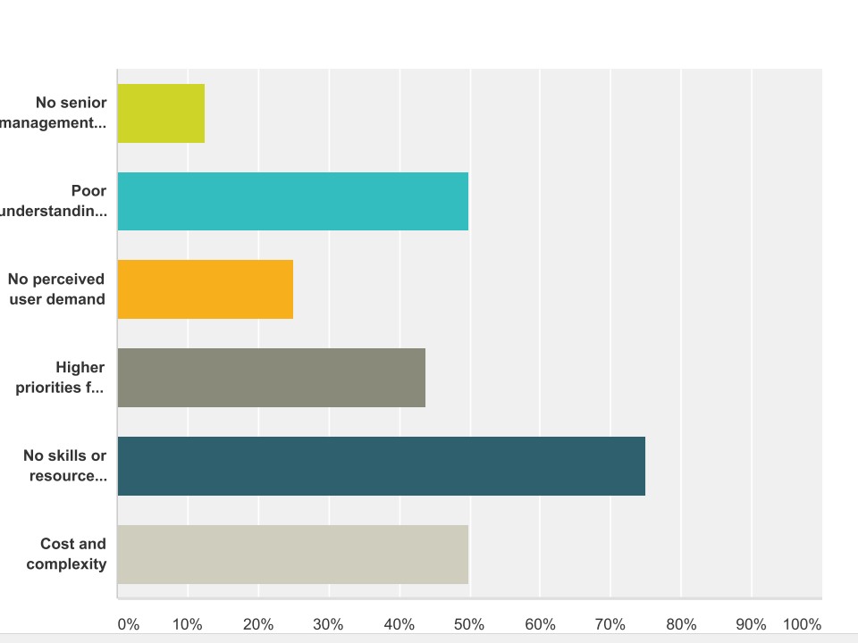
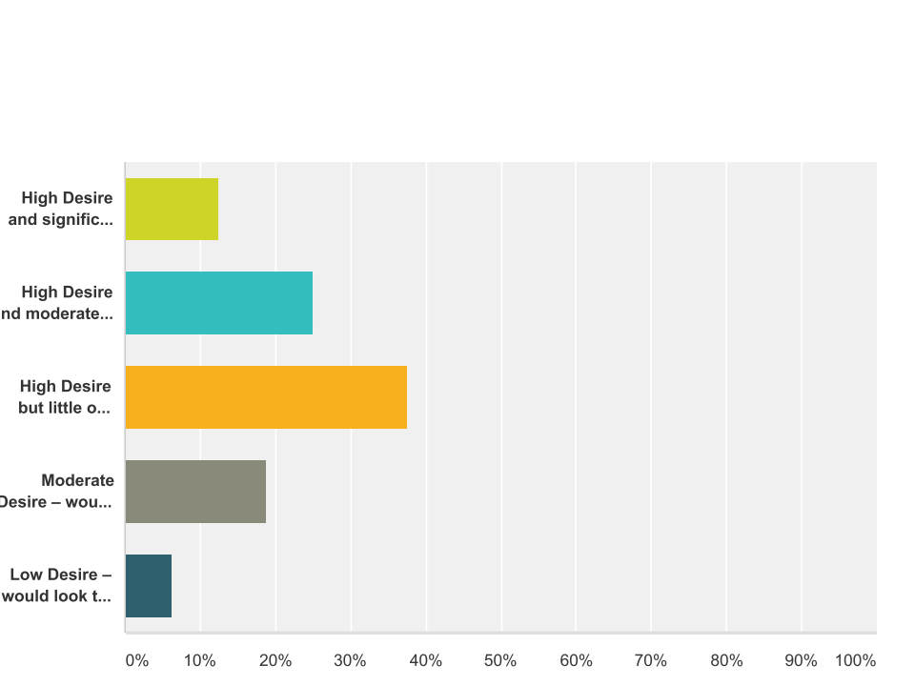
Survey Results 1/2
Q2:What is the desire and ability of institutions
to deliver Identity Provider services
Q3:What are the main barriers to adoption of federated Identity services?

Slide 8
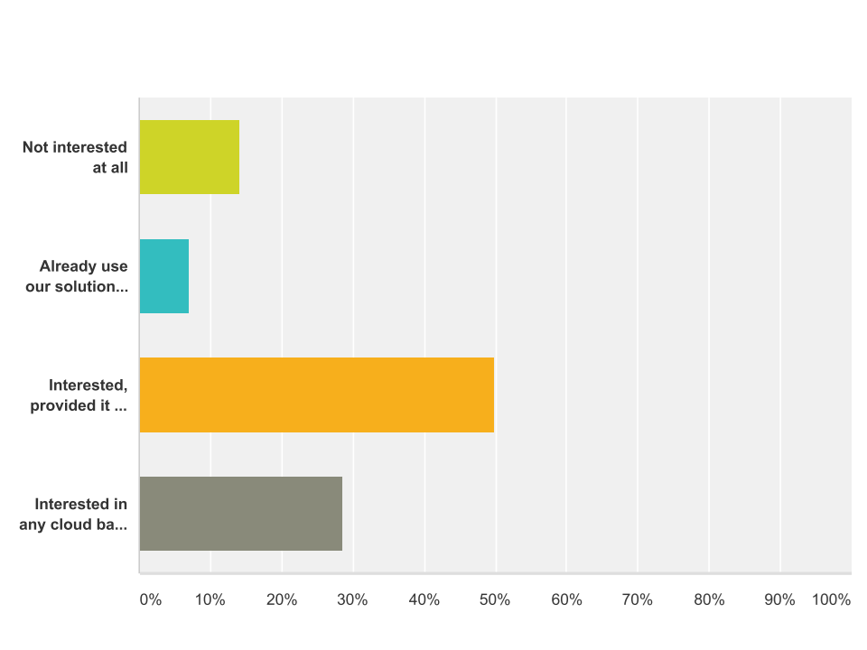
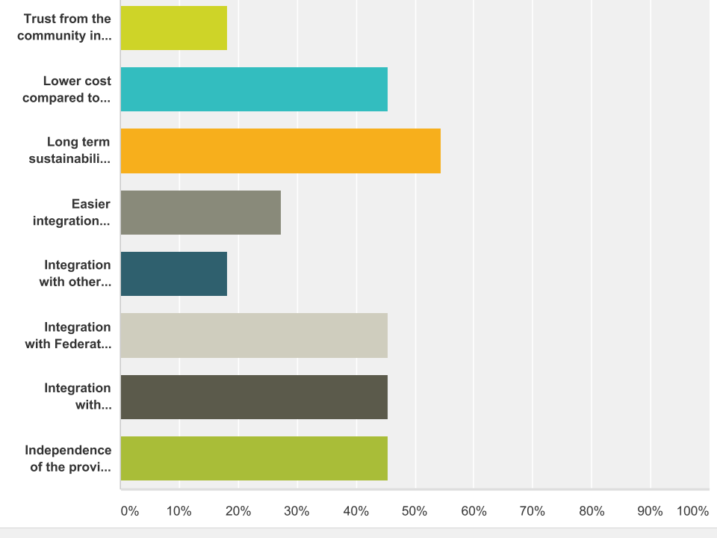
Survey Results 2/2
Q8: How interested would your individual institutions be in outsourcing the provisioning of a local IdP to a managed service provider?
Q11:Principle advantages of a GEANT provided and managed Cloud based solution for the IDP?

Slide 9
Market Analysis for Supporting Services for Campus IdPs Deliverable
D9.1 - Market Analysis for Supporting Services for Campus Identity Providers - due by end of December:
Deliverable needs to be completed in its overview of current Cloud IdP solutions by NRENs
Pending
FInalize description of Cloud IDP offers by some NRENs (ARNES, JISC, HEANet, SWITCH...)
Injection of outcome of Cloud IDPs NRENs survey
Complete the use cases requirements for Campuses and Federations with and without FaaS
GEANT role section
Currently in progress at
https://docs.google.com/document/d/1bWN8wyHO-PyyOBAu5aSqR2Hrbuurv0eJgwSyWtKzdkg/edit?usp=sharing
Delayed by 1 month due to need to define boundaries towards AARC activities on Cloud IdP

Slide 10
Cost Benefit Analysis
We need to deliver a CBA Analysis for the Campus IDP -
  Milestone for Month 6 - Approved by M8
CBA should highlight relevant economical aspects related to the proposal of Campus IDP service
An empty skeleton - shared google doc - is available at http://tinyurl.com/hx9uyth
  It is now really time to write it :-)
  Including the associated CBA Excel file
    We should be able to get an empty template for it

Slide 11
CBA document structure - GN4 CBA template
Executive Summary
Background and Objectives
Considerations and recommendation ( Available options and recommended one )
Summary information
Business Model
Values users
Value proposition / Community need
Value creation
Value chain
Value capture
KPIs and critical success factors
Risks
Costs
Benefits
Cost/Benefits summary
Excel documentation - Embed the CBA excel file
Product/Service description
Technical Requirements
Operational Requirements
Timescales
Conclusion and next step
References
Glossary

Slide 12
Requirements for the Campus IdP platform
Due to spread in NRENs currently adopted technologies, be as portable as possible ( independent of specific private cloud platform and infrastructure deployment model )
Security :
  Secure way to interface the LDAP/AD backend ( LDAPS - disable LDAP)
  Ensure secure AuthZ approach towards MD-backend integration ( JSON Web Token ( JWT) )
Different levels of GUI management profiles:
  basic ( all defaults)
  skilled manager ( access to more advanced options)
Plug in JAGGER Resource Registry, but more general - design a general solution
Possibility to integrate configuration management
  via Ansible ( and Puppet ? )
Provide both:
  Ansible playbooks for automated IdP deployment on Docker
  Integration of Openstack: automated spawning on IdPs on Openstack via Docker container
Longer Term requirements to be addressed
Provide High Availability for the IdP instances
Consider integration with eduROAM GUI and a unique management interface for both

Slide 13
Functionality to be provided by the Campus IdP platform
Generic Docker templates
Archive and management of the IdP metadata
Private Docker repository
SAML SSO support to the Platform (registry) Service Provider (.i.e.: the Platform itself will be a federation SP e.g. using FaaS)
Configuration of the IdP instances Define source of user registry
  Attributes mapping
  Defining source of signed metadata
  Locally defined attribute release policy and/or define remote attribute release policy
  Customized login page
Upload of required configuration files from the platform instance to the IdP ones, including public certificates
Bulk configuration, patches, security updates management for all IdP instances through the generation of automated scripts ( eg: Ansible playbooks, Puppet recipes..)
Build versioned docker template based on current configuration and upload to private docker repository
Spawn of new IdP instances according to Docker containers

Slide 14
Initial draft architecture

Slide 15
Roadmap
Finalise the market analysis deliverable D9.1 (december/january)
Write the CBA document (january)
Develop further a detailed design for the Gn4.2 solution for IdP
Compile a shopping-list of required individual components and related developments
Analyse in detail the required bits to interface FaaS
Pledge resources to start setting up a development testbed

Slide 16
Suggested Discussion items today
Agree on the goals
Detail the work to do in a breakdown of specific work items
Assign people to work items according to personal skills / taste
Resources
Common tools for remote collaboration on the work items
Shall we schedule periodic joint remote-working sessions ?

