Slide 1
eduTEAMS Scenarios
A few scenarios fom the resource point of view that leads to some questions on how to work with eduTEAMS

Slide 2





Sample VO structure (web / wiki / files / …)
Blue and Red teams have a strict privileges.
Owners have all rights even in red and blue teams
VO pages
- VO owners
- VO members
- VO visitors
Sam
Bob
Blue team pages
- Blue members
- Blue visitors
Alice
 | VO Pages | Blue Team | Red Team
VO Owners | CRUD | CRUD | CRUD
VO Members | CRUD | CRUD | R
VO Visitors | R | R | R
Blue Members |  | CRUD
Blue Visitors |  | R
Red Members |  |  | CRUD
Red Visitors |  |  | R
Red team pages
- Red members
- Red visitors
Paul
Lisa
Play ground case

Slide 3
Playground Personas
Sam is the VO administration, he sets up the groups structure
  All members of the Owners groups can manage everything .
Bob is member of the Blue Members groups.
  All members of the Blue Members can manage the blue team pages
  All members of the Blue Members can manage the blue team groups
  All members of the Members groups can manage the VO common content
Alice is member of the Blue Visitors group
  She can navigate and read the VO common content
  She can navigate and read the blue team pages

Slide 4
Groups
It will be nice to have group calculation
  VO visitors = Blue Visitors + Blue Members + Red Visitors + Red Members
  VO members = All members – Red members
  Intersection
  minus

Slide 5
1
Bob member’s of VO-x connects to VO-x service
1 – Access Resource
2 – Redirect to SP
3 – Redirect to Discovery
4 – Select / Redirect to IdP
5 – SOAP request to AA
6 – Redirect to SP and access
IdP
Identity Hub
2
Bob gain access through his group membership in VO-x
Discovery
Service
VO-…
Service
Provider
(SP)
Resource1
VO-y
VO-x
Voot
Users
Group X
enroll
provision
Group Y
Resource2
Group Z
Attribute
Authority
Administrators
eduTEAMS
Sign-in overview - 1

Slide 6
Sign-in
Workflow
  Once authenticated, the SP must call Attribute Authority in order to obtain the user VOId and groups
Questions :
  Should the resource change is SP ?
  Is there an enrollment for my SP in eduTEAMS ?
  How do we exchange metadata ? eduGAIN ?
  Why a discovery service if we enroll Bob from IdP X ? Are we allowing a user to signup from multiple IdP (non scope check)

Slide 7
1
1 – Access Resource
2 – Redirect to SP
3 – Redirect to Discovery
4 – Select / Redirect to IdP ???
5 – SOAP request to AA
6 – Redirect to SP and access
Alice member of VO-x connects to VO-x service
Social
IdP
???
Identity Hub
2
Bob gain access through his group membership in VO-x
Discovery
Service
VO-…
Service
Provider
(SP)
Resource1
VO-y
VO-x
Voot
Users
Group X
enroll
provision
Group Y
Resource2
Group Z
Attribute
Authority
Administrators
eduTEAMS
Sign-in overview - 1

Slide 8
Social sign in
Does the identity hub act as a proxy IdP, so the SP should treat it as an IdP ?
What’s involved ?

Slide 9
Bob member’s of VO-x connects to VO-x service
Give access to a person or group
How to get the value of the group or the user in my VO to give him access ?
How to enroll the SP for the VO
IdP
Identity Hub
1
I want to give access to Bob as an author
Discovery
Service
VO-…
Service
Provider
(SP)
Resource1
VO-y
VO-x
Voot
Users
Group X
enroll
provision
Group Y
Resource2
Group Z
Attribute
Authority
Administrators
eduTEAMS
Set access rights

Slide 10
Set rights
How do I check / get the Id of a user / group in my VO to give access.
  Add Bob to the member group, this is not a right way but.
  Add the author group (users) from my VO to the authoring rigths in the ressource
    Leads to RBAC groups of user in eduTEAMS and groups of actions (rights) in the resource ( seperation of concern)
    How to make the maping, will eduTEAMS read from the SP or the reverse ?
What is the value of the group attribute for my VO, the value of the group attribute send over by the AA for my Vo

Slide 11
Alice
from social IdP
Bob
from an IdP in eduGAIN
1 – VO admin goes to eduTeams
2 – VO admin add Bob to the VO and groups
3 – eduTeams sends a mail to Bob
IdP
Identity Hub
1
Sam the VO admin enroll Bob and Alice.
Discovery
Service
VO-…
Resource1
VO-y
VO-x
Users
Group X
Attribute
Authority
enroll
provision
Group Y
Resource2
Group Z
Administrators
eduTEAMS
Enrollment

Slide 12
Enrollment
Questions :
  The existing SP should do IdP Chaining and call the attribute authority
  How to enroll my SP in eduTEAMS ?
  Why a discovery service for the SP, after enrollment the user’s IdP should be selected ???
  How to check enrollment ? Like an activation email with a guid

Slide 13
Alice
from social IdP
Bob
from an IdP in eduGAIN
Bob and Alice heard a bout a nice resource and aim to participate.
IdP
Identity Hub
Sam the VO admin
Discovery
Service
VO-…
Resource1
VO-y
VO-x
Users
Group X
Attribute
Authority
enroll
provision
Group Y
Resource2
Group Z
Administrators
eduTEAMS
Self Enrollment
Notes:
Questions :
How to bootstrap the process
What is the process, the user select the groups where he want.
Is there any restriction in Federation IdP and Social IdP

Slide 14
How to bootstrap the process ?
What is the process, the user select the groups he want.
Is there any restriction in Federation IdP and Social IdP
What is the check worflow / technique

Slide 15
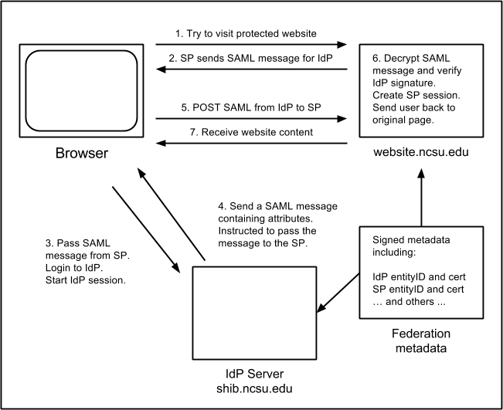
A user tries to visit a protected resource on a website.
The SP on that website issues a SAML message, encodes it in a URL, and redirects the user's browser to the IdP with that message.
The IdP verifies the SAML message that it received and allows the user to perform a login.
Once the user logs in, the IdP generates an IdP session, and refers to its Attribute Release Policy (ARP) to see what attributes it is permitted to send back to the SP.
The IdP constructs a SAML reply message for the SP and instructs the user's browser to return to the SP.
The browser posts the SAML message to the SP.
The SP decodes the SAML reply, verifies the IdP signature, and uses that to generate an SP session on the website.
The SP then sends the user back to the original protected resource. That resource will lookup the SP session, permit the access, and retrieve the user's attributes.
* Discovery Service fits in between steps 1 and 2
From https://docs.shib.ncsu.edu/docs/shibworks.html
Federated sign in flow

Slide 16
1
3
Bob member’s of VO-x connects to VO-x service
Bob gain access through his group membership in VO-x
IdP
Service
Provider
(SP)
2
Bob’s claims are augmented with Vo-X attributes (group membership) using an attribute authority or an API
Vo-X service
VO-…
Discovery
Service
Attribute
Authority
VO-y
VO-x
Users
Group X
enroll
provision
Group Y
Group Z
TEIP
Administrators
eduTEAMS
Access overview
Notes:
Old draft

