Slide 1
AI
(or GÉANT and NRENs in the post-LLM World)
Above the Net 2023 CTO Workshop

Slide 2
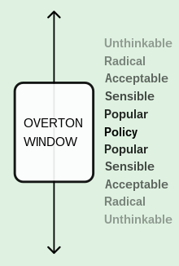
Notes:
The Overton window: We have not been talking about AI in the NREN context; it was completely outside our radar. But should it move center-stage? Should it concern us in matter, even or policy?

Slide 3
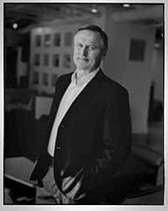
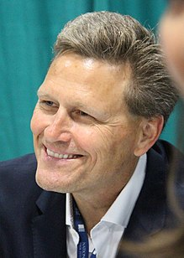
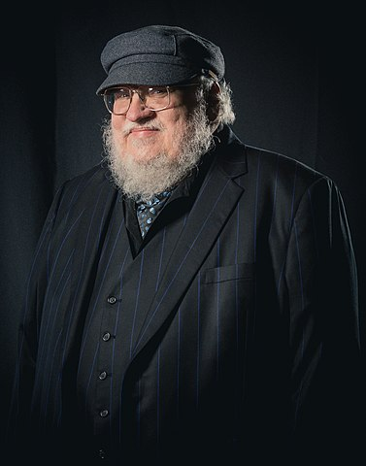
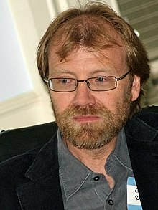
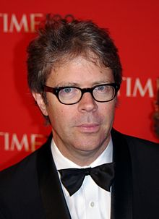
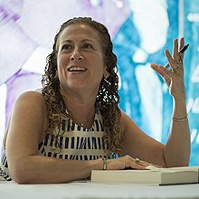
Notes:
David Baldacci, Mary Bly, Michael Connelly, Sylvia Day, Jonathan Franzen, John Grisham, Elin Hilderbrand, Christina Baker Kline, Maya Shanbhag Lang, Victor LaValle, George R.R. Martin, Jodi Picoult, Douglas Preston, Roxana Robinson, George Saunders, Scott Turow, and Rachel Vail.
Famous authors in a class-action suit against OpenAI, for its use of their material in their products. So all the world is talking about it, really...
From left to right, top to bottom:
John Grisham
David Baldacci
R. R. Martin
George Saunters
Jonathan Franzen
Jodi Picoult

Slide 4
Yang et al., Harnessing the Power of LLMs in Practice: A Survey on ChatGPT and Beyond, https://arxiv.org/abs/2304.13712
Notes:
How did we get here? It took a very short time. It is only five years ago since the first Transformer-based models were proposed. What we see looks like a Cambrian explosion.

Slide 5
Use of Public Data
“Llama 2 was pretrained on 2 trillion tokens of data from publicly available sources. The fine-tuning data includes publicly available instruction datasets, as well as over one million new human-annotated examples. Neither the pretraining nor the fine-tuning datasets include Meta user data.”
https://github.com/facebookresearch/llama/blob/main/MODEL_CARD.md
Notes:
One of the major issues, which relates to NRENs as harvesters, curators, and providers of data, is the use of this very data for training the Large Language Models.
To give you an idea of the scale, here is what we know about one of the open-sourced models. Llama-2 has used 2 trillion (yes) tokens.
And we have little idea of what, for instance, OpenAI and other companies developing closed models are doing.

Slide 6
Use of Public Data
“We are releasing three sizes of Code Llama with 7B, 13B and 34B parameters respectively. Each of these models is trained with 500B tokens of code and code-related data...
Code Llama – Python is a language specialized variation of Code Llama, further fine-tuned on 100B tokens of Python code.”
https://about.fb.com/news/2023/08/code-llama-ai-for-coding/
Notes:
Another example: Code Llama, fine tuned for developers: 500 B tokens + 100 B tokens of Python code. That probaby covers a significant part of the publicly online available code.

Slide 7
Use of Public (?) Data
“SA-1B consists of 11M diverse, high-resolution, privacy protecting images and 1.1B high-quality segmentation masks that were collected with our data engine. It is intended to be used for computer vision research for the purposes permitted under our Data License.
The images are licensed from a large photo company.”
“The FACET dataset is constructed of 32k images from SA-1B, labeled for demographic attributes (e.g perceived age group), additional attributes (e.g hair type), and person-related classes (e.g doctor).”
https://facet.metademolab.com/
Notes:
Or another example, SA-1B, a dataset used for image segmentation.
Interestingly, a subset of the dataset was used to create another dataset whose purpose is to benchark the fairness of vision models. That, by the way, entailed a lot of human effort, and points to something to something else: should NRENs have a role in ensuring / promoting fairness in their data?

Slide 8
Fairness, Use, and Attribution
Fairness vs. Bias
Intended use
Originality
Authorship
Intellectual property
Transparency
Disclosure
Notes:
And then this massive use of public data brings forward the following topics...

Slide 9
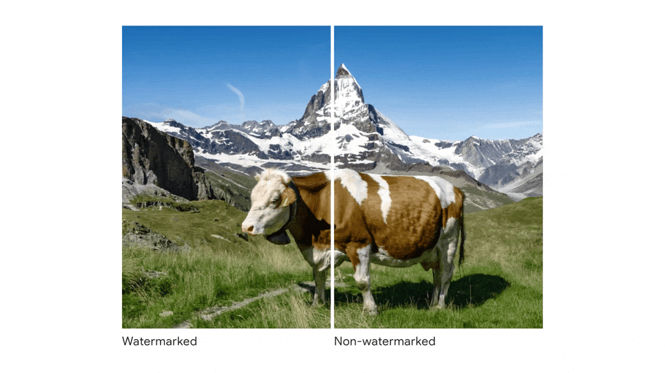
Digital Watermarking
Notes:
It would be nice to think that technology will provide the solutions. For instance, here are some nice examples of watermarking images using AI (from Google’s SynthID).

Slide 10
Digital Watermarking
Proprietary Solutions? (SynthID is proprietary and only for some Google products)
Open-source Solutions? (https://arxiv.org/abs/2305.20030)
Watermarks for text?
Notes:
However, that is a proprietary solution.
Open-source solutions do exist, but the problem is not solved. And we do not have good methods for watermarking text.

Slide 11
Lean Resource Languages and Data
Existing business models do not necessarily align with curating and providing data for less popular languages.
Similarly, for underrepresented communities.
But NRENs can speak for them?
Notes:
Moreover, despite the massive use of public data, this data does may not cover adequately languages that are not very widely spoken; “lean resource languages”.
Similarly, image and other data may be plentiful for some communities and groups, but severely restricted in others.
NRENs do know such communities and they do work with data in various languages spoken in each country. Shouldn’t NRENs be engaged to promote richness and variety in publicly available data?

Slide 12
Use of Non-Public Data
Valuable for improving existing Large Language Models.
Used for providing context in prompt construction.
Used for fine-tuning existing models.
Challenge: Sensitive Data
Challenge: If used for commercial benefit, how can the owners of the data be compensated?
Notes:
Beyond public data, private data can be a treasure trove. Think of possibilities in medicine. Even in text-based Generative AI, it can be very valuable for fine-tuning large models.
The challenge of course is that this data is sensitive.
And who stands to benefit from its use? If leveraged from commercial benefit, shouldn’t the owners of the data be compensated?

Slide 13
Use of Non-Public Data
Membership Inference Attacks
Shokri et al., Membership Inference Attacks Against Machine Learning Models, IEEE S&P, 2017.
Notes:
As with provenance, issues of privacy and security cannot be easily addressed with technological examples. For a simple example, consider the “Membership Inference Attacks”, where we can manipulate a model to learn if some data has been used in its training.

Slide 14
Required Resources
Recent AI models require substantial, customised resources (i.e., modern GPUs) to run.
Recent GPUs do not even work on workstations, are only approved for server (data centre) installations.
Situation is worse when models are not used solely for inference, but also for training and fine-tuning.
Procurement of such resources, in the form of renting from public cloud providers, will take a significant portion of overall procurement budgets.
Notes:
Once the models are in place, we have to use them. But that is not very straightforward.
These models require very substantial computational, and specialized, resources to run. It can be difficult or downright impossible to run them on workstations.
The situation is even worse when the models are used for fine-tuning, and not just for inference.
So, procuring such hardware will eat into more and more of the NRENs budgets. Procurement will likely be in a renting model, as purchasing this hardware is difficult (due to shortages) and NRENs may have to scramble with technological developments (procurement cycles are longer than hardware releases).

Slide 15
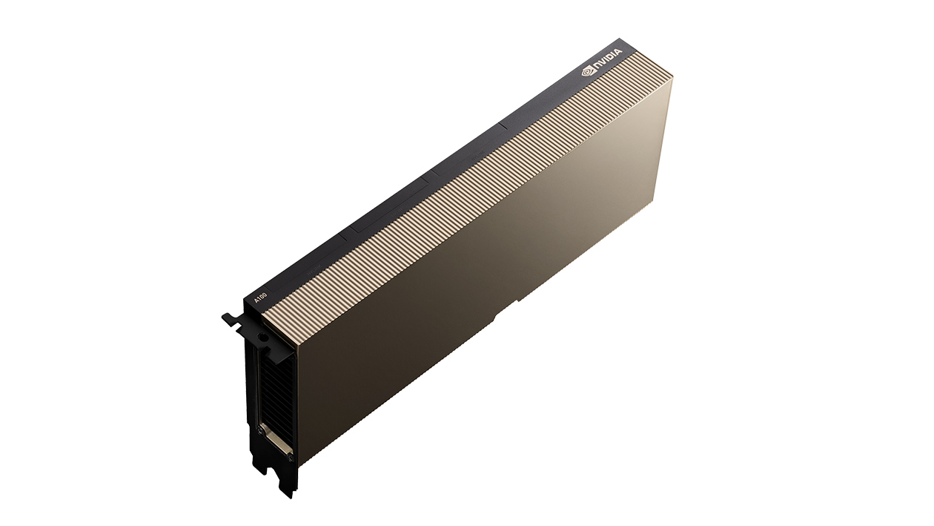
Required Resources
NVIDIA HGX™ A100-Partner and NVIDIA-Certified Systems with 4,8, or 16 GPUs NVIDIA DGX™ A100 with 8 GPUs
– Data Centre Only
> €15,000
NVIDIA A100 for PCIe 100 GB
Notes:
An example: The NVIDIA A100 is the entry point for using such models.
It starts at around €15,000 per piece, and can only be installed on servers, i.e., that’s a datacentre solution.

Slide 16
Required Resources
IaaS for specialised hardware.
Use of pretrained models (e.g., HuggingFace on AWS, Google Vertex AI Model Garden).
Use of pretrained models through API calls (OpenGPT, Bard AI, Anthropic Claude 2, etc.).
NRENs are data providers for pretrained models, quid pro quo?
Notes:
Instead of buying or renting hardware, we can pay to use hosted models.
But this can be expensive. And, less we forget, these models are trained on publicly available data, very likely hosted by NRENs and their communities. So we’ll be paying for something that could not exist without our contribution?

Slide 17
Discussion Points
GEANT / NRENs partners in regulation efforts?
Curation of open datasets?
Evaluation of curated datasets wrt bias, fairness etc.?
Providing seals / marks to curated datasets?
Promote diversity of data?
Security / privacy for training data?
Procurement models for big AI models?
If NRENs are data providers for big AI models, investigate possible compensation models (monetary, preferential access to new models, etc.)?
NRENs provide data for models that will be guaranteed for specific uses (e.g., copyright free, public domain, etc.).

Slide 18
Shouldn’t the Discussion Start Now?
What will NRENs and GÉANT be?
Guards?
Sepherds?
Curators?
Toll-collectors?
And some thoughts from the GRNET experience so far...

Slide 19
And Some Thoughts from the GRNET Experience
Demand of AI-related resources from public cloud is strong and will only get stronger.
Universities / research institutions cannot negotiate with the big public cloud providers.
Big cloud providers prefer to talk to a single entity at the country level.
Research data can be brokered by the NREN (to facilitate channels and communication between universities / research institutions).
Legal issues are easier to resolve at the country / NREN level.

