Slide 1



GÉANT CTO workshop Fall 2023 – Above-the-Net
Item 1: infrastructure-cloud
27 September 2023
jan.meijer@sikt.no
Norwegian agency for shared services in R&E
Notes:
Give an overview of European R&E cloud collaborations – past, present, reflect a bit over this and look at some future opportunities lined up.
Geant / Nordunet context.
In community with 40 countries, 1000s of institutions, dozens of RIs and dozens of EU projects, much going on, so I don’t claim to have the full and ultimate overview. Grateful for any shared data points or insights.

Slide 2
Current roadmap: 3 key areas
Service: joint procurement-compliant European agreements for IaaS+
Product: eduMEET native WebRTC VC software
Collective strategy: attempt to arrive at (a start of) a joint cloud strategy

Slide 3
Service: OCRE IaaS+ joint procurement-compliant agreements for all of European R&E
Critical: 900+ institutions, 26 countries, €100 million/year
Important GEANT contribution to European Open Science Cloud
Requires a continuous engine of sufficient quality and longetivity:
  Demand aggregation, procurement, contract & supplier management, agreement delivery through NRENs
  Q4 2020 agreements: planning 2018, exec 2019-2020
  Q4 2024 agreements: planning 2022, exec 2023-2024
  Q4 2028 agreements: planning 2026, exec 2027-2028
Evolution?
Long term sustainable delivery, much is operations: some to cost share?
What is the subject matter: cloud or joint procurement?
GEANT as supplier of access to commercial services in EOSC

Slide 4
Product: eduMEET native WebRTC VC software
Niche product with 4 main value propositions for good subset of NRENs:
  Well-integratable with anything web
  For those who can’t afford commercial solutions
  Digital sovereignty / full control use cases
  Maintain a viable alternative
Software package technical development OK but small scale
  Transitioning from GNx project to more open environment
  6 FTE, ca. 5 NRENs, interest from non-NREN organisations
  SW supports federation
Evolution options:
  Continue as-is with technical development, organic deployment
  Put (project?) effort in “from start-up to serious size effort”
    Work systematically towards larger deployment in R&E and outside
    Scale up resourcing, financing, development effort
    NREN eduMEET federation?

Slide 5
Collective strategy and other collective action
Cloud strategy forum: early days – useful in longer run?
Research workloads appear most interesting in long run
Possibly interesting collective activity:
  Joint technical platform for using infrastructure cloud (flexible, self-service, de-burdened)
  Personal data protection in public clouds
    Technology and compliance challenge, competence center, joint action?
New opportunities through EOSC context
  Collective very large storage service for research data?

Slide 6
THE END – CTO workshop - Infra-cloud & edumeet
27 September 2023
jan.meijer@sikt.no
Norwegian agency for shared services in R&E
Notes:
Give an overview of European R&E cloud collaborations – past, present, reflect a bit over this and look at some future opportunities lined up.
Geant / Nordunet context.
In community with 40 countries, 1000s of institutions, dozens of RIs and dozens of EU projects, much going on, so I don’t claim to have the full and ultimate overview. Grateful for any shared data points or insights.

Slide 8
Current roadmap: 3 key areas
Facilitating continued joint procurement of IaaS
Likely to require more effort and better spread effort, as consumption and quality requirements to the process, both towards suppliers and towards NRENs/institutions. Also likely to wish to off-load more particulars to central team
Question is whether to keep paying this from project funding, or to move a chunk to alternative funding, e.g. cost sharing

Slide 9
Evolutions

Slide 10
Where are we now?
NREN – SIG-CISS
Forum for NREN community cloud providers
NREN - GÉANT GN4-3
European Open Science Cloud
OCRE:
  Refreshed IaaS+ agreements
  Stimulate adoption of services
EOSC-Future
  Develop EOSC portfolio of contracts with research-relevant commercial services
  Stimulate adoption of those
EOSC-Association
  TF Financial Sustainability of EOSC
Joint procurement of IaaS+
  40 countries
Joint procurement “engine”
  FW support infrastructure
  Contract management
  Joint procurement collaboration
Other joint procurements (Insufficient interest)
CloudFlow (discontinued)

Slide 11

Should we be content about our collaborative efforts?
tsja

Slide 12
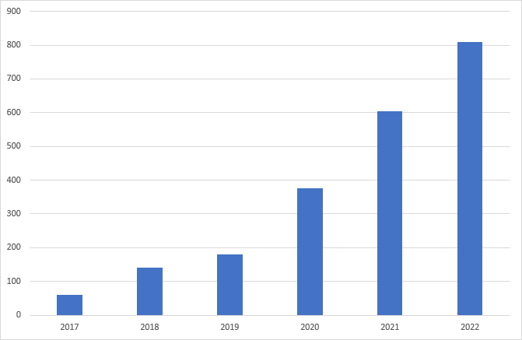








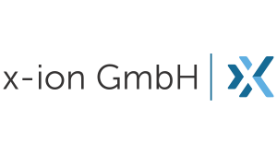










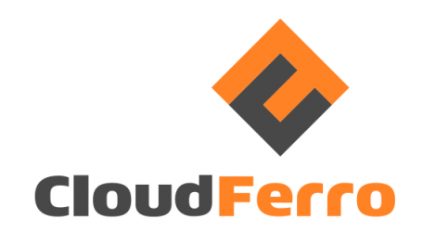




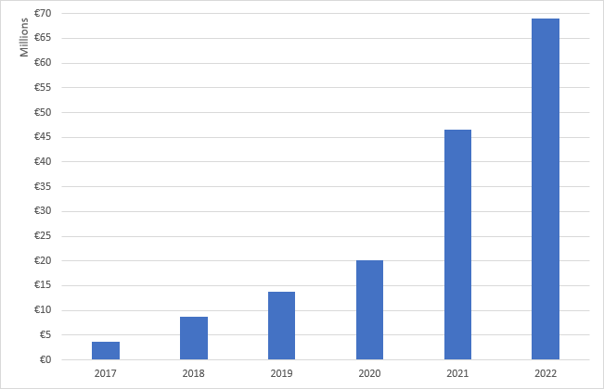
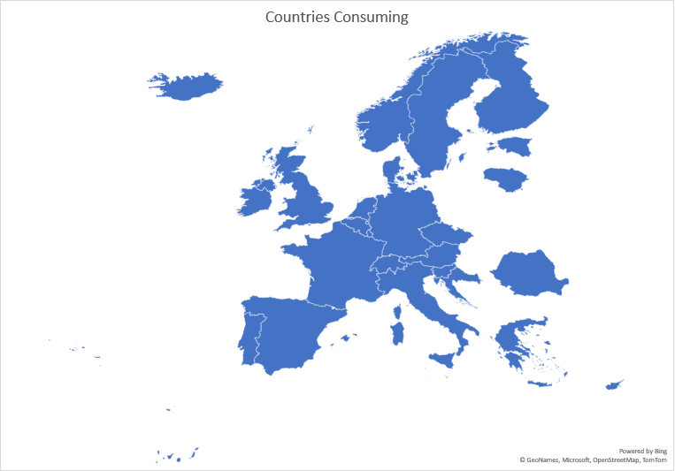
Cloud IaaS joint procurement
2020 IAAS+ FW (gen2)
GN3+
GN4
GN4
OCRE
EOSC-Ftr
GN5
Notes:
GEANT has built its capability over the past 10 years
- Joint IaaS procurement – 26 platforms
Slide with table of aggregated revenue going through FWs, and countries consuming

Slide 13


2019 – 2022 working research adoption funding IaaS & Earth Observation services
22
Countries represented
All OECD disciplines
120
Project proposals
Notes:
30 projects

Slide 14














Modelling of Drug Deposition with Realistic Dosages in Patient-Specific Lung Airways
Agile Response To High performance computing needs for Undergraduate Research
Quantifying war damage in Ukraine based on EO data (impact to global food production)
Stimulate practical application of forestry impact results by industry
High Availability OpenStack Cloud IaaS platform
Slide courtesy Dave Heyns

Slide 15
EOSC-Future project - April 2020 – September 2023
Aggregator | Solution | Platform
GWDG Germany | AWS Trusted Research Environment | AWS
Portugese national computing infrastructure | Commodity Google Cloud | Google
SURF | European Environment for Scientific Software Installation | Microsoft
University of Sussex Applied Language Modelling Facility | Hate Classifier service | Oracle
Vienna Scientific Cluster | OpenScienceLabs for HPC | Google
Demand assessment
Delivery channels
Buying data
Service sustainability – EOSC Association TF sustainable financing
Notes:
Survey – meh
More labour-intensive approach through NRENs – tsja
Whom do you ask?
Not solved yet
Delivery channels: include projects (pictures?)
5 projects awarded, aggregators making services available. Fewer aggregators than

Slide 16


Schrems2
cyber warfare
Trump
Covid
War in Ukraine
What’s the right answer?
What is the right question?
BUILD!!
BUY!!
do stuff
Gaia-X
EOSC
NRENs?
EOSC
data sovereignty
digital autonomy

Slide 17
Collaboration on community cloud service delivery
Number of NREN cloud services – significant investments
Much collaboration talk, less collaboration doing
Delivery or brokerage of community services across administrative boundaries has so far not really worked over time:
  Neither national nor cross-border
  Exceptions: Germany, LUMI
Challenges: sustainable business model, customer facing business side, business scalability?
Collaboration challenge: mandate (consumer, producer), funding national, lack of international transaction framework
lack of drivers to jointly deliver community IaaS to R&E?

Slide 18
CHANGING LANDSCAPE - EOSC Exchange – marketplace for services
Single European market for digital research services (for public sector research)
Vision supported by member state commitments to European Research Area
Current simplified view: three components
  Service brokerage between 4000 institutions, eInfrastructures and Research Infrastructures (hey, that sounds familiar)
  Portfolio of agreements with commercial services
  Portfolio of centrally financed services
    Selected from the aforementioned two categories
NEW OPPORTUNITY!

Slide 19
Ensure R&E has access to and reaps the benefits of infrastructure-cloud services collaborate to: do together what you can’t do alone do once what otherwise needs to be done 1000s of times bigger & better
2002: AWS launched
2004: EC2 added

Slide 20
Some reflections on the future
Hyperscalers will get bigger, and we’ll get less important for them
  MS intelligent cloud 2021 revenue > $60 billion
Data sovereignty, digital autonomy
Future is clearly hybrid, but how? What is our role?
  Central services, stable brokering layers, data in-country, …?
Integration of research infrastructures, institutions are changing, NRENs are changing
Data economy, data-as-a-service and our obligations to society
Are we dreaming big enough?
Notes:
Azure > $60 billion
GDPR intelligence exception for EU intelligence agencies
Remember what happened at the start of Covid? The EU is not the USA

Slide 21
Potential collaboration arenas for the next years
Geant -> GN5-1, GN5-2 project
  GN5 projects
  Cloud roadmap update September!
EOSC opportunity
  Association
  Exchange - single marketplace for digital research services
  Upcoming EU project calls, e.g. sensitive data
Data spaces (messy, unclear)
Gaia-X (messy, unclear)

Slide 22
  GN5-1 WP4 - Above Net Services
  New Work and Key Changes
  Cloud Service Delivery
T1 Eva Nestorovska - MARNET
T2 Garvan McFeely - HEANet
T3 Monique Pellinkhof - GÉANT
T4 Jan Meijer - SIKT
User-facing
delivery chain
Vendor- facing
delivery chain
Infrastructure cloud tender
Strategic Planning
IaaS+ Framework rollout
Requirements gathering
Central information hub
Community enablement
Contract management
Consumption monitoring
Business desk
High level relations
Renew the flagship product in 2024
Basis for further value delivered by NRENs
Coherent cloud strategy
Guidance for future collective NREN positioning
Steering signals for
Above-net activities
  Development
  Value
  Opportunity for NREN value in digital services
  Great effort and cost saving across Europe
  Progress on cloud strategy
  Strategic position at table
  with hyperscale providers
  Innovation around service delivery models
T5 Co-TL Dave Heyns - GÉANT
T5 Co-TL Bartlomiej Idzikowski - PSNC
Service spin-out development
Incubator
Experiment and learn in a low-risk environment
Develop and test service features and ops concepts
Exit ramp for services out of the project toward stakeholder-led sustainability
First use-case: eduMEET

Slide 23
Strategy forum purpose: organise our collective strategic decision making for above-the-net services
A first step on a longer journey to systematically organised NREN-backed collective action and collective strategic decision making on infrastructure-cloud
Towards collective approaches and collective strategic choices to address data sovereignty in infrastructure-cloud
Ensure NREN backing at top-level management for the upcoming joint procurement
Collective continuous dialogue towards commercial suppliers
Purpose of strategy forum:
Collective framework for sourcing strategies for infrastructure-cloud
Well-organised framework for strategic advice to key choices to be made in joint reprocurement of infrastructure-cloud framework agreements

Slide 24
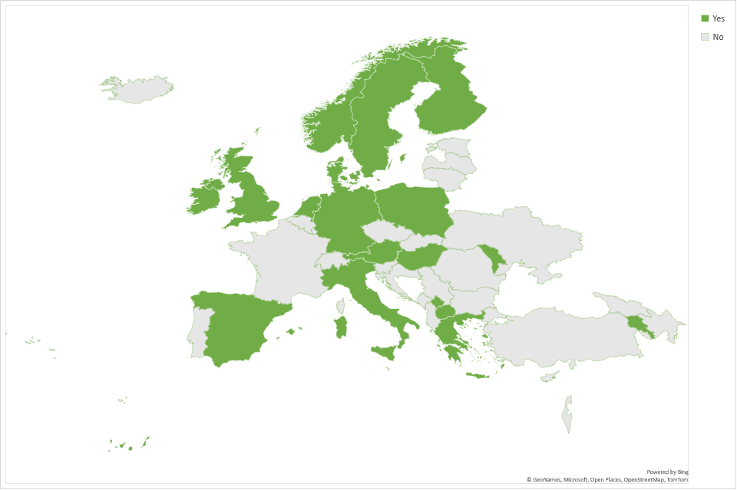
Status cloud strategy forum
Participants: 21/44, not counting ESA/CERN
VC: Monday 19 June – 10:00-12:00 CET
  Focus on sourcing strategy infrastructure-cloud
  Continue from Brussels f2f 26 May
VC: Monday 10 July – 10:00 – 12:00 CET
  Focus on joint infra-cloud procurement
  Update on requirements spec
  Discussion on formal-signup agreement (ca. October 2023): rights & obligations
Previous meetings:
  1 VC introducing forum
  2 VCs focus on procurement
  1 f2f focus on sourcing strategy

Slide 25
Concluding
Do together what we cannot achieve alone
Do once what otherwise has to be done 1000 times
Time for strategic alignment
  so our individual efforts make more of an impact: GN5-1, GN5-2, European Open Science Cloud, secure processing environments, research cloud?
  dream bigger dreams
Give input to new IaaS+ agreements in 2023, let’s make sure they’re fit-for-purpose on arrival in 2024
Ample opportunity – let’s not waste it
jan.meijer@sikt.no +47 90177711

