Slide 1



NIS2 Infoshare
CISO Meetings Summary
Ana Alves
CISO & DPO
November 2023
© GEANT Limited on behalf of the GN4 Phase 2 project (GN4-2).
The research leading to these results has received funding from the European Union’s Horizon 2020 research and innovation programme under Grant Agreement No. 731122 (GN4-2).

Slide 2

CISO Meetings – Intro

Slide 3
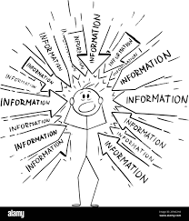
CISO Meetings - NIS2 Stage
Different perspectives (EU and Non-EU members)
Different stages of readiness
Uncertainty about the roles
No understanding of the legal requirements
No (clear) communication

Slide 4

CISO Meetings - NIS2 Getting ready
Following best practices
Looking for more information
National & International
Getting certified (ISO)
Improving Internal Maturity and
supporting their Community
Being positive about the
changes and challenges

Slide 5

CISO Meetings - Positives & Concerns
Planning and Improving
Human Resources
Incident Management
Networking and Support
Creativity dealing with challenges
Cyberattacks
Risk Management
CISO and DPO Role
Training & Awareness
Certification + Best Practices

Slide 6
Thank you
ana.alves@geant.org
© GEANT Limited on behalf of the GN4 Phase 2 project (GN4-2).
The research leading to these results has received funding from the European Union’s Horizon 2020 research and innovation programme under Grant Agreement No. 731122 (GN4-2).

