Slide 1
CLAW
Crisis Management Event
Charlie van Genuchten
Creator of Chaos, GÉANT/SURFnet
Infoshare
September 20, 2018

Slide 2
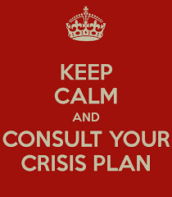
CRISIS!
Notes:
We’ve all had it. Something is not working. In the network, in one of your services, in something very noticable for your clients and members and people are starting to freak out. You try to find out what is going on, you try to communicate what is happening, you try to work together with others. With a plan this is already very tricky, let alone when you don’t have a crisis management plan and you just have to wing it each time things go wrong.
The CLAW Crisis Management Event is about learning together how to deal with crises and how to create crisis management plans.

Slide 3
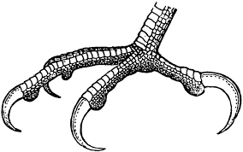
Why?
Notes:
Crisis management is something that most NRENs are just starting to make processes for.
It is a subject that entails a lot of people working together that don’t usually work together in a team.
So it needs a collaborative and well thought through approach with a basic plan/proces and some exercise to see what works.
Crisis management both on NREN level and on European/Global level important.

Slide 4
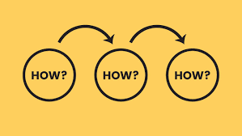
How?
Notes:
Experiencing a crisis situation together
Sharing successes and challenges in crisis managment
Training crisis management skills

Slide 5

What?
Notes:
Crisis management event of 1,5 days
People from different NRENs and different communities: NOC, CSIRT, Communication, ISM
Consisting of exercise, lightning talks and training

Slide 6
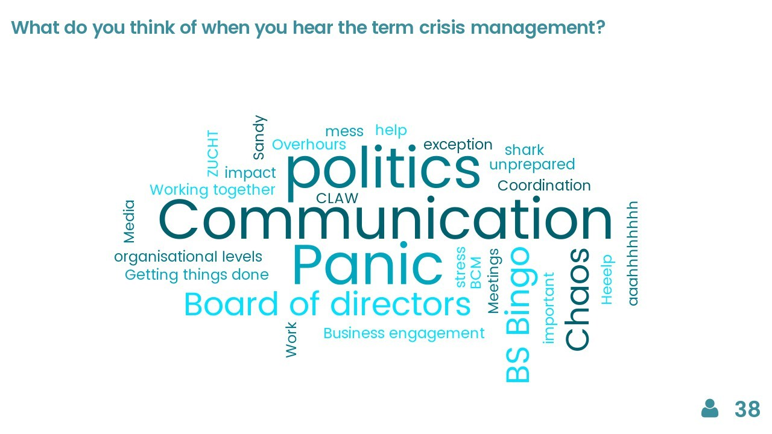
CLAW 2017
Notes:
Participants: 40 participants from 17 organisations (NORDUnet, SURFnet, Jisc, RedIRIS, RESTENA, BELNET, GEANT, GRENA, HEAnet, CSUC, ARNES, DeiC, DFN, Funet/CSC, GARR, ASNET, GRNET)
Exercise in teams NOC, ISM, Comms and CSIRT
First steps toward crisis management guideline
Discussions about European approach to crisis management and comon ways to describe crisis in our community
Sharing a lot of ideas and experiences

Slide 7
Take aways CLAW 2017
“Finding out that there are plenty of people who've are solving the same problem and there is a lot of experience out there.”
  “…another result of the Malaga meeting for me was to
  accept that accident situations are not normal. Stress situations can lead
  to "unnormal" reactions and actions which would in this form never have
  happened in "normal" situations. That's a very important insight!”
“Crisis management involves everyone, not just one person writing a plan.”
Notes:
Awareness
Lack of plans and mandate leads to heated emotions and friction
Need for more sharing of processes, tools and practical tips

Slide 8
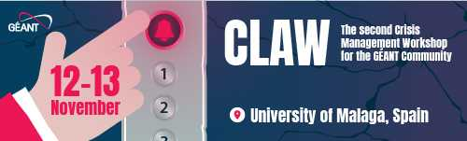
CLAW 2018
Notes:
Goals:
Ensuring awareness of crisis management as a priority throughout the community;
Ensuring all NRENs have the tools and guidelines to form or enhance their crisis management plans and procedures;
Everyone goes away with at least one point of action on crisis management

Slide 9
Programme
November 11
  Opening Dinner
November 12
  Crisis Management Exercise
  Training: Team Work during Crisis
  Lightning Talks
November 13
  Lightning Talks
  Train the Trainer: How to build your own Crisis Exercise
  Show and Tell Sessions
  Training: What is a Crisis?

Slide 10
Differences/similarities last year
Key differences:
  More focus on basics crisis management
  More focus on team work
  Training on how to create your own crisis management exercise
What will be the same:
  Sharing experiences and best/worst practices about crisis management
  Different communities coming together

Slide 11
More info and register
More info: https://www.geant.org/People/Community_Programme/Pages/CLAW.aspx
Register: https://eventr.geant.org/events/2899
Material CLAW 2017: https://wiki.geant.org/display/gn42na3/Crisis+management+information+sharing

