Slide 1
Mobility Day
Opening
Paul Dekkers & Casper Dreef
Salle 2
Monday 10 June

Slide 2
Agenda
14:00 - 14:15 | Welcome | Paul Dekkers & Casper Dreef
14:15 - 14:25 | IETF Updates | Janfred Rieckers
14:25 - 14:45 | geteduroam update | Paul Dekkers
14:45 - 15:00 | My First WiFi 7 / WPA3 | Paul Dekkers
15:00 - 15:20 | CAT | Maja Górecka-Wolniewicz & Tomasz Wolniewicz
15:20 - 15:30 | OpenRoaming policy updates | Stefan Paetow
15:30 - 16:00 | Coffee Break
16:00 - 16:20 | Mapping work beyond the OpenRoaming map | Hiroyuki Harada
16:20 - 16:50 | Blast RADIUS (TLP:AMBER+STRICT) | Janfred Rieckers
16:50 - 17:00 | Closing - thank you – farewell – shameless plugging 'Mobility' sessions | Paul Dekkers & Casper Dreef

Slide 3



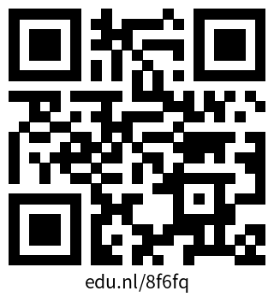

Traffic Light Protocol
TLP CLEAR
Unlimited – no restrictions
TLP GREEN
Community-wide, not public
TLP AMBER
In-house (organization + clients), need-to-know distribution
TLP AMBER+STRICT
In-house (organization ONLY), need-to-know distribution
TLP RED
Personal, for named! recipients! only!
More information: https://www.first.org/tlp

Slide 4
Thank you
Any questions?

Slide 5
Mobility Day
Closing
Paul Dekkers & Casper Dreef
Salle 2
Monday 10 June

Slide 6
Mobility related sessions and presentations
Wednesday
09:00 - 10:30 | GeGC | Salle 13
14:00 - 15:30 | T&I on the fly with Guy | Les Dortoirs
Thursday
09:00 - 10:30 | Campus Network as a Service | Les Dortoirs
11:00 - 12:30 | Lightning Talks Strike 2 - University 4.0: Exploring the Transformative Potential of 5G in the University Campus | Le Grand Auditorium
12:45 -13:45 | OMREN's Achievements: Breaking Barriers, Building Bridges | Community Hub

Slide 7
Thank you
Any questions?

