Slide 1
WISE
WISE Information Security for Collaborating E-Infrastructures

Slide 2
What is WISE?
Wise Information Security for Collaborating E-infrastructure
A trusted forum where security experts can share information on different topics like risk management, tools for operational security and threat intelligence in the context of e-Infrastructures

Slide 3
How everything started
Joint effort of GEANT SIG-ISM (Special Interest Group on Information Security Management) and SCI (Security for Collaboration among Infrastructures)
Workshop in Barcelona Spain, October 2015
50 participants
Notes:
-an open forum where experts from its community exchange information, knowledge, ideas and best practices about specific technical or other areas of business relevant to the research and education networking community
- SCI (Security for Collaboration among Infrastructures) is a collaborative activity of information security officers from several large-scale infrastructures, including EGI, PRACE, EUDAT, WLCG, XSEDE and HBP

Slide 4
How everything started
Main idea: 4 big e-infrastructures EGI, EUDAT, GEANT and PRACE getting together to facilitate the exchange of experience and knowledge on security
But also NRENs, XSEDE, NCSA, CTSC and communities like HEP/CERN, HBP and many others participated
A profound need for a real collaboration became evident

Slide 5
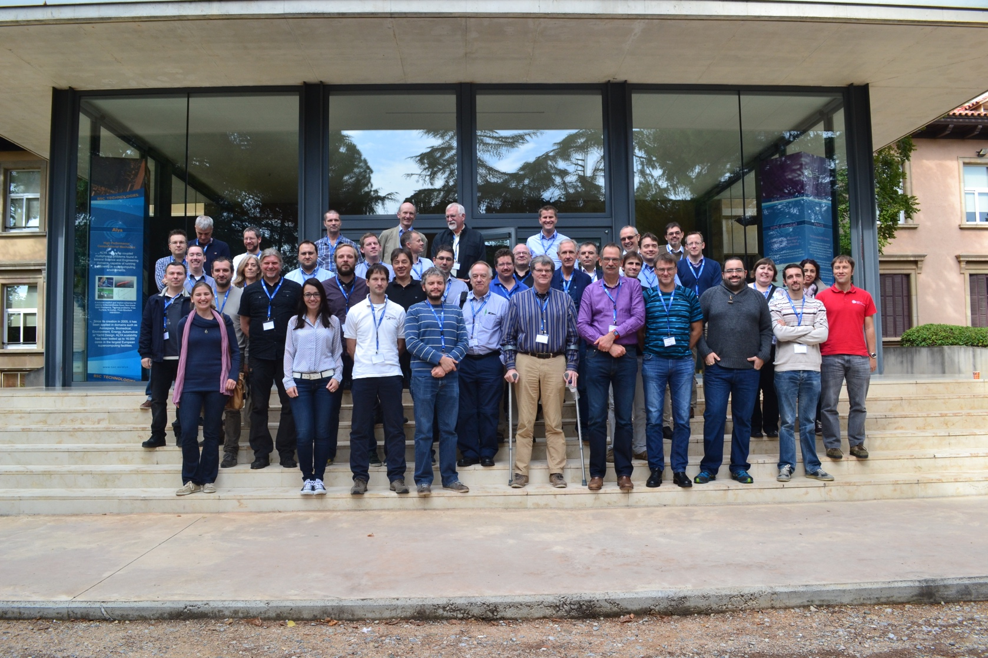
WISE – The new born community
WISE Workshop – Barcelona Supercomputing Center – October 2015

Slide 6
Since then
June 2016 – BoF (Birds of a Feather meetup) at TNC16, Prague
July 2016 – 1 day Workshop at XSEDE, Miami
September 2016 – 1 day Workshop at DI4R, Krakow
March 2017 – 2 day Workshop hosted by Nikhef, Amsterdam

Slide 7
Activities
Community of volunteers
Led by a Steering Committee
Two face-to-face meetings a year, focus on producing practical output
Updating the SCI framework (SCIV2-WG)
Risk Assessment WISE (RAW-WG)
Security in Big and Open Data (SBOD-WG)
Working Groups
Security Training and Awareness (STAA-WG)

Slide 8
SCIV2-WG
Updating the SCI framework:
Existing framework created by the SCI (Security for Collaborating Infrastructures) group at ISGC 2013
SCIv2 will become the 1st WISE framework defining best practices, trust and policy standards for collaboration
SCIV2-WG is finalising version 2 of the SCI document, which will be presented and endorsed at TNC17 in Linz (Austria)
https://wise-community.org/updating-the-sci-framework/
Notes:
The aim of this work was to establish a common understanding of the security measures each infrastructure has implemented and to start work on guidelines for interoperation such as the exchange of information during security incident handling

Slide 9
STAA-WG
Security Training and Awareness:
Training is wanted and needed for security professionals, systems and network managers and engineers, users of the infrastructures and for decision makers
Main activities of the WG:
  Documenting good practices in security training
  Collecting information about existing training courses
STAA-WG is defining v1 of the training catalogue for organisations in the WISE Community
https://wise-community.org/training-and-awareness/
Notes:
Several organisations already have some or several trainings in place, but not on all topics. Some others have to get started with a training programme. There is a lot of training in the commercial market and there is a lot of open source material available.

Slide 10
RAW-WG
Risk assessment WISE:
Large e-infrastructures are vulnerable to high impact security incidents because of the relatively easy way that an incident may spread among partner organizations due to the collaborative services that exist among the constituent organizations
The objective of the RAW-WG is to provide e-infrastructures and their member organizations with guidelines on how Risk Assessments can be effectively implemented.
RAW-WG is currently producing a draft of a risk management template to be shared among sites and infrastructures.
https://wise-community.org/risk-assessment/
Notes:
It is an important activity as part of the implementation of an Information Security Management System (ISMS). The implementation of effective security controls depends very much on a reliable risk assessment, so that the right measures can be taken.

Slide 11
SBOD-WG
Security in Big and Open Data:
The WG focuses on security issues that arise when dealing with Big and Open data especially within the e-infrastructures
Main activities of the WG:
  list and discuss already existing studies and state of the art the starting point for the rest of the work
  work on a list of issues particularly important for e-infrastructures and on a set of recommendations on how to minimize the impact of these issues
https://wise-community.org/security-in-big-and-open-data/
Notes:
Big data refers to large datasets that are not always public. Open data refers to datasets that are not necessarily large but are available to everyone and can be used and republished without restrictions. Large datasets from scientific research sources.
Security issues in this context concentrate on confidentiality, integrity and availability. Confidentiality regulates access to the information, integrity assures that the information is trustworthy, i.e. has not been changed without authorisation, and availability guarantees access to the information by authorised people at any time.

Slide 12
Participate in WISE
Join the WISE Mailing List
Interested in any of the the working group subjects?
  Subscribe to the workgroup mailing list on the WISE website
  Contact the workgroup chair and let’s work together
www.wise-community.org

Slide 13
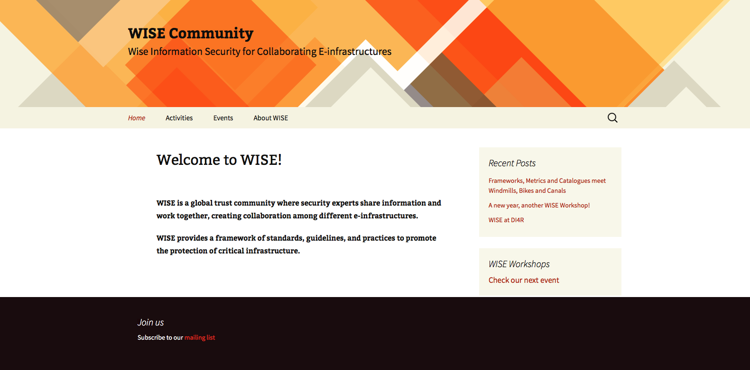
Find out more
www.wise-community.org

Slide 14
Thank you
Questions?
wise@lists.wise-community.org

