Slide 1
„Comply and Explain” or
Exempted under „ Research”
NIS-2 Infoshare
24th of June 2024
Edit Herczog

Slide 2
Entity’s self-identity is key
Level of self-autonomy regarding due-diligence
No man’s land
Digital infrastructures
Research infrastructures
A | GÉANT is both DI and RI
B | GÉANT is RI
C | GÉANT is DI
D | GÉANT is No man’s land

Slide 3
Comply and Explain
Scenario 1.

Slide 4
Security Union Legislative landscape
We are still awaiting tertiary acts for NIS2 (+CER, CRA and eIDAS)
DA which categories of essential and important entities are to be required to use certain certified ICT products, ICT services and ICT processes
IA laying down the technical and the methodological requirements of cybersecurity risk-management measures with regard to DNS service providers, TLD name registries, cloud computing service providers, data centre service providers, content delivery network providers, managed service providers, managed security service providers, providers of online market places, of online search engines and of social networking services platforms, and trust service providers.
Rules
CRA
eIDAS2/eID fully in 2026
GDPR
GDPR enforcement
DA
CER
10/2024
NIS2
10/2024
Stakeholders are not responsible for late transposition by Member States.
+
Harmonized Standards
ICT Technical specifications
Common specifications
Cybersecurity Certification
Toolboxes
Targeted amendment April 2023
Cyber-
security Act
Infrastructure
Rights
ECCC
Security Union/ Cybersecurity
Digital Strategy
Data Strategy
Industrial Policy
Telecom Policy
Research Policy
Product safety
awaiting publication
in progress
agreed
in force
implemented
EUCC
IRIS²
Cyber Solidarity Act
Funding

Slide 5

Security requires supply chain-driven approach
Products
Services
People
Products
Services
People
Input
Operation
Output
Input
Operation
Output
Input
Operation
Output
Vertical supply-chain
Input
Operation
Output
Input
Operation
Output
Input
Operation
Output
NREN A
Private / Public / Academia Private / Public / Academia

Slide 6
Due - diligence
Input
Internal operations
Output
Safeguards to protect assets from cyber, physical and hybrid threats (NIS2, CER, Electronic Communications Code, Cyber Solidarity Act, 5G Toolbox, Nevers, Standardization and Certification, Cybersecurity Act)
Supply-chain protection: diversification; trusted suppliers; choke-points; eliminate dependence (Cyber Resilience Act; Export Controls of other countries)
Personnel: hire of third – country nationals (Export Controls of other countries)
IP protection
Dual –use (Export Controls, Sanctions Regimes)
Knowledge transfer: information sharing and personnel movements (Outbound investments)
Organizational and financial procedures (Foreign Subsidies; Foreign Investments, Foreign interference)
Partnerships
Reporting to authorities
Funding conditionalities: compliance with legal stipulations but also soft-laws

Slide 7
To consider
Improved security due diligence is no longer a choice. You are either:
  Covered by definitions
  Covered through spill-over from value-chain (end-users or providers)
The REN Community:
  Uses critical technologies (digital and ICT value-chain)
  Serves actors at the centre of economic security (research and development (= first chain in the industrial value-chain); HPC; quantum;)
  Unique service provider (monopoly over service in country; cross-border impact; economic and societal role of research)
Costs implied: entry barrier to compliance is high + moderate rise in OPEX
Laws are not tailored but universal. Reach out to Ministries. Meet them half-way. This is where explanation is necessary.

Slide 8
Exemption under „Research”
Scenario 2.

Slide 9
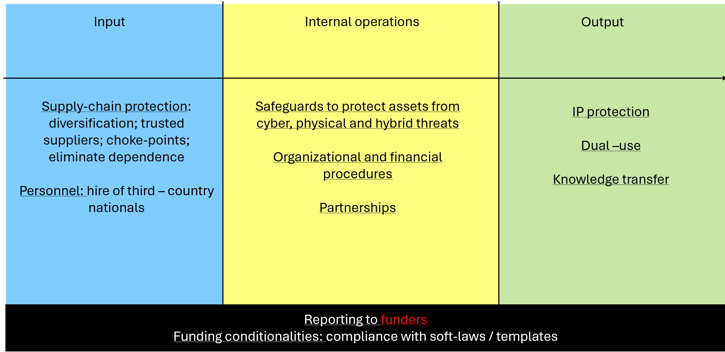
To consider:
Exemption is not given, but a decision of the Member States → Heterogeneity
Best practices non-binding but due diligence can still be enforced through funding conditionalities
Risks in the vertical and horizontal supply chains
  Complexity and insecurity due to lack of “template”
  Doing it yourself, and taking the responsibility
    Self-regulation and insurance (e.g.: GÉANT Security Baseline)
    Delegate the responsibility (Less technologically savvy needs to delegate)

Slide 10
Comply where possible, explain where necessary
Especially as the new MFF and the EU forthcoming Strategic Agenda put Security at the top of the EU agende

Slide 11
Annex

Slide 12
Soft-laws for digital infrastructures
Table 1. Soft-laws for digital infrastructure protection, dedicated section for submarine cables
Existing risk assessments | Existing mitigations | Planned
EU Coordinated Risk Assessment Of The Cybersecurity Of 5G Networks (2019) Nevers Report - Cybersecurity And Resiliency Of Europe’s Communications Infrastructures And Networks Report on the cybersecurity of Open RAN | EU Toolbox on 5G Cybersecurity (EU Toolbox) (2020) + implementation reports (2020 and 2023) and Communication of 2023 ENISA 5G control matrix Nevers Report - Cybersecurity and resiliency of Europe’s communications infrastructures and networks. ENISA Guideline on Security Measures under the EECC and 5G Supplement Good Practices For Supply Chain Cybersecurity | Nevers Action Plan ICT Supply Chain Toolbox
Study On The Resilience Of Undersea Cable Infrastructure (non-public) ENISA: Subsea cables - what is at stake? | ENISA: Subsea cables - what is at stake? BEREC Report on the general authorisation and related frameworks for international submarine connectivity Commission Recommendation of 26.2.2024 on Secure and Resilient Submarine Cable Infrastructures | Cable Security Toolbox

Slide 13
Brno Declaration on fostering a Global Ecosystem of Research Infrastructures (2022)
6. The RIs ecosystem represents a key component of the critical infrastructure (i.e., physical and virtual systems and assets which are essential for the functioning of a society and its economy), in addition to energy, environmental, emergency, healthcare, defence or security infrastructures. It empowers scientists and equip innovators to come up with novel and feasible solutions to address sudden threats, and increase the immediate response capacity of the society to deal with acute crisis scenarios, such as those induced by the SARS-CoV-2 outbreak and Covid-19 pandemic

Slide 14
Council Recommendation on enhancing research security (6 May 2024)
continue to promote and defend academic freedom and institutional autonomy, taking into account that research performing organisations are primarily responsible for their international research and innovation cooperation
Support for research performing organisations
15. Encourage and support research performing organisations to:
(b) implement internal risk management procedures in a systematic manner, including through risk appraisal, conducting due diligence on prospective partners and escalation to higher levels of internal decision-making in the event of issues that raise concern, while avoiding any unnecessary administrative burden
(c) when entering into research partnership agreements with foreign entities, including through Memoranda of Understanding, consider possible risks related to the international cooperation and include key framework conditions, such as respect for Union values and fundamental rights, academic freedom, reciprocity and arrangements on intellectual assets management, including the dissemination and exploitation of results, licensing or transfer of results and spin-off creation, and provide for an exit strategy to be in place in the event that the conditions of the agreements are not complied with;
(e) invest in dedicated in-house research security expertise and skills, assign research security responsibility at the appropriate organisational levels and invest in cyber hygiene and in creating a culture in which openness and security are in balance;
(h) introduce compartmentalisation, both physical and virtual, guaranteeing that for areas, such as labs and research infrastructure, data and systems that are particularly sensitive, access is granted on a strict need-to-know basis, and that, for online systems, robust cybersecurity arrangements are in place;
(i) assess risks related to equipment, laboratories and research infrastructure sponsored by or acquired from entities established in or controlled by third countries, notably focusing on any undesirable obligations imposed on hosting organisations;

Slide 15
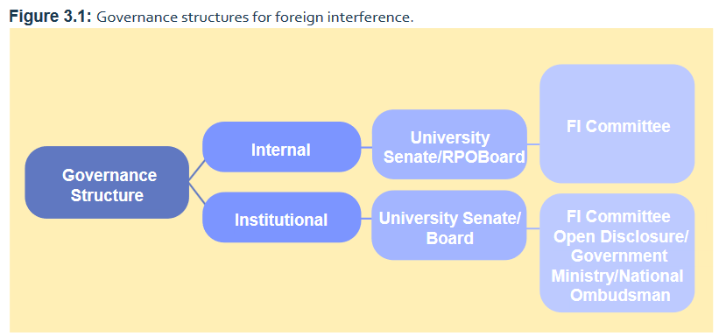
Template for compliance in research:
Commission Staff Working Document -Tackling R&I foreign interference
( 12 January 2022)
It is key to decode the vocabulary
  “Foreign interference”
  “Academic Freedom”
Governance:

