Slide 1
eduVPN BoF
Tangui Coulouarn, Rogier Spoor, François Kooman, Jeroen Wijenbergh
TNC24, Rennes
11 June 2024

Slide 2
Agenda
What’s eduVPN?
eduVPN in practice: how is it deployed and used?
Most asked features
Roadmap and current projects

Slide 3
eduVPN in one slide
eduVPN is an edu service built by collaboration of several NRENs, supported by GÉANT
Free Open Source Software
Based on OpenVPN and WireGuard
Well integrated with IdM systems used in R&E
Tested and audited
Used in production by 160+ universities and 19 NRENs

Slide 4
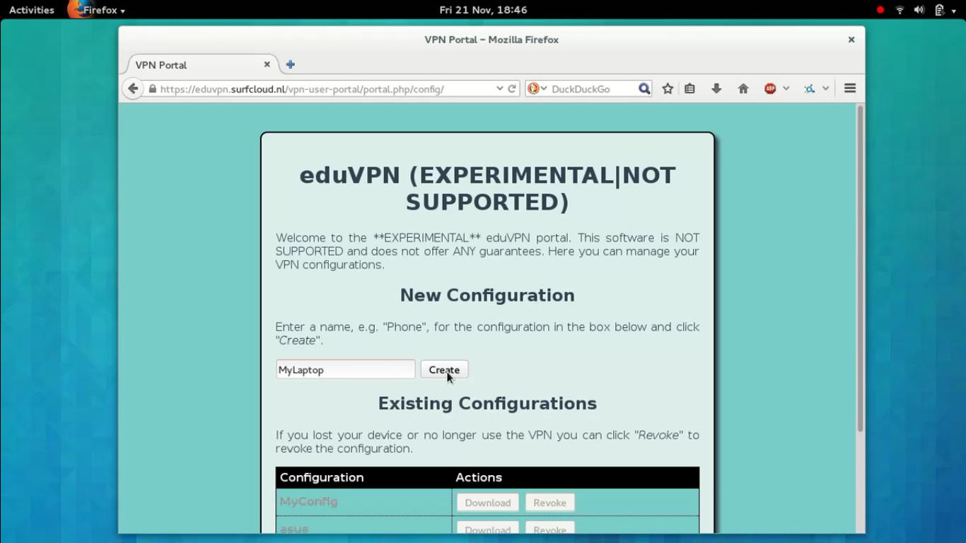
How did it start?
Innovation programme at SURF in 2014
Realisation that staff and students used a lot of shady VPN services
First use case: Secure Internet, i.e. access the public internet through trusted gateways
Notes:
. Back in 2014, programme for innovation at SURF(net) where employees could get 10kEUR to work on small projects
Rogier Spoor started working on VPNs with François Kooman as they realised students and staff were using a lot of shady services for security/privacy online
First use case was to have provide VPNs to students/staff to secure gateways when they were using networks they couldn’t trust

Slide 5
The Institute Access use case
Replace the corporate VPN solution to let staff and students access resources on a private network
Tricky due to procurement cycles
Early adoption in the NL
Notes:
Very quickly institutions in the Netherlands were interested in having a single VPN solution, both for the “secure internet access while on the move” use case but also to replace their traditional corporate VPN solutions

Slide 6
Requirements (1)
Use of open source software as a security requirement: OpenVPN (then)
Integration with IdM used at universities
  Do not require users to know the server name, but allow them to search for their institute
  Re-use the credentials from their institute in a safe way (through browser WebSSO)
NREN perspective: Allow for hosting the server elsewhere and have a L2 connection to the institute
--> here WebSSO is even more important... no need to give credentials to VPN provider

Slide 7
Requirements (2)
Scale beyond 1 server (not just fail-over)
Native IPv6 support out of the box
Available as OS packages on most common Linux server operating systems
  Easy install
  But more important: easy updates (apt, yum, dnf)
No per-seat licensing, so you only pay for hardware (and server administration)

Slide 8
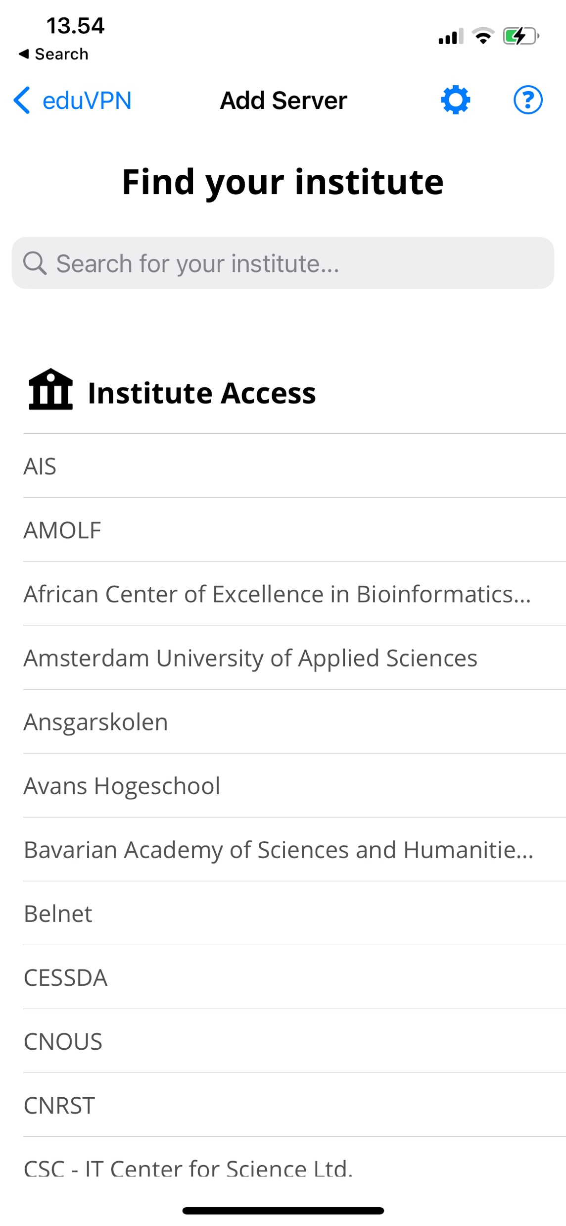
eduVPN today
VPN software package with
  server side components
  client apps for Linux, Windows, iOS/macOS and Android
Supports WireGuard and OpenVPN
Integrates well with identity management systems at universities (SAML, LDAP, RADIUS, OpenID Connect, Client certificates)
Granular profiles + possibility to provision managed devices
Scales from raspberry pi to multi-node deployments
See https://docs.eduvpn.org/server/v3/ for full feature list

Slide 9
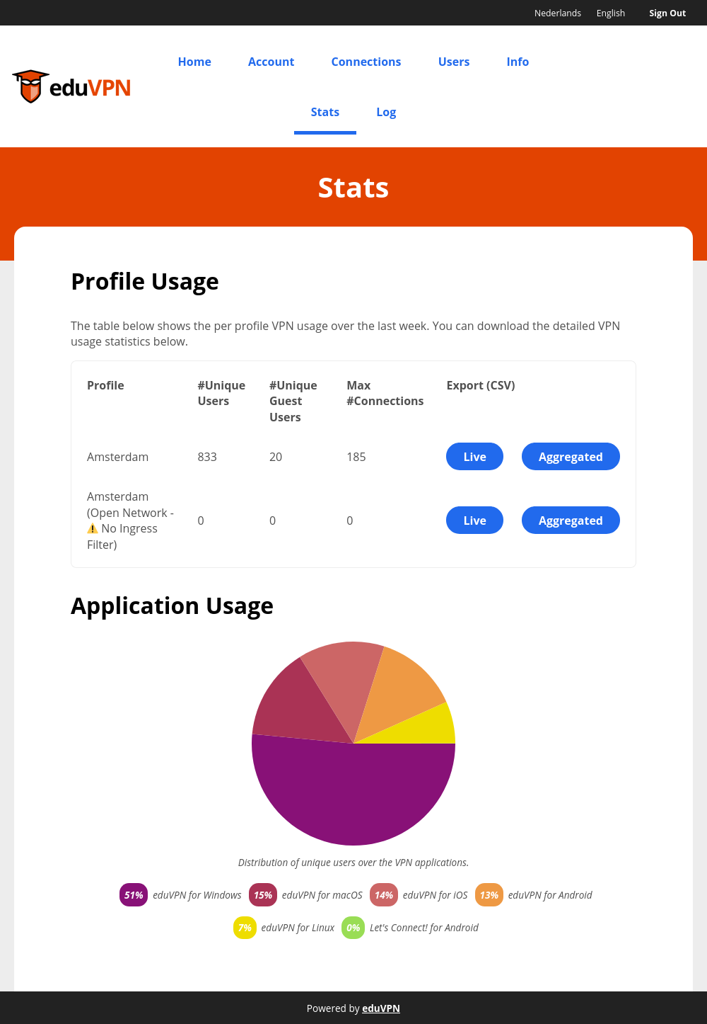
eduVPN today (2)
Used in production by universities (Institute Access) and NRENs (Secure Internet)
Also used outside R&E as “Let’s Connect!” (+ collaboration with govroam). Apps can be rebranded.
Software governance via The Commons Conservancy foundation
Service governance via GÉANT
2 main models of deployment: run-by-university or managed by NREN
Notes:
Most successful in NL (27), Germany (26 universities),

Slide 10
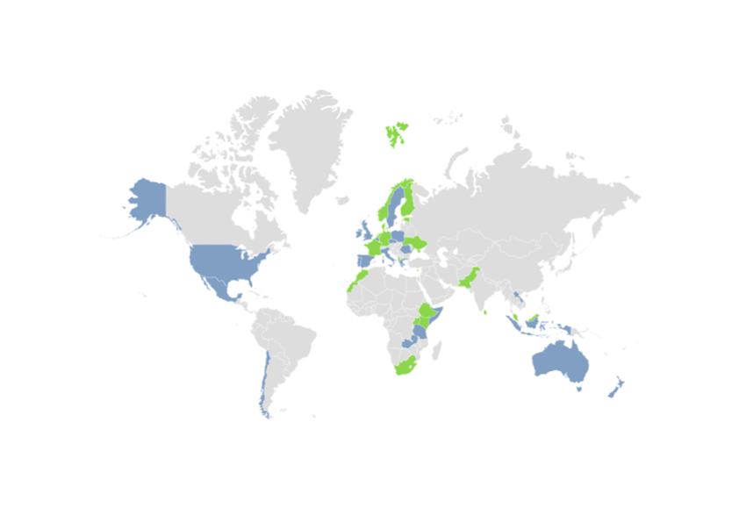
eduVPN today (3)
At least 165 universities and 19 NREN deployments
Used in (at least) 38 countries
Most successful in NL, Germany

Slide 11
Regular audits
Date | Type | By
Q4-2016 | Server audit | Radically Open Security
Q4-2017 | Windows app audit | Fox-IT
Q1-2018 | Server audit | Radboud University
Q3-2018 | Android app audit | GÉANT
Q4-2018 | iOS/macOS app audit | Radically Open Security
Q4-2019 | TunnelKit (iOS/macOS) library “fuzzing” | Guido Vranken
Q4-2020 | SAML (php-saml-sp) audit | Cure53
Q1-2021 | iOS/macOS app audit | Midnight Blue
Q4-2022 | 3.x Server audit | Cure53
Q4-2022 | Go-library audit (new linux client) | Radically Open Security

Slide 12
For comparison: cost of commercial VPN solution at Danish University
11000 students and 6000 staff
Requirements/features:
  1000 concurrent users;
  Hardware with 10Gbps interfaces;
  Differentiated access to services according to type of user, equipment used.
Cost in 2019: 100 kEUR for hardware + 35 kEUR in licenses for 3 years
Supplement for extra licences paid when COVID19 to be able to serve more users
UX is not impressive: username and password + microsoft second factor
Maintained by the IT department
Includes hardware but not network costs, maintenance, power, etc.

Slide 13
Example 1: Stand-alone instance. Otago University
Need to scale up because of CoVID-19: existing VPN used nearly EOL hardware. Needed to either buy new concentrators for 500 kNZD (275 kEUR) or look at alternatives
Requirement for MFA
Choice of eduVPN because they could reuse existing compute hardware + use of SAML and by extension leverage Azure Active Directory / Microsoft Entra ID with conditional access (MFA)
Use of php-saml-sp as it was easier to setup with Azure AD working out of the box with minimal changes

Slide 14
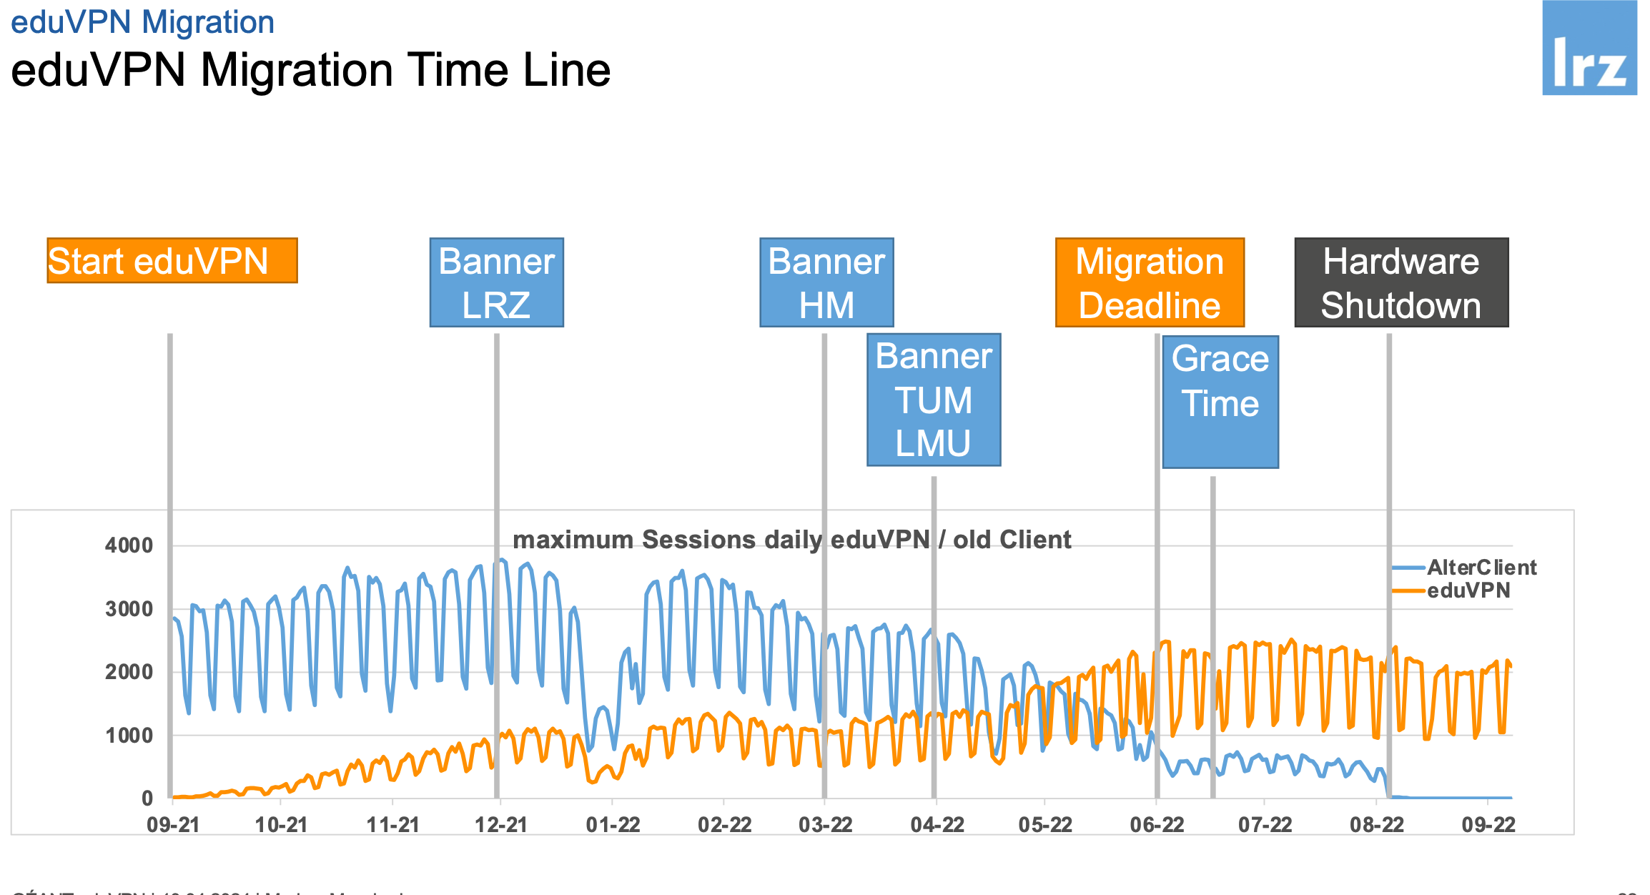
Example 2: eduVPN on shared resources. LRZ in Germany.
Regional computing centre providing network for several higher education institutions in the Munich area
During pandemic, often 6000+ concurrent users
Their solution was EOL
Standard OpenVPN tested but lacked features (including automatic client configuration updates)
Now operates eduVPN for most institutions in the greater Munich area
  Single server for each of the three biggest universities based on VPN user access: TUM, LMU and HM;
  one “catch all” server for the other institutions;
  one dedicated server for LRZ.
See Markus Meschederu’s presentation: https://events.geant.org/event/1515/contributions/1696/attachments/954/1472/eduvpn-GSD-2024-04.pdf
Notes:
The Leibniz-Supercomputing Centre (Leibniz Rechenzentrum, LRZ) is the computing center of both Munich Universities of Excellence: Ludwig-Maximilians University and Technical University Munich and a National Supercomputing Centre. The LRZ operates the Munich Scientific Network (MWN) for all universities and other research institutions in the greater area of Munich. MWN connects more than 130,000 users.
The structure of LRZ is different compared to many universities as we do provide services for several universities in the Munich area instead of only one university. The big ones, counted in VPN users, are:
Technical University of Munich tum.de TUM
Ludwig Maximilian University of Munich lmu.de LMU
HM Hochschule München University Of Applied Sciences Munich hm.edu
Weihenstephan-Triesdorf University of Applied hswt.de

Slide 15
Example 3: Institute Access as a Managed Service for a whole NREN
Model currently implemented in the Netherlands (.BE .NO same implementation model)
eduVPN instance managed centrally by SURF
L2 circuit back to the private resource
Support by SURF
No need for hardware on campus or licensing limitations

Slide 16
4 most asked features
Multi Factor Authentication
High Availability / Redundancy (HA/R)
Real Time Authorization
Managed devices

Slide 17
Multi-Factor Authenitcation
“First Factor”: Username & Password
“Second Factor”: (T)OTP, Hardware Token, WebAuthn, Biometrics, ...
Where does MFA belong?
  Service
  IdM
We chose for not managing MFA for the institutes
• MFA in IdM
• MFA in separate system, e.g. PrivacyIDEA

Slide 18
HA/R (1)
Architecture
Portal / controller
  Web interface, API, Database, Authentication, Authorization, Logging, (Server) Administration, ...
Node
  Handles VPN connections
Each component takes different approach
Portal
  HA/R DB, Session Storage, Hot Spare, Failover, ...
Node
  Simply have >1 and have the portal(s) direct user to one that is “up”
  Complexity obviously in the Portal

Slide 19
HA/R (2)
Portal
memcached (Session Storage)
PostgreSQL / MariaDB* (Database)
keepalived (Failover)
Node
When a client connects, it is directed to a “Node”
  ... that is “up”
  ... not under heavy load*

Slide 20
Real time authentication
Common in R&E to use SAML (“WebSSO Profile”)
Session is a valid for ~8 hours
No way to verify session after initial authentication
  User disabled?
  Permissions changed?
Having users authenticate (possibly with MFA) every 8 hours is not
Some Ideas
Use SAML for Authentication, LDAP for “Real Time” Authorization
Use OpenID Connect for Authentication and “Real Time” Authorization*

Slide 21
Managed devices (1)
Devices owned and managed by the organization “System VPN”
Bound to device, not necessarily user
Always on
Active before user authenticates to device
  For example: Kerberos/LDAP/AD only reachable over VPN
Enrollment
Obtain a per device VPN configuration file through the eduVPN Server “Admin API”
Deploy WireGuard on device
Copy a device specific VPN configuration file to device
Enable WireGuard service on system boot
Conceptually it is very easy!

Slide 22
Managed devices (2)
Practice
GPO works for Windows, but not (out of the box) with macOS
Intune works for Windows and macOS, but you can’t send a (device specific) configuration file to the device from what we understand...
Approaches
Try to make Intune work anyway (script runs on device to obtain configuration)
Take separate approaches for macOS and Windows
Pilot with institute in NL this year
If you know an organization that has Windows / macOS Managed Devices
Uses Intune and/or GPOs, or other software to control the devices
Wants to use eduVPN
Have the knowledge/resources to help us test it and provide feedback

Slide 23
Roadmap
4.x (Release: 2025-05?)
Drop OpenVPN ****************
“User Defined” Networks
Move Server Configuration to DB
  Allow server admins to change (some) configuration through Web UI

Slide 24
OpenVPN / WireGuard
The problem with OpenVPN…

Slide 25
WireGuard: The problem
Networks sometimes block UDP
WireGuard only uses UDP
VPN gets blocked
WireGuard over TCP?
transforming WireGuard's UDP packets into TCP is the job of an upper layer of obfuscation¹
1: https://www.wireguard.com/known-limitations/

Slide 26
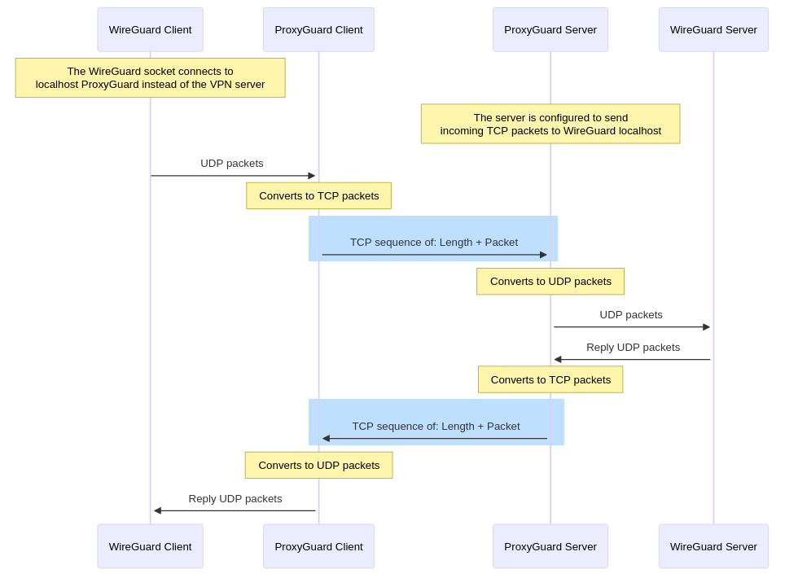
WireGuard over TCP: Our solution

Slide 27
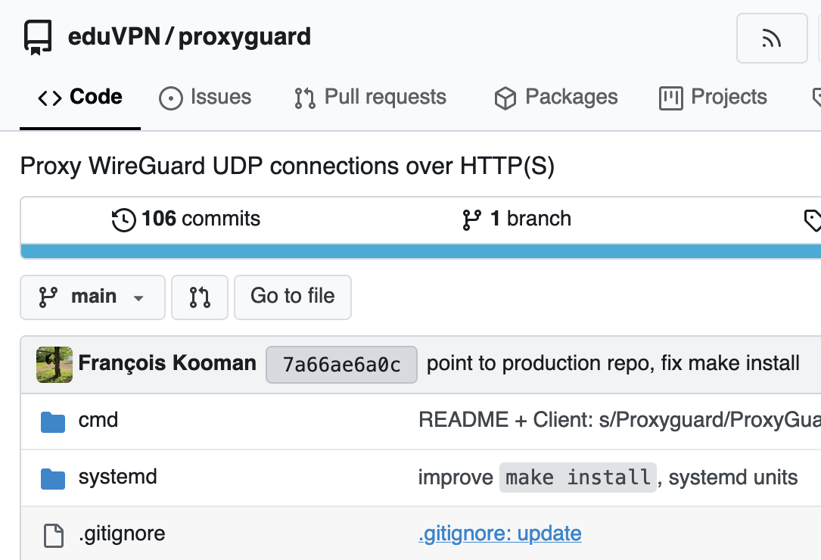
WireGuard over TCP: Implementation
Proxy: https://codeberg.org/eduVPN/proxyguard
Can be used behind a reverse proxy: HTTP handshake
Currently implemented in Windows, Android & Linux eduVPN client
Useful for OpenVPN (or any UDP traffic) too

Slide 28
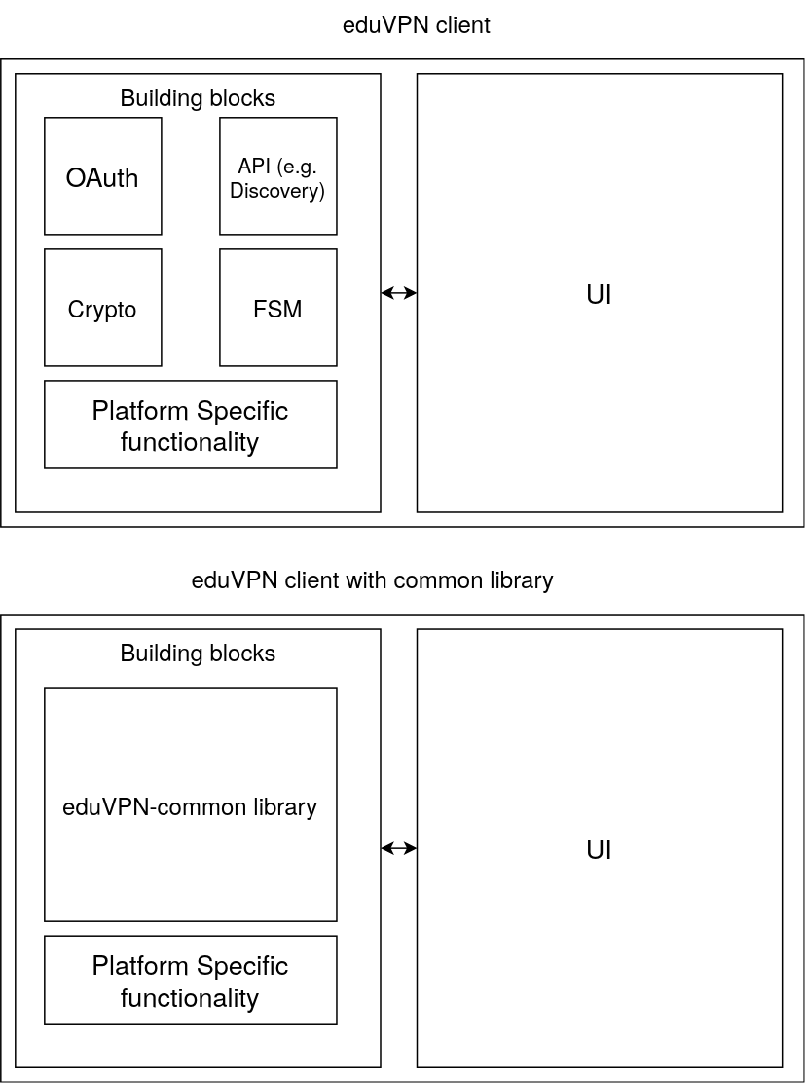
eduVPN client developments

Slide 29



eduvpn-common integration
New features ‘for free’:
  Online detection
  ProxyGuard
Fixes client bugs:
  Windows TLS stack
  Linux OAuth issues

Slide 30
Issues with EOL OS, eduVPN 2.x
As of 6 June 2024, 19 of the 184 eduVPN servers run EL7, 60 run Debian 10 and 2 run Debian 10
29 are running eduVPN 2.x

Slide 31
eduVPN side projects

Slide 32
Contact
eduVPN Team: eduvpn-support@lists.geant.org
Web: https://www.eduvpn.org

Slide 33
Thank you
Any questions?

Slide 34
Set up your own eduVPN instance in 6 steps
1. get a VM with one of the supported OSes
2. follow the deploy instructions
3. configure network (if necessary)
4. configure authentication
5. test server with eduVPN apps (by specifying hostname in search box)
6. request to be registered in eduVPN apps
https://docs.eduvpn.org/server/v3/#installation

Slide 35

The Commons Conservancy
Commons Conservancy is an 'organisation hypervisor' that can spawn and support virtual open source foundations
Each Programme runs independently from all the others, in perfect isolation
Each Programme determines its own operating environment (such as bylaws) with templates provided, and has own infrastructure (website etc.)
Templates to manage the legal stuff + support for the financial stuff

