Slide 1
RedIRIS
Connecting Spanish universities and R&D since 1988
www.rediris.es
GÉANT SIG-MSP - Poznan
24.10.2024

Slide 2





Who we are
For 36 years, RedIRIS has been the academic and research network (Spanish NREN)
RedIRIS is part of one of the 6 departments of Red.es
RedIRIS is managed by Red.es, which is part of the Spanish Government (Ministry of Digital Transformation).
Unlike other NRENs, which are Foundations or Associations.
50 M€ (2018-2023)
+​
RedIRIS-NOVA 100 project to renew equipment
+8M€​
It is currently owned by the Ministry of Science, Innovation and Universities (MICIU) and managed by red.es​ ​
50M€ RRF funds
(2023-2026)
Annual budget
Red.es is the Government's Digital Transformation Agency:
UNI-DIGITAL RedIRIS project for deployment of optical fiber and new shared ICT services
+1.000M€
+200
20
Annual spending budget
People ​
Staff
40 subcontractors

Slide 3
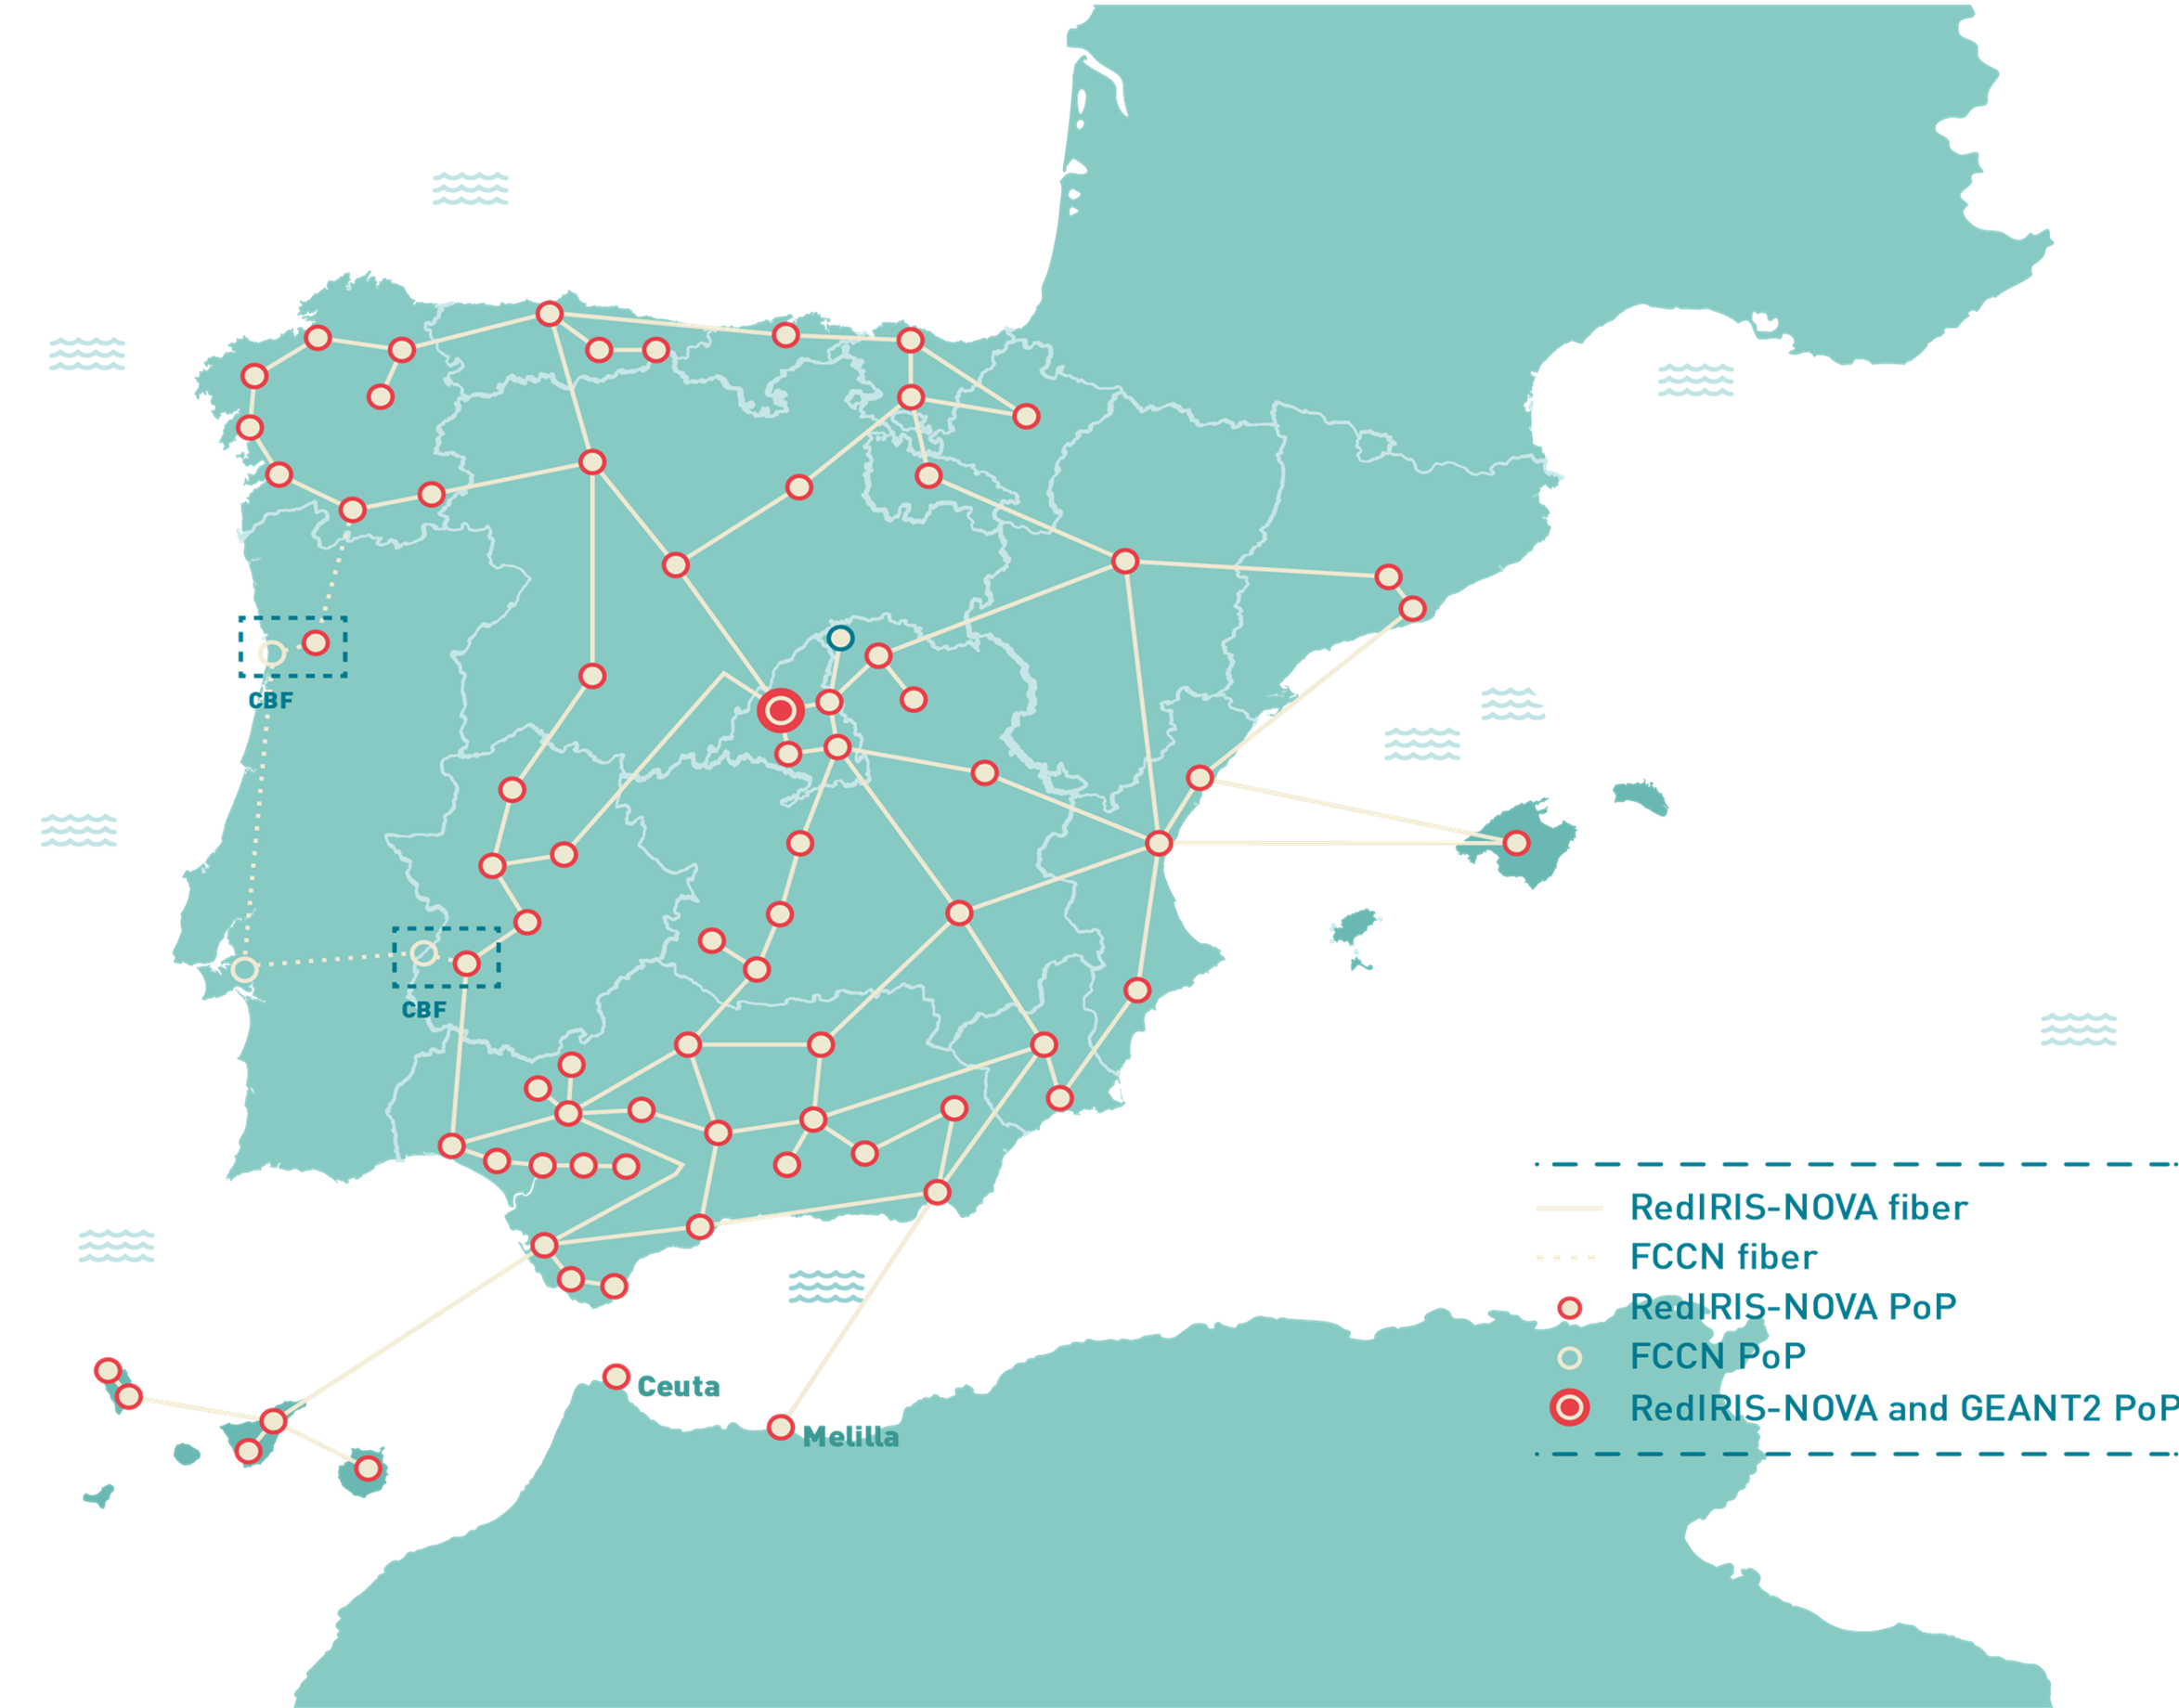
Who we are
We provide 500 affiliated institutions with a very high capacity backbone network:
+16.000km
Fiber IRU for 20/30 years​
Types of affiliated institutions
R&D Managers
Others
R&D centers
Universities
Research Departments of Hospitals

Slide 4
RedIRIS Services
PAST (1988)
PRESENT (2024)
FUTURE (2025 –…)
Evolution of service portfolio
Integration of new technologies
Provision of basic IT services
DOMAINS: RedIRIS managed the “.es” Registry until 2000.
WEB PAGES.
WEBMAIL: Web-based mail access.
NEWS.
SINGLE SIGN ON (PAPI): Proprietary system that provided Internet access control to restricted information resources.
CONNECTIVITY
IP Connectivity
IP Addresses
IRIS-SARA
IRIS DNS (Anycast)
Support for Open Science Cloud.
New cybersecurity services.
User-programmable virtual networks.
RedIRIS and new technologies (blockchain, quantum communications, time frequency, big data, AI, IoT & smart campus).
Support for UNI-DIGITAL services.
Optical circuits
Virtual circuits
Network incident management
SECURITY
Security Incident Management (IRIS-CERT)
Mitigatition of Denial of Service Attacks (DDoS)
Antispam filtering
Phishing simulation
DNS Firewall
SinMalos – malware information
DIGITAL IDENTITY
Federation of identities (SIR and eduGAIN)
Digital certificates (TCS)
COLLABORATION AND INFORMATION SHARING
Mailing Lists
AutoList
Data Transfer Service (FileSender)
CLOUD
GÉANT-OCRE agreements
DATA TRANSFER
Data transfer for e-Science (ASPERA)
TECHNICAL SUPPORT
E-administration
Monitoring tools
Other ICT tools
Consulting
MOBILITY
Eduroam.es
DIFFUSION
Events
Publications

Slide 5
RedIRIS Services
RedIRIS offers some unusual services among NRENs
Massive data transfer for e-Science based on “Aspera” software
DNS information management tool and Anycast secondary servers
Electronic administration support services:
Data exchange node, cloud-based electronic signature tool, electronic signature validation system, access through RedIRIS to the Administration network…

Slide 6
RedIRIS Services | Massive transfer of scientific data
Scientific data transfer using “Aspera” software
    RedIRIS has deployed an environment where affiliated entities can upload or download large scientific files.
Aspera is a commercial solution based on a patented protocol, which is responsible for solving the problems of:
Reduction of transmission speed when there is data loss in TCP protocols.
Main advantages:
Lack of appropriate interfaces in the non-commercial solutions to this issue
    Transfer large data files at maximum speed even over long distances, using the maximum available bandwidth.
    Encryption and data integrity verification.
    Web application-based user interfaces.
Investment from 2022 to 2025 (licenses, equipment, support)
    It has been used successfully by astronomical centers (IAA, "Uchuu" project), genomics, supercomputing, etc.
+2M€
Notes:
Expediente A016/22-RI – Valor verificado
743.639,46 € SIN IVA
899.803,75 € CON IVA
A002

Slide 7


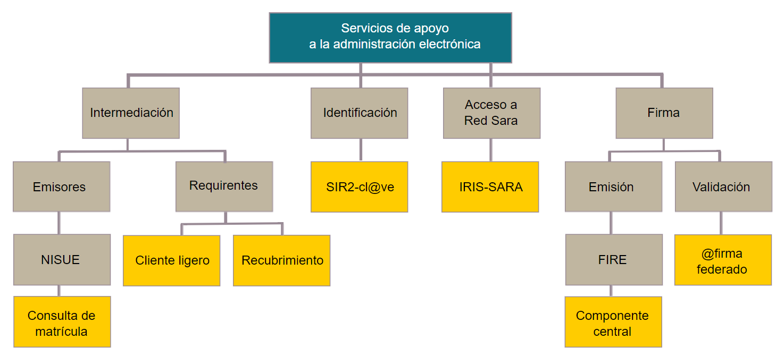



RedIRIS Services| Technical support to institutions
Support for electronic administration
Services provided with outsourced support
NISUE Enrollment data consultation: single point for the exchange of university information both among universities and between them and other organisations or institutions.
Cl@ve-SIR: unifies and simplifies electronic access of citizens to public services.
FIRe: tool provided by the Electronic Administration Portal (PAe) used for signing documents both locally and in the cloud.
@FIRMA federated: additional platform for validating electronic signatures and strengthening the reliability of this service
Estimated budget
+1M€
Public administration support services
Intermediation
Identification
Sara network access
Firm
Emitters
Applicants
Emission
Validation
Light client
Covering
@firma federated
IRIS-SARA: Rationalization of network infrastructure and access management through a single, secure, and rapidly deployable access to RedSARA e-administration services
Enrolment enquiry
Core component
Notes:
Expediente nuevo 009/24 (2024-)
Estado: Valoración de ofertas y presupuesto previsto de 440k+IVA

Slide 8
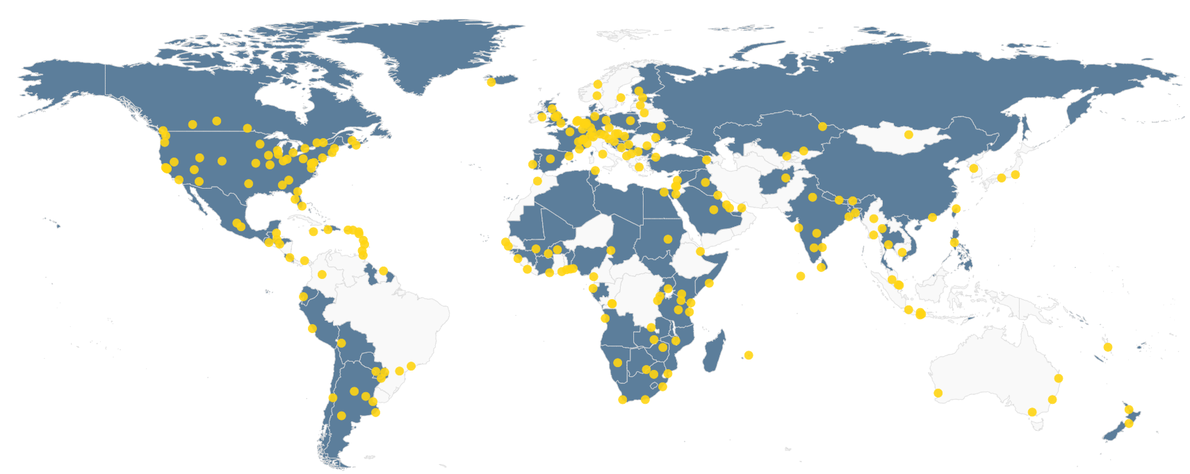
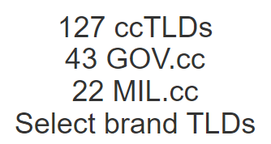

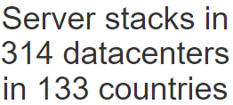

RedIRIS Services | Security
Management and hosting of DNS information of the affiliated institutions
IRIS-DNS is a tool that RedIRIS makes available to its Affiliated Institutions so that they can manage their DNS (Domain Name System).
Contract in execution between 2024 and 2028
RedIRIS hires 2 clouds of secondary anycast servers (with server networks across the planet) in which affiliated institutions can publish their DNS zones, to improve response time and have much greater resilience in the event of an attack.
+250K€
Notes:
Expediente 049/23 SI Servicio de Anycast para los dominios.es y RedIRIS (2024-2028), 70K+IVA. En ejecución
Expediente 089/22 SI Servicio Anycast y el servicio DNS de rediris (2024-2028), 132K+IVA. En ejecución

Slide 9


UNI DIGITAL - RedIRIS
As part of the Government of Spain's Recovery, Transformation and Resilience Plan (PRTR), investment is included in “Improving university infrastructure, equipment, technologies, teaching and digital assessment”, known as the UNI-DIGITAL program. (€144 million + VAT of RRF funds – of which €50+VAT million are for RedIRIS)
Scope
UNI-DIGITAL RedIRIS Digital Infrastructures to expand the RedIRIS fiber optic backbone network (€38M)
+16 Agreements with affiliated institutions (7 of them regional research and education networks) to carry out approximately 40 deployements
  Support for shared ICT infrastructure and services
It is planned to bring optical fibre to new scientific and academic organisations, and to collaborate with regional research and education networks in the renewal of optical and IP equipment to 100Gbps
Sources of funding
European funds - RRF
50M€ + VAT
UNI-DIGITAL RedIRIS shared ICT services to deploy ICT services and make more efficient management of resources, achieve economies of scale and improve interoperability (22M€)
Deployment of new services (in the fields of cybersecurity, electronic administration, blockchain, centralized acquisition of licenses for blended learning, support for open science, etc.), as part of the Agreement with the Ministry for Science, Innovation and Universities and in collaboration with CRUE (Spanish association of universities)

Slide 10
UNI DIGITAL - RedIRIS
Shared ICT Services
Cybersecurity
Digital Administration
DNS Firewall
Cyberintelligence Generation - SinMalos
Comprehensive Endpoint Detection and Response (EDR) system for Spanish Universities.
Licences for the improvement of blended learning (Kahoot, Genially, Kaltura/Panopto).
Transversal Platform for the Promotion of Open Science (PLATICA).
Single university archive.
Development of the academic standarized record (ECASUE).
Deployment of EBSI-based Blockchain nodes
Cloud infrastructure for the implementation of inter-university projects.
Blockchain
Educational Technology
CLOUD
Open Science

Slide 11
RedIRIS Services | Security
Generating cyber intelligence tailored to research and education networks
SinMalos is an effort by the RedIRIS cybersecurity community. This is a tool that allows you to analyze and group information in real time from each of the registered sources in order to block malicious traffic.
﻿+66
Institutions use SinMalos
﻿+25k
IP addresses (average) reported by SinMalos
The producing entities generate their own cybersecurity information, which they provide to SinMalos.
A contract for the improvement and consolidation of the service is being tendered
Estimated budget of:
The consumer entities have access to the feeds generated by the project for consumption in FWs, MTAs, SIEMs, etc.
SinMalos information lists are shared with the CCN-CERT National Network of SOCs
2M€
Notes:
Expediente A020/23 RI

Slide 12
RedIRIS Services | Security
Complementary security to traditional firewalls
﻿+70
Affiliated institutions benefit from the service
DNS Firewall
RedIRIS uses the Cisco Umbrella platform that complements traditional firewalls and other traffic inspection tools, focusing solely on DNS traffic.
Anycast cloud architecture to ensure the highest possible availability and resilience to failures
Access to the tool, so that each institution can customize the operation of the service and obtain its own usage statistics and alerts.
Current contract in execution (2022 – 2025)
Simple deployment, since it is only necessary to re-route DNS traffic to the service resolvers.
+2,75M€
Notes:
Expediente 088/21RI

Slide 13
RedIRIS Services | Security
Deployment of cybersecurity solutions
RedIRIS will provides EndPoint Detection and Response tools (EDR) to Spanish Universities
RedIRIS captures with the deployed EDRs additional cybersecurity information, and integrates it with other sources such as DDoS, DNS Firewall and antispam, in order to collaborate with the National Network of SOCs of Spain
Continuous monitoring and analysis of the End Points and the network.
Along with other security measures, these systems are deployed on university servers and computers to detect and respond to cyber threats.
Current contract being prepared
6M€
Estimated budget
Notes:
Expediente A025/24 en elaboración

Slide 14

RedIRIS Services | Educational technology
Provision of licenses for blended learning
RedIRIS purchases licences of tools which improve blended learning through increased interactivity
Joint collaboration between RedIRIS and the Conference of Rectors of Spanish Universities (CRUE).
Integration of tools which reinforce the Learning Manament Systems (LMS) that the universities already have in place enriching both face-to-face and distance learning
It is not a service commonly provided by other National Research and Education Networks.
Notes:
Kahoot: Expediente A024/23
Genially: ExpedienteA023/23
Kaltura: ExpedienteA043/23
Integramos licencia de docencia híbrida como refuerzo a lo que ya tienen. Enriquecer el entorno de docencia híbrida, presencial o a distancia

Slide 15

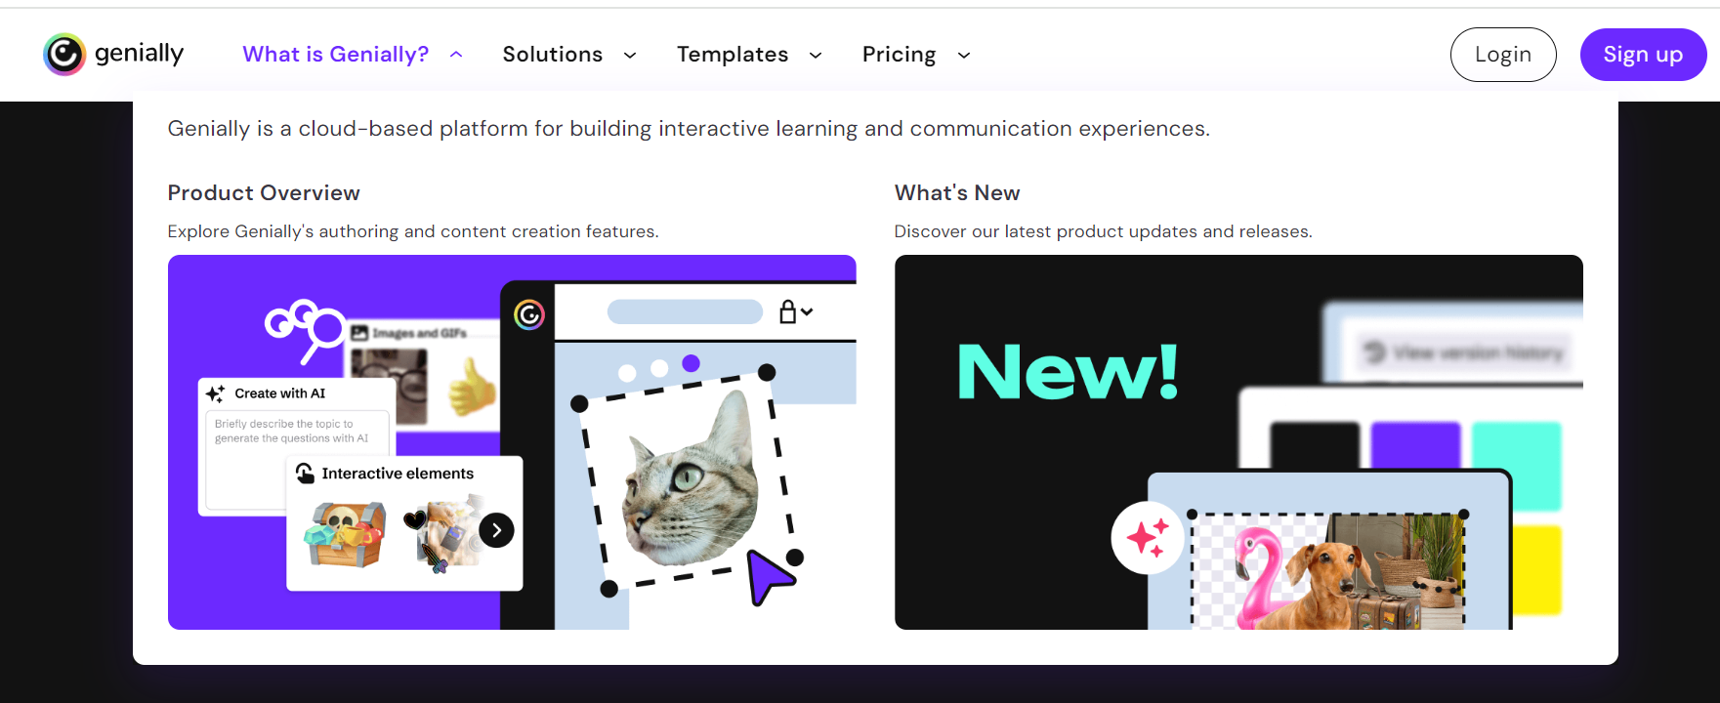
RedIRIS Services | Educational technology
Provision of licenses for blended learning
Online game-based learning platform
Generation of interactive content
Kahoot
Genially
Deployment phase
Deployment phase
Budget 1,3M€
Budget 1,5M€
Notes:
Kahoot: Expediente A024/23
Genially: ExpedienteA023/23
Kaltura: ExpedienteA043/23

Slide 16
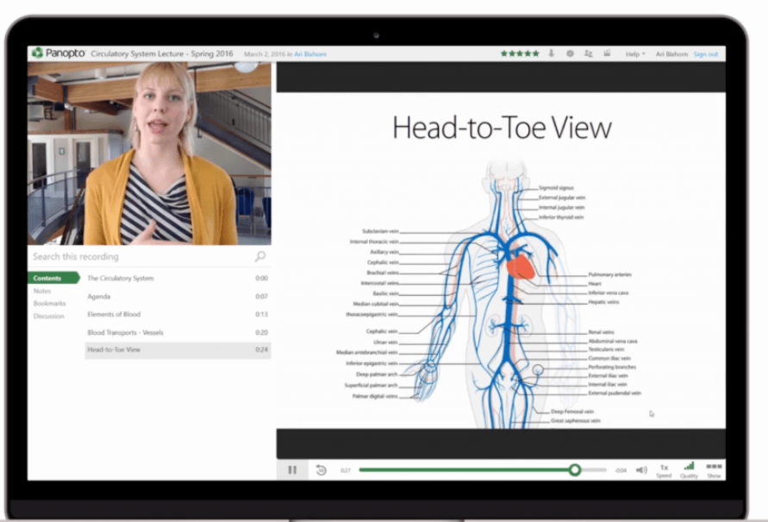




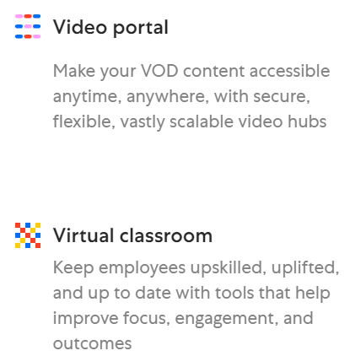
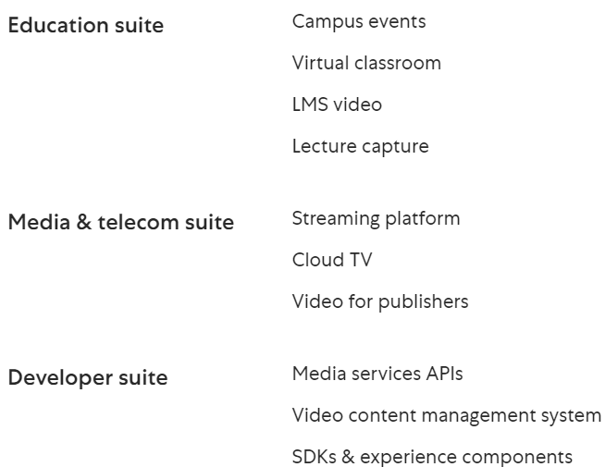
RedIRIS Services | Educational technology
Provision of licenses for blended learning
INCLUIR IMAGEN DE USO DE KALTURA
Kaltura
Panopto
In the process of tendering
Estimated Budget 3,2M€
Notes:
Kahoot: Expediente A024/23
Genially: ExpedienteA023/23
Kaltura: ExpedienteA043/23 – se ha cancelado Expediente 024.

Slide 17

RedIRIS Services | Open science
PLATICA: Transversal Platform for the Promotion of Open Science
Support Chatbot for the dissemination of open science.
Tool to help create and share data management plans for research.
  Catalogue, Registry and Repository of Research Data (CARREDI).
          Data ontology.
          Cloud storage for open data from scientific disciplines that do not have a reference repository.
Current contract being tendered
1M€
  Platform for the automation of statistical monitoring of Open Science in Spain.
Estimated budget
Notes:
Expediente 005/24

Slide 18

RedIRIS Services | Digital administration
Support for digital administration
Single digital archive
RedIRIS is deploying the Archive tool of the SGAD (General Secretariat of Digital Administration) on dedicated servers, allowing universities to access a centralized and secure storage solution so that they can comply with the legal obligation to archive their administrative information for a certain number of years
Contract in execution
+600K€
        This joint action prevents each university from having to deploy and maintain this system.
Notes:
ECASUE Expediente C001/23-DG
ARCHIVE Expediente 005/23

Slide 19
RedIRIS Services | Digital administration
Support for digital administration
Academic Standard Record of the Spanish University System
(ECASUE)
Data can be queried between public and private universities in the Spanish Higher Education system.
Automated processes make it easier to manage the queried data.
Data exchange is standardised, using a common language for all universities.
It facilitates implementation by university management systems.
The technological platform uses up-to-date, secure and reliable technologies.
Now with ECASUE the functionality of the NISUE interoperability node is expanded with 2 new use cases:
  Exchange of information on academic records
Pilot phase
  University Access
+1M€
Notes:
ECASUE Expediente C001/23-DG
ARCHIVE Expediente 005/23
Crea un sistema de datos de referencia para el intercambio de información / se estandariza un lenguaje común / ontología sistema de metadatos entre la información que intercambian las universidades

Slide 20

RedIRIS Services | Blockchain
Blockchain Infrastructure for Universities
  RedIRIS will deploy a reference node that complies with the EBSI (European Blockchain Service Infraestructure) node specification, which will also be implemented in nodes of several universities, in order to have a blockchain infrastructure on which universities can launch applications such as those related to diplomas.
Estimated budget
Tender preparation
+ 1M€
RedIRIS and CRUE have been collaborating in this field since 2018 through the BLUE project (Blockchain of Spanish Universities)
Notes:
Expediente 021/24

Slide 21

SERVICIOS CON LA DIRECTIVA NIS 2
RedIRIS Services | Cloud
Cloud infrastructure
Providing cloud infrastructure support to university projects
RedIRIS will provide cloud infrastructure (IaaS) to a selection of 13 UNI-DIGITAL interuniversity projects for a period of three years, allowing these projects to be deployed on that common infrastructure.
IaaS services are being contracted through the pan-European OCRE framework agreement tendered by GÉANT (which has significant advantages, but which in practice has generated many internal administrative problems)
Estimated budget
2M€
Notes:
A036 (1,6M) apertura de sobres y A025 en ejecución 428k

Slide 22
Assessment of the UNI DIGITAL- RedIRIS Initiative
Strengthening the RedIRIS service portfolio
  Reinforcement of existing lines of work and opening up to new areas
  Very attractive value proposition for universities (services requested by them, provided centrally by RedIRIS, and paid for with European funds)
Need to outsource services
Doing much more with the same staff members. Lack of internal staff to manage new services.
“Turnkey” projects. High dependence on third parties for the configuration and delivery of new services.
Complexity of tendering
Many simultaneous specifications, on very different subjects, in a very short time.
Need to cooperate with university representatives in order to define and implement the services.
Sustainability issues
European funding only covers the cost of some years of service.
RedIRIS can cover the recurring cost of some services, but not others (e.g. EDR licenses and blended learning licences)
Notes:
Pendiente ajustar texto

Slide 23
RedIRIS
Connecting Spanish universities and R&D since 1988
www.rediris.es

