Slide 1


The GÉANT Compendium of NRENs
Extend the Service Matrix for global use?
Jennifer Ross
Partner Relations
SIG-MSP, Poznan, Poland
24th Oct. 2024
Public / Confidential / Restricted

Slide 2
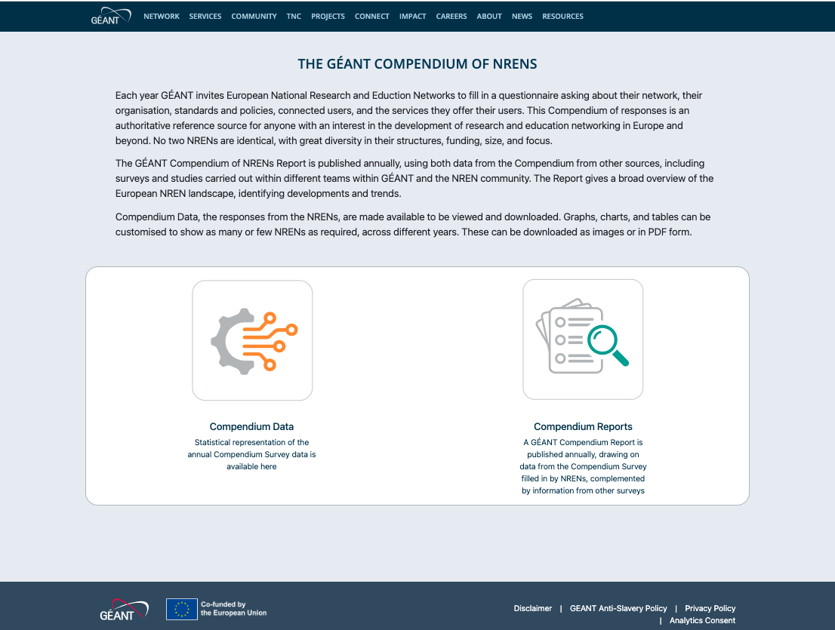
The GÉANT Compendium of NRENs: what, how, where, etc?
compendium.geant.org
Bespoke survey site
Repository of survey response data
Link to previous Compendium Reports
The Compendium survey opened for GÉANT NRENs annually
c.90 questions + services
High, steady response rate – only 2 NRENs regularly not completing some of the survey

Slide 3
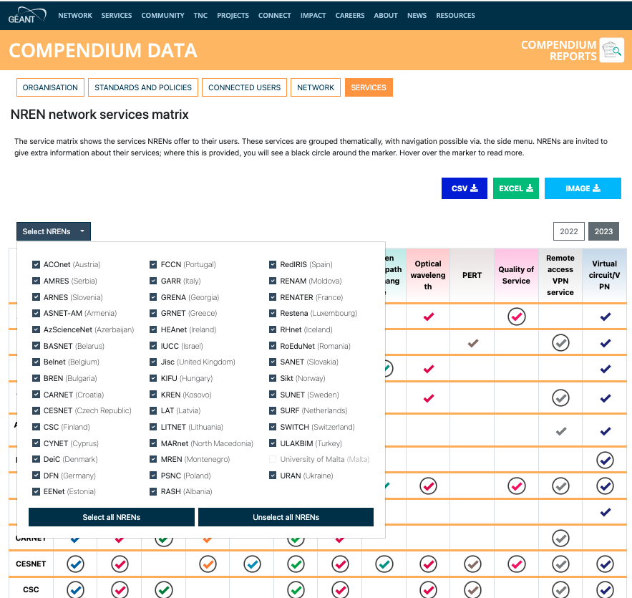
What I’ve been asked to talk about…. Non-GÉANT NRENs
Background:
TNC24 CEO Track discussion
Interest in knowing which services different NRENs offer their users
For GÉANT NRENs, this information is in the Compendium
Should we give non-GÉANT NRENs the option to contribute too?

Slide 4
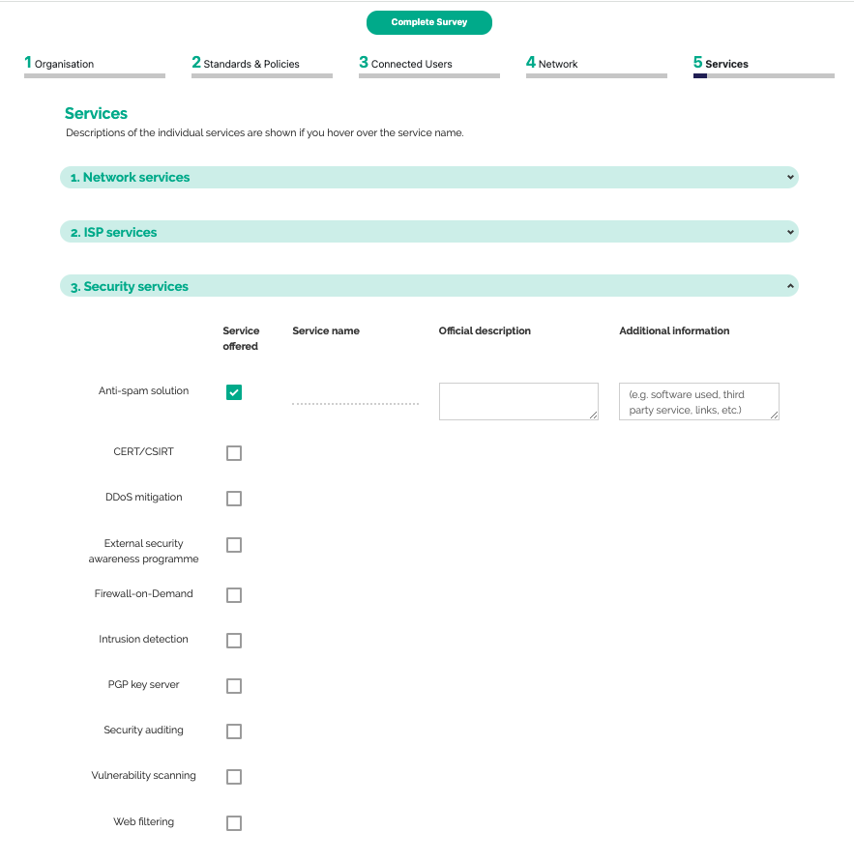
The Services Section
Known as the “service matrix” due to how the data is displayed.
Historic problem of asking NRENs to update the matrix, but no timestamp.
Now a part of the full survey.
Service Families: Network, ISP, Security, Identity, Storage & hosting, Multimedia, Collaboration, Professional.

Slide 5
Technical factors
The Compendium site is bespoke, and was created with the option to add “new” NRENs to the underlying database.
This would require work by the programmers.
We would have to decide whether the “new” NRENs fill in the full survey or just the services section.
Creating a separate survey also takes time.
Value in consistency: would be disapointing and a waste of time/effort to have patchy results.

Slide 6
My questions for you….
The Compendium is funded from the GÉANT Project. Do GÉANT NRENs see the value in spending developer time/effort on adding international NRENs?
Would you want responses from other NRENs presented alongside GÉANT Member NRENs?
Would you like the whole survey opening to non-GÉANT NRENs?
What “minimum commitment” would we expect from “new” survey respondents?

Slide 7
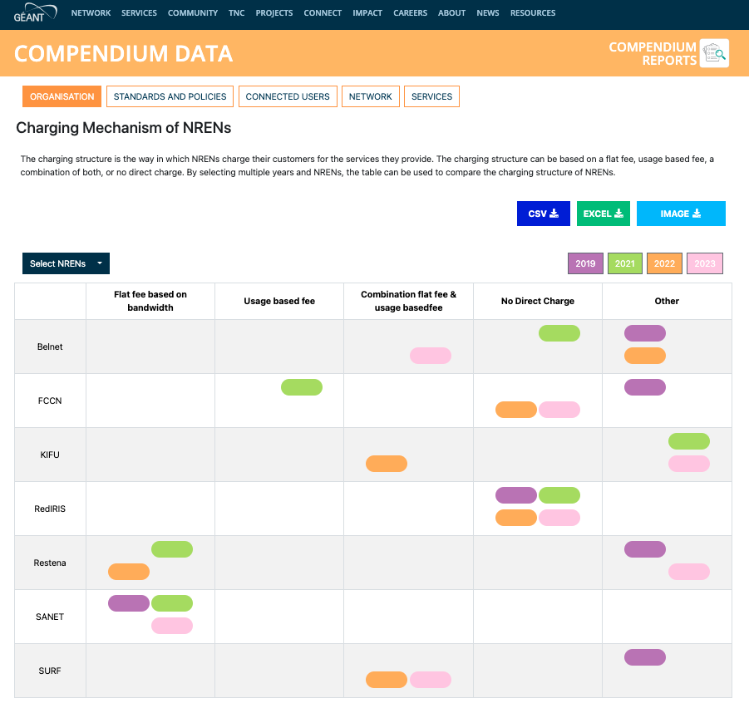
Other Compendium Things of Relevance to SIG-MSP Members
Information about how other NRENs charge their members is in the Compendium.
Question is perhaps skewed towards network services.
Would there be an appetite to add a new question?

Slide 8
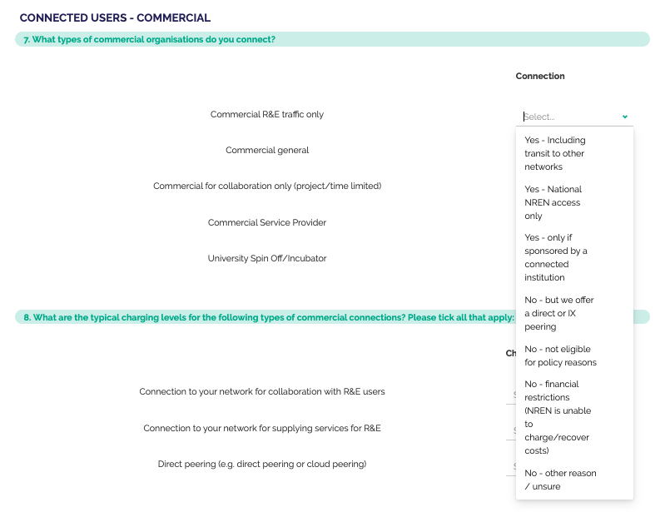
The Survey also asks:
Does your NREN operate a formal service managmeent framework for all of your services?
Are Service Level Targets available for your NREN services?
Which service types are available for which user types?

Slide 9
Final Message
The Compendium Survey is open until 6th December 2024.
2 NRENs have already completed it, 8 more have started.
Please make sure that your NREN fills in the survey in time!
The results will be published as soon as possible in the New Year on the data site.

Slide 10
Thank You
Any questions?
www.geant.org

Slide 11
Colour palette
Primary
Secondary
Hex | #004461
Hex | #EE426D
Hex | #F4E200
Hex | #3C51A2
Hex | #0ABBC2
Hex | #1AAA88
Teal is the lead primary colour, its neutrality providing a strong background for accent and secondary colours.
Crimson is the accent primary colour, its brightness providing a strong contrast to the teal and a lead for the secondary colours.
The secondary colours have been selected to complement the primary colours. These secondary colours should be used sparingly and only used in addition to, and where they will not interfere with the primary colours.

Slide 12
Best practice
Please note, this template is for use with GÉANT Association corporate content.
If you are representing project work, ensure you use the correct PROJECT template.
1
2
3
4
Less is more
Clear message
Use photos
Ask for help
Aim for one slide per minute of presentation (maximum!)
Keep your messages concise, try not to overload your slide
Use images to maximise impact
Add notes to request any diagrams, illustrations or photos

Slide 13

Typography
Slide Titles = 28pt Bold
Sentences = 24pt Regular. See Slide 4.
Paragraphs = 18pt Regular (never less). See Slide 2.
Captions = 14pt Regular. See Slide 6.

Slide 14












































Icon set

