Slide 1


OCRE2024 update
(confidential)
Michel Wets
24 October 2024
SIG-MSP Poznan
Notes:
Introduction + Open Cloud for Research and Education explanation

Slide 2







Nearly a decade of history
2006 – 2012
Start Cloud platforms
2015
Start collaboration NRENs to tender commercial Cloud services
2016 - 2020
(2016) First collective NREN tender
IaaS frameworks available in 27 countries
11 Cloud platforms available
2019
Start OCRE Project
How can Cloud computing be beneficial for Reseach and Education?
Open Clouds for Research Environments
2020 - 2024
(2020) Launch OCRE tender (IaaS+)
IaaS+ frameworks in 40 countries
On average 14 platforms availabe per country
2024 -2029
(2024) Launch OCRE2024 tender (IaaS+)
Frameworks availabe per 3/2/2025 – ending 2/2/2030

Slide 3
Timeline of the OCRE 2024 Tender
13.05.2024
Evaluation
December 2024
20.03.2024
Contract Completion
03.02.2025
Publication*
End Nov.2024
Start
Award + standstill
Deadline for Call-off Contracts
under OCRE 2020 (30.11.2024)
Commence date
OCRE2024
Duration of OCRE2024 Call-off Contracts is up to five (5) years from the Commence Date.

Slide 4
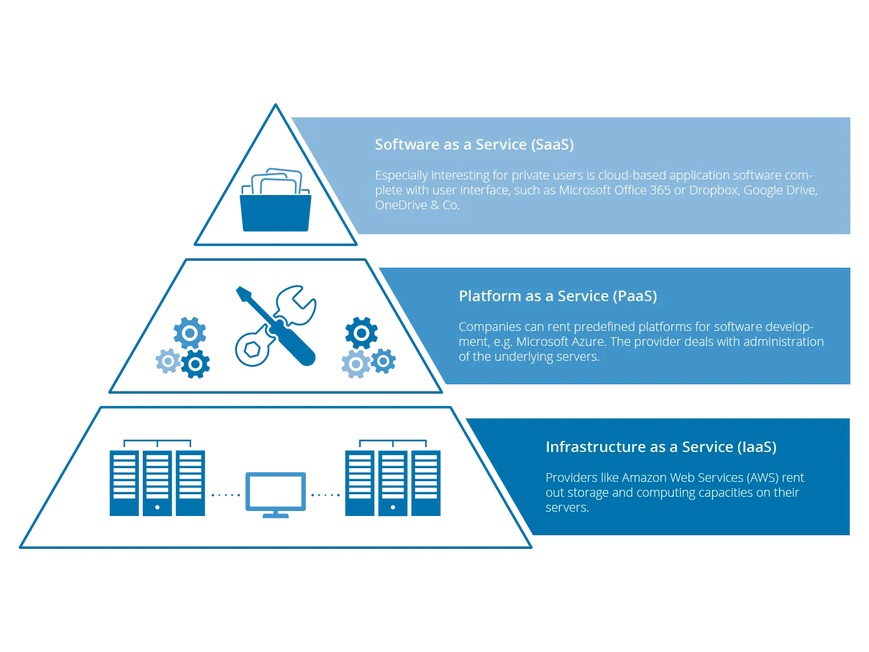
What is IaaS+?

Slide 5










Goal and key benefits for the R&E Community
Easy to use and compliant agreements. Fitting requirements of the R&E community
Set up of Cloud
Identity Management
Shared use across institutions
BYOL
Local support & trainings
Access to best in class suppliers and technologies.
Suppliers are continously monitored and managed
Pricing & Conditions
Minimal discount 8%
Access to vendor’s senior management via GÉANT CMG
Access to trainings and workshops on new technologies
Services offered by suppliers are compatible with GÉANT infrastructure
Connectivity
Peering Connection (Géant / NREN)
Minimum Egress waiver caped at 15% of monthly consumption and exit support
Provisions for large research data sets
Data Protection
GDPR analysis updated yearly
Information of data processing changes during contract
No AI training with customer data
Available standard DPA upon request
Safe data handling, GDPR compliant
Ease of doing business, reporting
Reporting
Online Portal
Split billing and E-invoicing / billing in local currency
Security incident reporting

Slide 6
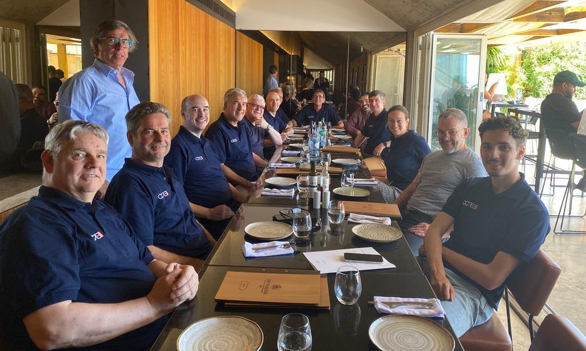
The OCRE2024 scoring team
Participating NRENs: RHnet, SIKT, DEIC, DFN, FCCN, SURF & GÉANT
Participants worked on this 3 days a week for 6 months, meeting 5 times in person
All are still actively involved in the aftermath of the scoring

Slide 7
Thank you
Questions please

