Slide 1

Belnet
24/10/2024

Slide 2
Product Management @ Belnet
SIG-MSP 24/10/2024

Slide 3
Product Management: Challenges
Challenges
Budgets
    Mixed of dotation and profits of several services like BNIX, OCRE, Security Services (DDoS)
People
    We lost quite some people lately and hard to find new ones.
    We hire consultants but that is expensive and often only a short term solution.
    2 product managers are responsible for all services, even doing contracts sometimes, CRM changes, …
  Customers
      Hard to add new customers
      Customers with uncertain budgets
      R&E world is still to discover

Slide 4
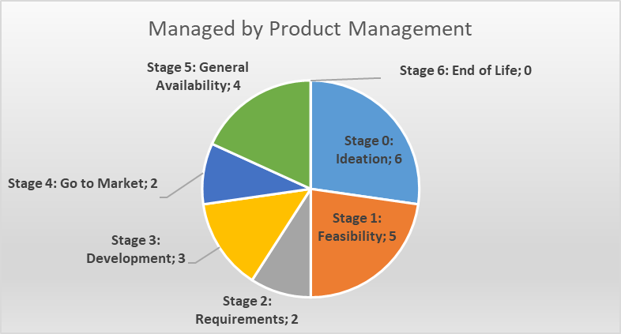
Product Management: Statistics

Slide 5
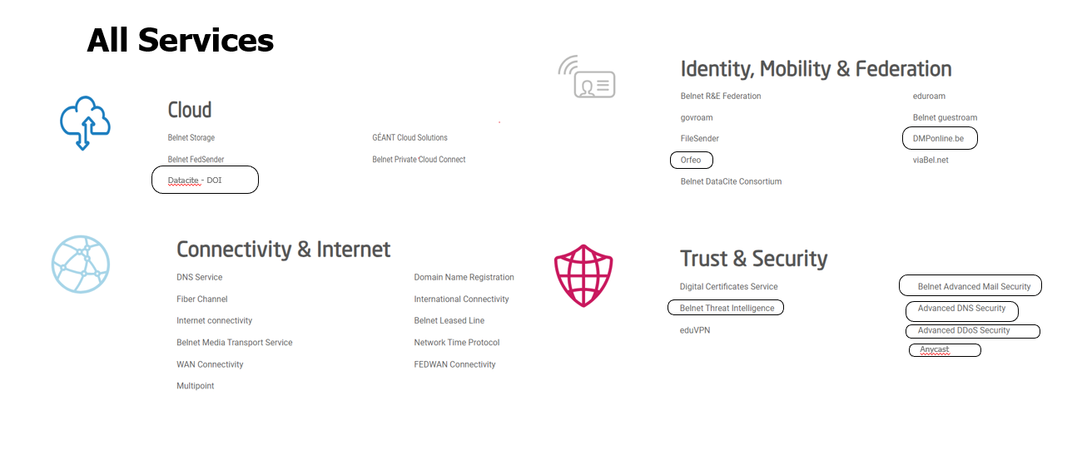
Product Management: All Services @ Belnet

Slide 6
Product Management: Products in development
Priority 1 products
DDoS Self-Service Portal – portal that allow customers to see what is going on, in real time, when suffering a DDoS attack.
SOC (Security Operations Center) – Belnet will launch a tender mainly intended for the R&E community to offer 24/7 network monitoring through the new framework
OCRE24 – Working towards new offers/partners
Belnet Advanced Mail Security: New pricing as tender has been renewed
Managed Wi-Fi (Campus as a Service) : Juniper Mist
Boosted : Belgium Optical network for Optical frequency Standards and TimE Dissemination
    Implementing a Time & Frequency (T&F) network
    cost evaluation

Slide 7
Product Management: Products in development
Other
Quantum Communication Infrastructure – A major milestone was the purchase of the Quantum Key Distribution (QKD) equipment. These machines are central to establishing secure connections.
PID – longer term
Pricing Public Internet - Revising

