Slide 1


GÉANT Vulnerability Management Service (VMS)
Zoë Fischer (GÉANT) & Jeroen Wijenbergh (GÉANT)
SIG-MSP Poznan 2024 (Remote)
24.10.2024
Public

Slide 2

https://www.shiftingshares.com/iceberg-order/

Slide 3
GÉANT Vulnerability Management Service
Scan network-attached IT assets on potential security vulnerabilities
Solution for R&E community
Swedish commercial supplier: Outpost24
First NREN using VMS
May 2024
Second NREN on trial
June 2024
Other NRENs interested
July-October 2024
Service officially launched
December 2023

Slide 4
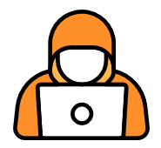
Why Do NRENs and Institutions Need VMS?
More and more services are connected to the internet
Malicious actors scan continuously
R&E is not immune to cyberattacks

Slide 5



Internal Scanning
External Scanning
External Facing Systems
Scanner
Internal Systems

Slide 6
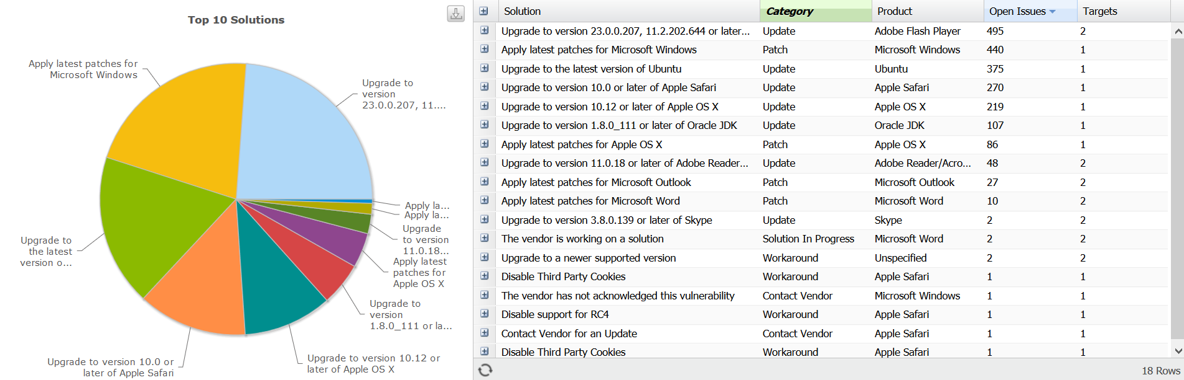
https://kb.outpost24.com/kb/reporting-tools#ReportingTools-Solutions

Slide 7
How can NRENs use VMS?
No fixed monthly fee for subscribing to the service
Billing based on usage
Offered via a layered approach
GÉANT acts as primary Service Manager
NRENs act as users and/or managers for their Institutions
Notes:
This slide provides a quick overview of the main points, which we'll discuss in more detail shortly.
GÉANT VMS enables NRENS and their connected institutions to scan IP-address ranges for software vulnerabilities.
Instead of a fixed monthly fee, NRENs are billed based on the number of IP addresses scanned. This means you only pay for what you use.
The service is structured through a layered approach, where GÉANT acts as the primary service Manager and the NRENs act as users and/ or managers for their connected institutions.

Slide 8
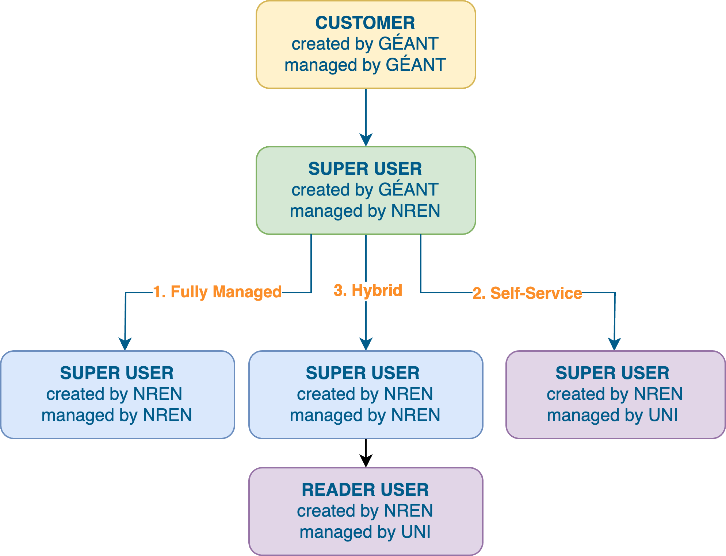
Service Models
Options:
Fully Managed Model
Self-Service Model
Hybrid Model
Main difference → Autonomy of connected institution
Notes:
There are three different service models, how the service can be used.
The main difference between the three is level of autonomy for connected institutions.
Fully Managed Model: The NREN handles scan management, asset management, and scan scheduling. They send results to connected institutions, checking for false positives before sending.
Self-Service Model: The NREN creates scan containers on the platform, manages users, provides first-line support, and handles invoicing. Connected institutions scan their own internal and external IP spaces.
Hybrid Model: The NREN manages scanning, while connected institutions review and export results from the platform.

Slide 9
Pricing and Charges
Charges based on IP-addresses scanned
Price per scanned IP address = € 0.04
10,000 IP addresses active in the portal
9,000 IPs scanned in one month
Costs for one month: 9,000 x € 0.04 = € 360.00
Invoiced each quarter
Example
Notes:
No billing
Added percentage – for example charging €0.05 per month per host.
Fixed quarterly fee – e.g. €250 per institution per quarter.

Slide 10




Pricing and Charges
Charges based on IP-addresses scanned
Price per scanned IP address = € 0.04
10,000 IP addresses active in the portal
9,000 IPs scanned in one month
Costs for one month: 9,000 x € 0.04 = € 360.00
Invoiced each quarter
Example
Options for Institutional Billing
Not Billing Connected Institutions
Add Percentage to Fee
Fixed Quarterly Fee
Notes:
No billing
Added percentage – for example charging €0.05 per month per host.
Fixed quarterly fee – e.g. €250 per institution per quarter.

Slide 11
Requesting Enrollment
NRENs should send VMS enrollment requests to Partner Relations
partner-relations@geant.org
Enrolled NRENs wishing to register new connected institutions send a request to
vms.admin@geant.org

