Slide 1

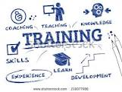

Up2U Training Plan
Athens, Up2U Meeting, 23/1/2018
Mary Grammatikou
mary@netmode.ntua.gr

Slide 2

Purpose of Training
Familiarization with Up2U platform and tools
Development of digital skills
Adequacy in most fields of the European Framework for the Digital Competence of Educators (DigCompEdu)

Slide 3

DigCompEdu - Digital Competence of Educators
Up2U in line with the DigCompEdu
Synchronizing the U2U survey results with DigCompEdu categories
Variety of skills for the teachers in different schools and countries

Slide 4
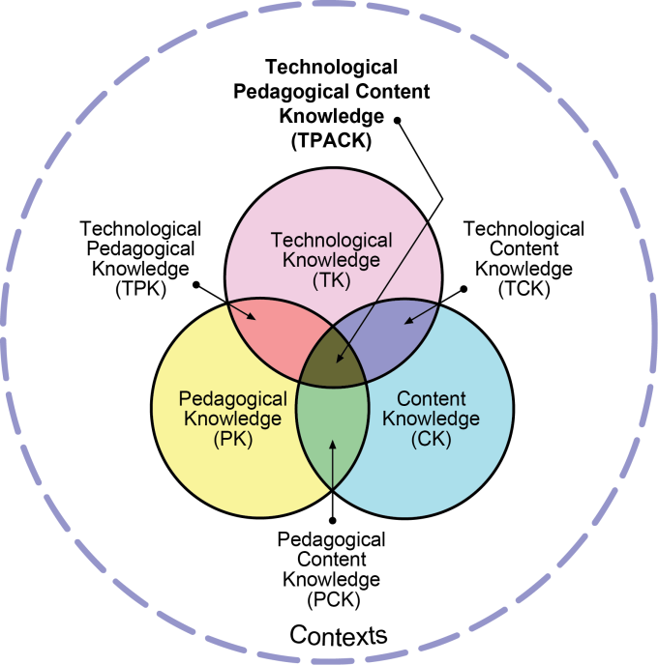
TPACK Framework - Technological Pedagogical Content Knowledge Framework
Three primary forms of knowledge:
Content (CK),
Pedagogy (PK),
Technology (TK)
The TPACK framework goes further by emphasizing the kinds of knowledge that lie at the intersections between three primary forms:
Pedagogical Content Knowledge (PCK)
Technological Content Knowledge (TCK)
Technological Pedagogical Knowledge (TPK)
Technological Pedagogical Content Knowledge (TPACK)

Slide 5
Bloom Taxonomy Methodology

Slide 6
Up2U Using the Bloom Taxonomy
Moodle as a Use Case
Administration
  Teachers will learn about the usability and characteristics of the Moodle platform. They will go through the main characteristics of a Moodle platform and will learn how to be navigated and how to administer the platform in order to be able to create a simple course for their students.

Slide 7
Construction
Teachers will learn to create a Moodle lesson and to use the main services and tools of Moodle in order to deliver a successful lesson, more specifically:
  How to construct the modules of the lesson
  How to use the main services and tools of the Moodle platform for delivering a successful, attractive and pedagogically correct course
  How to explore the web for Open Educational Recourses that can be used in their course

Slide 8
Content
Teachers will learn about constructing evaluation methods and tools for measuring pedagogical results.
They will learn about using assessment tools in a Moodle lesson as well as other tools which can be embedded on it.
They will learn about guiding students through a Moodle lesson in order to inspire them and to make the learning methodology more attractive though these digital tools
They will learn about Open Educational Recourses that can be found in the web and ways to use them in order to improve the educational practice
They will develop basic skills, as digital skills, methodological thinking skills, metagnostic skills, communication in their mother tongue skills and communicating in a foreign language, and finally skills for negotiating and developing arguments to support an opinion or an action etc.

Slide 9

Training Plan steps
Gathering trainees characteristics and needs (questionnaires) - done
Data analysis - done
Set targets to the training process (to do)
Creation of seminars and training material (to do)
Implementation (to do)
            Constant supervision by the SMC

Slide 10

Seminar Structure
First level of training – online and local courses
Intermediate training – local events (pilots)
Final training – online courses

Slide 11
Seminar Structure - First level
Introduction
Approach of teaching methods and educators training
Use Cases based on teachers needs
Practical training
Closing Session: Summarization, follow up, evaluation references

Slide 12
Seminar Structure -
Intermediate training
Focus on specific tools and their integration in formal and informal education
Accession of the platform to teaching practices
Description of further, more complicated use cases

Slide 13
Seminar Structure -
Final training
Local events in pilot countries
Teachers/Tutors will be better to participate after completing the first 2 online training levels (basic, intermediate)
Experts will ease and explain each tool’s details of use
Demonstration of methods and practices to activate students
Discussion on successful practices

Slide 14
Timeline
First level training from February 2018 to September 2018
Intermediate level training from October 2018 to February 2019
Final level training from March 2019 to September 2019

Slide 15
Your Comments are more than welcome

