Slide 1

Clouds update
GÉANT IaaS, Videoconferencing and File Sync & Share Frameworks
Maria Ristkok, Lars Fuglevaag
GÉANT Cloud Team
SIG-Marcomms meetings, Helsinki
14 March 2017

Slide 2

GÉANT Cloud collaboration
COLLABORATION
SERVICES
REALTIME
COMMUNICATION
E-learning
and education
services
FILE STORAGE
AND SYNC
INFRASTRUCTURE
AS A
SERVICE

Slide 3






















GÉANT Cloud Activity Outcomes

Slide 4
Benefits of the IaaS framework agreements
Procurement compliant in EU & EEA
Legal compliance (EU data protection law)
Institutional - supplier call off contracts under local law
Invoice billing, no credit card needed
Aggregate use discounts (10,000 institutions)
Mandatory SAML support (some eduGAIN)
Direct peering with GÉANT network
The NRENs and their Institutions that are part of this tender can use its outcomes without additional procurement required
There is no obligation whatsoever on the Customers to purchase, and the are entitled to run their own procurement to purchase any products covered within this contract

Slide 5
Quality & Qualifications institute (QQI) in Ireland achieves substantial savings with GÉANT Cloud Framework
Average daily spend Nov 2016 – Oct 2017
  33% cost reduction
  after QQI worked with the Irish NREN, HEAnet,
  to transfer their Microsoft Azure workloads
  to the GÉANT framework agreement,
  from July 2017 onwards

Slide 6
Goal at the end of 2018
Every NREN, that is part of the IaaS tender, has
  A cloud manager / team in place
  Signed the Service Commencement Forms (SCFs)
  Informed their institutions about the availability and benefits of the IaaS portfolio
  Established a national cloud community, with institutional cloud managers, a associated communication channels:
    An e-mail list
    A cloud website
    Face to face meetings; cloud events
In every country, institutional consumption is happening.

Slide 7
Adoption in Figures by March 2018

Slide 8
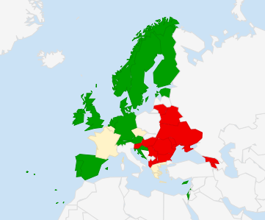
IaaS Framework Services Uptake Overview
More than half the countries sharing the FW information with their national communities
Organising national events
Creating national cloud website
Newsletters and informative emails on clouds
Attending the weekly GÉANT IaaS VC Forum
On the picture: most potential countries for the IaaS FW adoption are green
8

Slide 9
Marketing communication options
User events
local workshop, information day, conference, webinar
Marketing material
Newsletter, use cases, best practices, articles, fliers, handbooks and guidance for tools
Electronic channels
Mailing lists, website and user portal
Support from Suppliers
Events: technical workshops and trainings, webinars, presentations at conferences
Whitepapers
Support from GÉANT Clouds Team
Test accounts

Slide 10
Support from the GÉANT Cloud Team
Online communications
Speakers, presentations and communication material
Workshops, webinars and
other events
Adoption pilots
User stories, showcases & good practices
Toolkits
Skills development

Slide 11
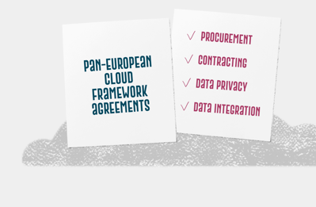
NREN cloud support
Established a community of NREN cloud managers:
ca 140 persons
Active e-mail list (94), newsletter (196 subscribers)
Weekly “Cloud Forum” video conferences
IaaS launch event for NRENs and suppliers
Face to face workshops on cloud service delivery
Contract repository
Supplier sessions
Online supplier comparison
GÉANT Funding – 6 months for Manpower
2-minute cloud videos to introduce IaaS portfolio
National cloud events and community interaction
Comms material (slides, articles, fliers)

Slide 12
GÉANT Community Clouds website
GÉANT clouds website, to better reflect the GÉANT cloud service delivery capabilities
Newsfeed & Cloud events
Cloud catalogue & IaaS Service Matrix
User stories
Maps for contacts
Guidelines
Contracts Repository
Chatbot (in process)
“Button” integration for all relevant information per country (in process)

Slide 13
Breakout Discussion
10 minutes for discussion No 1:
Find 3 top objections / questions that institutions (and your colleagues) may have against cloud services
Exchange the lists!
15 minutes for breakout discussion No 2:
Find the answers and solutions to the questions /objections
Feedback on the results for each group

Slide 14
List of problems and challenges that NRENs brought out at the GÉANT Symposium in Budapest (2017)
Lack of resources: communications, finding a clouds expert
Decision making is complicated: role, procedures, NREN vs commercial cloud
Understanding: FW offerings, pricing, unique selling point, clouds
Changing practices: services become charged, governmental procurement used
Availability of a provider or a service in the FW
Reseller conflicts
Special deal with a provider outside the FW
Different resellers used via FW than before outside the FW

Slide 15

JOINT EFFORTS PAY OFF
https://clouds.geant.org
clouds@geant.org

