Slide 1
NREN says: be Safe and Smart online
Tomi Dolenc
ARNES
Academic and Research Network of Slovenia

Slide 2
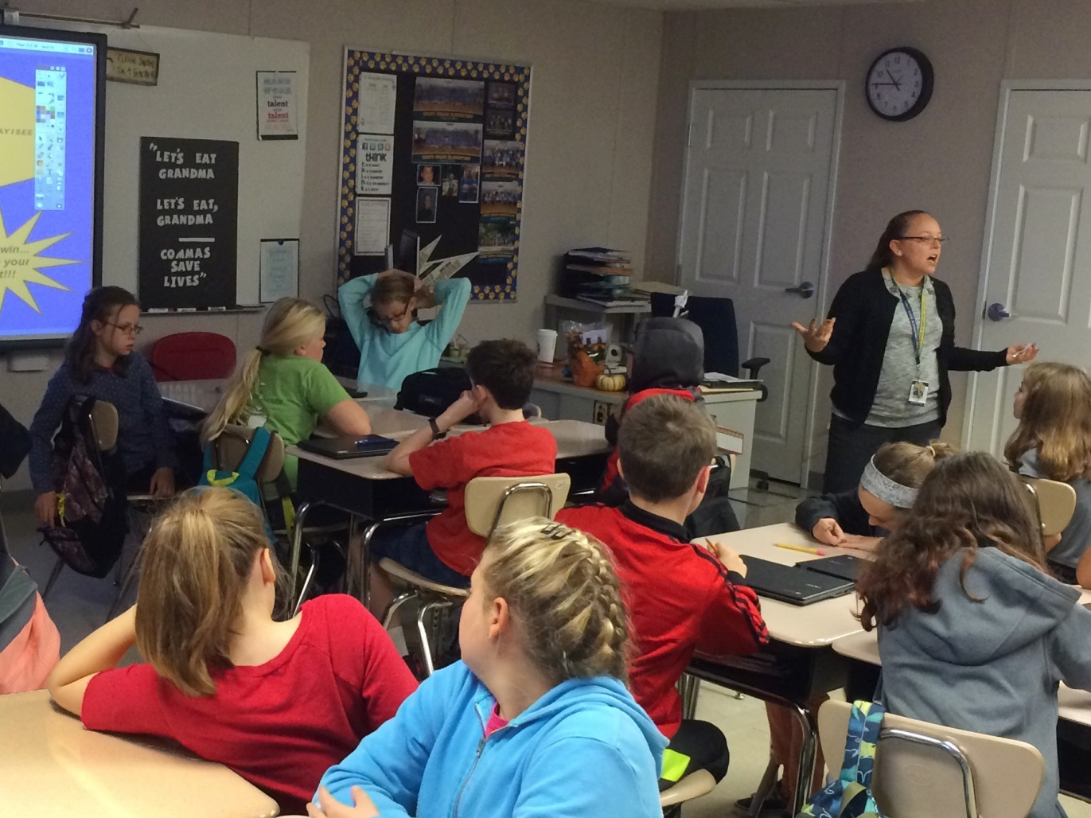
(CC) wodleywonderworks/flickr
ARNES has been connecting
schools for (almost) 25 years

Slide 3
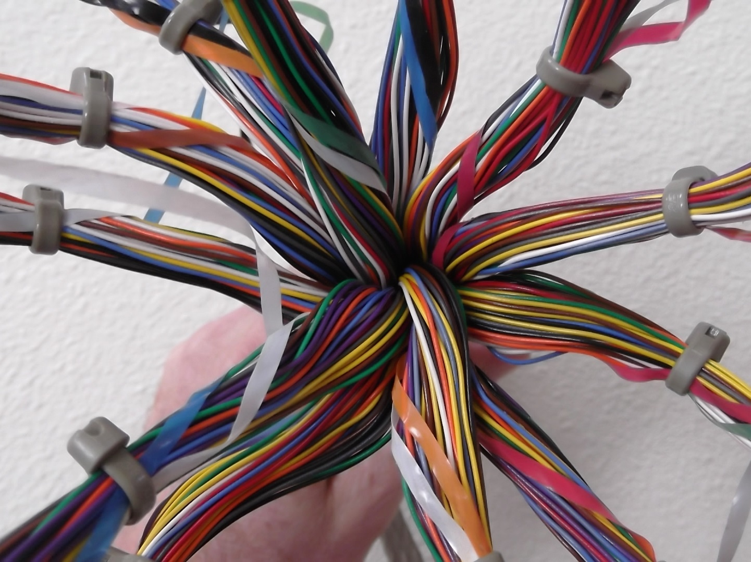
(CC) Brewbooks/Flickr
We provide network,…

Slide 4
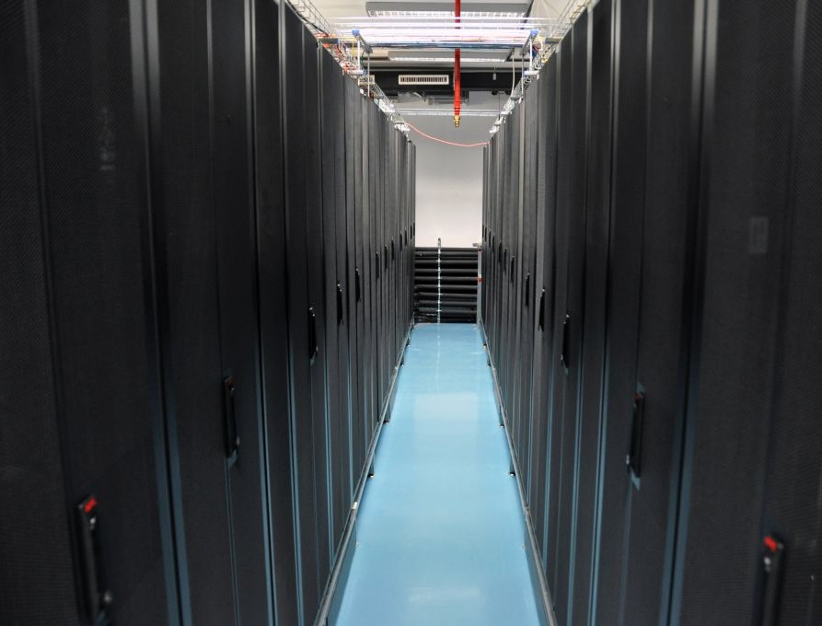
…we provide servers,…

Slide 5
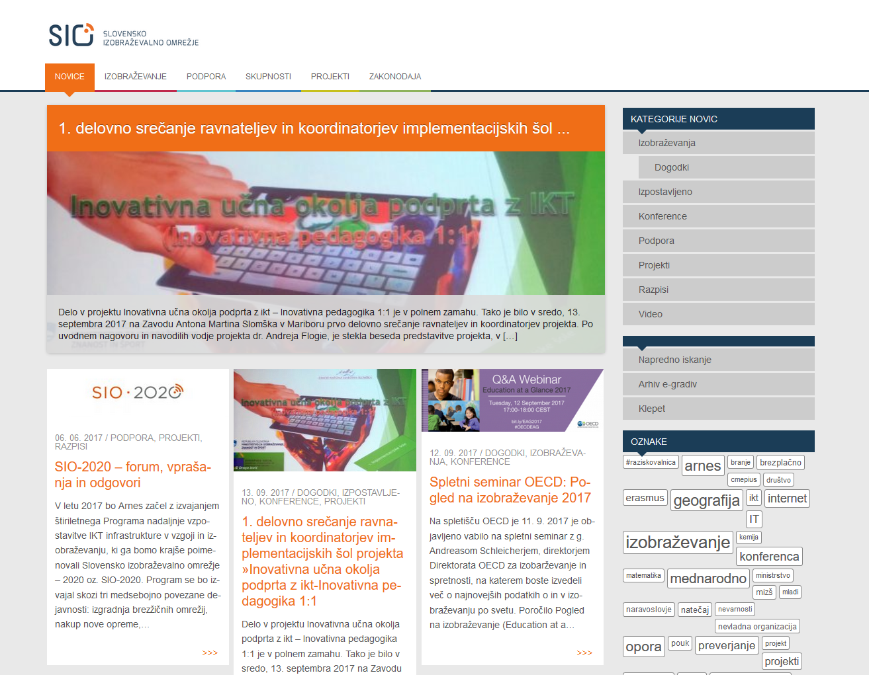
…we provide platforms and services,…

Slide 6
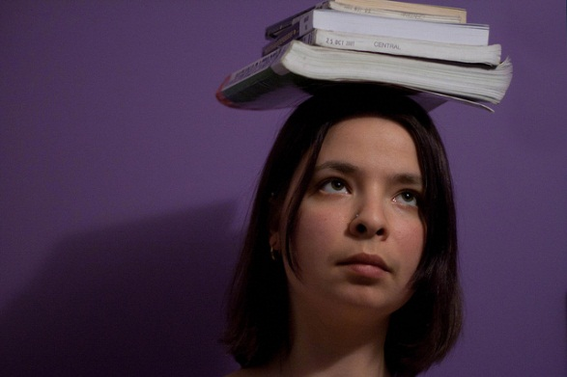
… so we just have to provide knowledge as well.
(CC) JuditK/flickr

Slide 7
Socially responsible NREN
25 years ago: bringing the technology
Today: educating how not to use it (how to avoid risks)
Strategic „service“
  The community needs it
  Our natural call
  It looks good
    Promotes services

Slide 8
Multi-level activities
Partner in Safer Internet Programme(s)
  National Safer Internet Centre
National cybersecurity campaign
  Varni na internetu (Safe on the internet)
MOOC on safer internet use
Lecturing for very diverse audiences

Slide 9
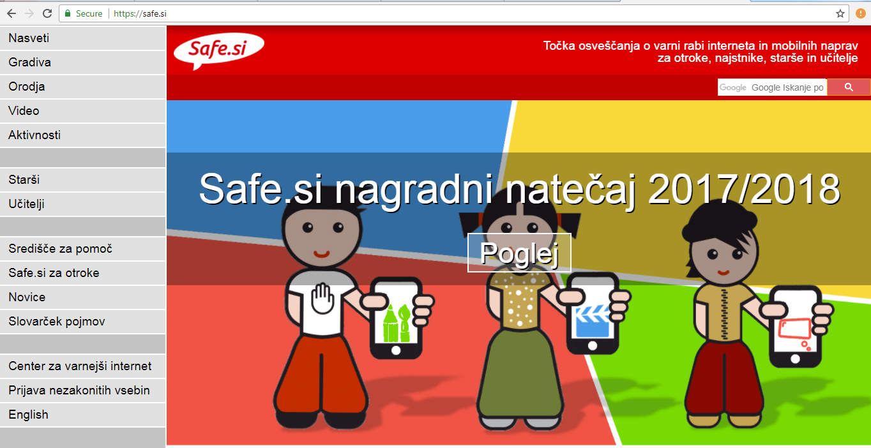
National Safer Internet Centre

Slide 10



Slide 11
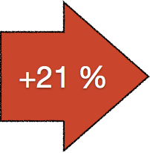
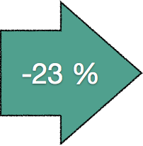
419 + LOTTERY SCAMS
FAKE WEB STORES
ON-LINE FRAUD
MALWARE
PHISHING
E-BANKING
IDENTITY THEFT
2009
HACKING

Slide 12



Safe on the Internet
It all depends on me

Slide 13
OBJECTIVES
online frauds
on-line shopping, e-banking
protect personal identity

Slide 14


TARGET AUDIENCE
24-54
SME

Slide 15
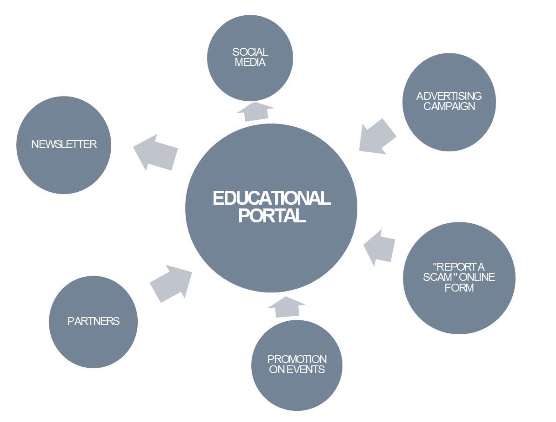

Slide 16



FB: 33.000 fans +
TW: 1000 + followers
newsletter: 7500 +
site visits: 160.000 / year

Slide 17
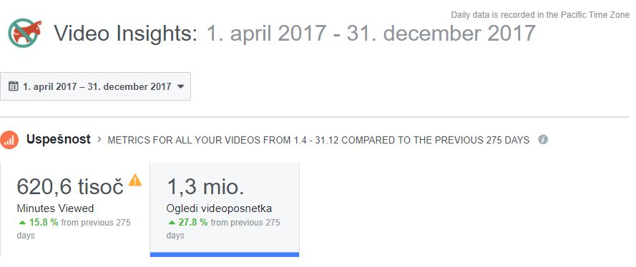
FB video series

Slide 18

The European Cyber Security Month is an advocacy campaign that promotes cyber security among citizens by promoting information security and sharing of good practices and competitions.
The European Union Agency for Network and Information Security (ENISA), the European Commission and Partners are deploying the campaign every October.

Slide 19

MOOC-S
mooc.arnes.si
Notes:
Toplo vas vabimo, da se nam pridružite na jesenskem MOOC-u.

Slide 20
Building digital competence
DIGCOMP framework (safety)
Integrates basic understanding and expert sources
Primary target audience: educators
  Variations
Mozilla open badges
  Valid certificate for promotion

Slide 21
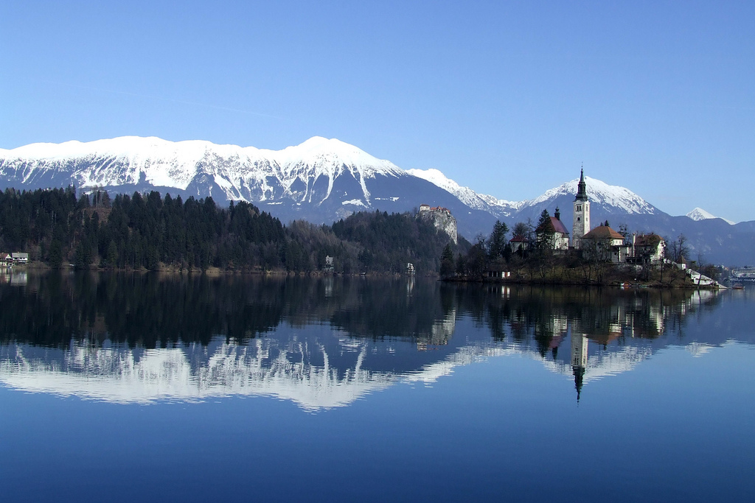
(CC) Mirci/Flikr
MOOC-S in numbers
Two editions per year
3 weeks of online learning
Videos, reading, quizzes
Live workshops – real cases
Over 5600 participants in 8 editions
65 % finished the online course
55 % finished online + offline workshop

Slide 22
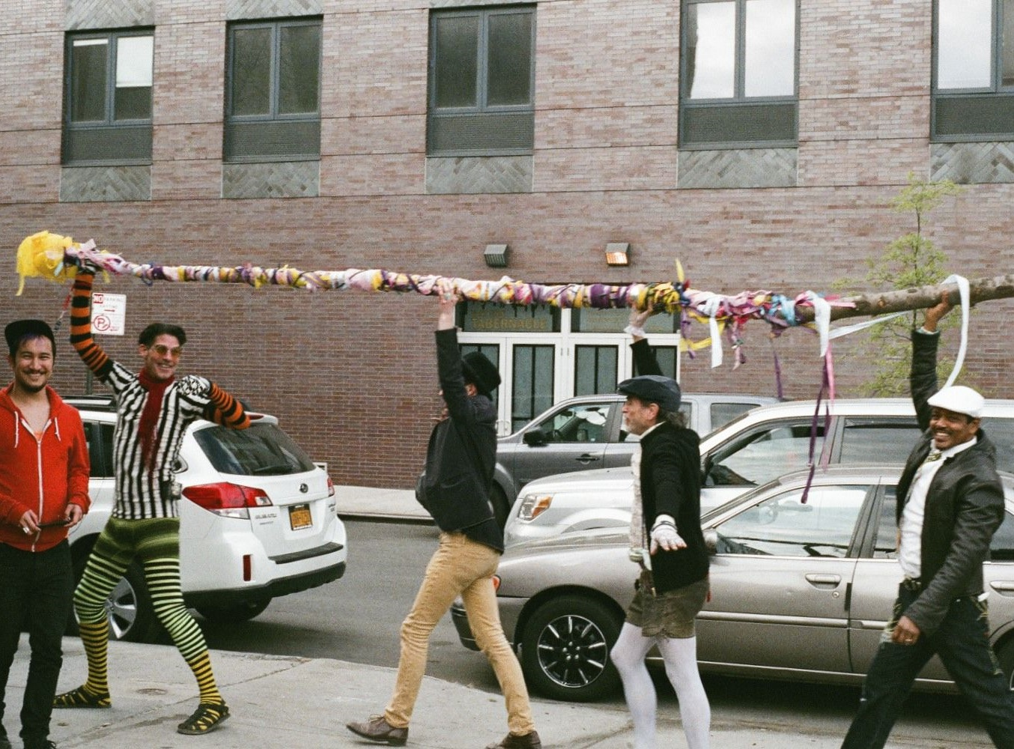
Building the community
(CC) AnthonyFine/Flickr

Slide 23
Work with different target groups
Banks, SMEs
Govt/military/police
IT enthusiasts, privacy advocates
Teachers/parents/librarians
Headmasters
Students
Child neurologists

Slide 24
Wide spectrum
Cybersecurity, online scams, privacy, cyberbullying, fake news
Workshops, lectures, roundtables, media interviews
Course on media literacy in schools
Collaboration with institutions & experts
  Information commissioner
IGF

Slide 25
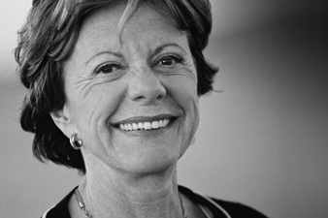
‟Keep your eyes open and use common sense!“
European Commissioner for Digital Agenda Neelie Kroes

