Slide 1
CLAW workshop, November 20-21, 2017

Slide 2
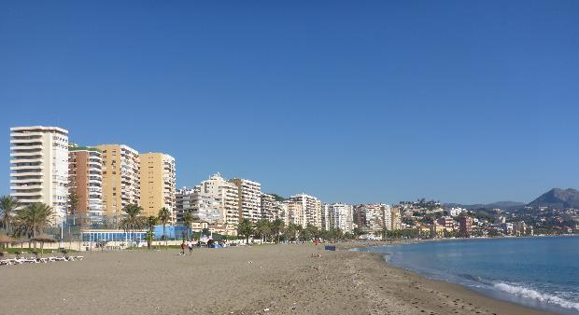
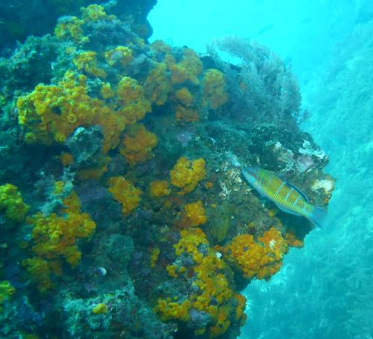
CLAW Crisis Management Exercise
Malaga in November – still warm enough for diving

Slide 3

DKCERT participation
DKCERT is the CSIRT (Computer Security Incident Response Team) of DeiC, the Danish NREN
Henrik Larsen, manager of DKCERT – Team ISM
Bjarne M. Schacht, incident response – Team CSIRT
Simon Nexø Jensen, incident response – Team CSIRT
Torben B. Sørensen, communications – Team CSIRT – observer role
Other teams without DKCERT representation:
Team NOC
Team Communication

Slide 4
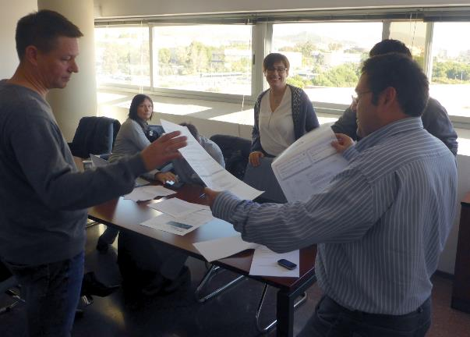
Team CSIRT
Every 20 minutes a new day began – new information was received
The participants looked at the information and tried to find out what was going on
First information: Many failed attempts at login using eduroam

Slide 5
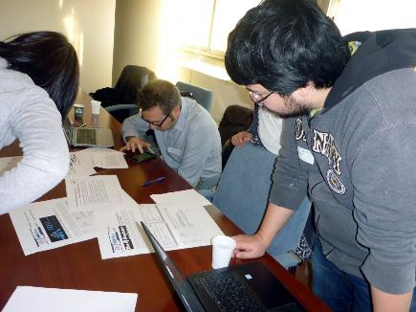
Notes from the observer
No team leader was appointed
No roles were defined, everybody equal
No presentation round, nobody knew the others’ fields of expertise
More communication was needed – within the team as well as with other teams
At first there was no communication with other teams, this was established later. One representative from each team met and discussed the latest developments

Slide 6
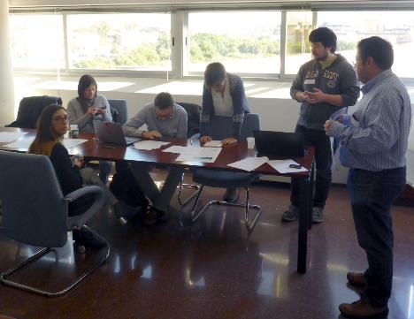
Bad is good
We made a lot of observations about bad stuff: The team did not operate efficiently
This is good
Shows room for improvement
What we need to go back and work on
A proper procedure for handling crises

Slide 7
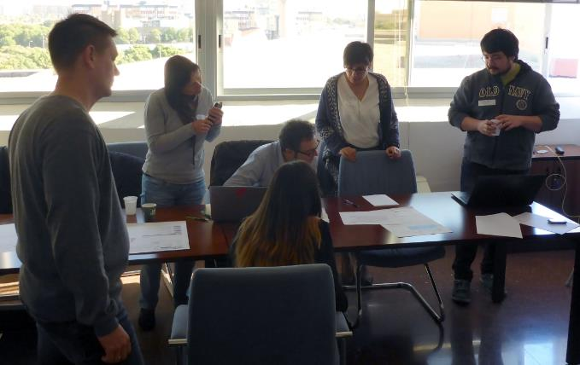
Feedback to organizers
It’s a game, we need to know the board, rules and players before starting
Let teams organize internally before starting
Let teams know the organizational structure they are a part of
It was fun, we’d like to do it again!

