Slide 1
CSC – Finnish Expertise in ICT for Research, Education and Public Administration
SIG Marcomms -meeting 13th March 2018 @Espoo, Finland
Harri.Kuusisto@csc.fi
v. d/2017

Slide 2

Non-profit
state company
with special
tasks
Turnover
in year 2016
36.8
M€
Headquarters
in Espoo,
datacenter
in Kajaani,
Finland
Sisältyy jäsenmaksuun
Owned by state (70%)
and all Finnish higher education institutions
(30%)
Circa
285
employees
in year 2016

Slide 3
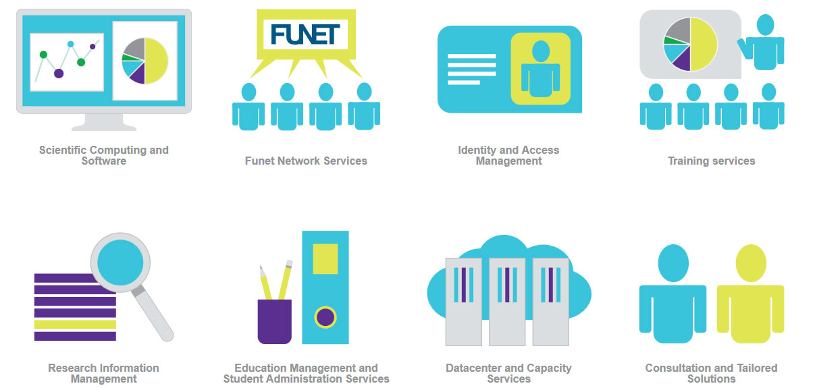

CSC’s Services

Slide 4
Funet is the National Reseach and Education Network (NREN)
Finnish universities and research community have state of the art national and international connectivity and network services at their use

Slide 5
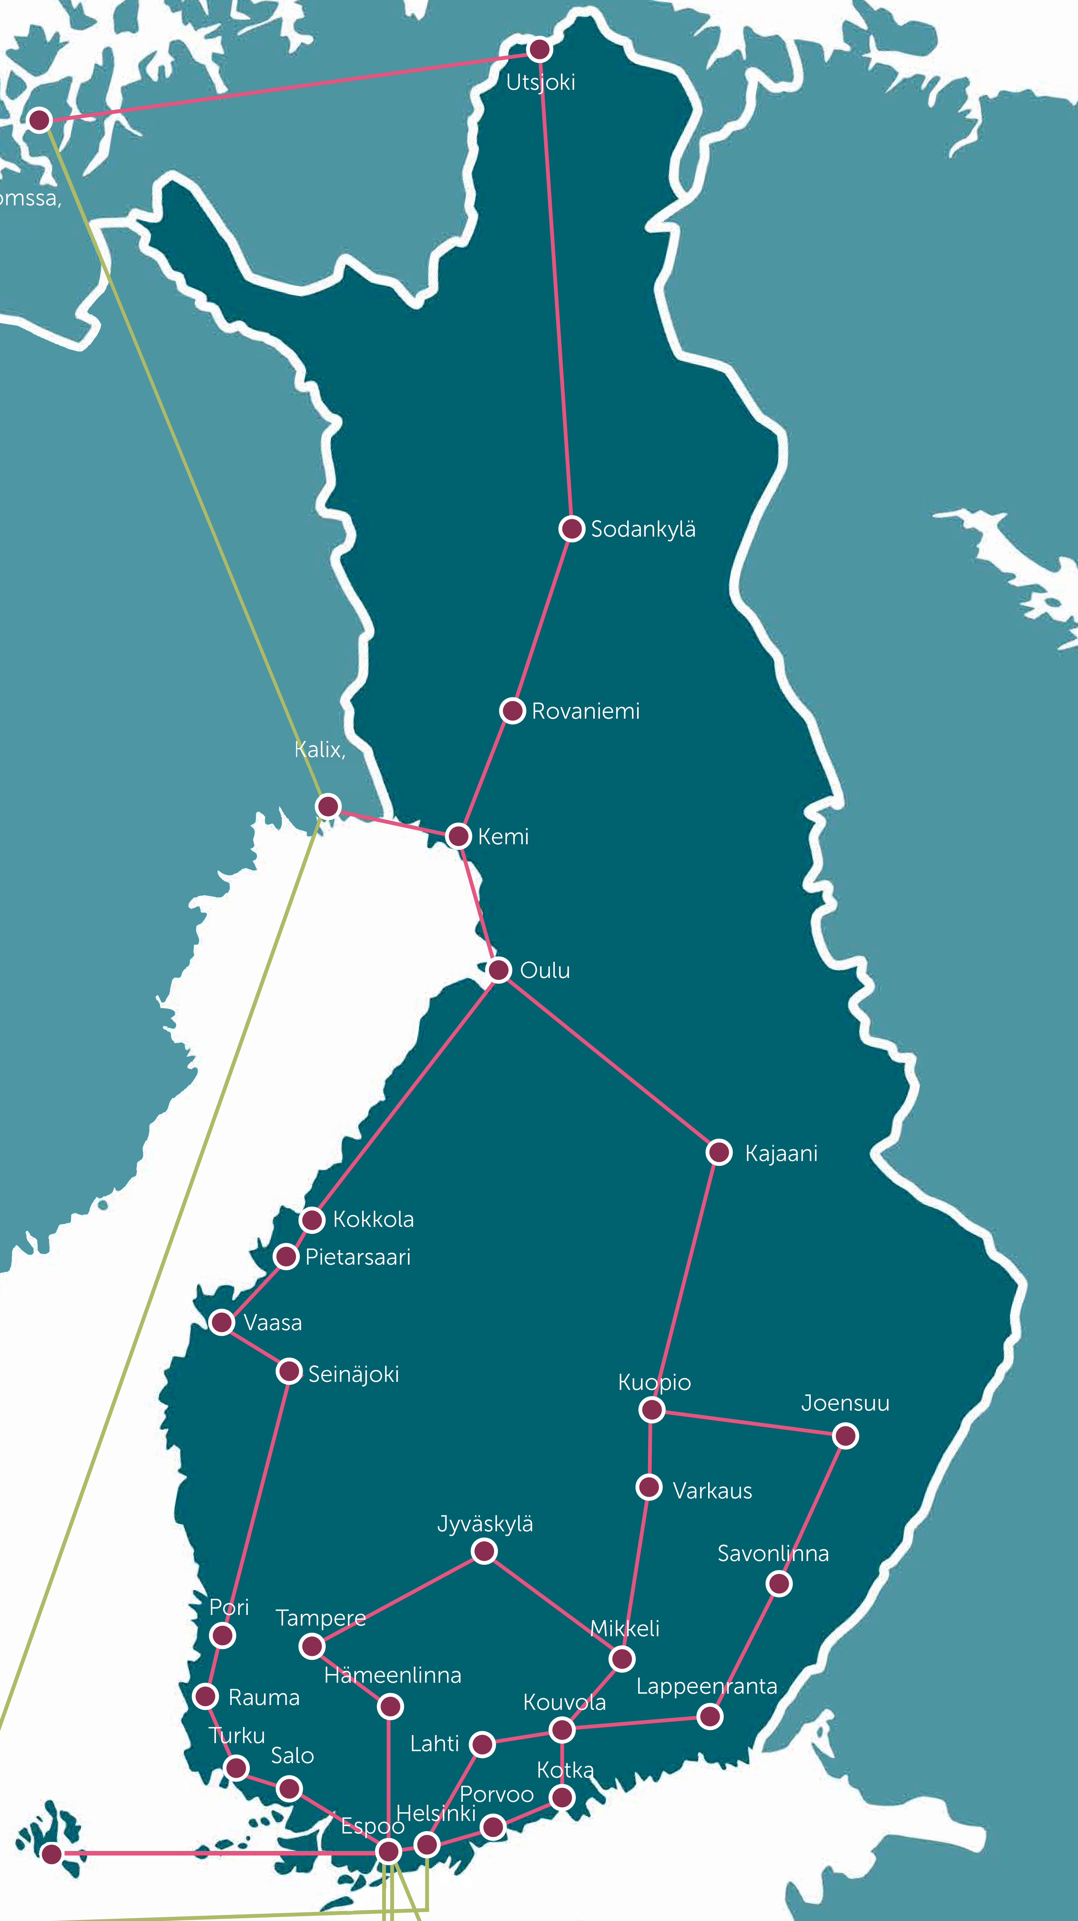
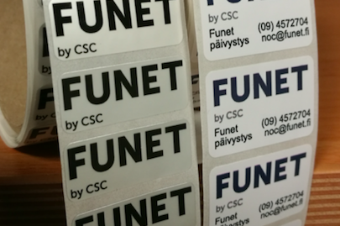

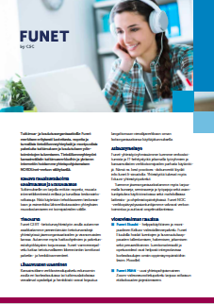


Funet activities from marketing point of view
New Funet logo
New Funet logo stickers
New Funet2020 testbed racks for routers (with the twist)
New Funet Services -leaflet
Old Funet safety reflectors (with another twist)

Slide 6





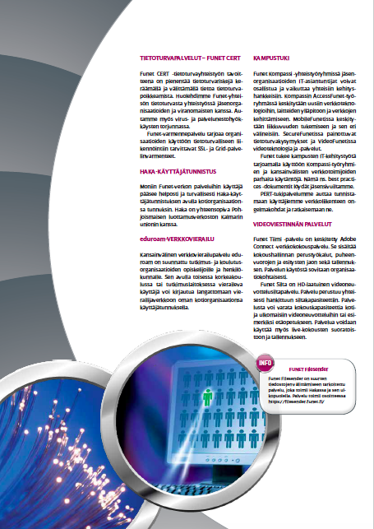
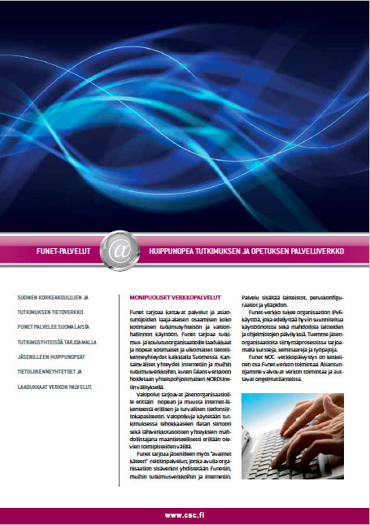



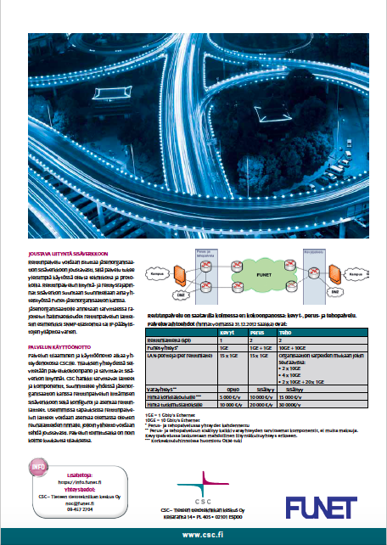
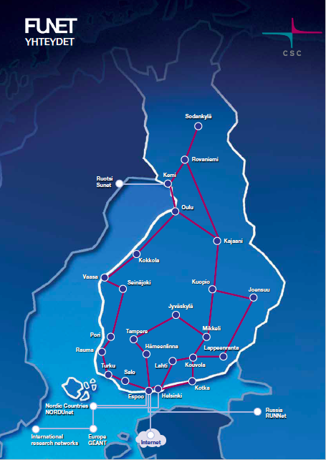
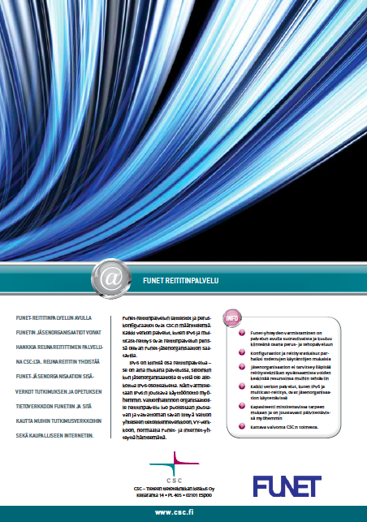
Posters, rollups, videos…
https://www.youtube.com/watch?v=RGfVYvYE9f4
https://www.youtube.com/watch?v=Ec0jtXMNs-k

Slide 7
Customer extranet https://info.funet.fi
Up-to-date information about Funet activities
Open and member-only material
Service descriptions, contact information
Technical guidelines
Best Practice Documents
Prices etc.

Slide 8
Funet Newsletter
Bunch of short plain text articles sent to email list with 500 people from Funet organisations
  Administrational contact persons
  Technical contact persons
  Security related contact persons
  IAM contact persons
  Other persons from Funet organisations
Funet newsletter is published 10-12 times per year
Information about network, services, changes in service portfolio, asking for feedback, questionnaires…

Slide 9
Funet conference aka. Technical Days
Two days conference once per year with presentations and workshops
  50-100 participants, also remote
  Some current hot topics (IPv6, Security, GDPR, Funet2020 ☺)
  Workshops (network, services, planning…)
Includes also Funet Annual Meeting
  Administrational meeting with an agenda including reports, cost sharing etc.

Slide 10


Thank you!

