Slide 1

How ARNES created an internet of people?
ARNES 25 years‘ anniversary
Notes:
So last year ARNES celebrated its 25th anniversary and I‘ll present you
how we organised different activities which presented to the public how ARNES made a significant contribution to the digitalisation of Slovenian society
And I‘ll explain how we organised a special event, a celebration, that we named an internet of people.

Slide 2
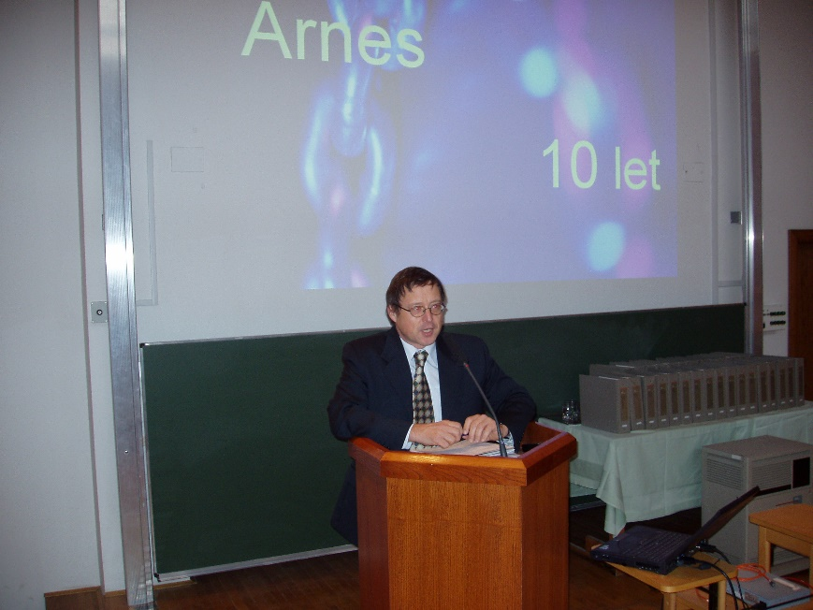
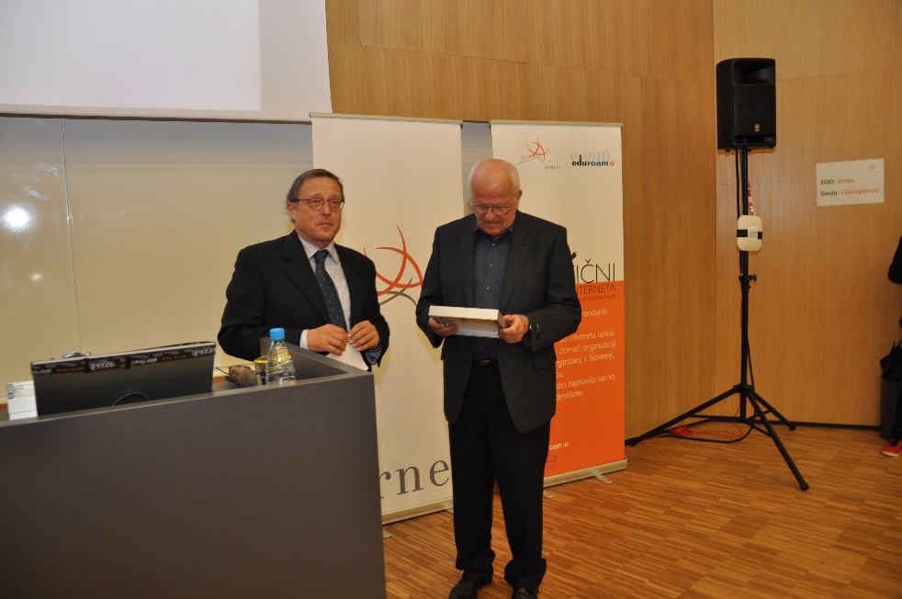
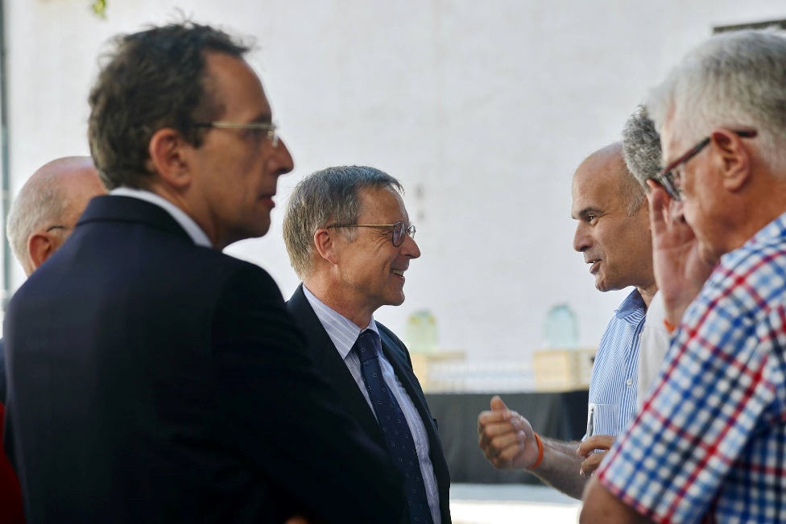
It all started in 1992
In 2017 it was our turn for the celebration of our 25th anniversary
Notes:
ARNES was created in 1992 and we organised similar promotional events in the past, for example for our 10th and 20th anniversary.

Slide 3
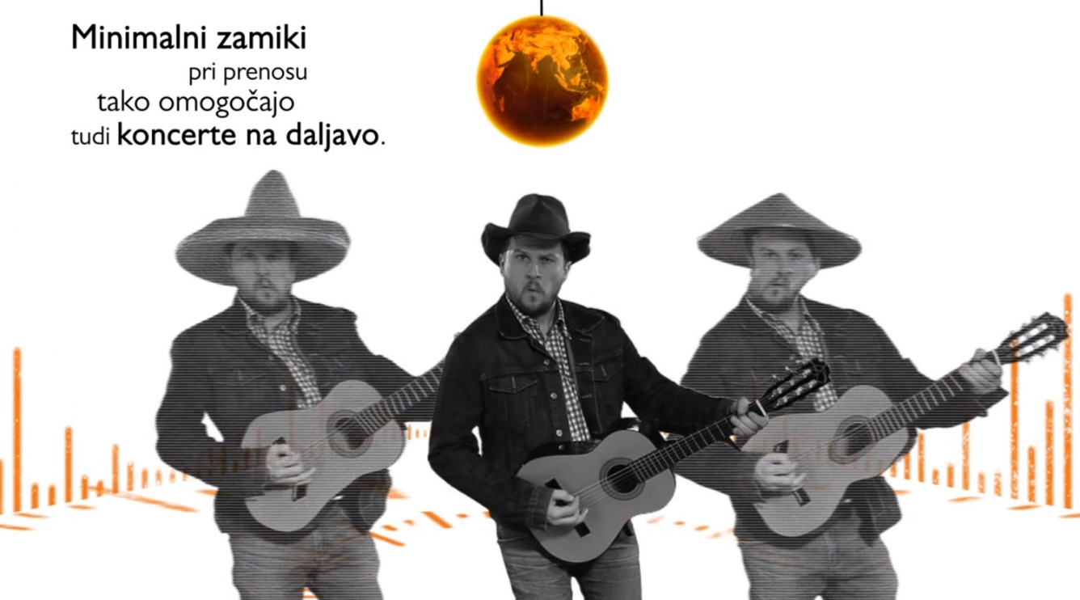
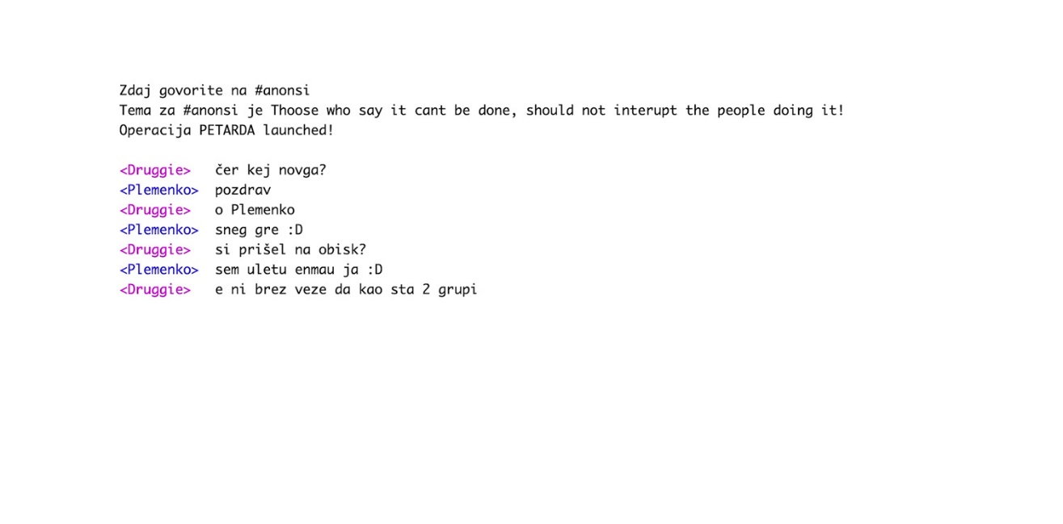
20th anniversary of ARNES
  creation of a music video ARNES song
  https://video.arnes.si/portal/asset.zul?id=f17GH9u8Y7o3VnbJP7CR6JOu
20th anniversary of SI-CERT
  movie #hekerji.si about Slovenian hackers:
  https://video.arnes.si/portal/asset.zul?id=ClofXjVadPQAHTB4Q4YTo1Db
Notes:
On our 20th anniversary we made a music video
and on the 20th anniversary of our CERT, our colleagues made a great movie about Slovenian hackers.
It was shown in a cinema and on a national TV as well.

Slide 4
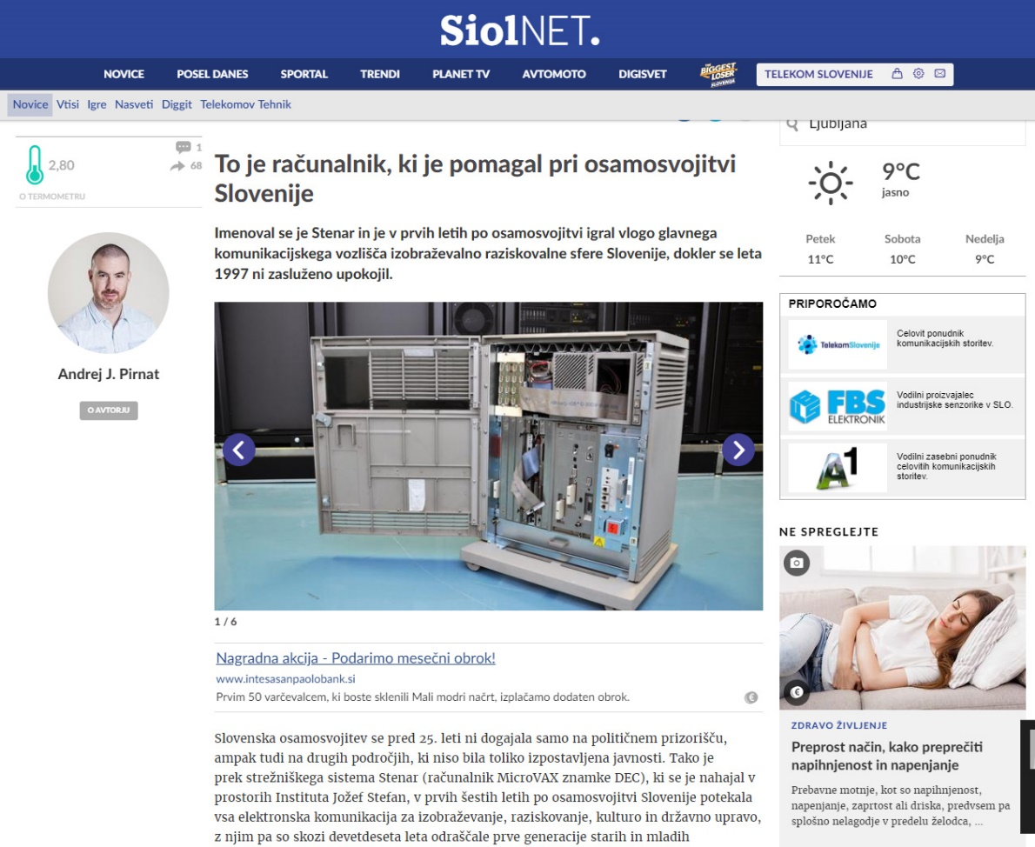
Let‘s get started
ARNES is a pioneer of Slovenian internet
news, articles, posts, with interesting and success stories from the history of ARNES
and stories about the history of internet in Slovenia
Notes:
We started promoting our anniversary in 2016 with different articles, posts on social media.
Here you can see an article about the most famous Slovenian internet server in one of the most popular news outlets,
Stenar, like any other server in ARNES, got its name from Slovenian mountain peaks.
It was the synonym for Internet access in the 1990s and the Independence War hero. Many Slovenians still remember it with nostalgia.

Slide 5
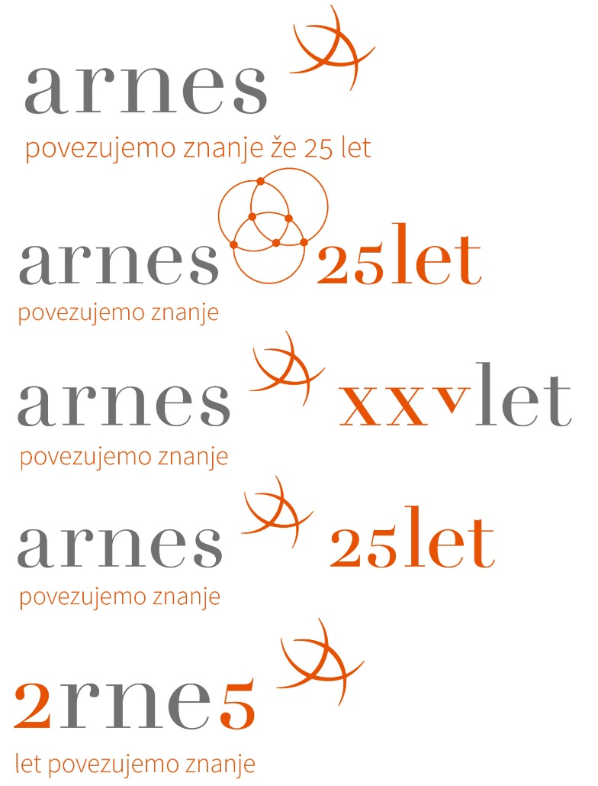
From Arnes to 2rne5
#arnes25
a new logo
and a hashtag change to
#2rne5
Notes:
On social media we first used one hashtag with short and interesting facts about ARNES. After some time we changed it.
Why? Well we selected about our anniversary logo, that we used on our webpage, for our services and as a signature in e-mails.
The sentence here means that we are connecting knowledge for 25 years.

Slide 6
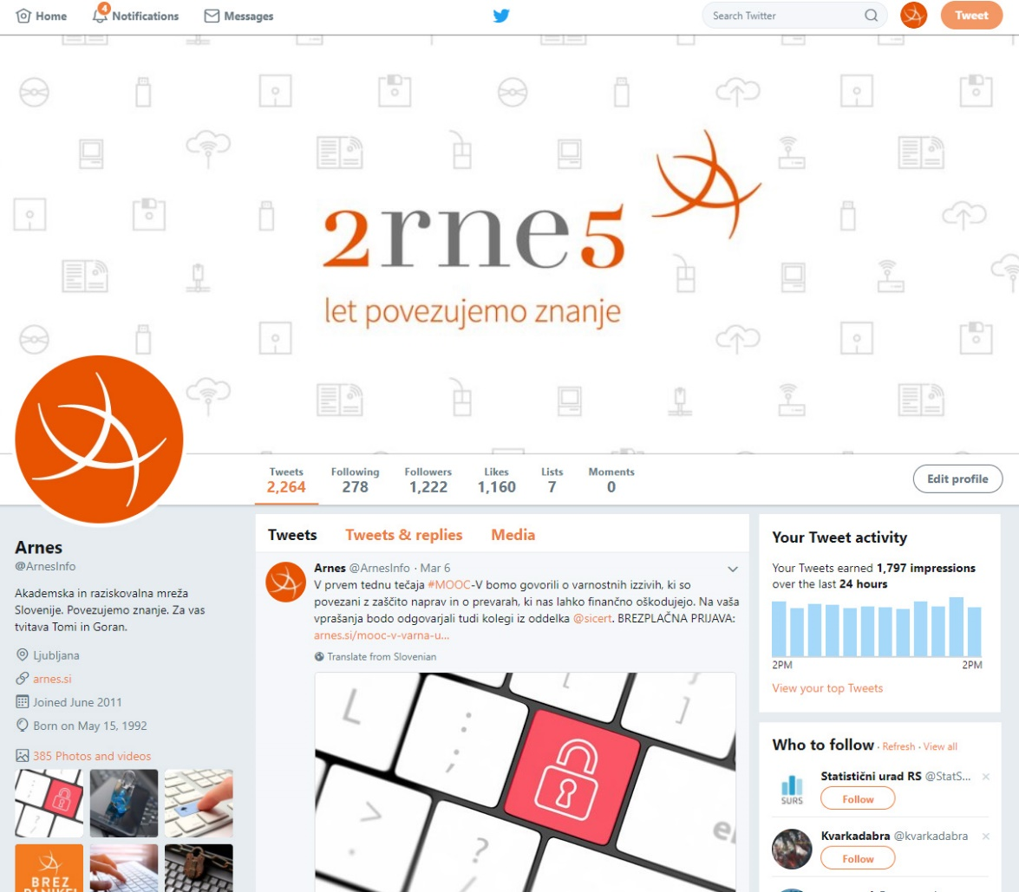
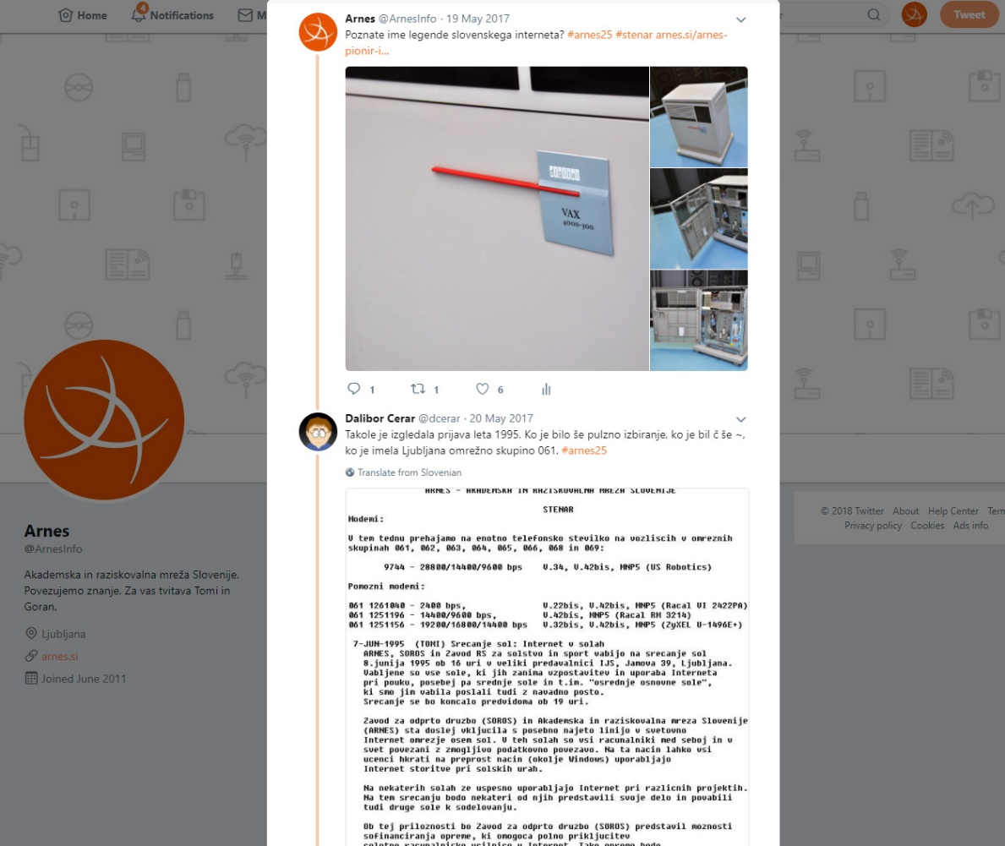
Social networks
Notes:
And on accounts on social networks, there‘s one example.

Slide 7
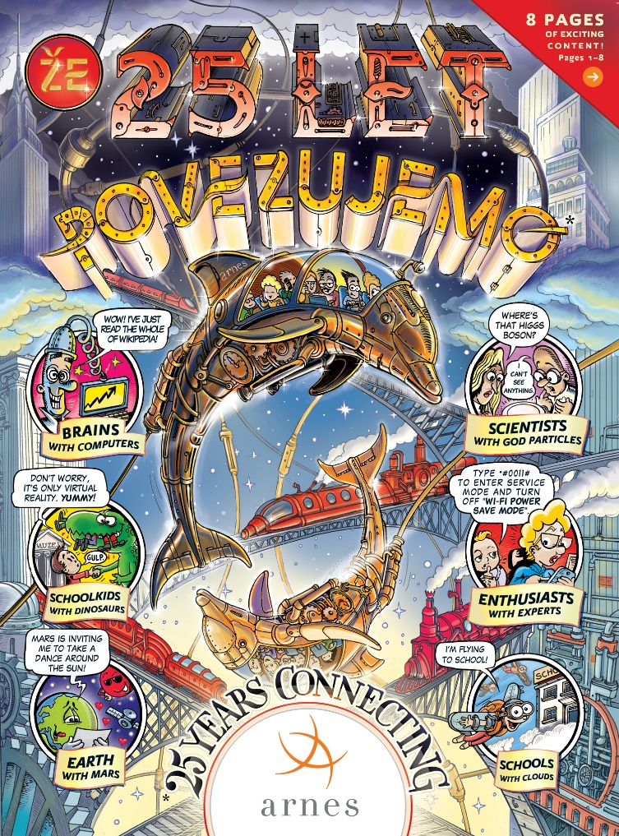

Brochure?
Let‘s make something interesting …
Let‘s create a comic book!
Notes:
Now we were thinking about a promotion, something that we can give to anyone that wants to know something about ARNES.
On the 20th anniversary we went down the classical road with a brochure. Now we really wanted to make something interesting.
Now I guess we all really liked to read comic books when we were younger. OK, we still love to read them.
So we decided to create a comic book.
It was a long process of selecting interesting stories, facts, data … we had interviews with our co-workers and intensive meetings with an illustrator.
In the end we created a newspaper with eight pages about the topic, how is ARNES connecting different things …

Slide 8
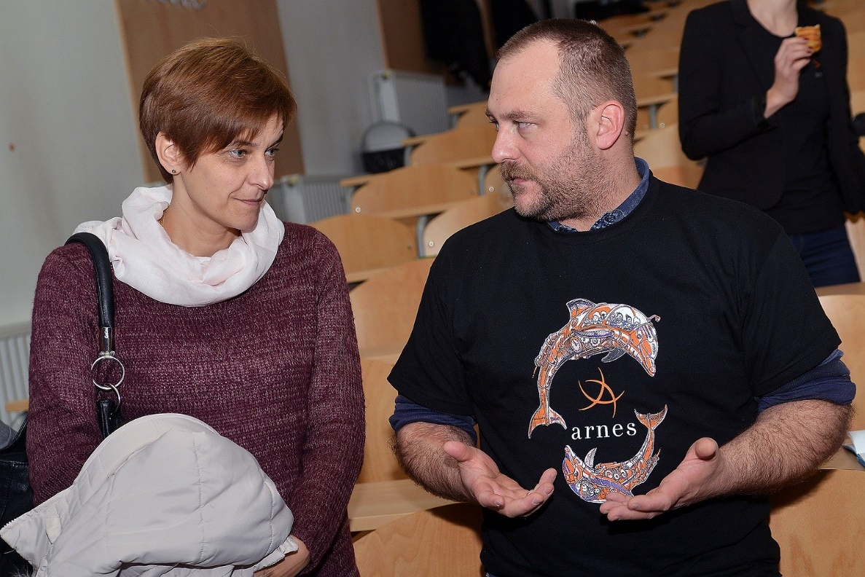
Different promo material
Bracelets
T-shirts
USB keys with comic books
Notes:
We also created different promo materials, like the T-shirt with the dolphins.

Slide 9
How to find a perfect venue?
Location
Venue size
Let‘s rent a place from our users
Good and bad weather alternatives
Roof against the rain will come handy on a hot day
Additional lights, sound system, music band …
Notes:
Now, about the event for our anniversary.
You really have to think about different things

Slide 10
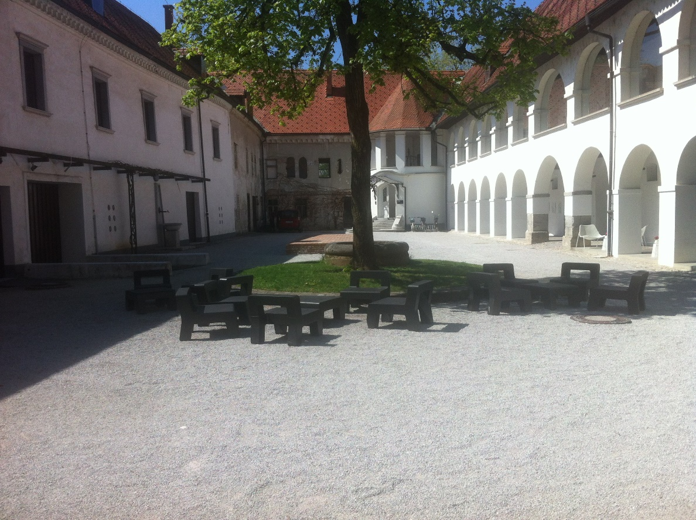
We‘ve got it … a castle in Ljubljana
Musem of architecture and design
Perfect platform in the back
Or is it?

Slide 11
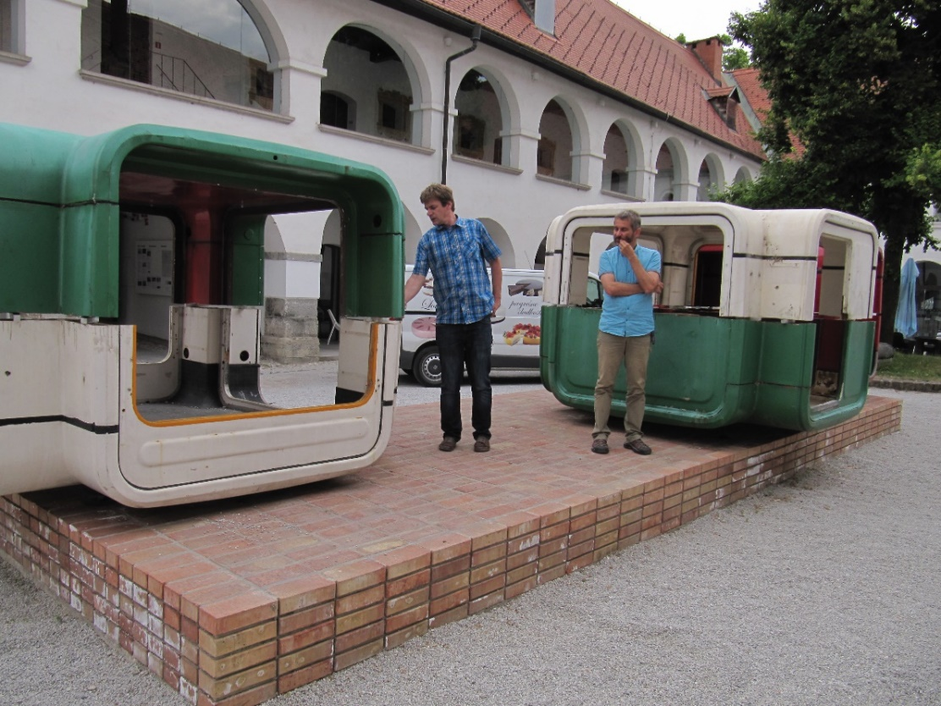
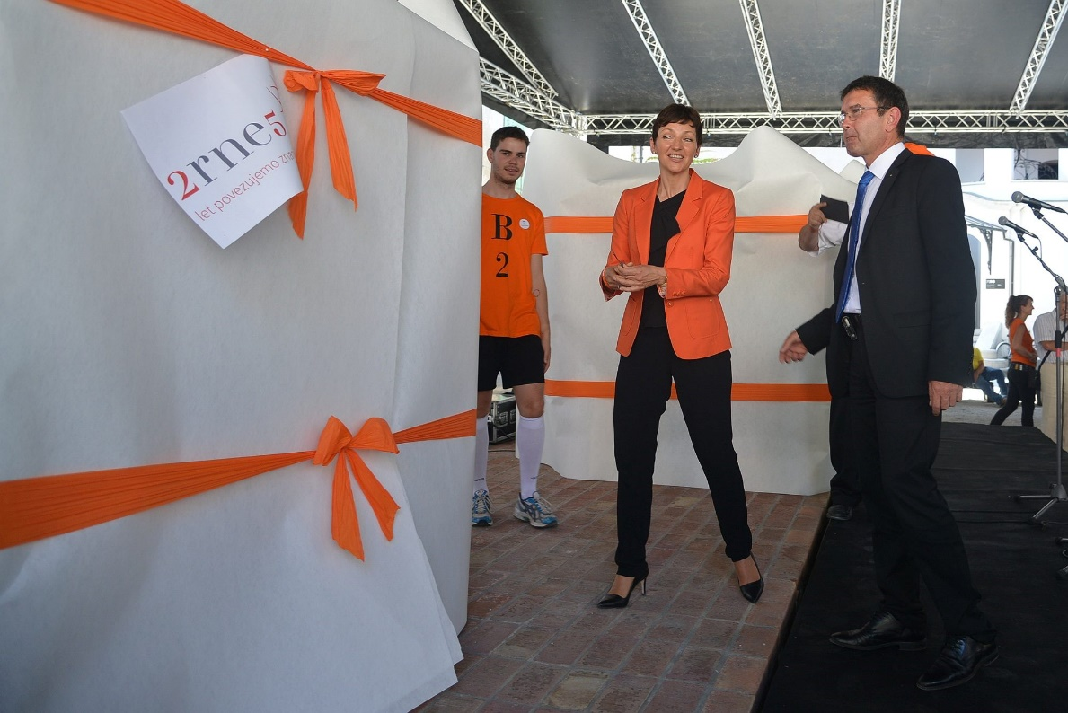
Kiosks?
Notes:
Surprise, now, there is an art exibition with old kiosks and no, we are not allowed to move them an inch.
Let‘s turn the kiosks into a place for exhibition …

Slide 12
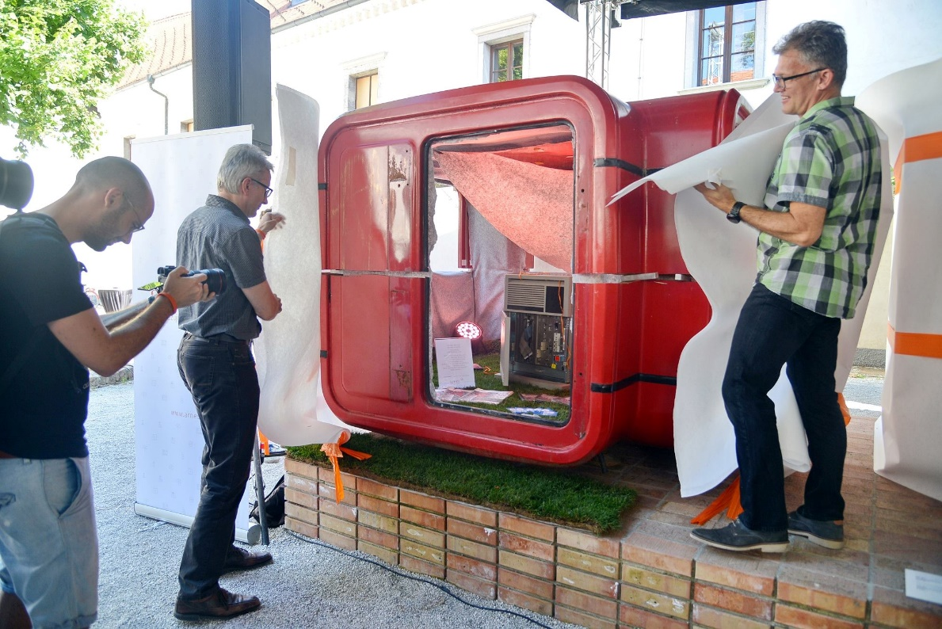
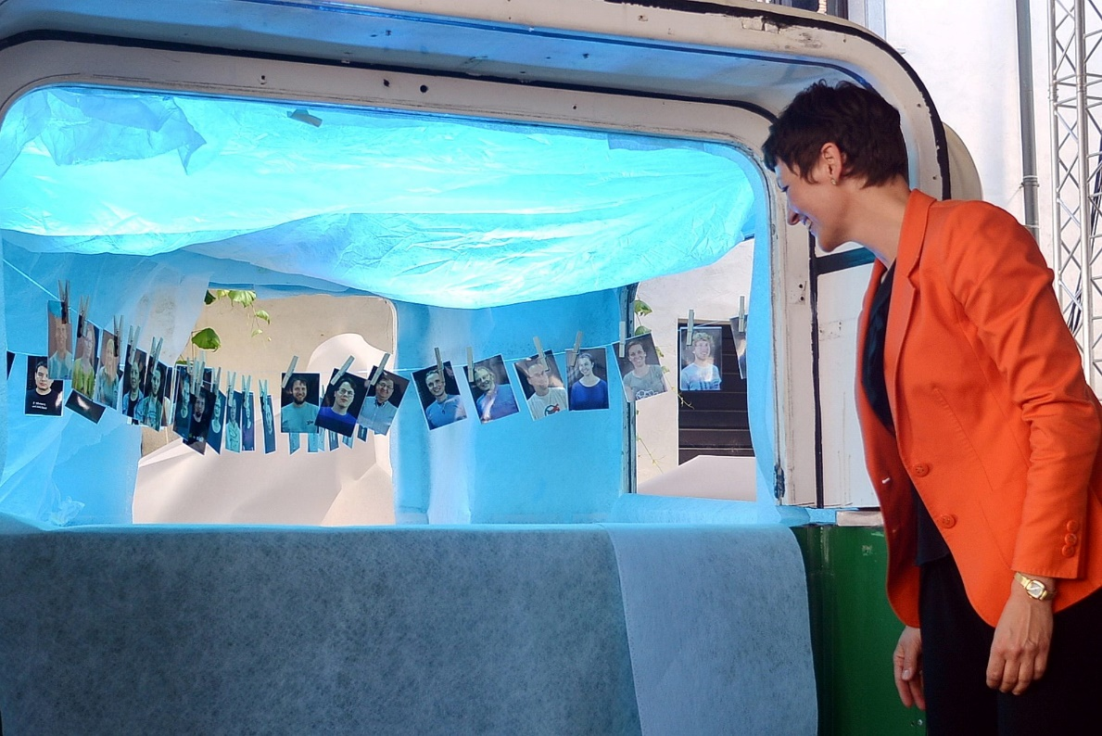
Proud of the past, connecting the present,
Notes:
In the first one there was VAX, resting in peace on a real grass
In the second one there was a post-avant-garde installation, where we presented ARNES Cloud.

Slide 13
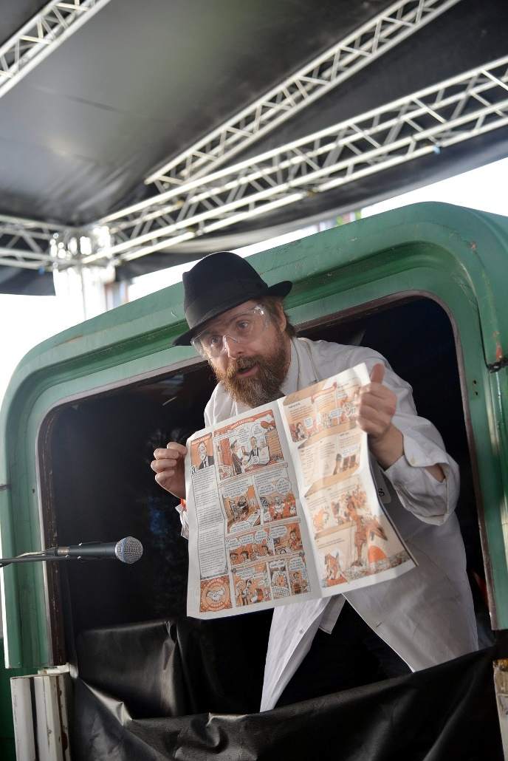
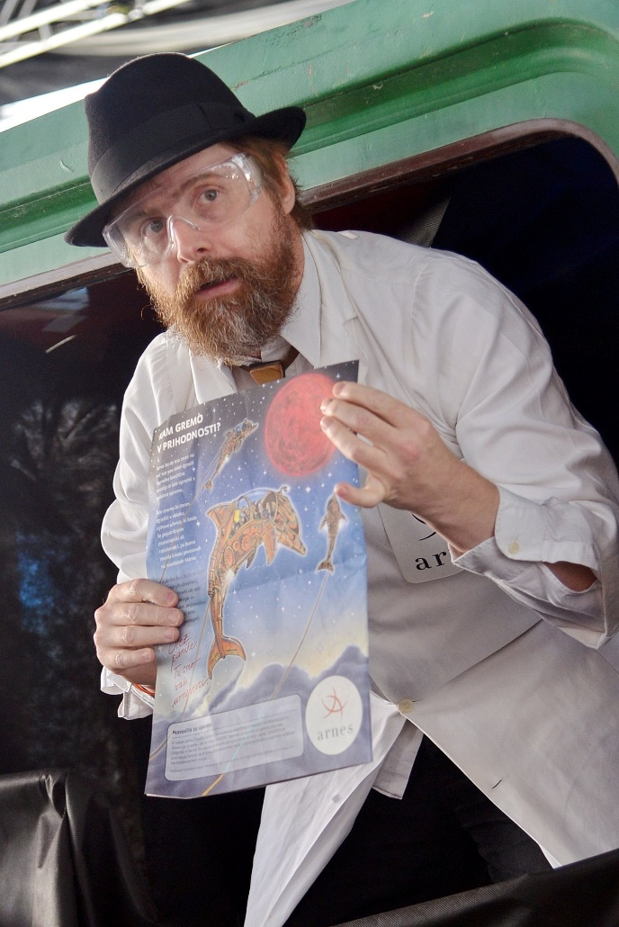
… building the future
Notes:
And in a third one a crazy doctor with a new invention from our Labs. A newspaper.
And in the dark of space a dolphin carrying an optics cable from Earth to Mars. So we let the people know that if necessary, we will connect Elementary School on Earth with an Elementary School on Mars.
So we saved the problem with kiosks and people actually thought that we brought them there.

Slide 14
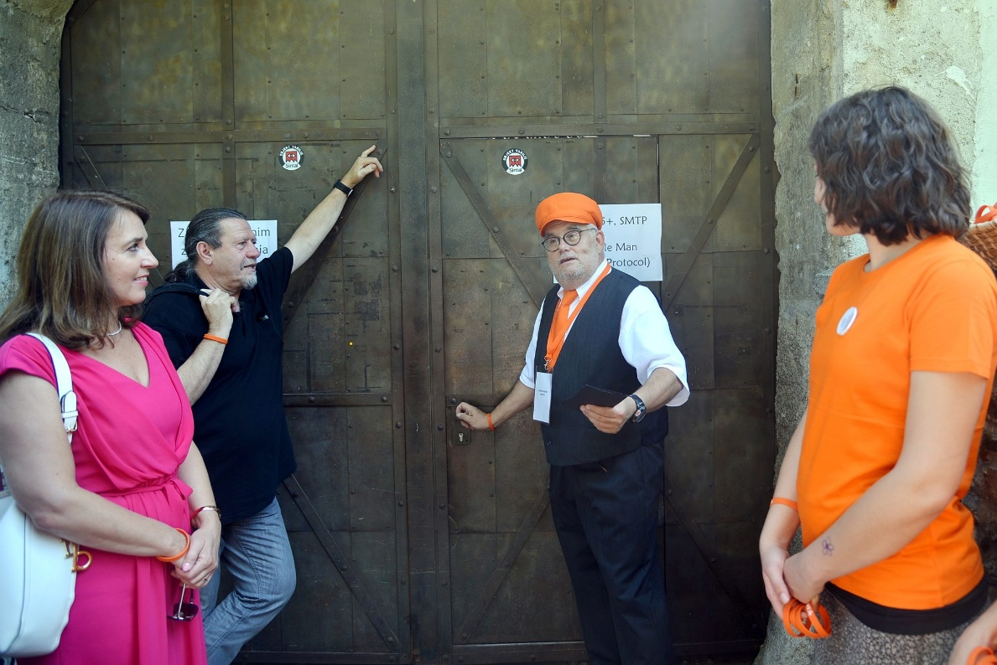
A „normal“ program or a theatre play
We don‘t want to have a boring program
Ana Monro Theater is the oldest independent theatre group in Slovenia
Let‘s create an internet of people
Notes:
Now we also wanted to turn the normal program in a theatre play …
We took boring technical stuff and transformed it into interesting street teatre connecting people

Slide 15
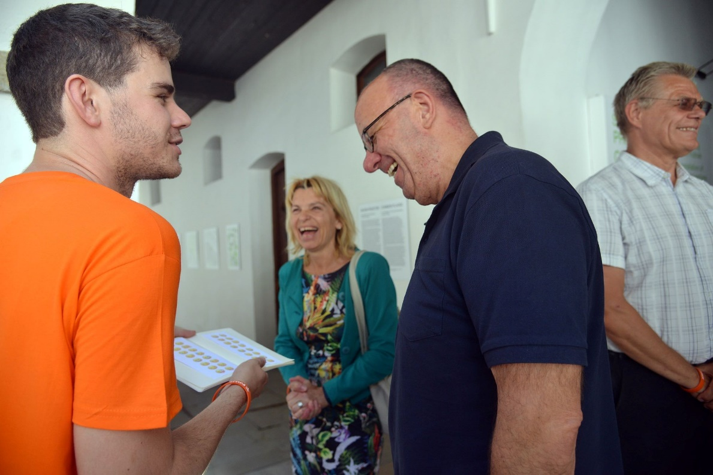
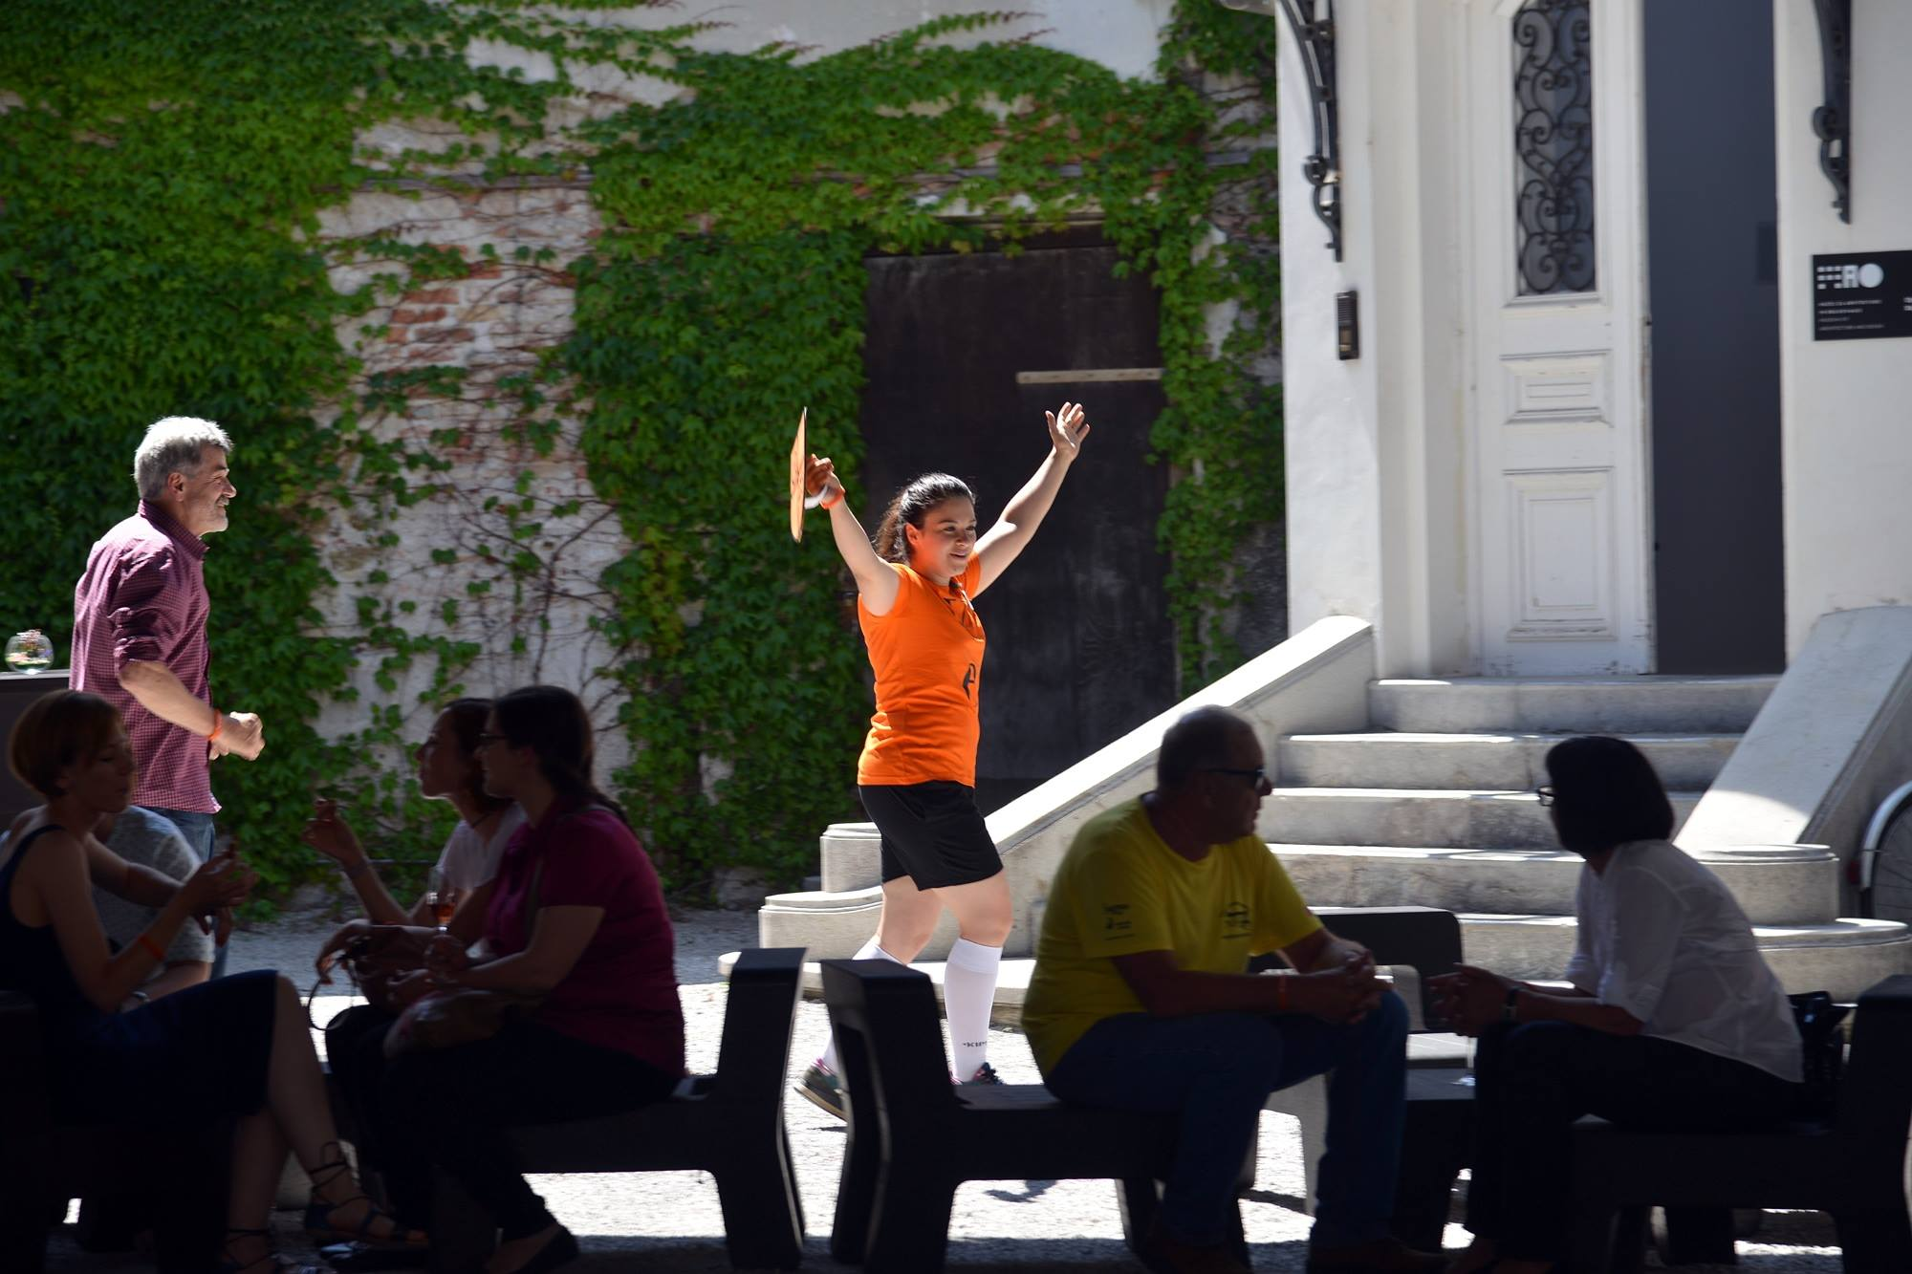
Send an emoji, keep in shape with an antivirus …

Slide 16
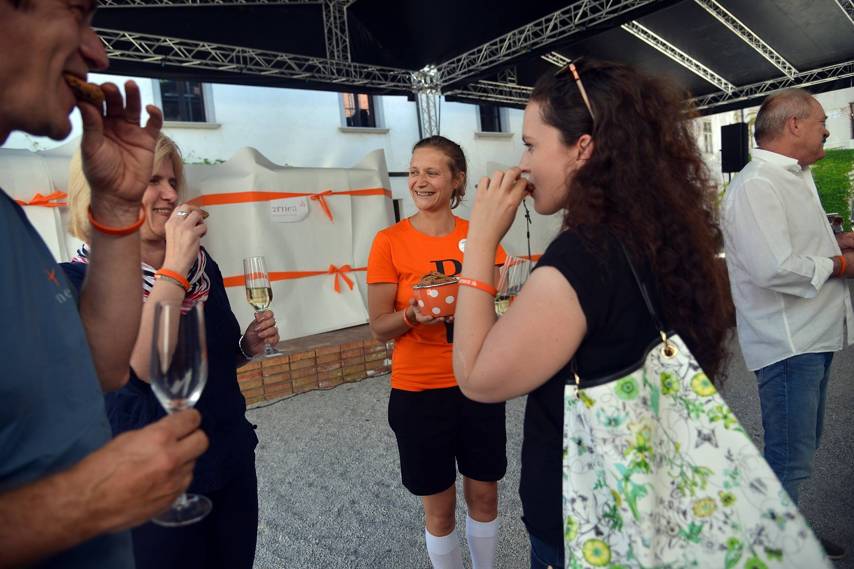
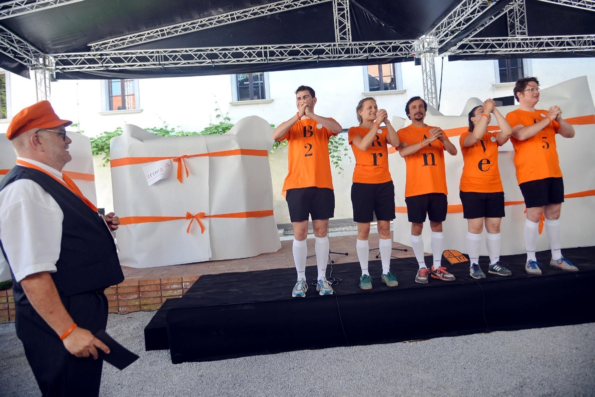
Accept our cookies

Slide 17
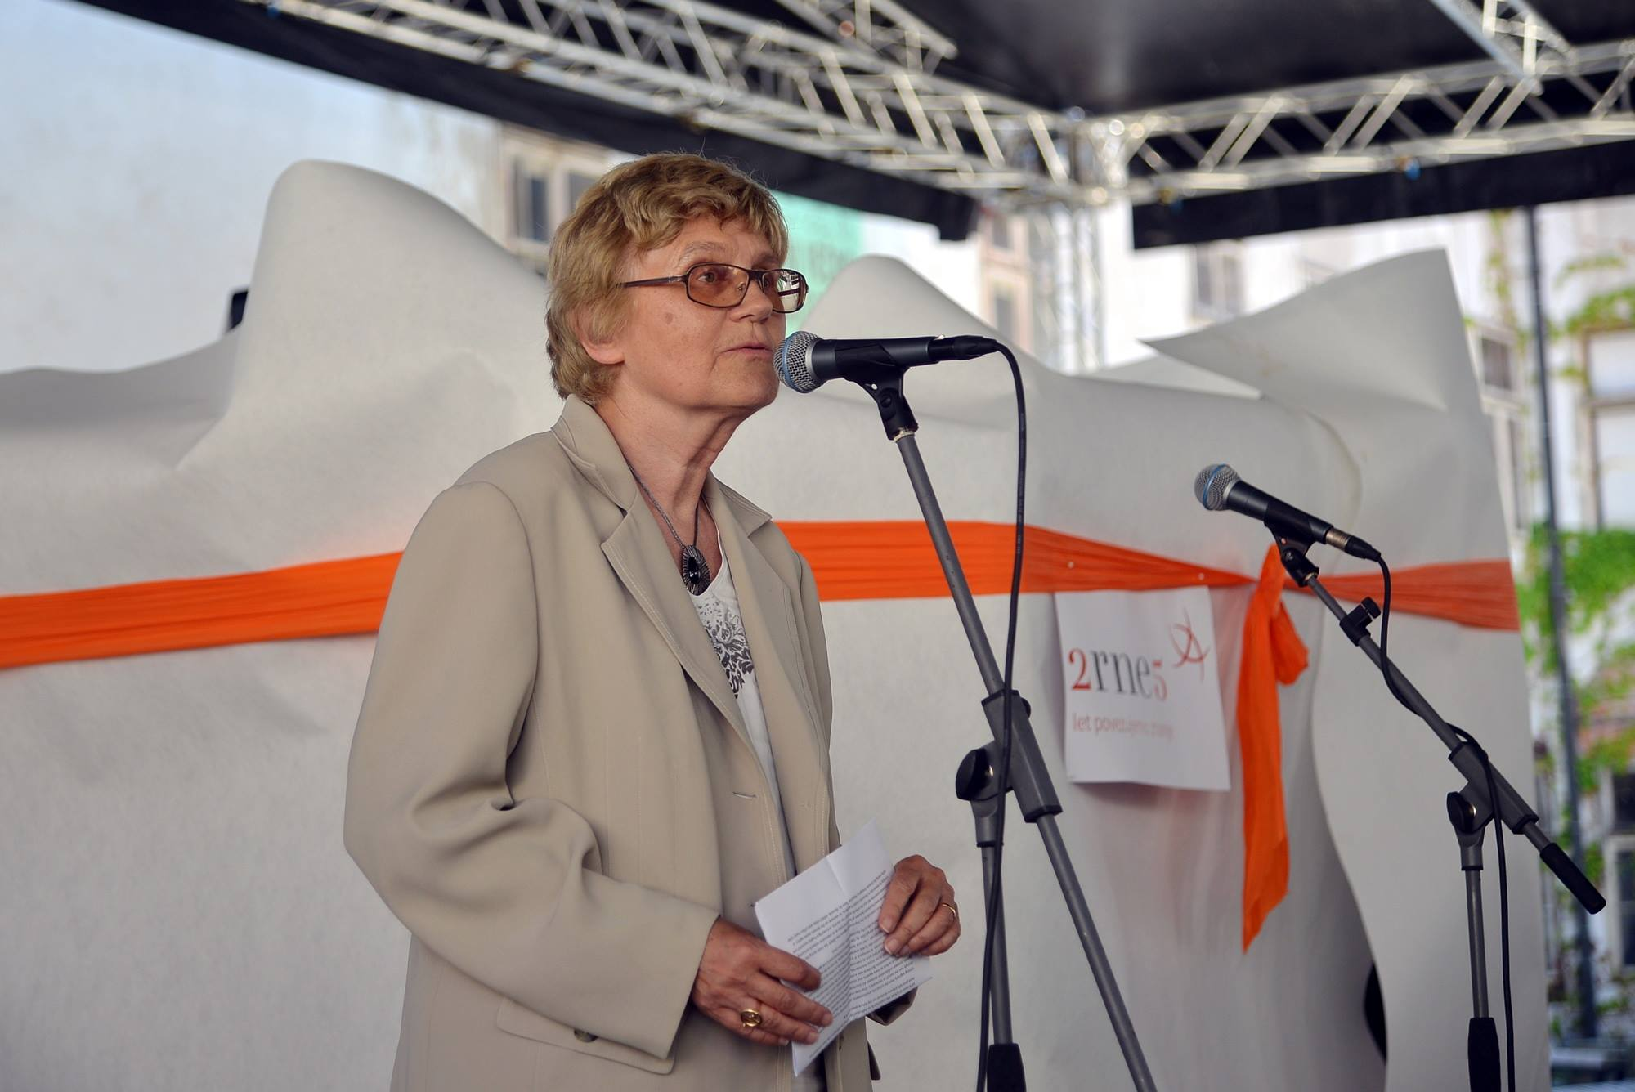
Dorte Olesen, a member of the Board of Directors of GÉANT, a special guest at the event said: “Congratulations to all of you at ARNES for your splendid achievements and the positive difference you make to education and research in Slovenia and all over Europe.”

Slide 18
Minister of Education, Science and Sport Maja Makovec Brenčič highlighted a series of important projects focusing on e-learning and e-knowledge.
The Minister of Public Administration Boris Koprivnikar added that the society of the future will be digital, the major foundations for which will also be contributed by ARNES.
Notes:
Minister of Education, Science and Sport Maja Makovec Brenčič, who highlighted a series of important projects focusing on e-learning and e-knowledge.

Slide 19
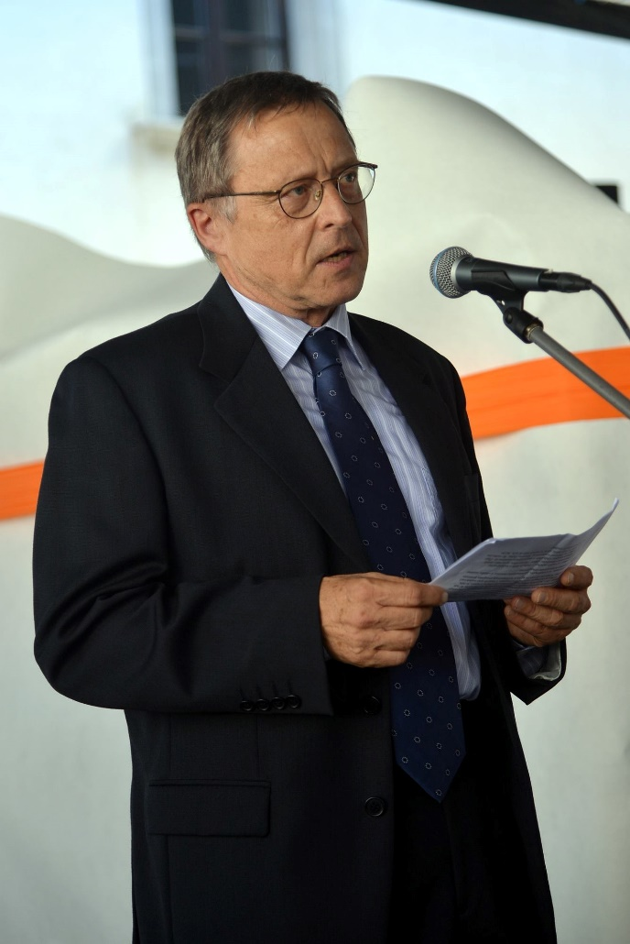
Director Marko Bonač explained that it is impossible to predict what type of technologies and services we will offer in the future, but we do know that: “We will always respond to the wishes and needs of our users.”

Slide 20
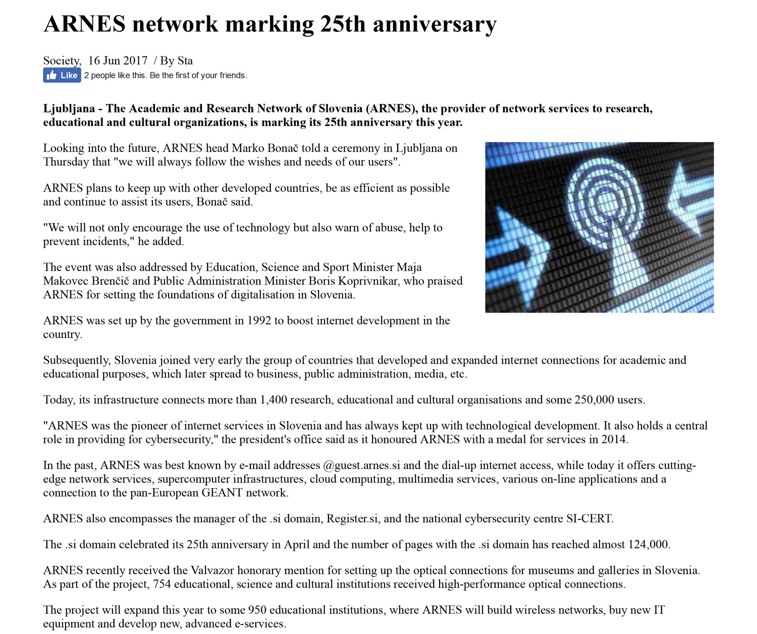
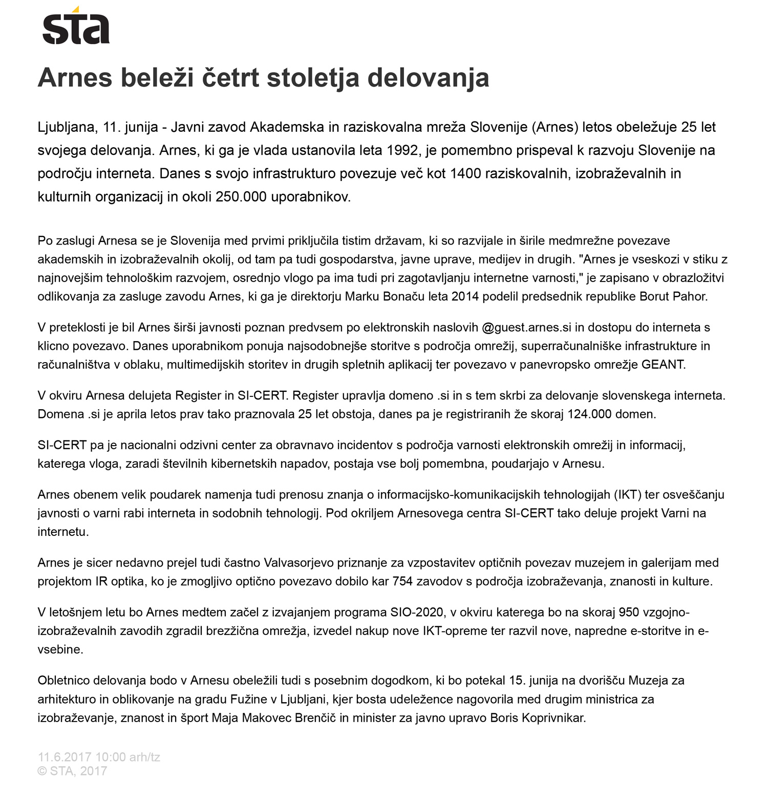
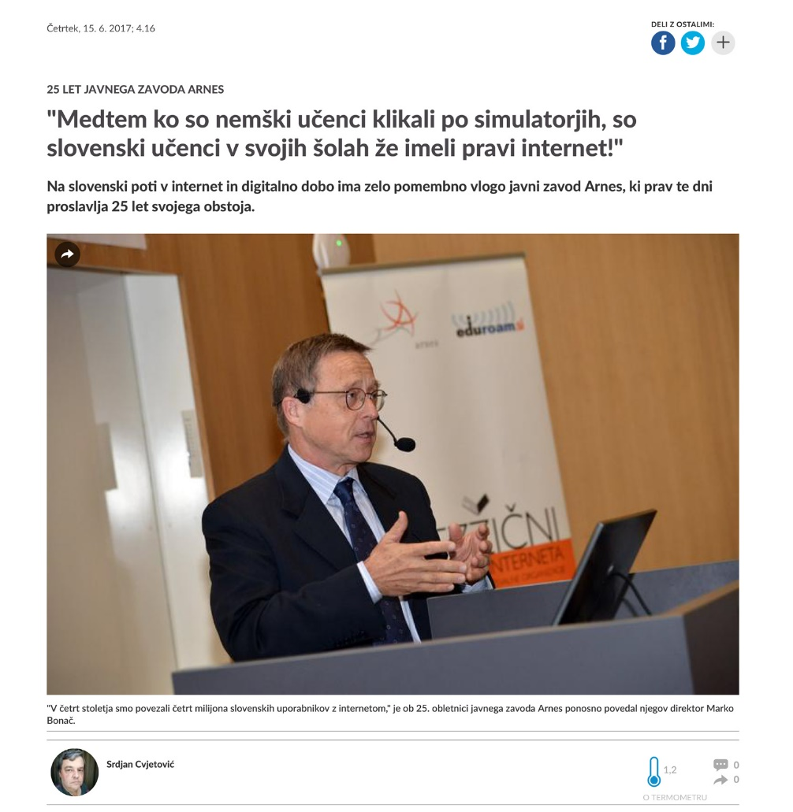
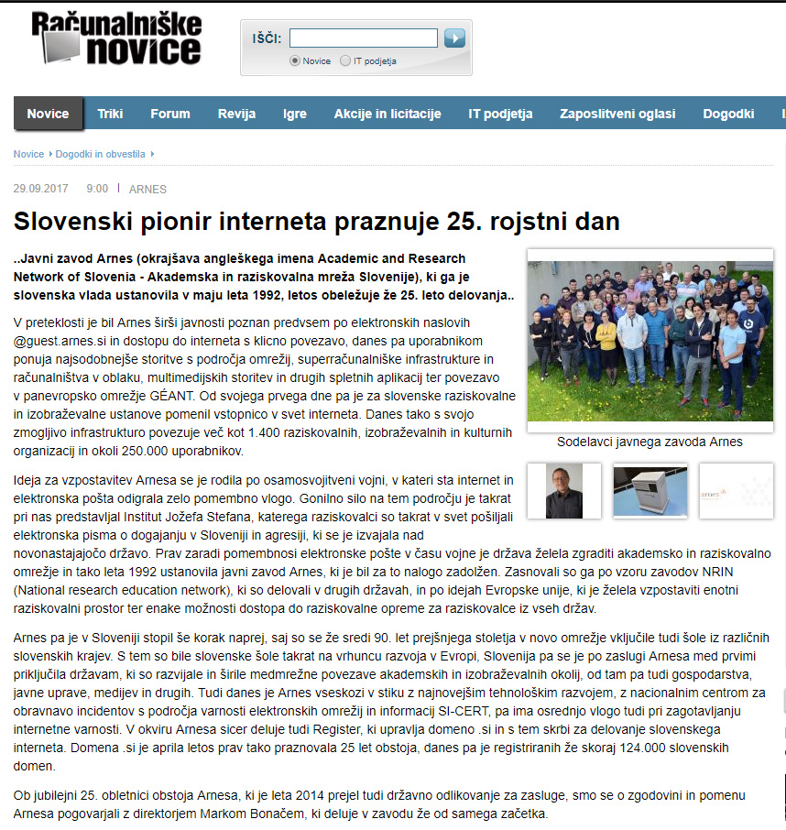
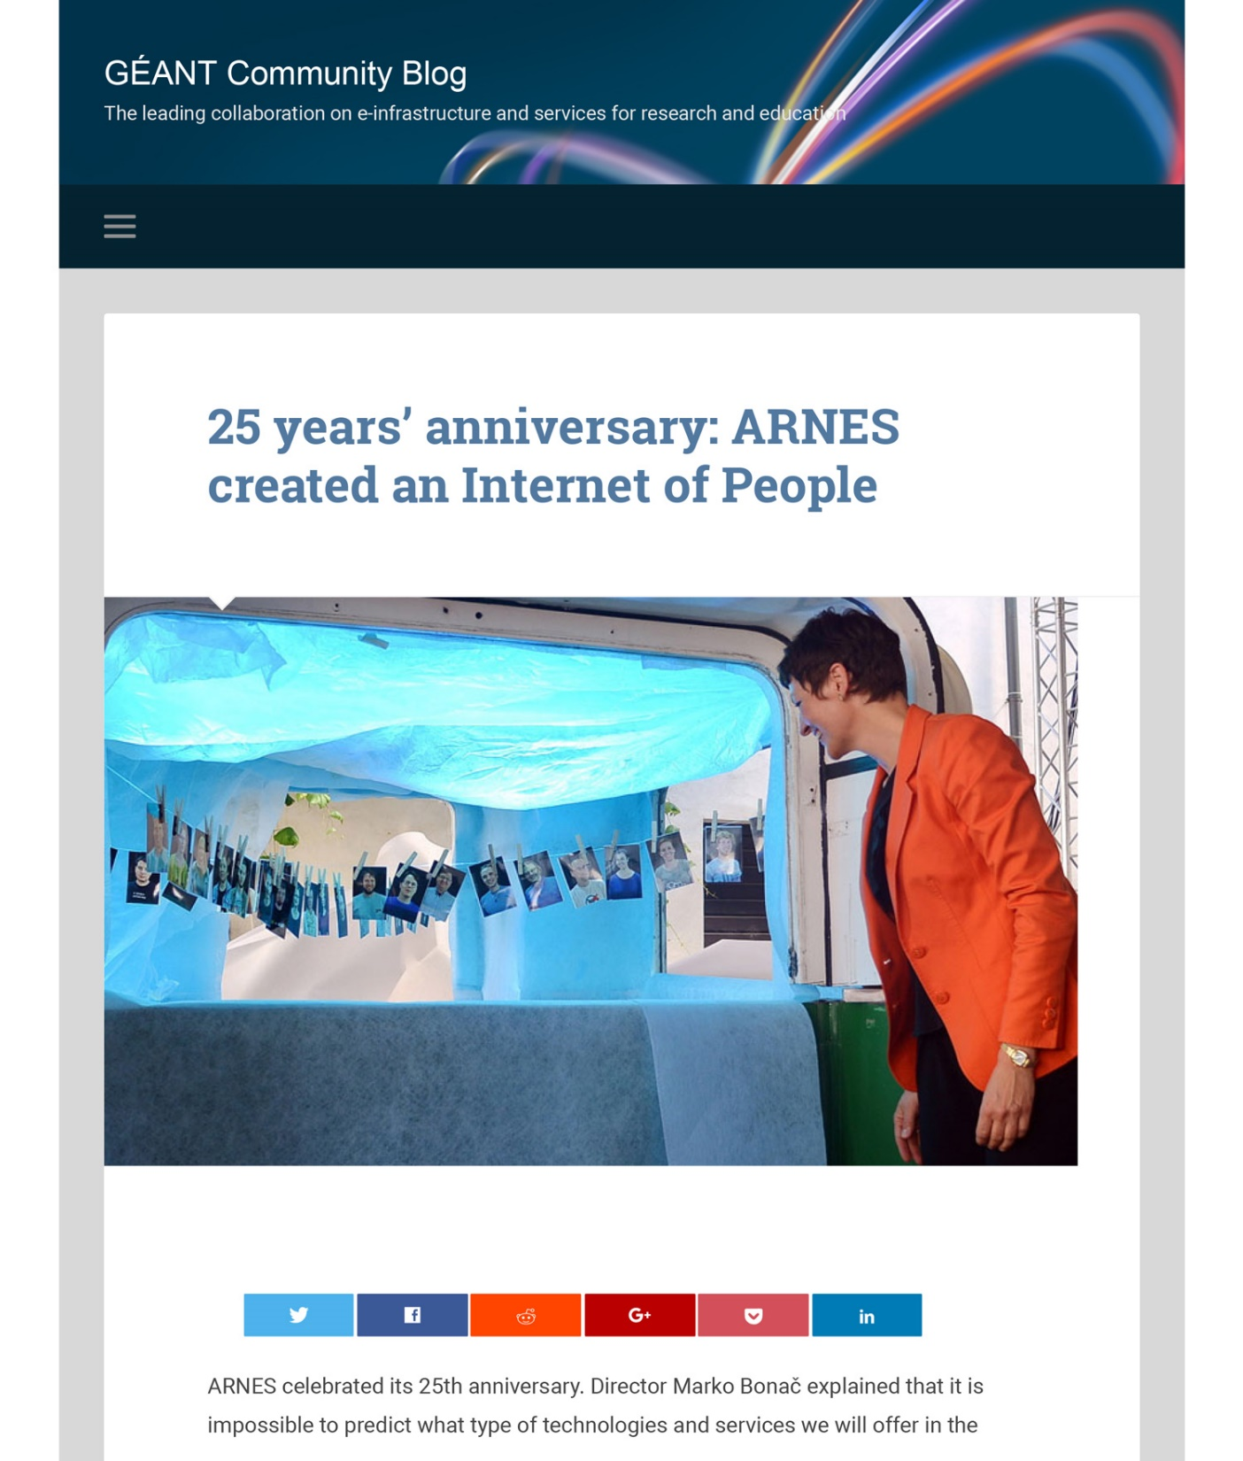
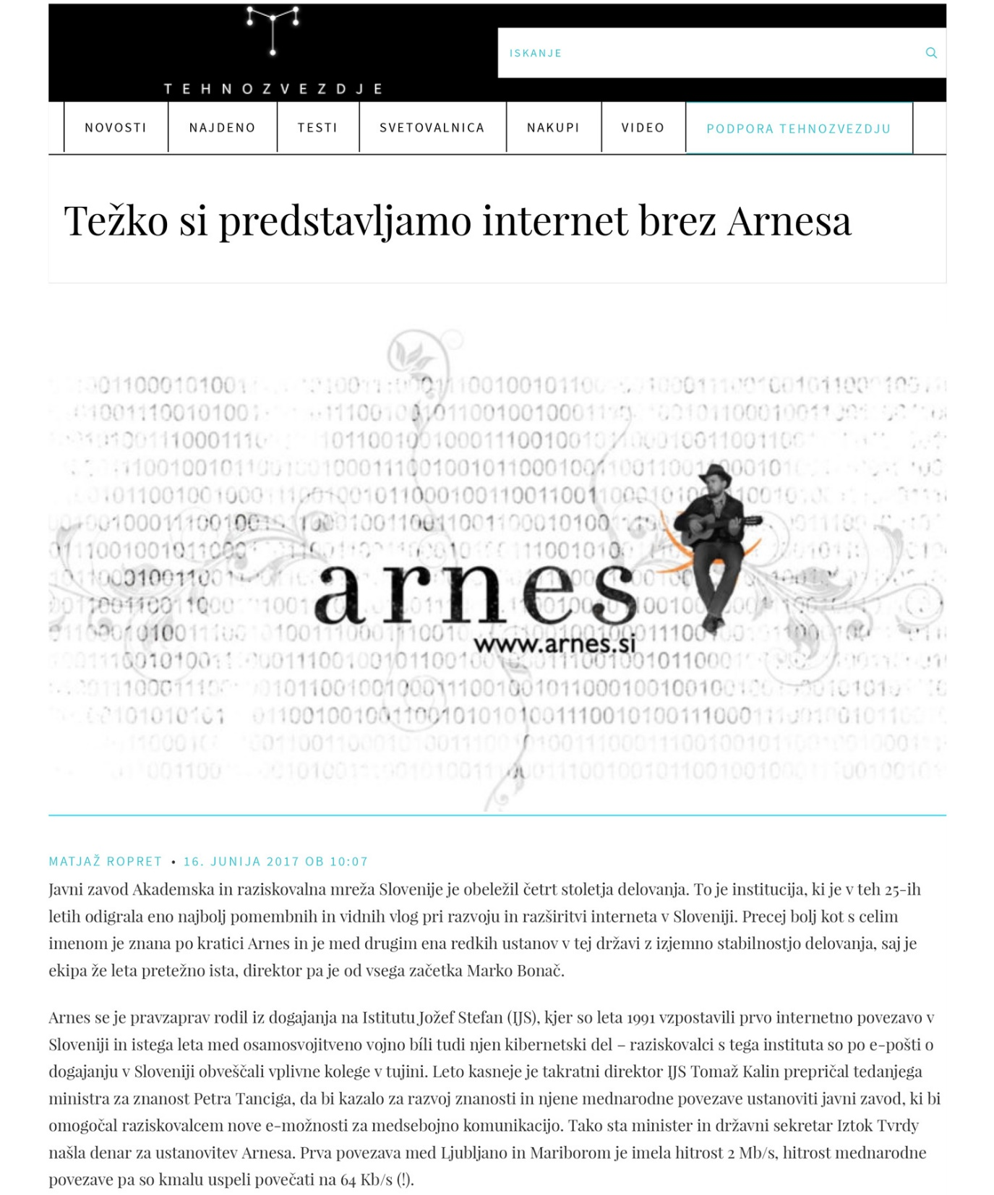
Media coverage

