Slide 1
UNINETT 2018
Mari Prestvik, Head of Communications

Slide 2
UNINETT 2018: Post-establishment of the Government Agency for ICT Services in Research & Education:
UNINETT transferred several services and 32 employees to the government agency. No drama, but still quite a difference
UNINETT now has 55-60 permanent employees
UNINETT is Norway’s NREN – no changes there!
New focus: infrastructure and middleware
Strategy process started – will take time to conclude, will be coordinated with the government agency
Portofolio now consists of:
  Infrastructure and middleware
  Measuring and analysis
  Services catalogue

Slide 3
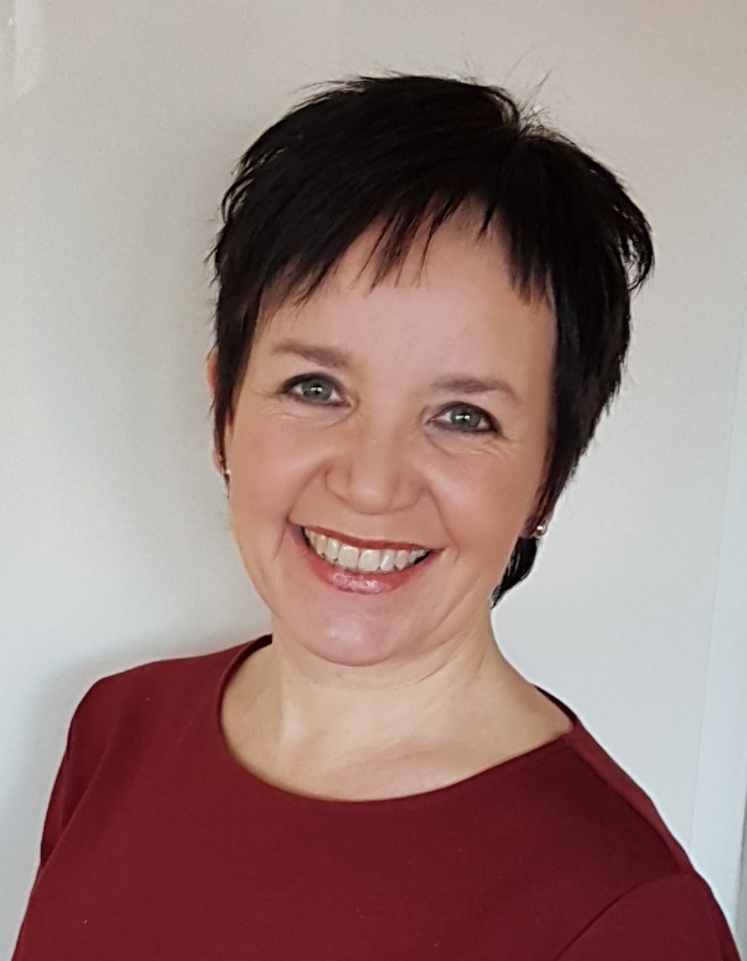
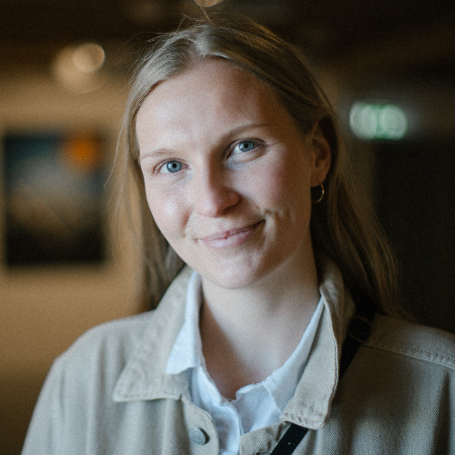
Communications
  1,5 full time eqivalents (FTE) – (which feels like next to nothing for the time being…):
    Full time: Head of Communications: Mari. Worked at UNINETT for 8,5 years
    Half-time: Silje. Journalist, summer job last summer, now hired part-time

Slide 4
Communication: No stopping, full speed!
  Main aim is to show results!
  Since January 1, we have done the following:

Slide 5

External communication (1)
Stopped producing the customer magazine. Too time-consuming at the moment

Slide 6
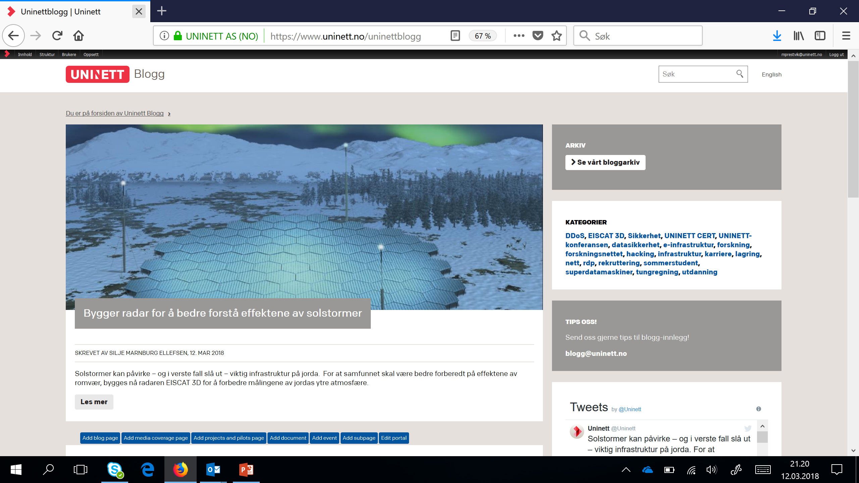
External communication – (2) established the UNINETT blog

Slide 7
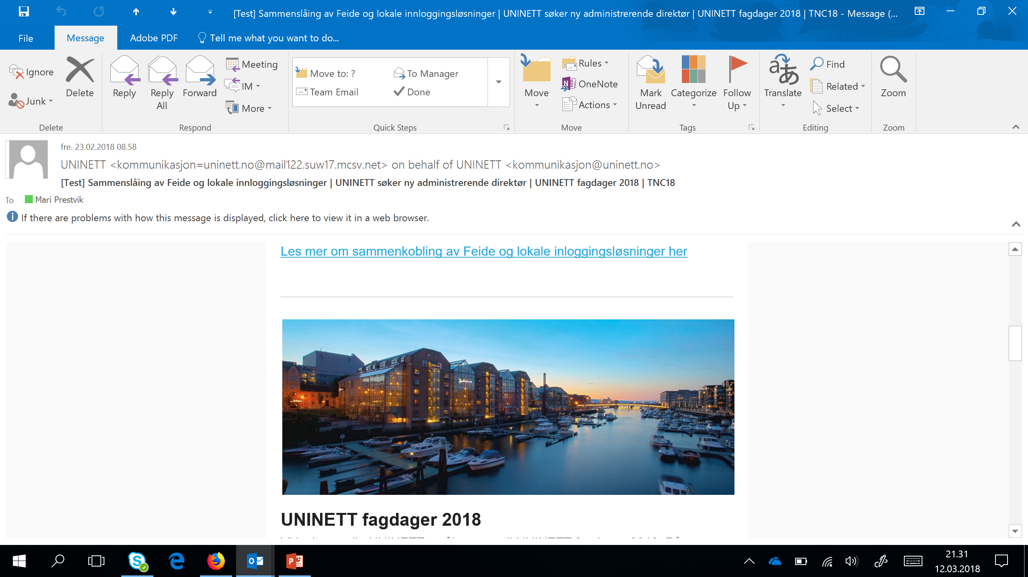
External communication – (3) monthly distribution of official newsletter

Slide 8

External communication – (4) active use of social media (Facebook, Twitter, LinkedIn)

Slide 9
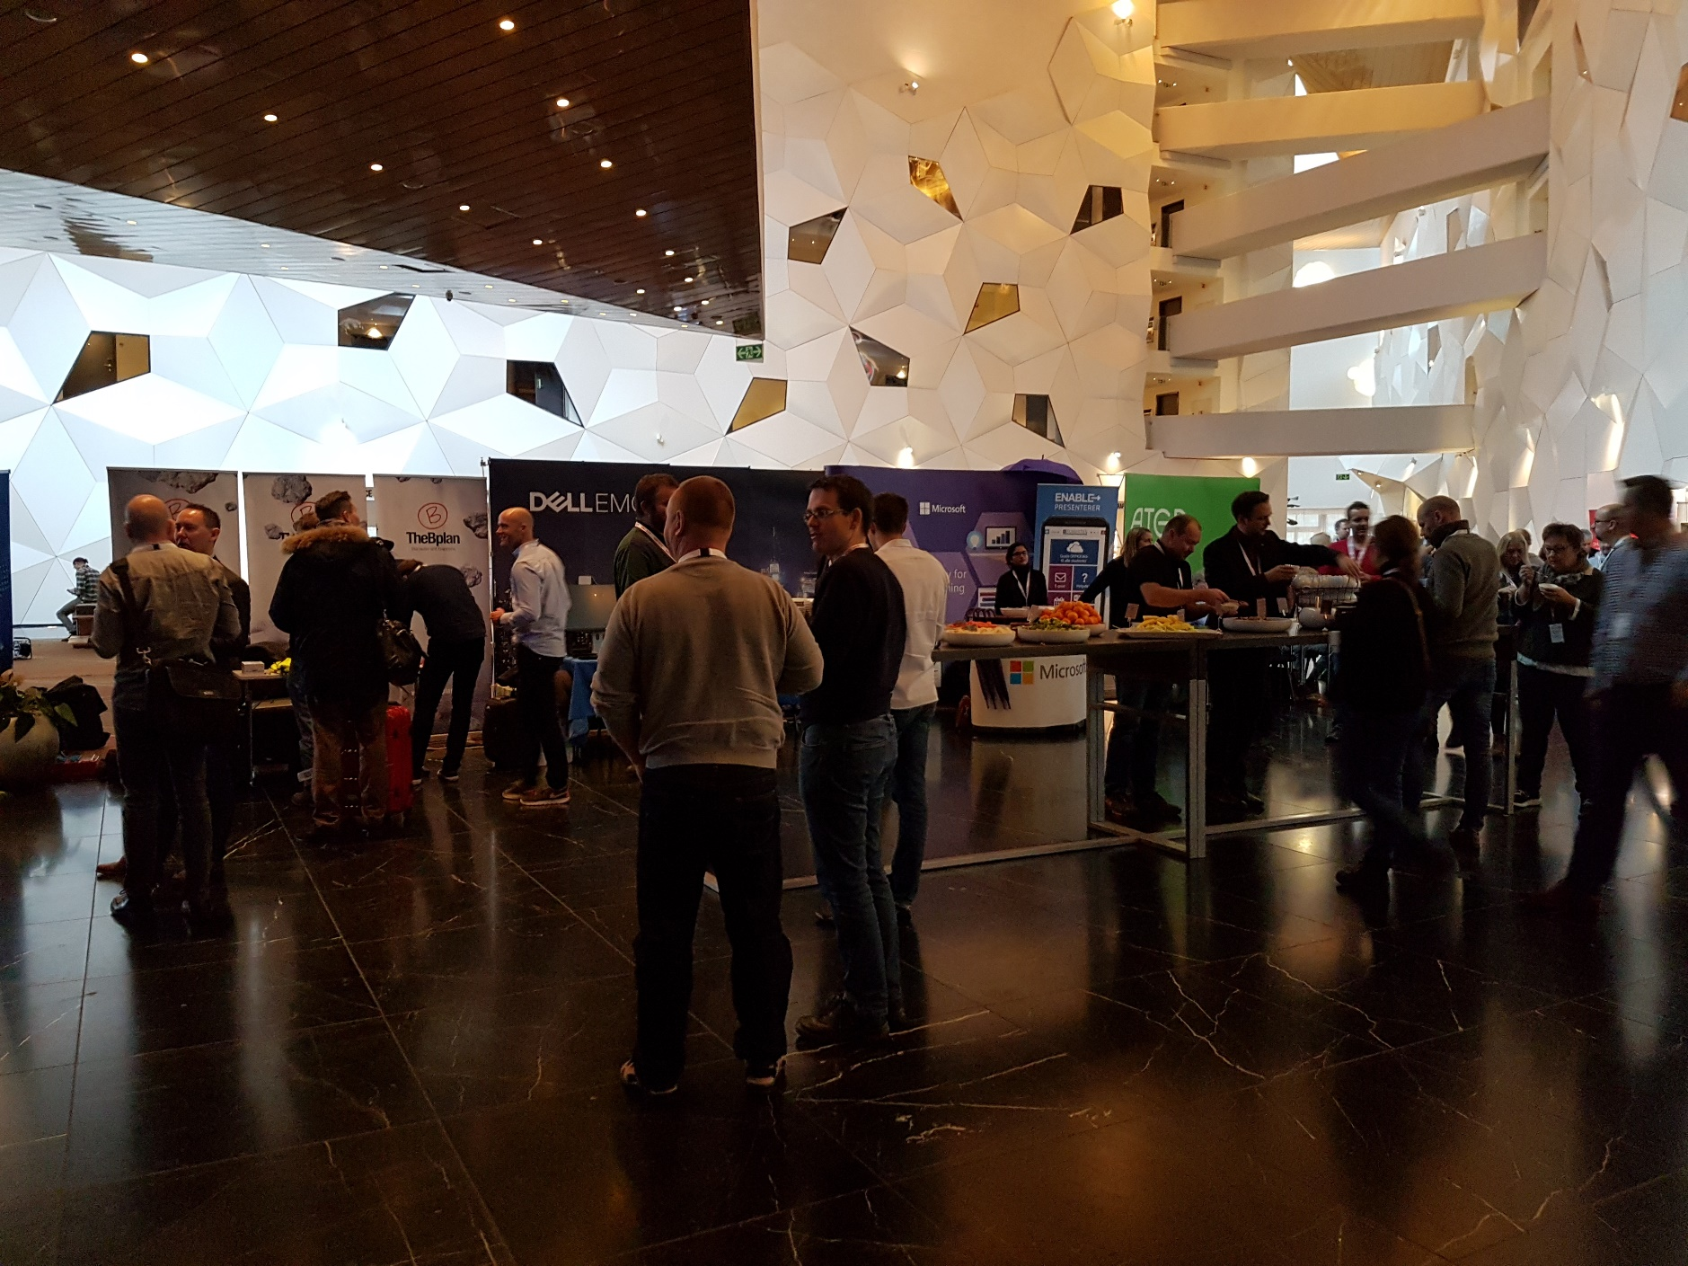
External communication – (5) organize national conferences, seminars, worskhops

Slide 10
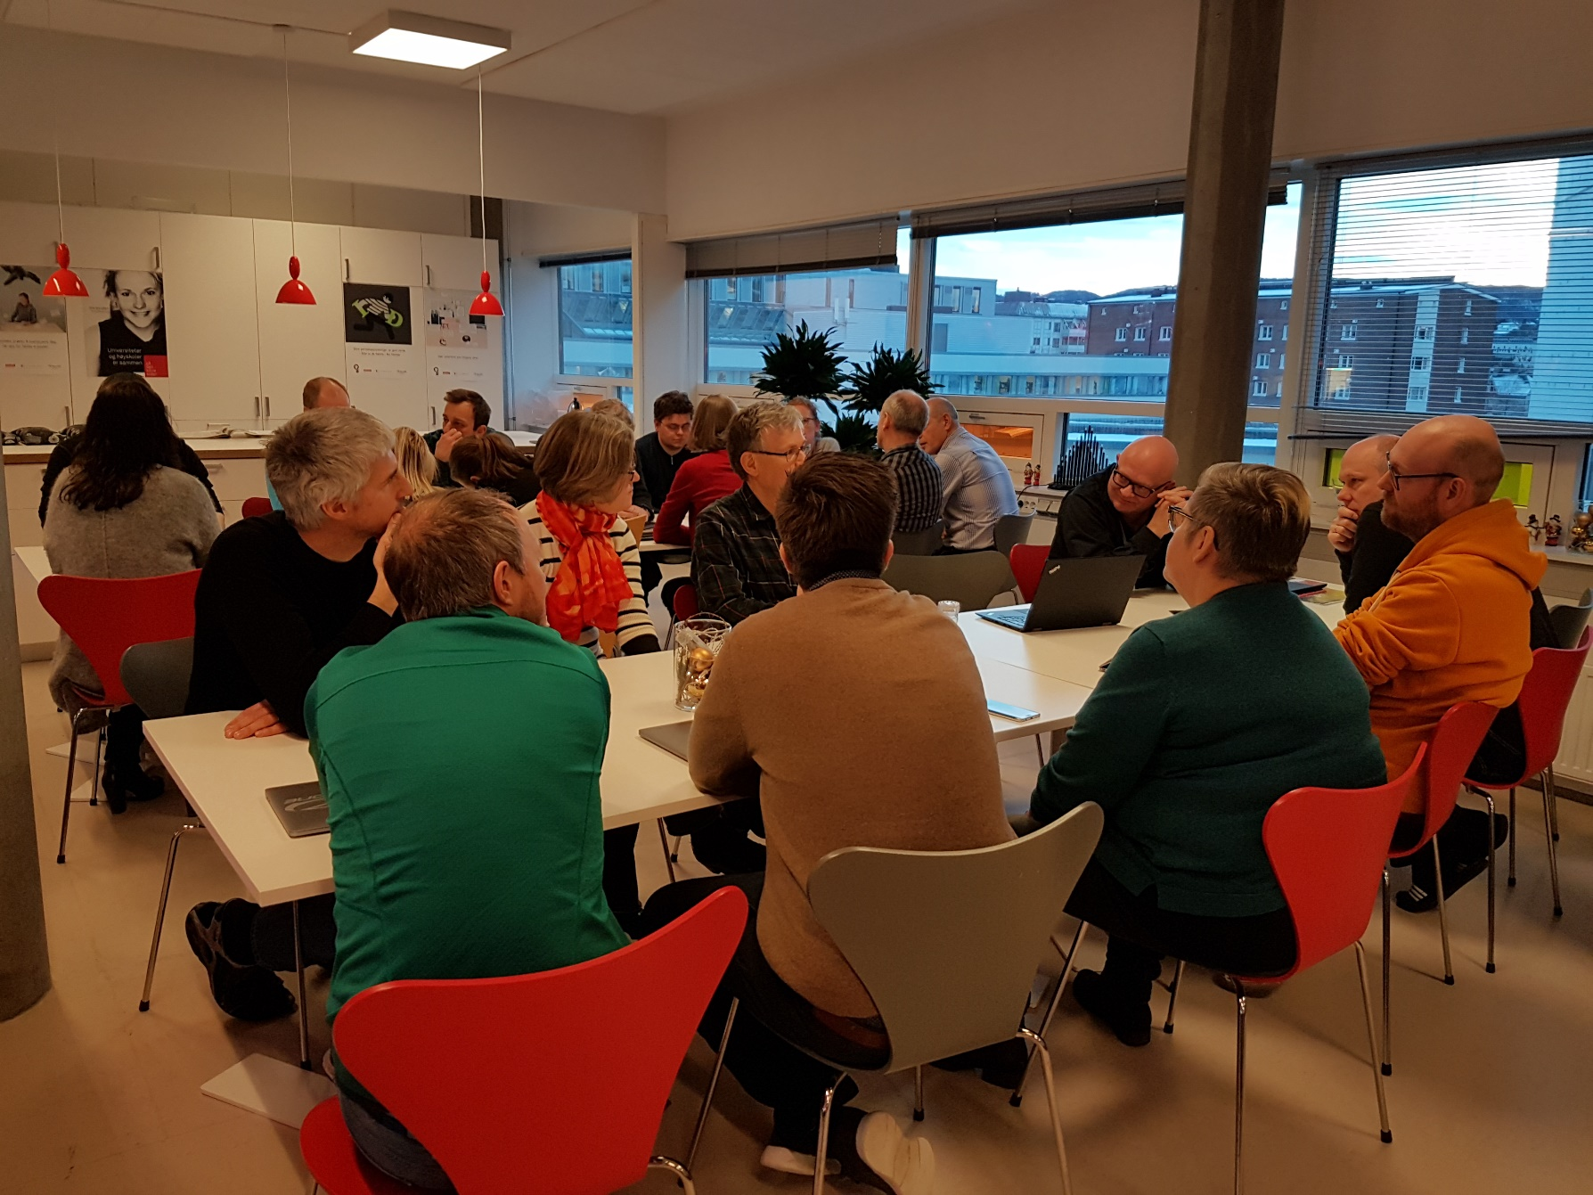
Internal communication (1) - organised «strategic coffee breaks» for all employees: main aim to get everyone involved in the ongoing strategy process.

Slide 11
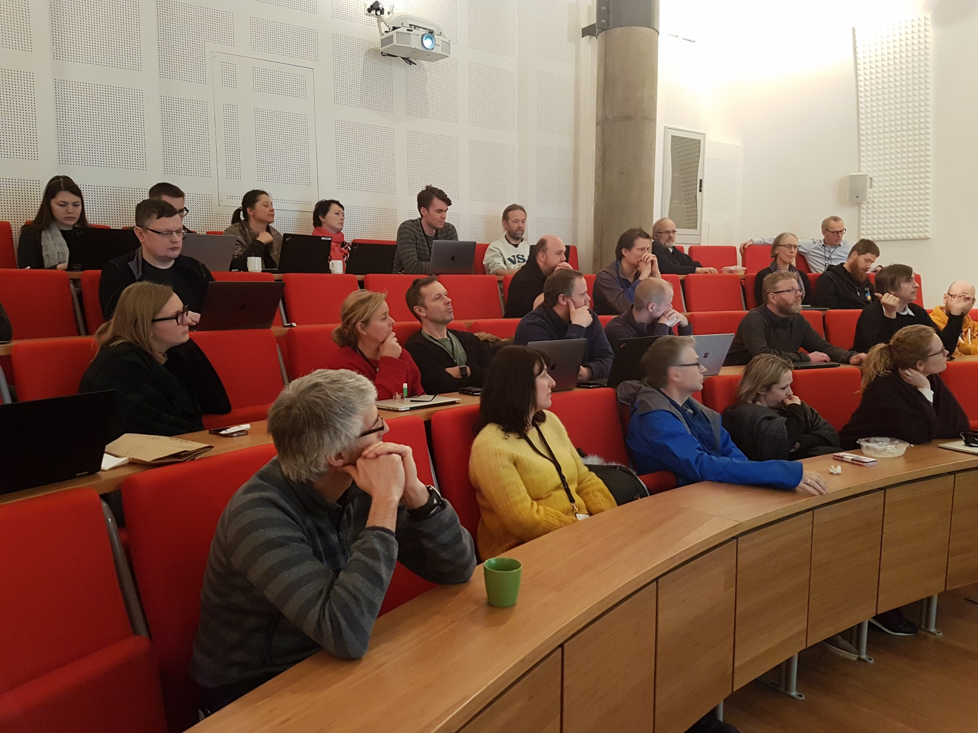
Internal communications (2): extra general assemblies and workshops Aim: to minimize the gap between the management team and the employees. Build bridges between board, management team, employees

Slide 12
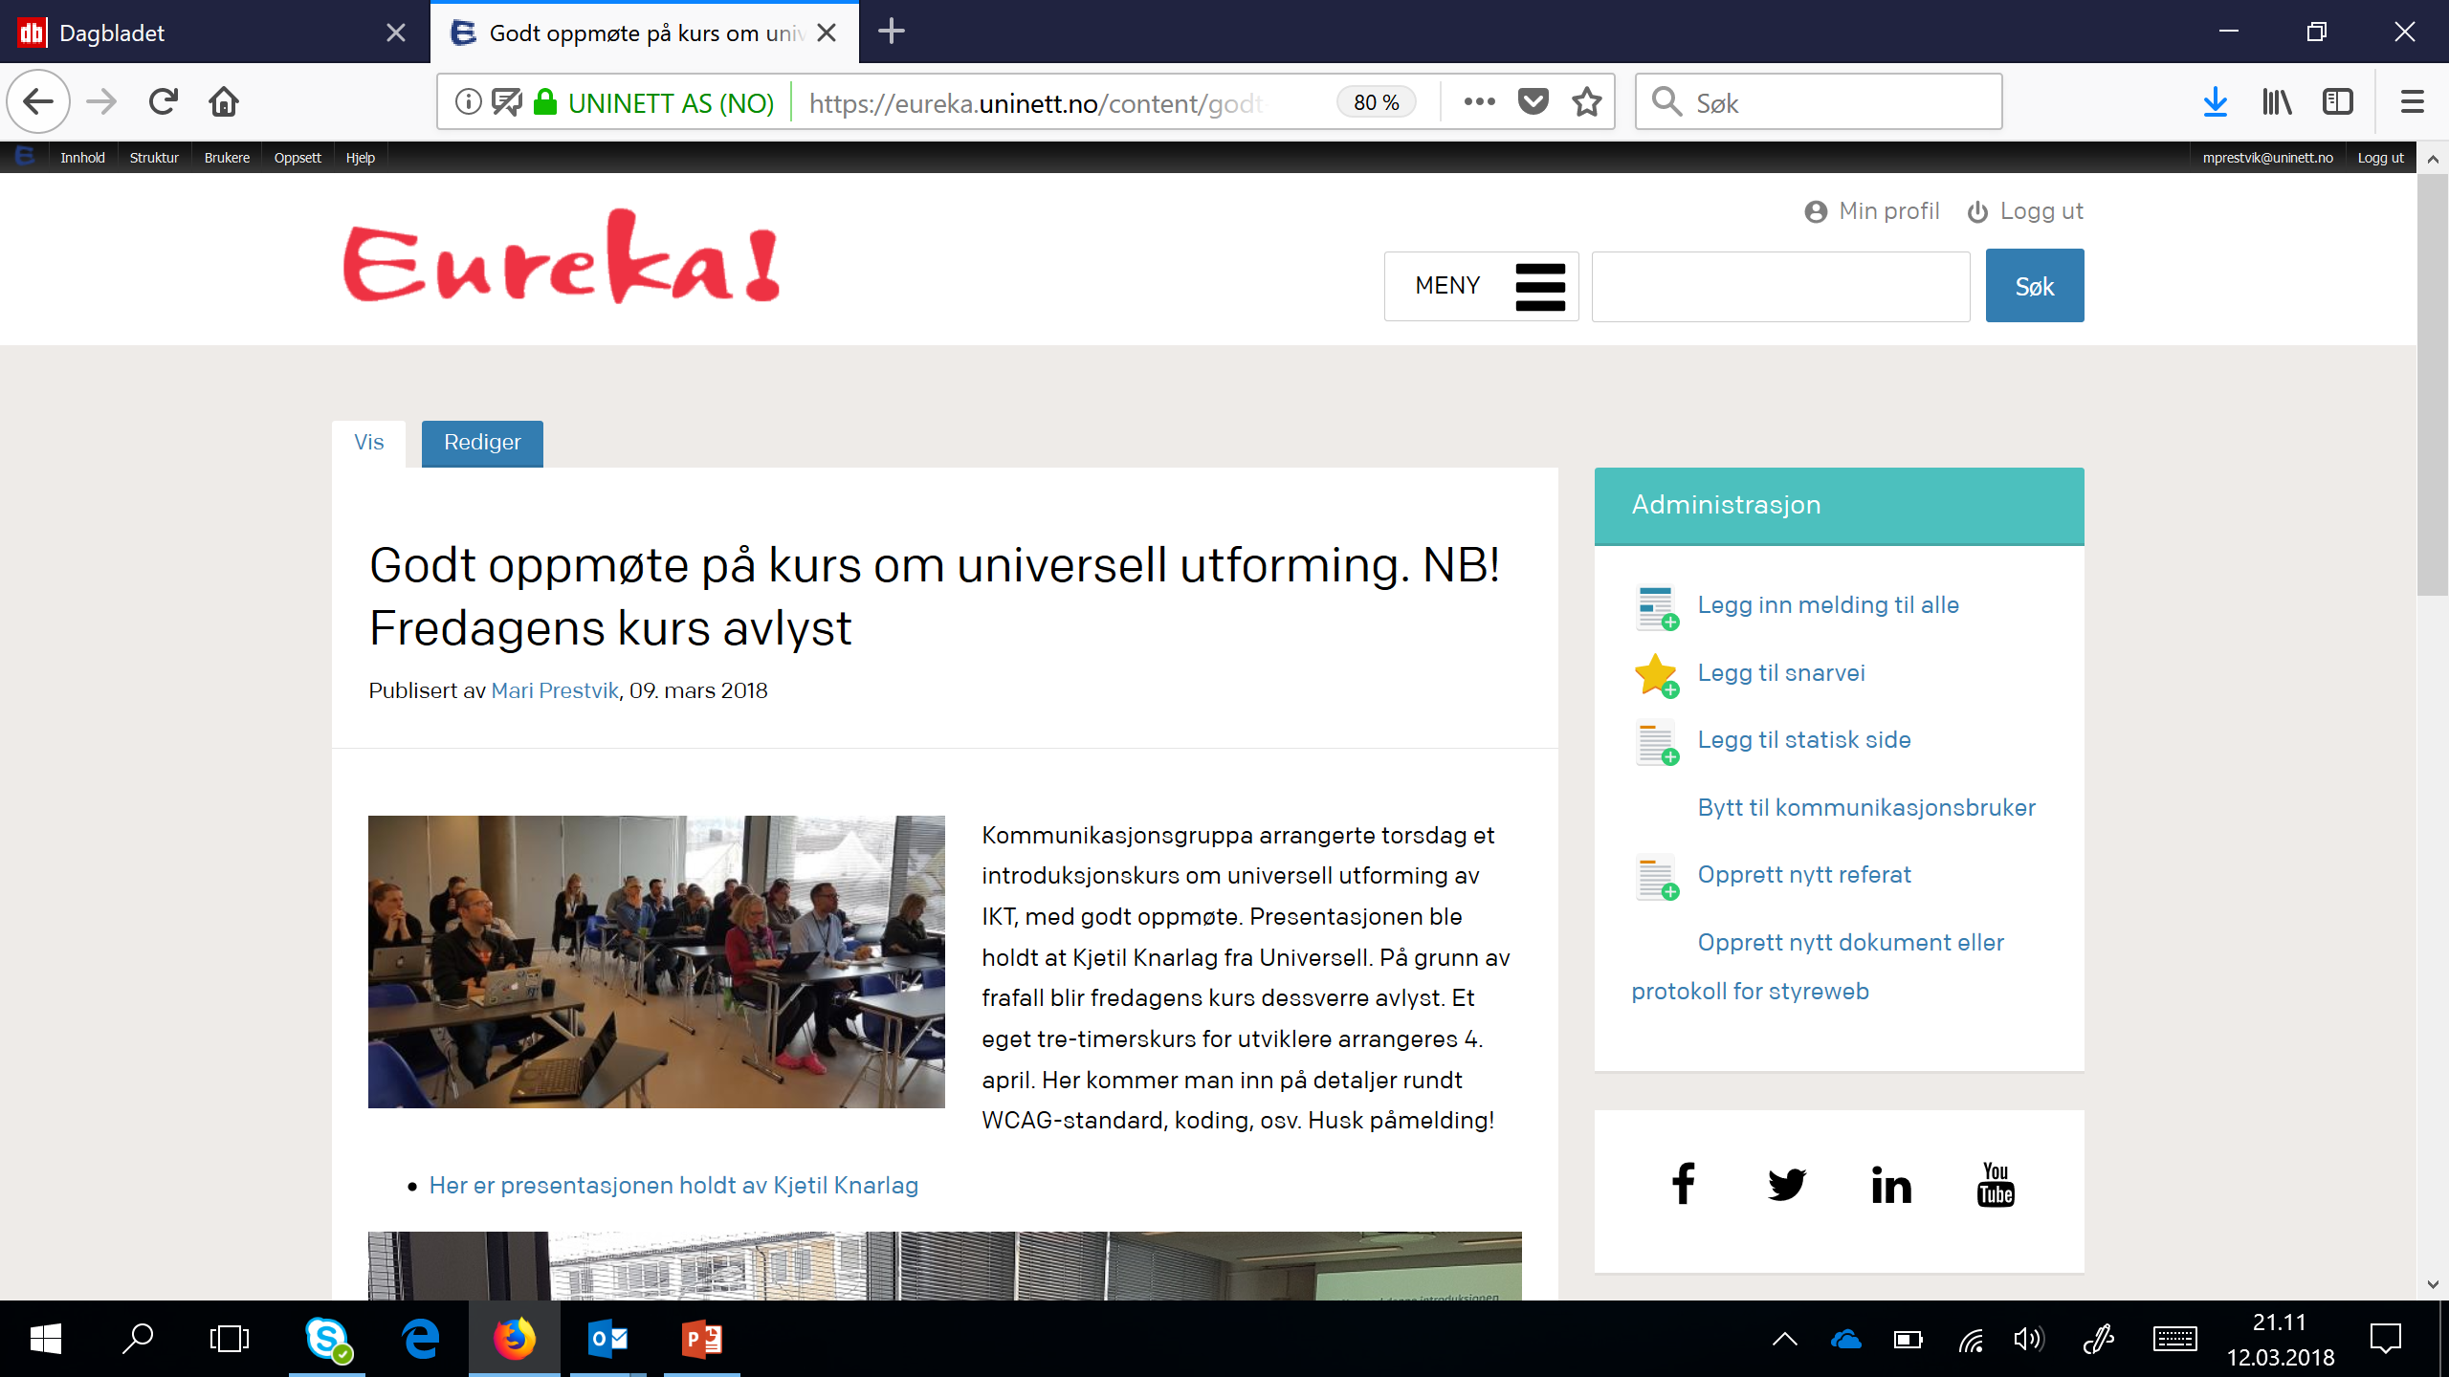
Internal communications (3): frequent updates on the intranet: «what’s new, what’s going on?»

Slide 13
Internal communications (4): support the executives
Participate in all executive meetings
Give communications advice on executive level
Actively participate in the strategy process
Actively help all teams with proactive communication issues

Slide 14
Further plans 2018:
Hosting TNC18 in Trondheim
Hosting national annual workhops in April (three days)
Attending NDN18 in Ellsinor
Celebrating our 25th anniversary as NREN (1993-2018)
More plans to come!
…..and the show must go on…full speed…..

Slide 15
Thank you ☺
To get in touch: mari.prestvik@uninett.no

