Slide 1


PeaR Community News & GÉANT Community Blog – the past, present and future
SIG-Marcomms
Espoo
www.geant.org

Slide 2
GÉANT – Reviewing comms activity (reprise from yesterday)
Channels
We are always reviewing the communications channels
  Website(s) – geant.org + many other sites (services etc.)
  CONNECT – continue with print? Continue to ship to you?
  Social media – plans created for major areas – e.g. TNC18 and DI4R events, trust and identity, e-infrastructure relationships etc.
  Community blog site – planning overhaul of this
  PeaR newsletter – discussion today

Slide 3
Where are we now?
PeaR – a channel unlike the others
Origin: TF-PR - now SIG-Marcomms
A community ‘newswire’ by and for NRENs
Implemented by TERENA
Federated login to upload articles
‘Home’ on TERENA web homepage
Weekly email newsletter
Change: April 2017
TERENA webserver shut down
PeaR moved to pre-existing GÉANT blog platform
Open form to upload articles

Slide 4
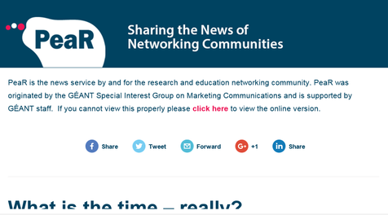
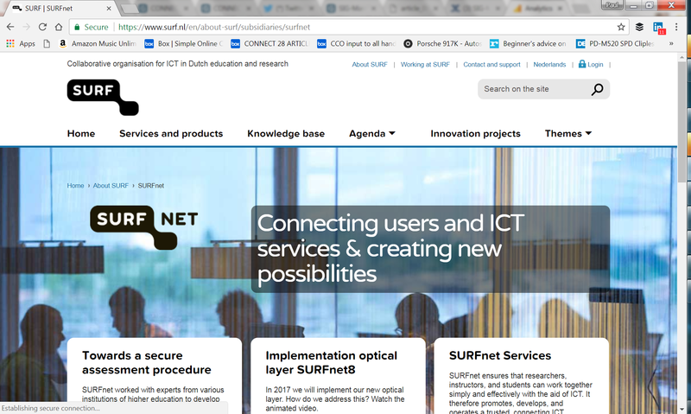
Where are we now?
PeaR newsletter goes out to 850 subscribers
Uses simple MailChimp template
Shares blog.geant.org platform with full-length blogs that ‘live’ here
All items added go into the newsletter, issued every Tuesday
PeaR posts should be teaser texts only, linking to full articles on external websites

Slide 5
Where are we now?
PeaR : 7 July 2016 – 14 March 2018
  280 articles published
    14 ‘InTheField’ (recent addition)
    153 with / for commercial partners short PeaR teasers
    33 long PeaR texts (4 linking to originals in other languages)
    80 full blogs
Of these
  153 (54%) published by GÉANT, including
    13 with / for commercial partners
    13 about regional connectivity projects
    21 about SIGs and TFs
  54 (19%) posted by 14 European NRENs
  21 (7.5%) by non-European NRENs
  44 (15.7%) by AARC (16), RIPE (14), GLIF (3), REFEDS (1), Vietsch Foundation (1)
  8 (2.8%) by others

Slide 6
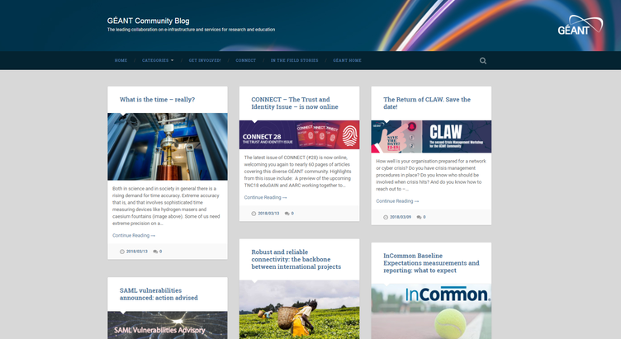
Where are we now?
For past 10 months PeaR’s home has been blog.geant.org
Blog space been active for some time
A community portal for blogs and articles – had a slow start

Slide 7
Where are we now?
Blog.geant.org
In past 12 months, it has had:
  5,200 unique visitors (up 160% on previous)
  35,000 page views

Slide 8
So what’s next?
But:
Is there brand confusion with a shared platform?
Is there a need to reintroduce federated login?
Do you still see PeaR as a community / SIG channel, or is it now really a GÉANT channel?

Slide 9
So what’s next?
We are thinking to:
Improve processes between Blog and PeaR (to make it more user friendly and so that click through is improved)
Redesign the PeaR newsletter template (to include other type of content (videos, tweets, articles)
Refresh the Blog site (to improve appearance, navigation, branding etc.)

Slide 10
So what’s next?
We need to:
Review our mailing lists – GDPR!
Make sign-up to receive the newsletter better!
Make this fit better with your Marcomms efforts… so…

Slide 11
Questions to you:
We want your input:
Do you still use PeaR? (Post, Share, Distribute internally…)
What else would you like to see in PeaR newsletter?
Should we rebrand Blog and PeaR?
What else would you like to see on these two channels?
How do you use PeaR and Blog with your channels?
What else?
Task: Break into groups and address these questions

