Slide 1


GÉANT (Organisation) Update
SIG-Marcomms
Espoo
www.geant.org

Slide 2

GÉANT – So what’s changed?
From the top:
Erik Huizer appointed Interim CEO since July 2017
  Recruitment for Permanent CEO ongoing
Exec Team:
  David Wrathmall – Chief Financial Officer
  Matthew Scott – Chief Programmes Officer
  Bram Peeters – Chief Network Operations Officer
  Shaun Cairns – Chief Development Officer
  Klaas Wierenga – Chief Community Support Officer
  Cathrin Stover – Chief Collaboration Officer
    Marcomms; Events; Design; International Relations

Slide 3
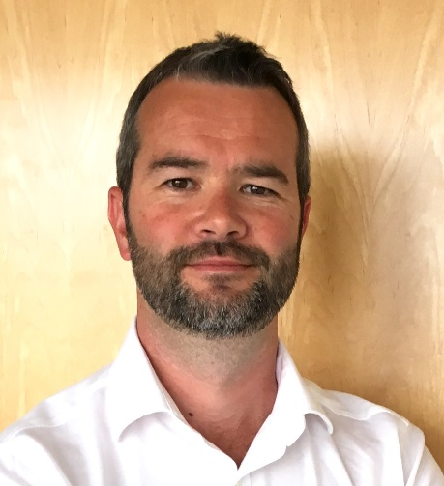
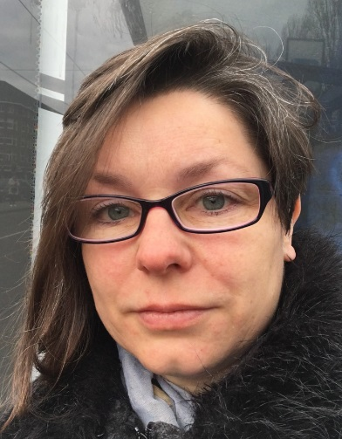
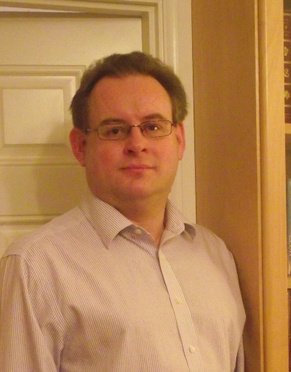
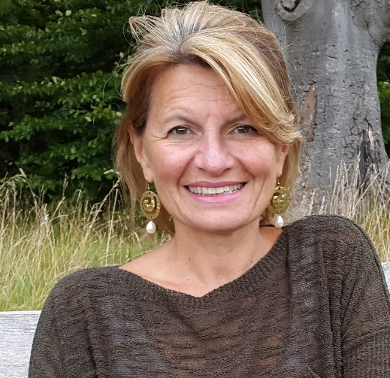

GÉANT – Team updates
Marcomms
  Paul Maurice – Head of Marketing and Communications
  Laura Durnford – Senior Communications Officer
  Karl Meyer – Product Marketing Officer
  Rosanna Norman – Communications Officer
  Dimple Sokartara – Digital Engagement Officer (p/t)

Slide 4

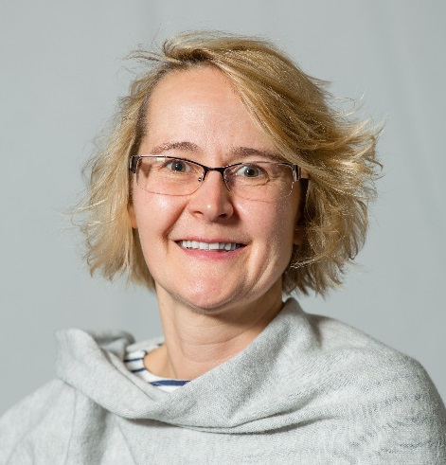

GÉANT – Team updates
Events
  Gyongyi Horvath – Extended Maternity Leave
  Steffie Bosnan – Conference Organiser
  Anna Everitt – Events Specialist
  Jessie Brockhoff – Events Support

Slide 5

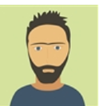
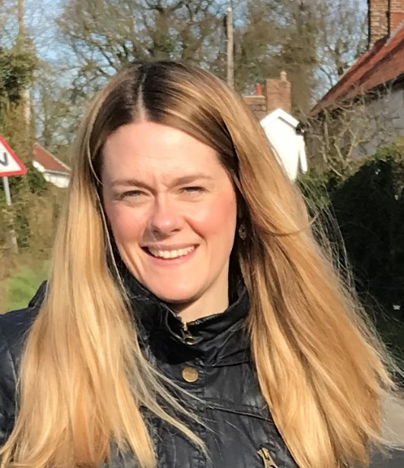
GÉANT – Team updates
Design
  Paul Hasleham – Head of Design
  Andrea Meloni – Graphic Designer
  Fiona Baylis – Web Assistant (p/t)

Slide 6
GÉANT – So what’s changing?
GÉANT the Organisation
At the end of this month, we will complete the legal merger between GÉANT Association (Amsterdam office) and GEANT Limited (Cambridge office).
Finally we will be GÉANT Association – with our Head Office in Amsterdam (where we have a nice new office), and a UK Branch in Cambridge (where we have a nice old office).

Slide 7
GÉANT – Reviewing comms activity
Channels
We are always reviewing the communications channels
  Website(s) – geant.org + many other sites (services etc.)
  Community blog site – planning overhaul of this
  PeaR newsletter – discussion tomorrow
  CONNECT – continue with print? Continue to ship to you?
  Social media – plans created for major areas – e.g. TNC18 and DI4R events, trust and identity, e-infrastructure relationships etc.

Slide 8
GÉANT – Project update
GÉANT the Project
We are in GN4-2, which runs to December 2018
Work is already underway for GN4-3, which will run January 2019 to December 2022
White papers have been written for:
  Network
  Security & Privacy
  Trust & Identity
  Application Services and Clouds
  General Services
  User, Community, Outreach and Human Capital Development

Slide 9
GN4-3 Planning Overview
White Papers phase (Sep 2017 – Feb 2018)
  Write White papers
Selection of project elements phase
(Mar – Apr 2018)
  Assess the contents of the White papers taking into account the feedback from the NRENs, based on NRENs’ levels of interest
Detailed GN4-3 & IRU SGA Planning, Budgeting & Recruitment phase (May – July 2018)
GN4-3 & IRU SGA Proposal writing & Submission phase (July – September 2018, to be submitted Q3 2018)
NOT MY SLIDE
Find out what we want to do
… - Dec 2017
Get NRENs feedback
+ NIFs for missing ideas
Jan-Feb 2018
Select the GN4-3 & IRU SGA project elements
Mar 2018
Write the Work Packages
Apr – Jul 2018
Finalise – Submit GN4-3 & IRU-SGA
Sep – Oct 2018
5
Notes:
White papers - , incorporating input from user requirements gathering using PLM, Quality Control and NRENs’ review
NRENs will provide feedback to white papers mid Jan 2018 – Feb 2018 + NIFs if something is missing
the body of each White Paper will be max 10 pages & that the assessment process will be based on short templates giving a general roadmap, budget and milestones

