Slide 1


SIGs and TFs Overview
SIG-Marcomms, CSC, Espoo, Finland
Nicole Harris, GÉANT, 15-03-18
www.geant.org

Slide 2





GÉANT Community Programme
Task Forces and Special Interest Groups
Community Projects
Specialised Workshops
Oversight by the GÉANT Community Committee:
https://wiki.geant.org/display/TTC.
How to propose a group:
https://wiki.geant.org/display/TTC/
How+to+propose+a+GCP+activity.
Small project funding is available!
(Up to 50K a year)
How we assess groups:
https://wiki.geant.org/display/TTC/Reviewing+or+Exiting+a+GCP+Activity

Slide 3

Objectives for Task Forces and Special Interest Groups
“Task Forces (TFs) and Special Interest Groups (SIGs) are groups of (grassroot) volunteers and world experts from NRENs, user organisations, research institutions, commercial and industrial sectors. TFs and SIGs provide an effective framework for forums to share information and best practices and to discuss possible innovations and further developments of services.”
✓
To facilitate exchange of information and best practice between experts working in the GÉANT NREN community and (much) more widely in the sector.
To design and progress collaborative work items between individuals from multiple organisations with the objective of improving services, expertise and understanding in the NREN community.
✓

Slide 4
Why are we Different?
Task Forces and SIGs are designed to be outward facing, not internally GN4 facing.
Non-project participants are welcome and encouraged.
HOWEVER: this creates problems with funding activity and participants from GN4 (we have to rely on hosts).
Ideas should come from the NREN community and be led by the community.
Need to maintain some distance between GN4 and Community Programme.

Slide 5
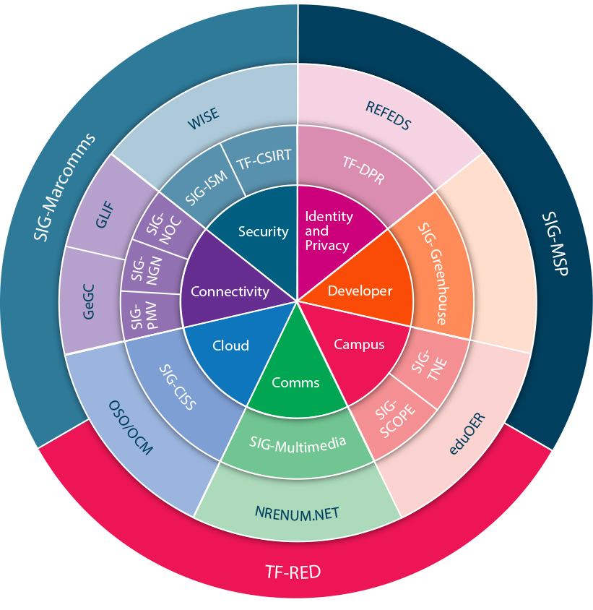
GÉANT Community Programme Portfolio
From May 2016 – August 2017 there were:
22 Formal Task Force and Special Interest Group Meetings.
576 attendees (excluding TF-CSIRT).
56 attendees at a specially organised mobility day.
576 additional attendees at 4 TF-CSIRT meetings.
Notes:
Yes it is freaky that the numbers both = 576, but it is correct ☺

Slide 6


Community Ideas to Delivered Outputs
SIG-Greenhouse worked with NLnet to create the Commons Conservancy – a European software conservancy. This has enabled the Filesender project (among others) to effectively receive funding and deliver a beta version of the Filesender 2.0 software.
The TF-CSIRT community defined and piloted a “response testing” tool to ensure security incident teams have up-to-date contact information and good incident response practice. This is now an embedded part of the Trusted Introducer service; quality of data and response times have measurably improved.
Notes:
The idea here is to show impact and working in partnership with outside organisations to achieve the needs identified by the community through the TF and SIG communication channels. These are only some highlights – I’ve not included all of the outputs. Do you need more?

Slide 7


Community Ideas to Delivered Outputs
TF-Storage provided the oversight for a favoured pricing agreement under which GÉANT national and international members and their users and members can purchase ownCloud *Enterprise Edition* licences at a discount.
SIG-Marcomms and SIG-NOC provided training and training materials for the community: training on blogging and online communication from the Marcomms group and a business case and plan for developing training for NOC professionals from SIG-NOC.

Slide 8


Meeting Community Needs: Enhancing Security Portfolio
Wise Information Sharing for eInfrastructures
Group formed – SCIv2 framework released
SIG-ISM
SIG-ISM White Papers on Risk Management
and Security Management
CLAW
Workshop
Crisis Management Exercise for NRENs
CEO Forum
Security Group
Contributing to group fostering trust at
CISO level in NRENs
New TF-CSIRT Strategy to support continued
growth in group and services
Notes:
In 2016 the community clearer communicated to us that we needed a stronger focus on security and that this had be come a rising concern for them. We responded by ensuring the TF and SIG portfolio represented this area well.
If someone can make this prettier, please do!

Slide 9
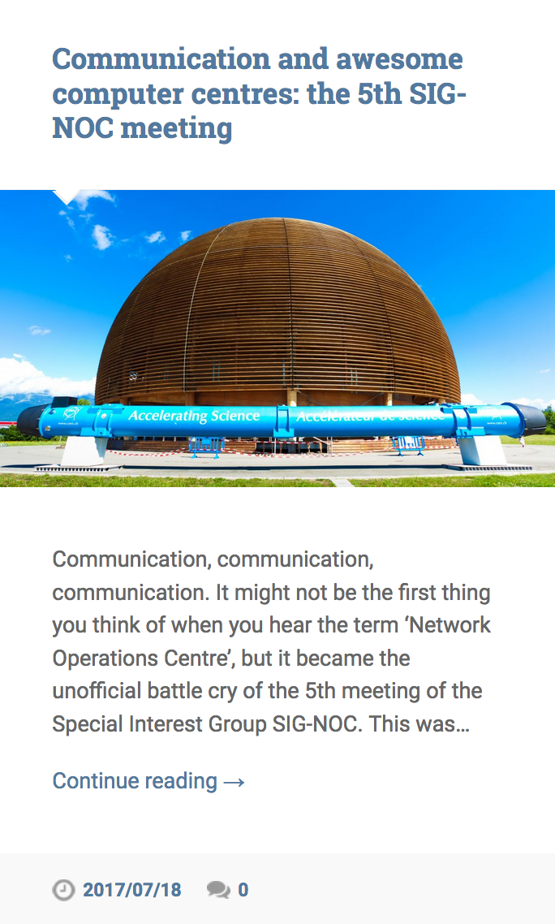
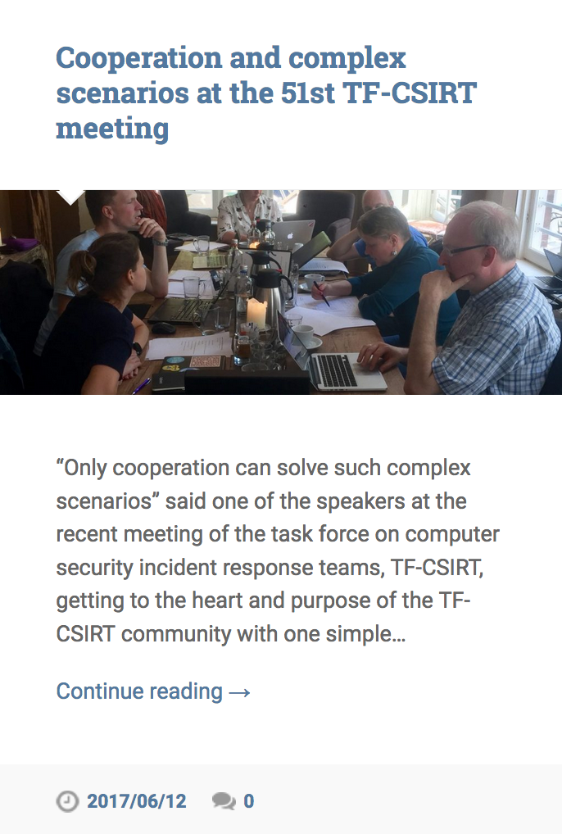
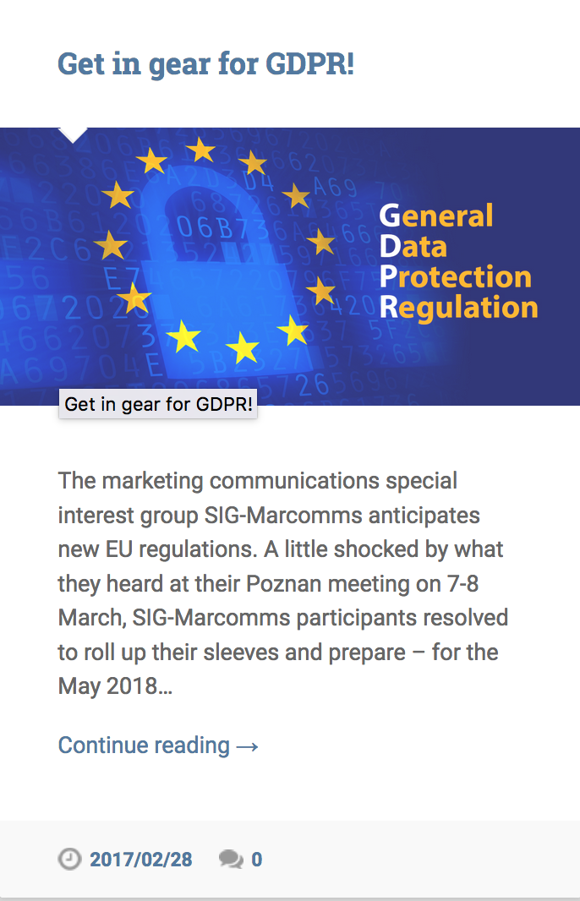
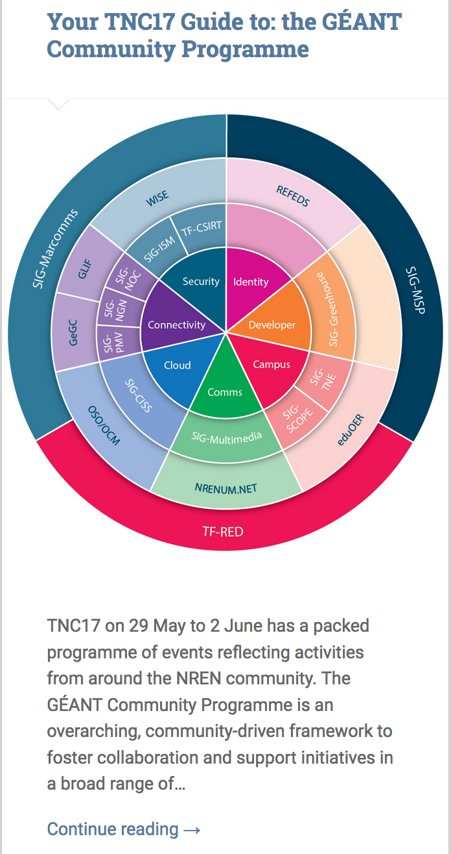
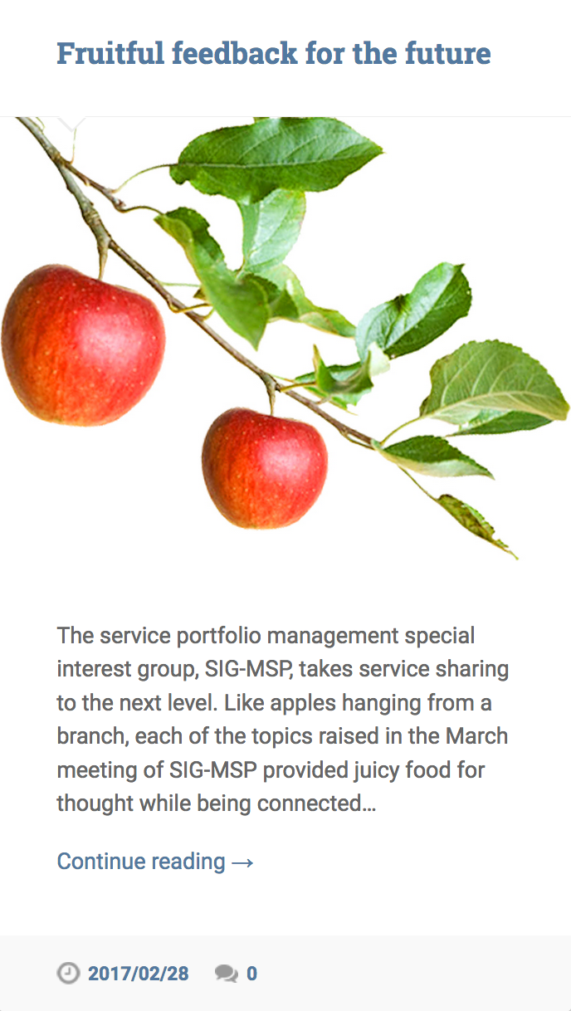
Focus on Improving Communication

Slide 10
Do you have ideas for us?
Did you know about the small project funding?
Is the portfolio right?
Is the difference between GN4 tasks and TF and SIGs clear?
How can we communicate better? (See Rosanna’s slides)
What can we do for SIG-Marcomms?
Can you find and use our outputs (white papers, presentations, ideas etc).

Slide 11
SIGs and TFs Communications
SIG-Marcomms, CSC, Espoo, Finland
Rosanna Norman, GÉANT, 15-03-18
www.geant.org

Slide 12

Communication activities to date
Increased number of posts and news items
GÉANT Community BLOG https://blog.geant.org/
PeaR Weekly Newsletter (every Tuesday at 14.00 CET)
GN4 Weekly PMO updates (every Monday am)
CONNECT magazine

Slide 13
GÉANT Community web pages: new design, new lay out
Updated web content
https://www.geant.org/People/Community_Programme/Pages/Home.aspx
SIGs and TFs in alphabetical order
More recent photos
No more acronyms
New lay out
Next meeting information
Ease of registration
Link to wiki pages
Mailing list subscription
Steering committees and secretaries
Visible links to useful resources: CONNECT, PeaR, BLOG
Notes:
This picks up an old discussion between telcos and Internet people about how to build and interconnect networks.

Slide 14


Ad-hoc communication support
CLAW 2017 – The first Crisis Management Workshop for the GÉANT Community
Brand development
Regular communications (Blog, PeaR, GÉANT PMO, CONNECT, geant.org)
CLAW 2018 – The second Crisis Management Workshop for the GÉANT Community
SAVE THE DATE teaser
Regular communications (Blog, PeaR, GÉANT PMO, CONNECT, geant.org) plus a dedicated microsite
Notes:
This picks up an old discussion between telcos and Internet people about how to build and interconnect networks.

Slide 15
More communication? Different communication?
Regular blog writing from SIGs and TFs participants
Central repository for materials and presentations to improve circulation of produced materials
Briefing information/document for new members of the Community
SIGs and TFs quarterly newsletter
WHAT ELSE?

