Slide 1

RENATER in 2018
SIG-Marcomms
13 Mar-15 Mar 2018

Slide 2

New marketing strategy

Slide 3
New marketing process for every project
Business model
Mix marketing
User pre-testing
Service commissioning and communication plan
Strategic marketing to detect opportunities
Scoping study with technical team
KPI checking and service updating

Slide 4
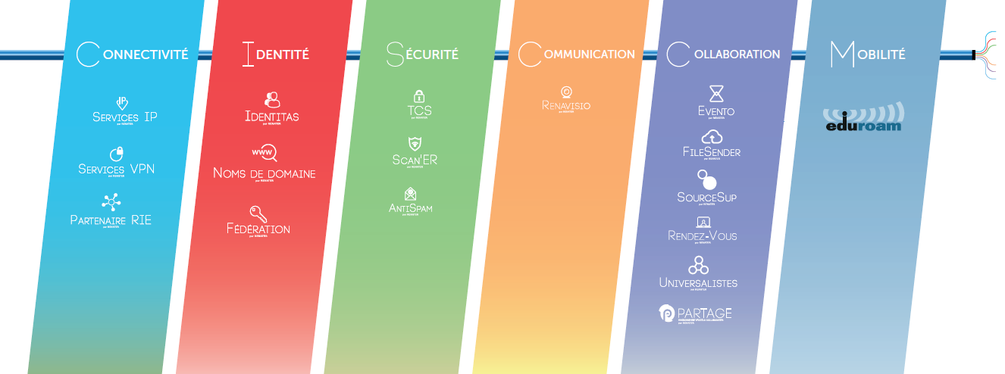
New services segmentation
Next step: better targeting (any advice welcome! )

Slide 5
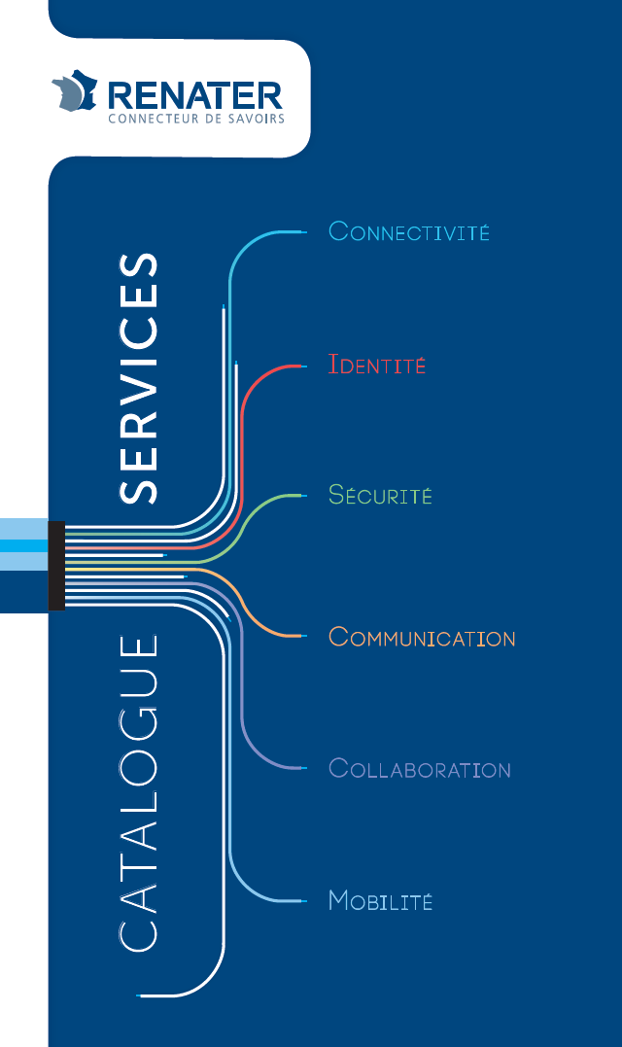
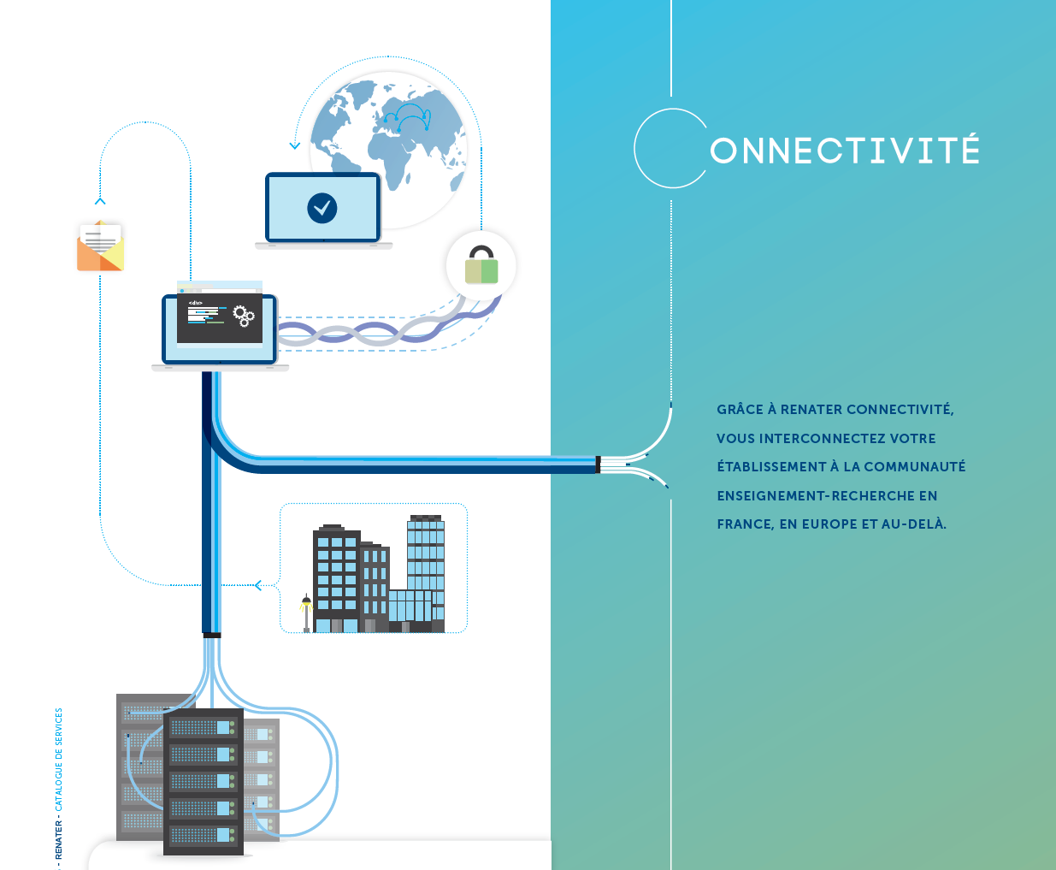
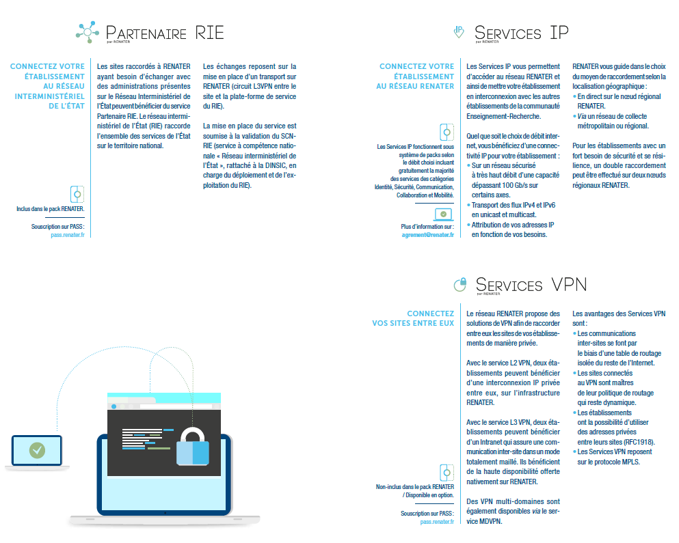

Slide 6
New services

Slide 7


Two new services launched in 2017

Slide 8

Coming next: Moment our open-source software

Slide 9
Vidéo evento

Slide 10
New pricing strategy

Slide 11
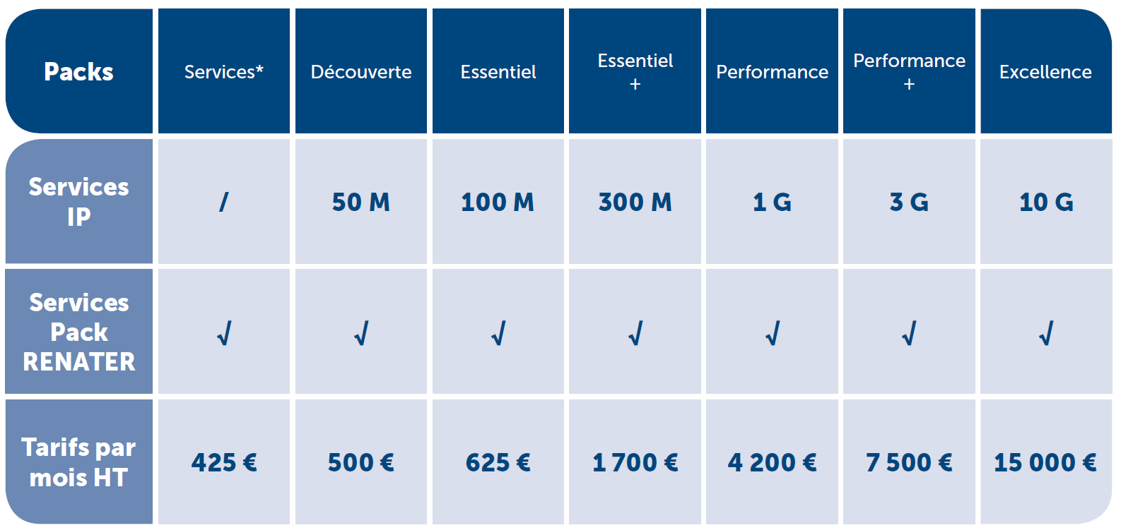
New prices for our pack system

Slide 12
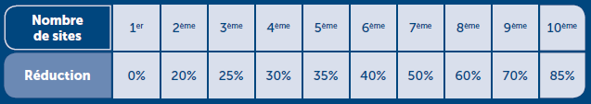
With a degressivity principle

Slide 13
RENATER strategy for 2017-2020

Slide 14
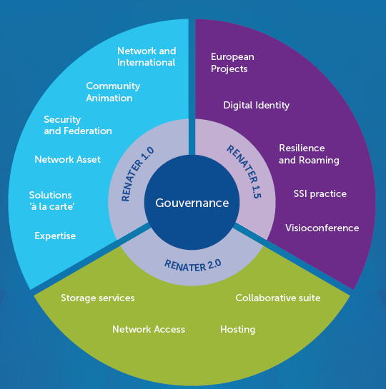
3 main axes to RENATER strategy 2017-2020
RENATER 1.0: Network &Security
RENATER 1.5: Usage extension
RENATER 2.0 : Digital transformation

Slide 15

New website

